Slide 1
Keep Your Eyes on the Dashboard October 15, 2015
Presented by:
Candace DeMaris, MAIS
Consultant
Partners in Medical Education

Slide 2
Introducing Your Presenter…
Candace DeMaris, MAIS
GME Consultant
30+ years experience throughout the spectrum of medical education: from undergraduate to GME, primary care to surgical specialties, in academic medical centers and community based-teaching hospitals.
Expertise in both institutional and program requirements and the area of GME finances – including maximizing CMS reimbursement, assessing the financial feasibility of starting new programs and demonstrating the value of established programs

Slide 3
Learning Objectives
Identify the key metrics that ACGME requires to be tracked, and others that should be tracked
Organize a dashboard in a clear, concise format
Discuss the use of dashboards in…
APE and Self Study
AIR and GMEC Special Review
CLER
Describe 6 reasons why institutions and programs should consider using a dashboard to track performance

Slide 4
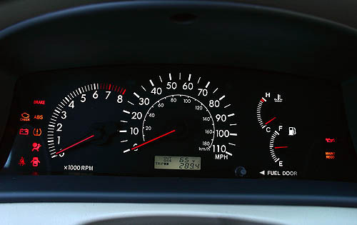
Your Car’s Dashboard…
…shows how your vehicle is performing
in quick glance

Slide 5
Your GME Dashboard…
…shows your programs’ performance at-a-glance. Aggregated program data can show your institution’s performance at-a-glance.

Slide 6
NAS
NOW!

Slide 7
NOW!
Outcomes-based accreditation
Annual RC review to identify under-performing programs and help them to improve
Accreditation process changes:
Annual review (no more cycles)
Site visits every 10 years or as needed
Annual ADS update replaces PIF

Slide 8
Continuous Accreditation Model based on annual review of data:
ADS Annual Update
Resident and Faculty Survey
Board Exam Performance
Milestone Data
Case Log Data
Faculty and Resident Scholarly Activity
Hospital Accreditation Data
Attrition

Slide 9
So…
The Programs, the DIO, the GMEC, and the programs must devise a way of continually monitoring program quality and demonstrating improvement.
Dashboards!

Slide 10
Dashboards in 3 Simple Steps

Slide 11
Step 1: Choose Your Metrics
What does the ACGME require?
Program Requirements
Institutional Requirements
What does your institution require?
What is important to your program?

Slide 12
Step 2: Obtain the Data
ACGME
Accreditation status
Case logs
Resident and faculty survey
Boards
Certifying exam pass rates
In-training exam scores
Hospital data systems
Program files
Web-based residency management systems

Slide 13
Step 3: Organize the Data
“At-a-Glance” = Keep it simple
Use database or spreadsheet software to format, calculate, trend, query, and analyze data.

Slide 14
Dashboards and Annual Program Evaluation

Slide 15
Annual Program Update has been streamlined, but still requires reporting on:
Program Characteristics
Board Pass Rates
Clinical Experience (Case Logs)
Resident and Faculty Survey
Resident and Faculty Scholarly Activity
Milestones Assessments
Attrition
MUST TRACK THESE!

Slide 16
New Emphasis: Annual Evaluation & Improvement Processes ANNUAL PROGRAM EVALUATION (APE)
“The program, through the PEC, must document formal, systematic evaluation of the curriculum at least annually, and is responsible for rendering a written, annual program evaluation.” ^{V.C.2}
Formalized the name: Annual Program Evaluation (APE)
Added a requirement for a formal Program Evaluation Committee (PEC)
Clarified the expectation of a performance improvement component
RRCs may have additional requirements. Check the current specialty-specific requirements

Slide 17
The program must monitor and track…
Resident Performance, including aggregated milestones assessments
Faculty Development
Graduate Performance, including performance of program graduates on the certification examination
Program Quality (using the results of confidential, written assessments of the program by residents and faculty)
Progress on the previous year’s action plan(s)
TRACK THESE TOO!

Slide 18
Other “High Value” Data – You Decide
Major changes
Curriculum Goals & Objectives
Resident QI & Patient Safety Engagement
Match results
In-Training Exam Scores
Policies (DH, supervision, handoffs, etc.)
Graduate feedback
“Where did our graduates end up?”

Slide 19
Annual Program Dashboard… an example

Slide 20
Dashboards and Self-Study

Slide 21
A few words about Dashboards and Self-Study…
Self-study is based on successive APEs
You cannot go back and re-create an APE
Dashboards will show trending from Year 1-Year 9
Catch deterioration and do something about it before it comes to the attention of the ACGME

Slide 23
Dashboards and Annual Institutional Review

Slide 24
New Emphasis: Annual Evaluation & Improvement Processes ANNUAL INSTITUTIONAL REVIEW (AIR)
The sponsoring institution’s evaluation of itself
Demonstrates ongoing attention to effective institutional oversight
ACGME does not specify how and by what criteria AIR should be conducted
Must include:
Results of the most recent institutional self-study visit
Results of ACGME resident and faculty surveys
Notification of programs’ accreditation statuses and self-study visits

Slide 25
“The Graduate Medical Education Committee must demonstrate effective oversight of the Sponsoring Institution’s accreditation through an Annual Institutional Review” ^{(1.B.5)}
The GMEC must identify institutional performance indicators for AIR
The AIR must include monitoring procedures for action plans resulting from the review
The DIO must submit a written annual executive summary of the AIR to the Governing Body”

Slide 26
What Can Institutions Learn by Aggregating Program Dashboards?
Aggregated program dashboards shows the
institution’s performance at-a-glance
Aggregated program dashboards identify
what the institution is doing well
Aggregated program dashboards identify areas where the DIO and GMEC must monitor, intervene, facilitate, or resolve at the institutional level.

Slide 27
2014-15 Performance At-a-Glance
ACGME Accreditation Status | Threshold | IM | FM | Peds
 | Continued Accreditation | = | = | =
Resident Survey | National % Compliance | IM | FM | Peds
Duty Hours | 97.1% | = | = | =
Faculty | 87.6% | = | = | =
Evaluation | 87.2% | = | = | =
Educational Content | 83.7% | = | = | =
Resources | 87.4% | = | = | =
Patient Safety/Teamwork | 95.7% | = | = | =
Faculty Survey | National % Compliance | IM | FM | Peds
Faculty Teaching & Supervision | 93.7% | = | = | =
Educational Content | 93.0% | = | = | =
Resources | 96.5% | = | = | =
Patient Safety | 89.4% | = | = | =
Teamwork | 98.7% | = | = | =
First Time Board Pass Rate (3-year) | Threshold | IM | FM | Peds
 | 80% | = | = | =
NRMP Fill Rate | Threshold | IM | FM | Peds
 | 100% | = | = | =

Slide 28
2014-15 Improvement Priorities
Institutional | Peds | IM | FM
Resident Survey – DIO to meet with residents before the ACGME resident survey is administered to clarify questions and program requirements | Subspecialty Rotations – Improve didactic and clinical experiences, with a focus on Heme-Onc and Nephrology | Ward Redesign– Continue full implementation of ward team redesign, changing the call model, and graduated levels of responsibility | Feedback – Develop timely and actionable feedback mechanisms for resident-to-peer feedback, faculty-to-resident feedback, and resident-to faculty feedback
Evaluation – GME office to centralize confidential written evaluations of the programs and of the faculty | Transitions of Care – Possible action plans may include standardized sign-out, reviewing the impact of AM -> PM -> night float sign-out, and reviewing faculty sign-out on weekends | Elective Rotations – Subspecialty liaison to oversee all subspecialty rotations, review the curricula, and provide consistent expectations | Curriculum Redesign – Introduce longitudinal curriculum components; develop structured educational opportunities in the Family Medicine Center and on the Family Medicine Inpatient Service
Professionalism – GMEC to develop and approve an institutional policy on Professionalism | Duty Hours in the ICU – Reduce vulnerability to duty hours violations through education that addresses reasons to extend shifts, need or Program Director notification, and compensatory mechanisms | Scholarly Activity – Generate list of ongoing clinical research and mentors within PHS. Subspecialty liaison has agreed to mentor academic projects for residents interested in competitive fellowships. | Maternity and Neonatal Care – Improve acceptance and support for residents on L&D and in the NICU
CLER Readiness – Provide ongoing awareness to C-Suite hospital staff of ACGME expectations for the Clinical Learning Environment Review

Slide 29
Dashboards and GMEC Special Review

Slide 30
New Emphasis: Annual Evaluation & Improvement Processes GMEC SPECIAL REVIEW
NOT an internal review
IS a review for underperforming programs that do not meet the GMEC’s performance criteria
GMEC must develop a protocol and identify program performance indicators.
Results in a report that describes quality improvement goals, corrective action, and a process for monitoring outcomes

Slide 31
“The Graduate Medical Education Committee must demonstrate effective oversight underperforming programs through a Special Review Process” ^{I.B.6}
The Special Review process must include a protocol that:
Establishes criteria for identifying underperformance; and
Results in a report that describes the quality improvement goals, corrective actions, and process for GMEC monitoring of outcomes.

Slide 32
So….Flag the metrics that will trigger a GMEC Special Review
Non-compliant performance
Performance below benchmark
Deterioration

Slide 33
Dashboards and Clinical Learning Environment Review

Slide 34
New Emphasis: CLINICAL LEARNING ENVIRONMENT REVIEW (CLER)
Oversight and documentation of resident/fellow engagement in improvement processes within the learning and working environment
Ensure that assignments are made to facilities that promote quality and safety
Review and approval of responses to CLER reports

Slide 35
The Sponsoring Institution is responsible for oversight and documentation of resident/fellow engagement in the following: ^{III.B}
Patient Safety
Quality Improvement
Transitions of Care
Supervision
Duty Hours
Professionalism

Slide 36
CLER Pathways to Excellence
Framework for evaluating the
clinical learning environment
Protocols for CLER visits align
with the Pathways document
Tool for promoting discussions
and actions that will optimize the
clinical learning environment

Slide 37
CLER Pathways to Excellence
6 FOCUS AREAS
34 PATHWAYS believed to be
essential to creating an optimal
clinical learning environment
89 PROPERTIES that can be
assessed from low to high along a
continuum of resident and faculty
engagement within the learning environment.

Slide 38
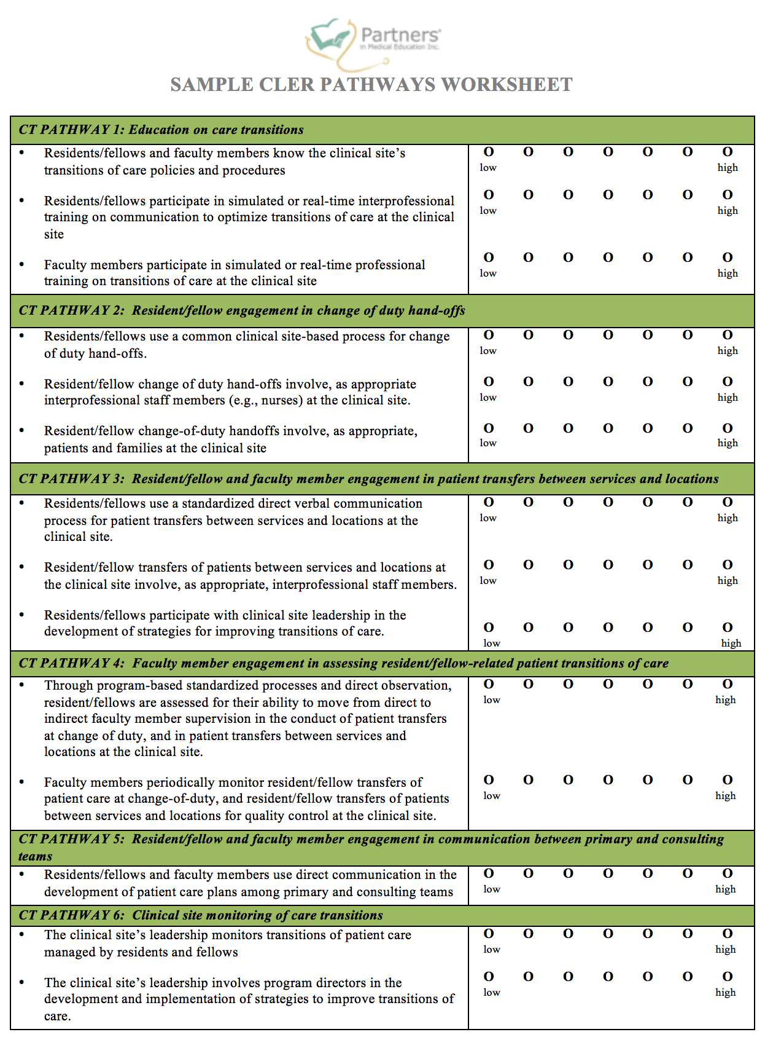

Slide 39
Take a critical look… at your CLER report
Organize the findings from the written report to identify improvement opportunities
Look for alignment in responses
Look for low response rates

Slide 40
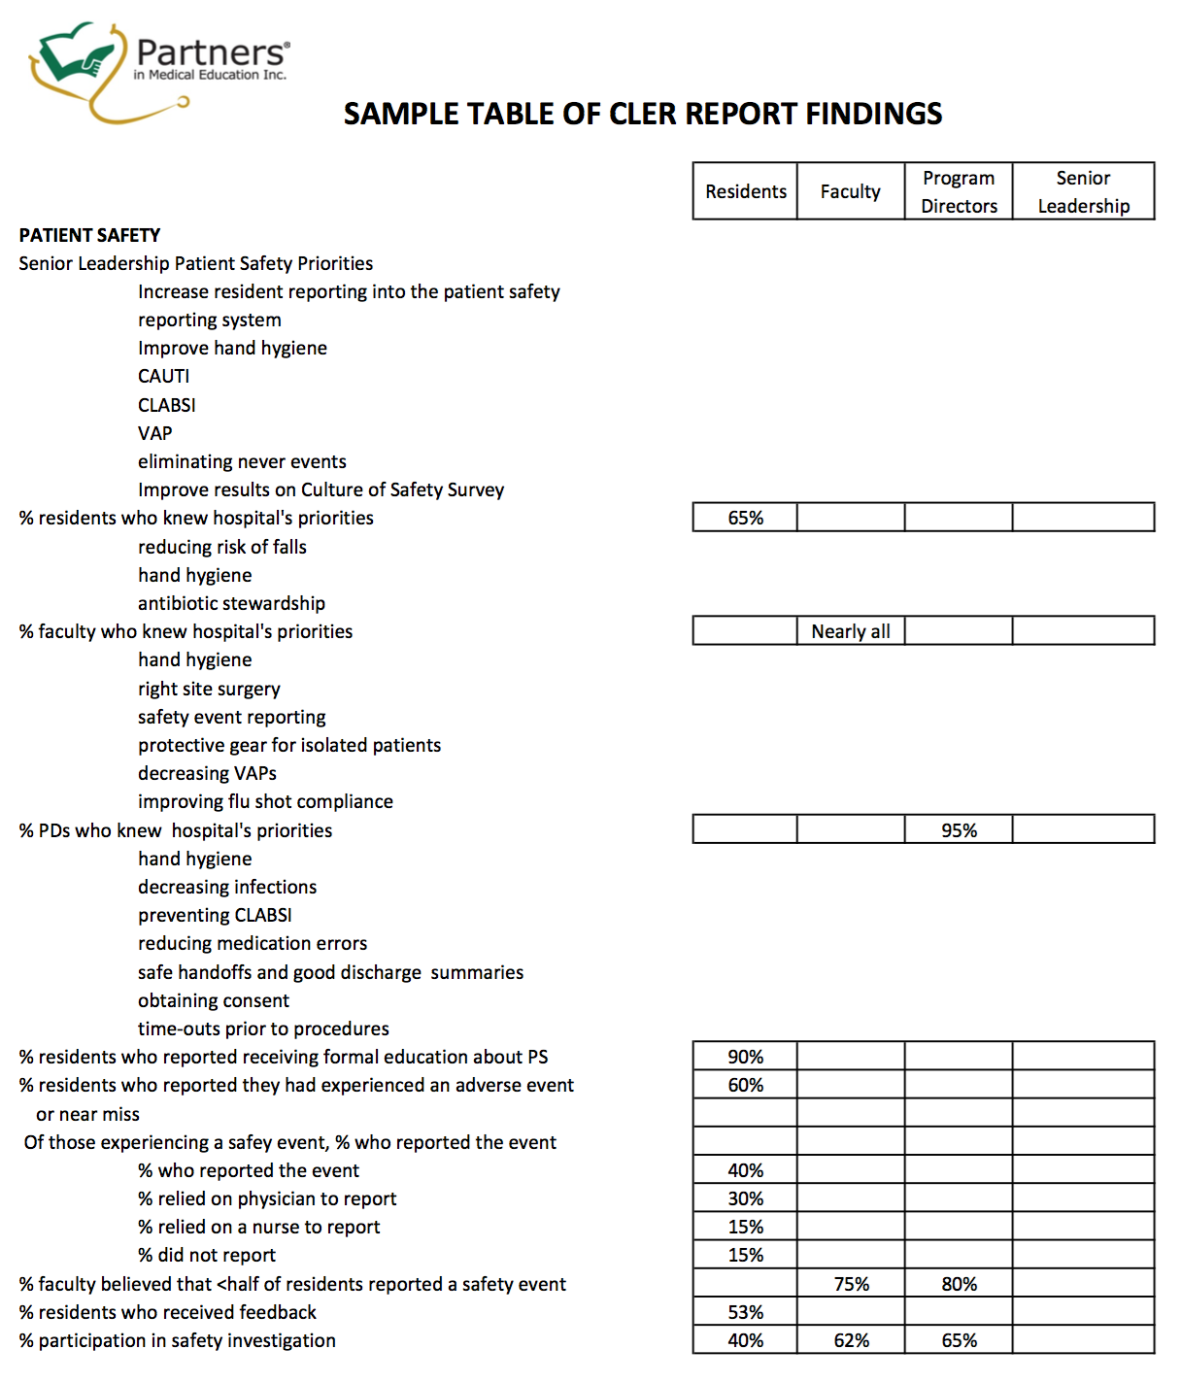

Slide 41
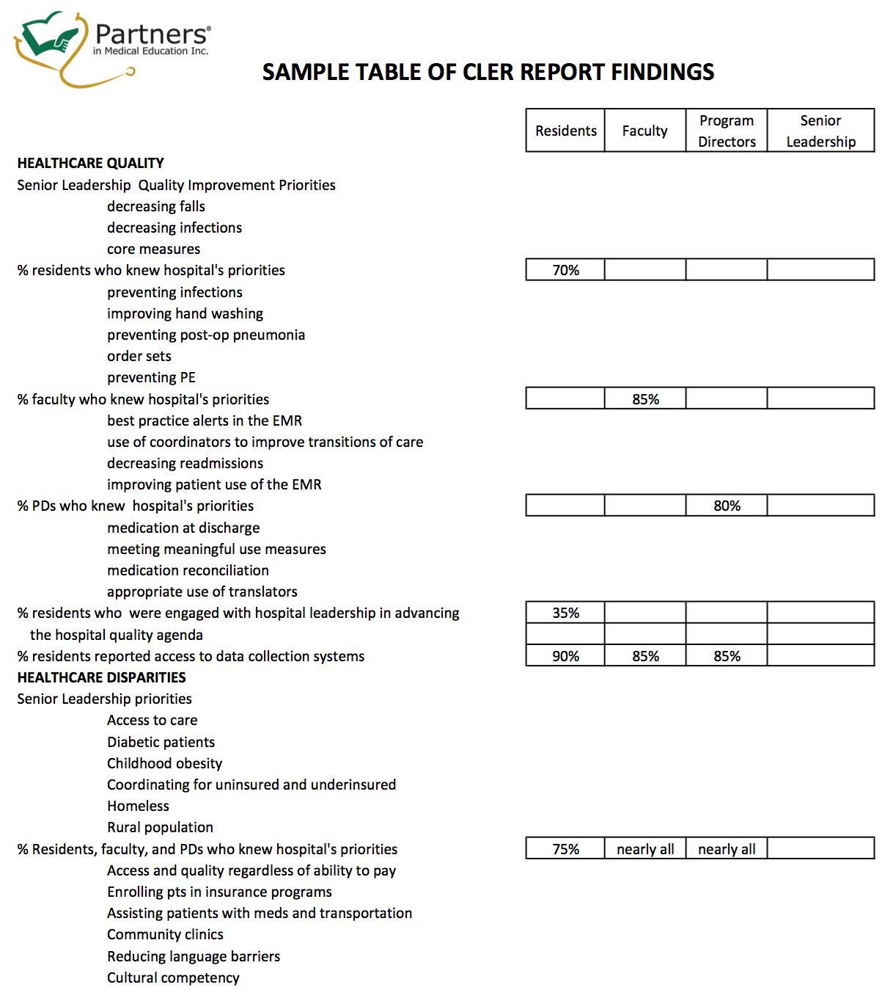

Slide 42
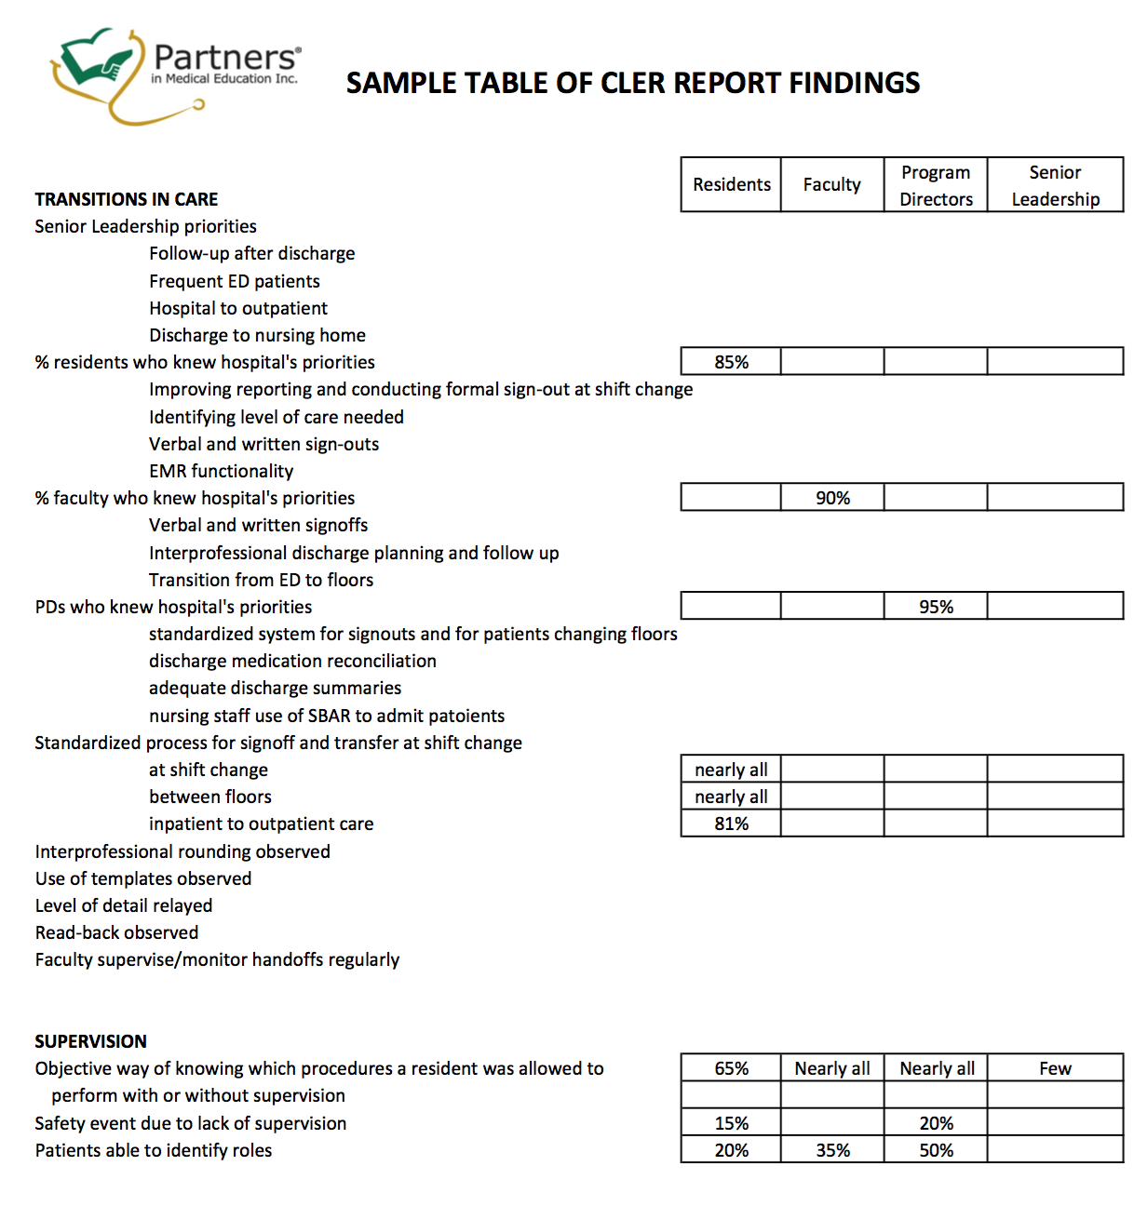

Slide 43
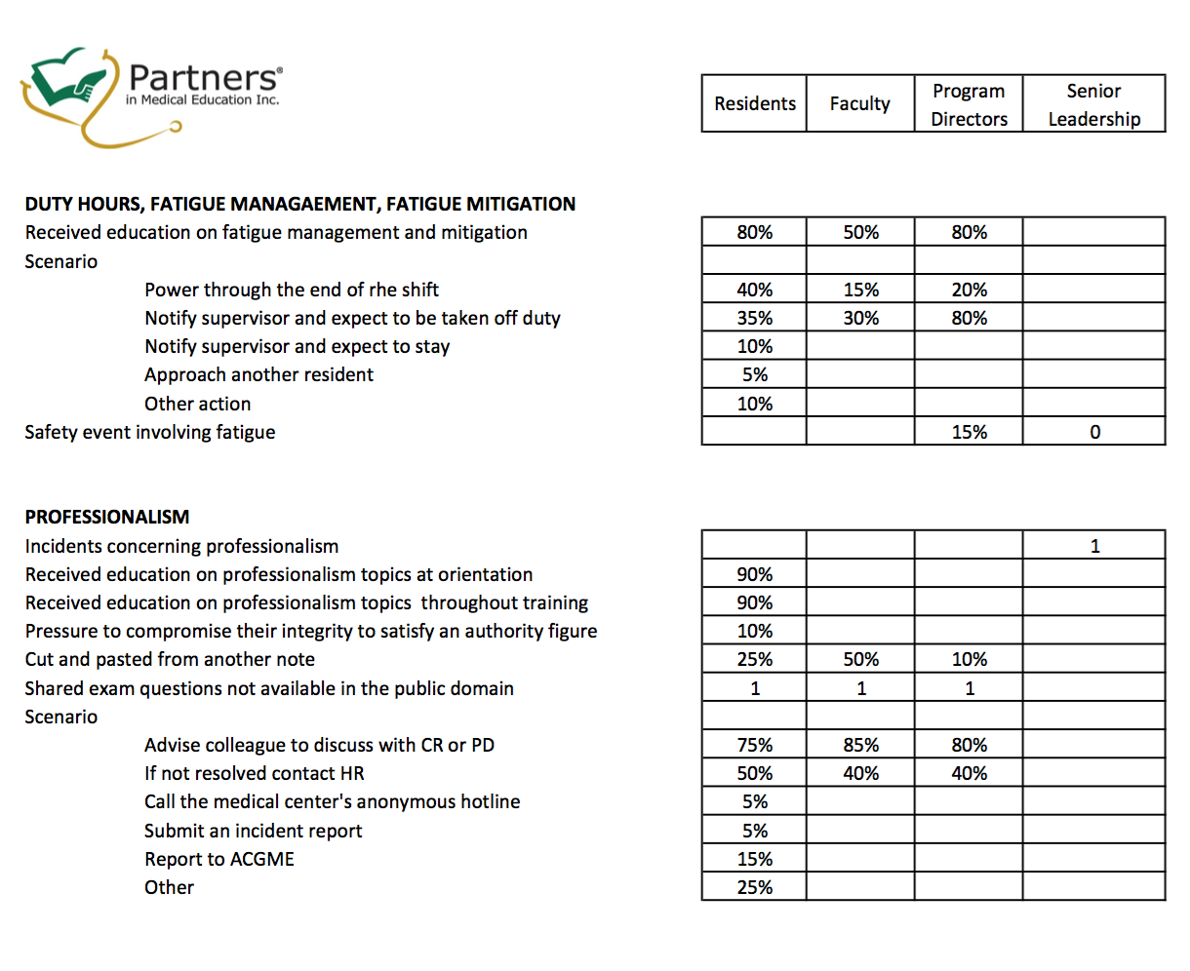

Slide 44
Take a critical look… at BOTH documents -- together
Look for alignment
Beliefs and perceptions vs. fact
Inventory your own activities around the 6 focus areas
Estimate your position along each of the pathways
National data, when available

Slide 45
Where Do We Start?
Consider a subcommittee of the GMEC
Composed of PD’s, APD’s, PC’s, residents, and the DIO
What are we going to measure and how often?
What is the benchmark?
Devise a rating scale
What will the dashboard look like? What software are we going to use?

Slide 46
Where Do We Start?
Where is the data?
Who is going to collect the data?
Where does the dashboard go after it is completed?
Who will see the dashboard and how will it be used?

Slide 47
Reasons Why Programs and Institutions Should Consider Using a Dashboard
Programs, DIO, and GMEC must devise a way of continually monitoring program quality. Dashboards represent continuous reporting.
ACGME requires that programs and institutions track certain data. Dashboards can be used assist data collection for the Annual Program Update…
…which feeds Annual Program Evaluation
…which feeds 10-year Self-Study
…which feeds Annual Institutional Review
…which feeds GMEC Special Review
Dashboards will be valuable as one of the tools to document institutional oversight for a Clinical Learning Environment Review
A dashboard can identify best practices as well as performance gaps, which represent opportunities for improvement
Regular monitoring of program dashboards demonstrates GMEC oversight
Aggregated program dashboards identify areas where the DIO and GMEC must monitor, intervene, facilitate, or resolve at the institutional level

Slide 48
Final Thoughts…
Do not wait to begin.
Trend your metrics over time.
Share your dashboard with everyone.

Slide 49
Partners’ Online Education
Upcoming Live Webinars
Strategies for Resident Engagement
in Patient Safety & QI
Tuesday, October 27, 2015
12:00pm – 1:30pm EST
Meet the Experts – Fall Freebie
Thursday, November 5, 2015
12:00pm – 1:00pm EST
Evaluations to Support
Milestone Assessments
Thursday, November 19, 2015
12:00pm – 1:30pm EST
PC Series
Thursday, December 10, 2015
12:00pm – 1:30pm EST
www.PartnersInMedEd.com
On-Demand Webinars
Self-Study Visits
Introduction to GME for
New Program Coordinators
Milestones & CCCs
GME Financing – The Basics
Single Accreditation System
The IOM Report
Institutional Requirements: What’s New?
Contact us today to learn
how our Educational Passports can save you time & money!
724-864-7320

Slide 50
Partners in Medical Education, Inc. provides comprehensive consulting services to the GME community. For more information, contact us at:
Phone: 724-864-7320
Fax: 724-864-6153
Email: Info@PartnersInMedEd.com
www.PartnersInMedEd.com

