Slide 1
Partners Webinar Alert
Reminder…Because of the amount of individual logins for this webinar. Please DO NOT Unmute your Microphone after you enter this webinar.

Slide 2
Demystifying Diversity
Christine Redovan, MBS, MLIS
Tori Hanlon, MS, CHCP

Slide 3
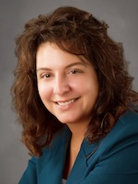
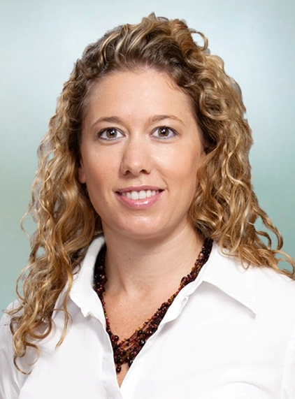
Introducing Your Presenter…
Christine Redovan, MBA, MLIS
GME Consultant
Tori Hanlon, MS, CHCP
GME Consultant
Seasoned Director of Medical Education and GME Operations
Accreditation and Management Expert For New and Established Institutions and Programs
ACGME-I Accreditation Expert
Successful GME Start-Up Implementation
Focused on Continuous Accreditation Readiness. Data Mining, and Useful GME Resources
20+ years GME experience
Over 13 years working in Medical Education
Bachelor’s in Health Services Administration
Master’s in Health Administration and Policy
Designated Institutional Official
Experienced in GME at a large academic medical center

Slide 4
Objectives
To understand what diversity is, specifically as it relates to medicine
To understand why diversity matters in GME
To develop diversity tools to evaluate and enhance diversity in your GME programs

Slide 5
Defining Diversity
Any dimension that can be used to differentiate groups and people from one another (Global Diversity Practice)
Age
Gender
Ethnicity
Religion
Disability
Political beliefs
Race
Sexual orientation
Education
National origin
Life experience
Language

Slide 6
Diversity vs. Inclusion
Diversity is a fact, inclusion is a choice

Slide 7
History of Diversity

Slide 8
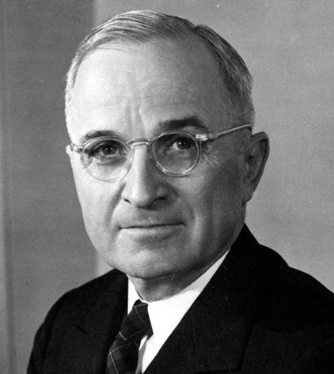
History of Diversity
1948 – Executive Order 9981
First diversity initiative in the workplace?
1964 – Civil Rights Act
Title VII

Slide 9
History of Diversity
1987 – Workforce 2000 published
1990’s – Decade of Diversity

Slide 10
History of Diversity
2000’s – Increasing diversity across the U.S., Diversity & Inclusion
2020 – Multigenerational, Unconscious bias, Gender identify and expression, Political thought, Diversity, Inclusion & Equity,

Slide 11
Diversity in Medicine

Slide 12
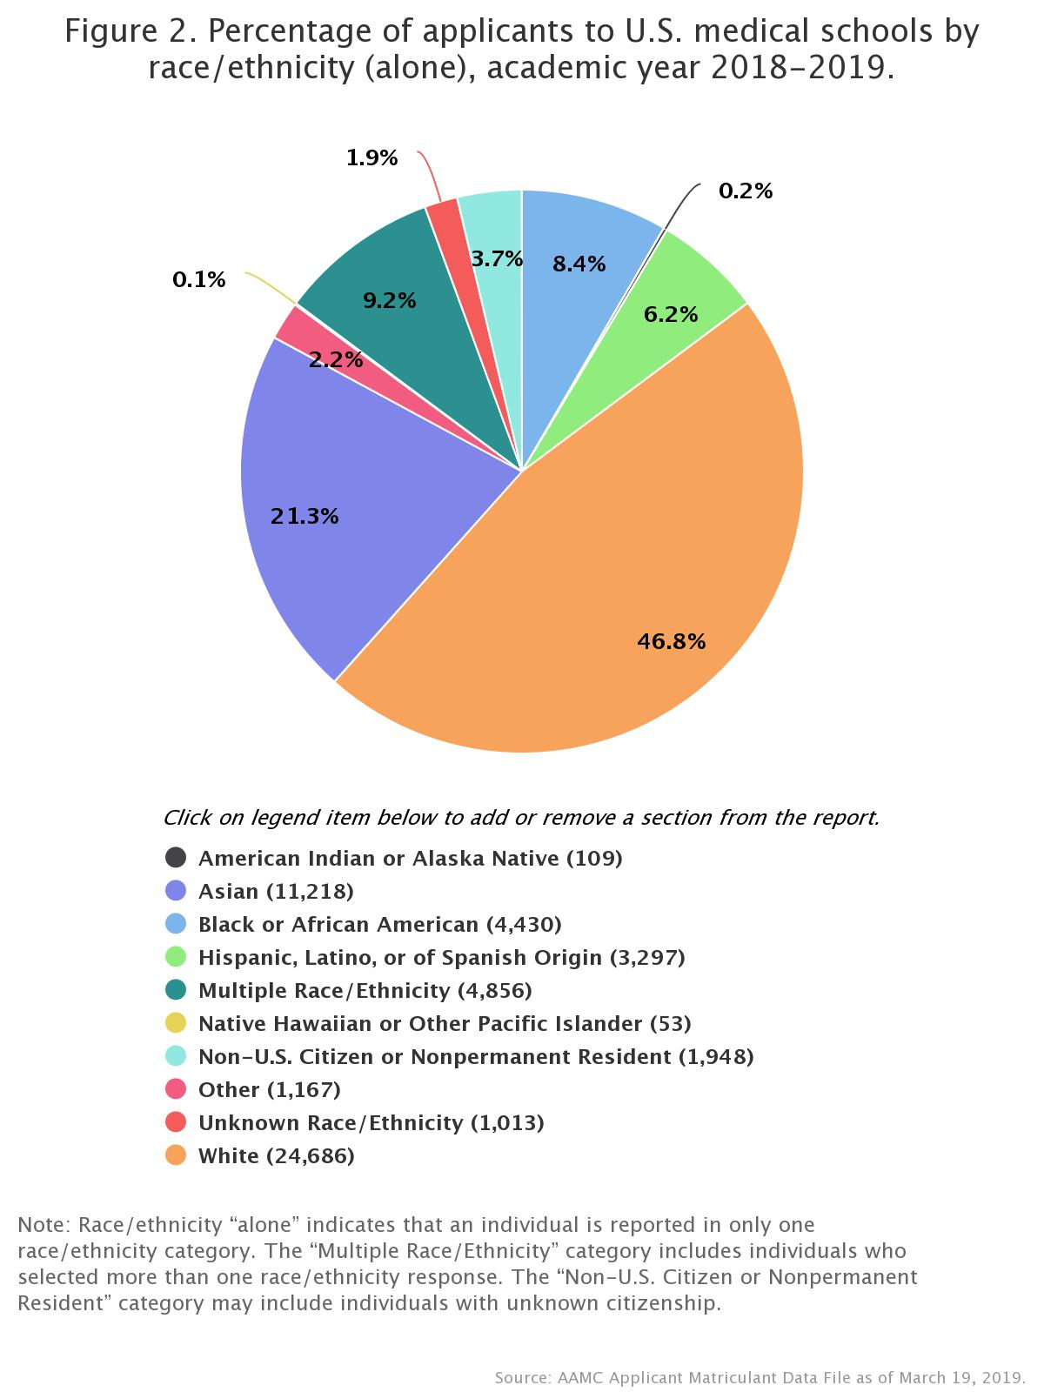
Diversity in Medicine

Slide 13
Diversity in Medicine
Accreditation Council for Graduate Medical Education. (2019). Data resource book: Academic year 2018-2019. ACGME:Chicago,IL.

Slide 14
Diversity in Medicine
Physician Workforce (2018)
35% women and 34% white*
65% male and 53% white*
9% of underrepresented minorities make up physician work force^ (36% of the general population~)
4% of underrepresented minorities identify as LGBT+ in the physician workforce^

Slide 15
Diversity in GME Why it Matters

Slide 16
Why Does Diversity Matter in GME?
Right thing to do
Shifts in population demographics
Reduction in health disparities
Enhances CLE
Recruitment and retention

Slide 17
Diversity
Patient
Safety
Quality
Teaming
Supervision
Well-
Being
Profession-
alism

Slide 18
CLE
CLE Area
Patient Safety | Communication; disclosure of events
Healthcare Quality | Health care disparities
Teaming | Collaboration; common vision and goals
Supervision | Safe and supportive environment
Well-Being | Physical and emotional aspects of well-being
Professionalism | Attitudes, beliefs and skills

Slide 19
ACGME Requirements

Slide 20
ADS Diversity Questions
Describe how the program will achieve/ensure diversity in trainee recruitment, selection, and retention
Describe how the program will achieve/ensure diversity in the individuals participating in the training program (e.g. faculty, administrative personnel, etc.)

Slide 21
Recruitment & Retention
Intentional Recruitment
Mission, vision, values
Gap analysis
What is ideal state?
Respectful Inclusion
Retention
Innovative and representative workforce

Slide 22
Student Perceptions
Diversity and allyship
Curriculum reform
Open conversations
Safe spaces
Ackerman-Barger, K, Boatright, D, Gonzalez-Colaso, R, Latimore, D. Seeking inclusion excellence: Understanding
racial microagressions as experienced by underrepresented medical and nursing students. Academic Medicine
2020; 95: 758-763.

Slide 23
Creating a Diversity Profile

Slide 24
Diversity Profiles
Useful to get an idea of the current state of diversity
Personal profile – identify your own biases, views, and improvement areas
Program profile – identify where your program is and areas you may want to improve

Slide 25
Diversity Initiative Plan
Gather data
Identify areas of concern
Address policies and practices
Identify program objectives
Get buy in and support
6. Implement initiatives
7. Communicate initiatives
8. Measure and disseminate outcomes
9. Review and adjust

Slide 26
Tools
Diversity Survey
How to Develop a Diversity & Inclusion Initiative
Diversity Activities

Slide 27
Benefits of Diversity

Slide 28
Measurable Benefits of Diversity
Training in a diverse setting prepares for treating a diverse population⁺
Higher trust from patients treated by same race physician; longer visits⁺
Greater customer (i.e. patient) satisfaction#
Higher employee satisfaction#
Higher stock prices# (i.e. reputation for hospitals)
Higher company performance#
Lower litigation expenses#

Slide 29
What Can You Do?

Slide 30
Action Items
Report accurate ethnicity, race, and other diversity data; encourage others to report accurately
Develop a diversity plan
Develop a holistic approach to applicant review (Aibana, 2019 )(Ganzaga, 2020)
Review resident and faculty wellness approaches
Consider providing scholarships for URM
FARMS database (farmsdatabase.com)

Slide 31
Action Items
Set diversity as a PEC agenda item
Seek out other hospital sites for ideas
Try a “Healthcare Hackathon” (Wang, 2018)
Implement a diversity activity into a resident/department meeting
Take a class

Slide 33
References
*AAMC. (2019). Diversity in medicine: Facts & figures 2019. Retrieved from https://www.aamc.org/
Aibana, O., Swails, J., Flores, R., & Love, L. (2019). Bridging the gap: Holistic review to increase diversity in graduate medical education. Academic Medicine, 94(8), 1137-1141, doi:10.1097/ACM.0000000000002779
Ganzaga,AM., Appiah-Pippim, J., Onumah, C., & Yialamas, M. (2020). A framework for inclusive graduate medical education recruitment strategies: meeting the ACGME standard for a diverse and inclusive workforce. Academic Medicine, 95(5), 710-716, doi: 10.1097/ACM.0000000000003073
^Greater Influence, Inc. (2020). Home. Retrieved from https://greaterinfluence.org/

Slide 34
References
# Managing Demographic & Cultural Diversity. (2012). In Organizational Behavior, Saylor Academy. Retrieved from https://www.saylor.org/
~McMahon, S. (2020, June 30). U of L medical student launches nonprofit to help minority students. Retrieved from http://www.medicalnews.md/
+Rothman, P. (2016). Diversity in medicine has measurable benefits. Dome. Retrieved from https://www.hopkinsmedicine.org/
Wang, J., Roy, S., Barry, M., Chang, R. & Bhatt, A. (2018). Institutionalizing healthcare hackathons to promote diversity in collaboration in medicine. BMC Medical Education 28(269), 1-9, doi: 10.1186/s12909-018-1385-x

Slide 35
Upcoming Live Webinar
Faculty Development Planning: Sponsoring Institution Role Thursday, July 16, 2020 12:00pm – 1:00pm EST
ADS Annual Update: Best Practices Tuesday, July 28, 2020 12:00pm – 1:00pm EST
Graduate Medical Education Financing
Tuesday, August 11, 2020 12:00pm – 1:00pm EST
Artificial Intelligence in Medicine: Its Impact on GME
Thursday, August 27, 2020 12:00pm – 1:00pm EST
Latest On-Demand Webinars
Research and Scholarly Process in a Nutshell: Getting Started
Ask Partners – Spring Freebie Lessons Learned: Accepting Displaced Orphan Residents
Is your Coordinator Well Enough: Coordinators as Role Models of Wellness
Research Proposal Development: Tips for Success Working with your Governing Board
Recognizing & Addressing Precursors of Burnout: The Value of Shame Resiliency Training to Support Resident Well-Being
Working with your IRB
Digging for Data II
NEW Faculty Development Series
15 Minutes to Effective Feedback
Toolbox for Teaching Millennials
Taking Supervision to the Next Level
Contact us today to learn how our Educational
Passports can save you time & money!
724-864-7320
www.PartnersInMedEd.com
35

Slide 36
Partners in Medical Education, Inc. provides comprehensive consulting services to the GME community.
Partners in Medical Education
724-864-7320 | info@PartnersInMedEd.com
Christine Redovan, MBA GME Consultant
Christine@PartnersInMedEd.com Tori Hanlon, MS, CHCP
tori@partnersinmeded.com
www.PartnersInMedEd.com
36

