Slide 1
Please Note…
Please make sure your Start Video is OFF when logging into the WebEx platform.
Here is what it should look like
ALSO
It is NORMAL to not hear any sound until the webinar starts at 12:00 noon EST.
Your phone line is muted, but you can always chat to the host, BJ Schwartz, if you have any questions or concerns during this time.

Slide 2
Developing Residency Budgets
Amy Durante, MHA

Slide 3
Introducing Your Presenter
Amy Durante, MHA
Over 15 years’ experience in GME in both the coordinator and GME roles
Created budgets to assist and ensure compliance

Slide 4
LEARNING OBJECTIVES
Discuss the value of GME budgets
Review various budgetary processes
Identify the major categories of a GME budget
Understand the impact of poor budgeting

Slide 5
All Different Processes

Slide 6
What’s Your Institutions Process?
Program GME
Program Department Chair
GME CMO/CFO
Program CMO/CFO
Consortium Model – Who will be responsible

Slide 7
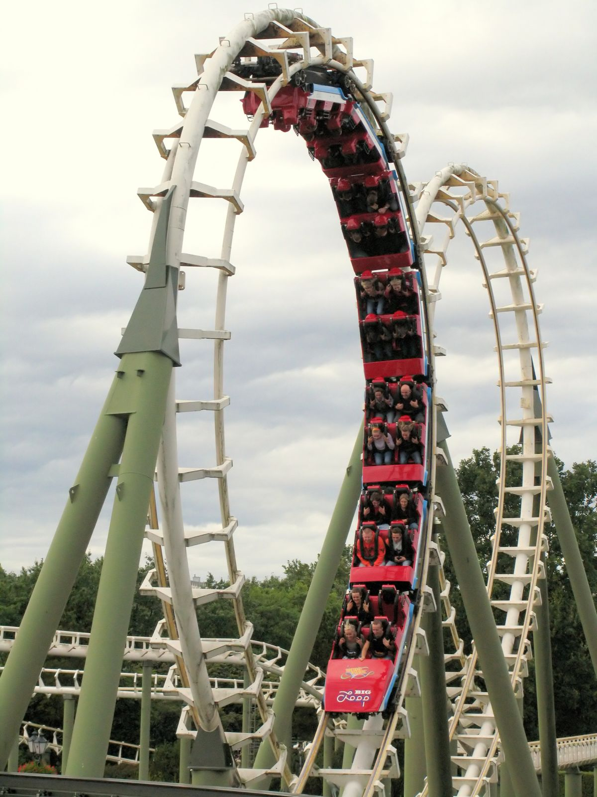
Keeping GME in the Loop
To ensure you have requested everything
To keep residents/fellows morale up
To assist future programs

Slide 8
GMEC Discussion
The GMEC must have oversight of the quality of the GME learning and working environment within the Sponsoring Institution, each of its ACGME accredited programs, and its participating sites Learning environment (IR - I.B.4.a).(2)
All programs on the same page
Educate new programs/Program Directors

Slide 9
Human Resources
Who pays the salary?
Who will do the credentialing?
Who will do the promotion?
Who enters the residents/fellows into the payroll system and completes the HR documentation?

Slide 10
What Does the Budget Include?

Slide 11
Budget Categories
Recruitment
Education
Administrative Staff
Human Resources
Space/Logistics/Other
Well-Being/Program Requirements
Food
Program Structure
GME Budget

Slide 12
Budget Requests
Recruitment | Pre-Recruitment Costs Hotel Transportation Virtual software Gifts/Swag Updated program videos Website updates Visa Costs Food
Education | Board Review Books Education fund Conference Registration Travel to Conferences In Service Exams Faculty Development Faculty Retreats Resident Retreats Simulation Devices Payment for Outside Rotations Transportation for Outside Rotations Lodging for Outside Rotations Invited Speakers Research Symposium Visual and Other Educational Aids Telecommunication technology Scholarly Activity Funds Membership Dues Laptops Phones

Slide 13
Budget Requests
Administrative Staff | TAGME Computers Printers Conference Registration Travel to Conferences Office Supplies Career Development
Human Resources | DIO Salary Institutional Coordinator Salary Resident/Fellow Salary and Benefits (family insurance?) Program Director Salary and Benefits Associate Program Director Salary and Benefits Faculty Salary and Benefits Program Coordinator(s) Salary and Benefits Fingerprinting Drug testing Licenses Residents/Fellows Meal Allowance Residents/Fellows Housing Stipends Chief Resident/Chief Fellow Stipend LOA’s

Slide 14
Budget Requests
Space/Logistics/Other | Computers – Both New and Replacements Office Space Call Rooms Lounge maintenance Lab Coats Scrubs Accommodations for residents with disabilities Board Recertification License Fess License Recertification Remediation Costs Probation Costs Graduation Celebration Costs
Well-Being/ Program Requirements | Wellness Retreats Wellness Activities DEI Confidential Affordable Mental Health Counseling Other Program Specific Requirements

Slide 15
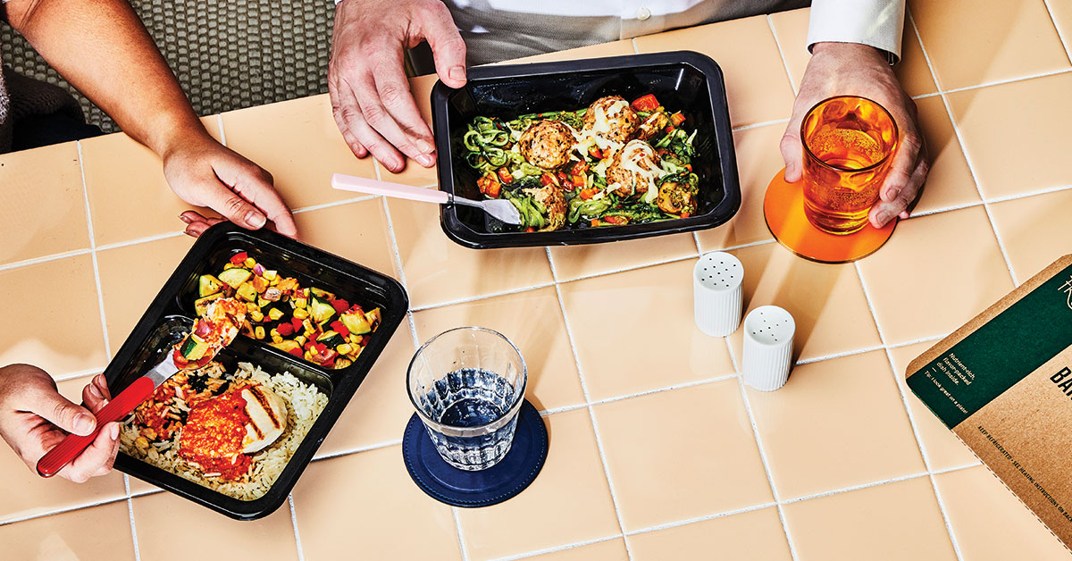
Budget Requests
Food | Graduation Party Conferences Orientation Journal Club Medical Students Etc. Etc. Etc.

Slide 16
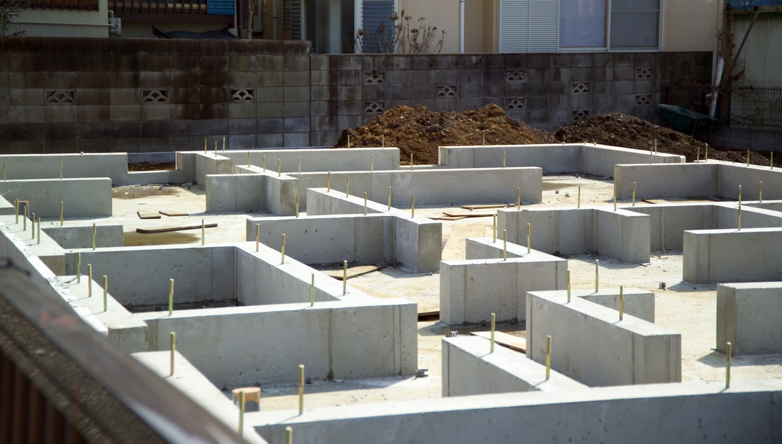
Budget Requests
Program Structure | Complement Increases Salary All Items in Education All Items in Space/Logistics New Programs Application Costs PD/Faculty Recruitment Program Coordinator Recruitment Space – Existing Remodel or New All Items in all other categories

Slide 17
Budget Requests
GME Budget | Resident Management Suite (New Innovations/MedHub) Faculty Development Faculty Retreat ERAS NRMP ACGME Fees ACGME Applications Educational Funds Orientation Onboarding Food Wellness Retreats Resident/Fellow Appreciation Week Program Coordinator Appreciation Day Certifications BLS ACLS PALS NRP Pain Management Accreditation Visits Travel/Mileage Library/Resources Scholarly Activity Resources

Slide 19
Be Mindful
Who - Is budgeting for the item?
Consortium – who requests the budget
Many items can overlap with GME
GME to ensure they are being budgeted for
What - Exactly are they budgeting for?
Does your program need something additional?
Where – Will the budget monies be housed?
Who is tracking?
When – Will the program/GME office have access?
Budget released?
Why – Is it being budgeted there?
Who tracking and are there exceptions?

Slide 20
Value of GME Budgets

Slide 21
Value of GME Budgets
Use ACGME requirements to justify the budget item
Justifications should focus on the impact to the hospital
Fulfill requirements
Resident/Fellow morale
Maintain structure
Happy C-suite

Slide 22
Impacts of Poor Budgeting

Slide 23
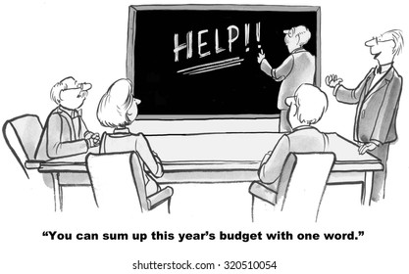
Impacts of Poor Budgeting
Education for the residents/fellows is not allowed
Morale of residents/fellows they know what other programs get from interviews
Morale of faculty and staff
Time: redistribution of funds

Slide 25
Upcoming Live Webinar
Onboarding Residents
Thursday, February 2, 2023
How Semi-Annual Evaluations Document, Educate, and Improve
Thursday, February 9, 2023
Ask Partners – Spring Freebie
Tuesday, March 21, 2023
GMEC Best Practices
Thursday, March 30, 2023
Back to Basics for New Coordinators III
Thursday, April 6, 2023
Latest On-Demand Webinars
SI Self Study 101
Motivating Faculty to Mentor & Do Reseach
Meet the Experts – Fall Freebie
Lights, Camera…Zoom!
GME Educational Program Design II
Site Visits Are Coming!
SI 2025: 2022 Check Up
Back To Basics: Intermediate Topics for New Program Coordinators
GME Educational Program Design I
Wellness is a Team Sport
Looking Behind the Current of CMS Reporting
ADS 2022: Part II
NEW Program Director Coaching Series
Jan – March Session – FULL
Next Session Starts April – June
6 one-hour group sessions over 12wks
2 one-on-one 30 min indiv. Sessions
Limited Enrollment for interactivity
Course Materials/GME Community Network
Email BJ@PartnersInMedEd.com for pricing and availability
Contact us today to learn how our Educational
Passports can save you time & money!
724-864-7320
www.PartnersInMedEd.com
Presented by Partners in Medical Education, Inc. 2023
25

Slide 26
Partners in Medical Education, Inc. provides comprehensive consulting services to the GME community.
Partners in Medical Education
724-864-7320 | info@PartnersInMedEd.com
Amy Durante, MHA
Amy@PartnersInMedEd.com
www.PartnersInMedEd.com

