Slide 1
Digging For Data Part I
Christine Redovan, MBA, MLIS -- GME Consultant

Slide 2
Introducing Your Presenter…
Christine Redovan, MBA
GME Consultant
Seasoned Director of Medical Education and GME Operations
Accreditation and Management success for both ACGME & AOA Programs
ACGME-I Accreditation Expert
Successful Continued Accreditation & New Start-Up Implementation
Focused on continual readiness and offering timely and useful GME resources
19 years GME experience

Slide 3
Learning Objectives
Discover various data sources useful for GME
Learn to determine authenticity/authority of data sources
Integrate data into program improvements and action plans

Slide 4
Data Explosion
Notes:
1

Slide 5
Evaluating Sources
Authorship
Publishing Body
Currency
Relevance
Accuracy
Adapted from: https://guides.library.jhu.edu/evaluate/internet-resources
This Photo by Unknown Author is licensed under CC BY-SA

Slide 6
GME Specific Data Sources

Slide 7
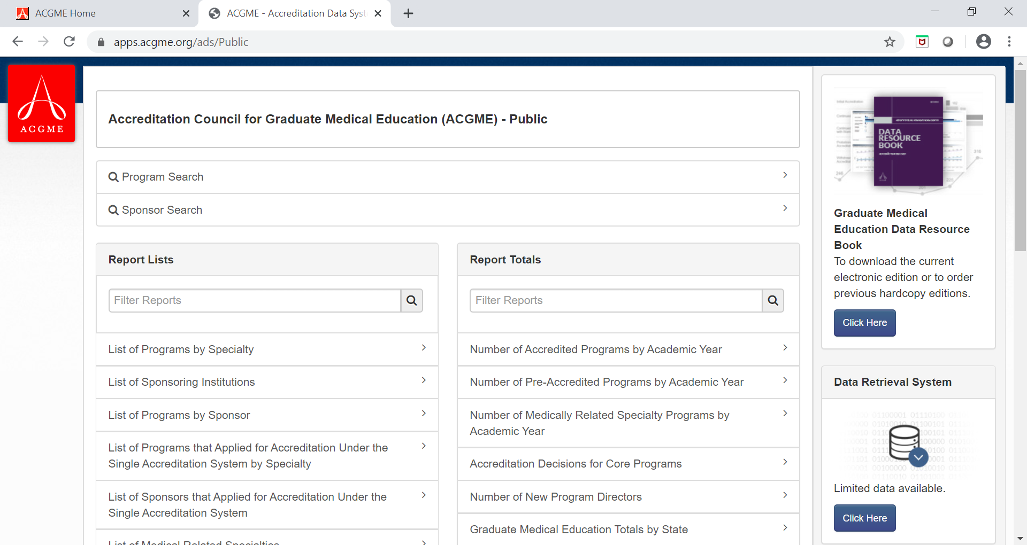
ACGME Public Data

Slide 8
ACGME Public Data
What can I do with this data?
Research your competition
Determine the current landscape for your area/specialty
Number of programs
Number of established/new programs
Participating site information
Osteopathic recognition
SI information
Withdrawn programs
New SI’s

Slide 9
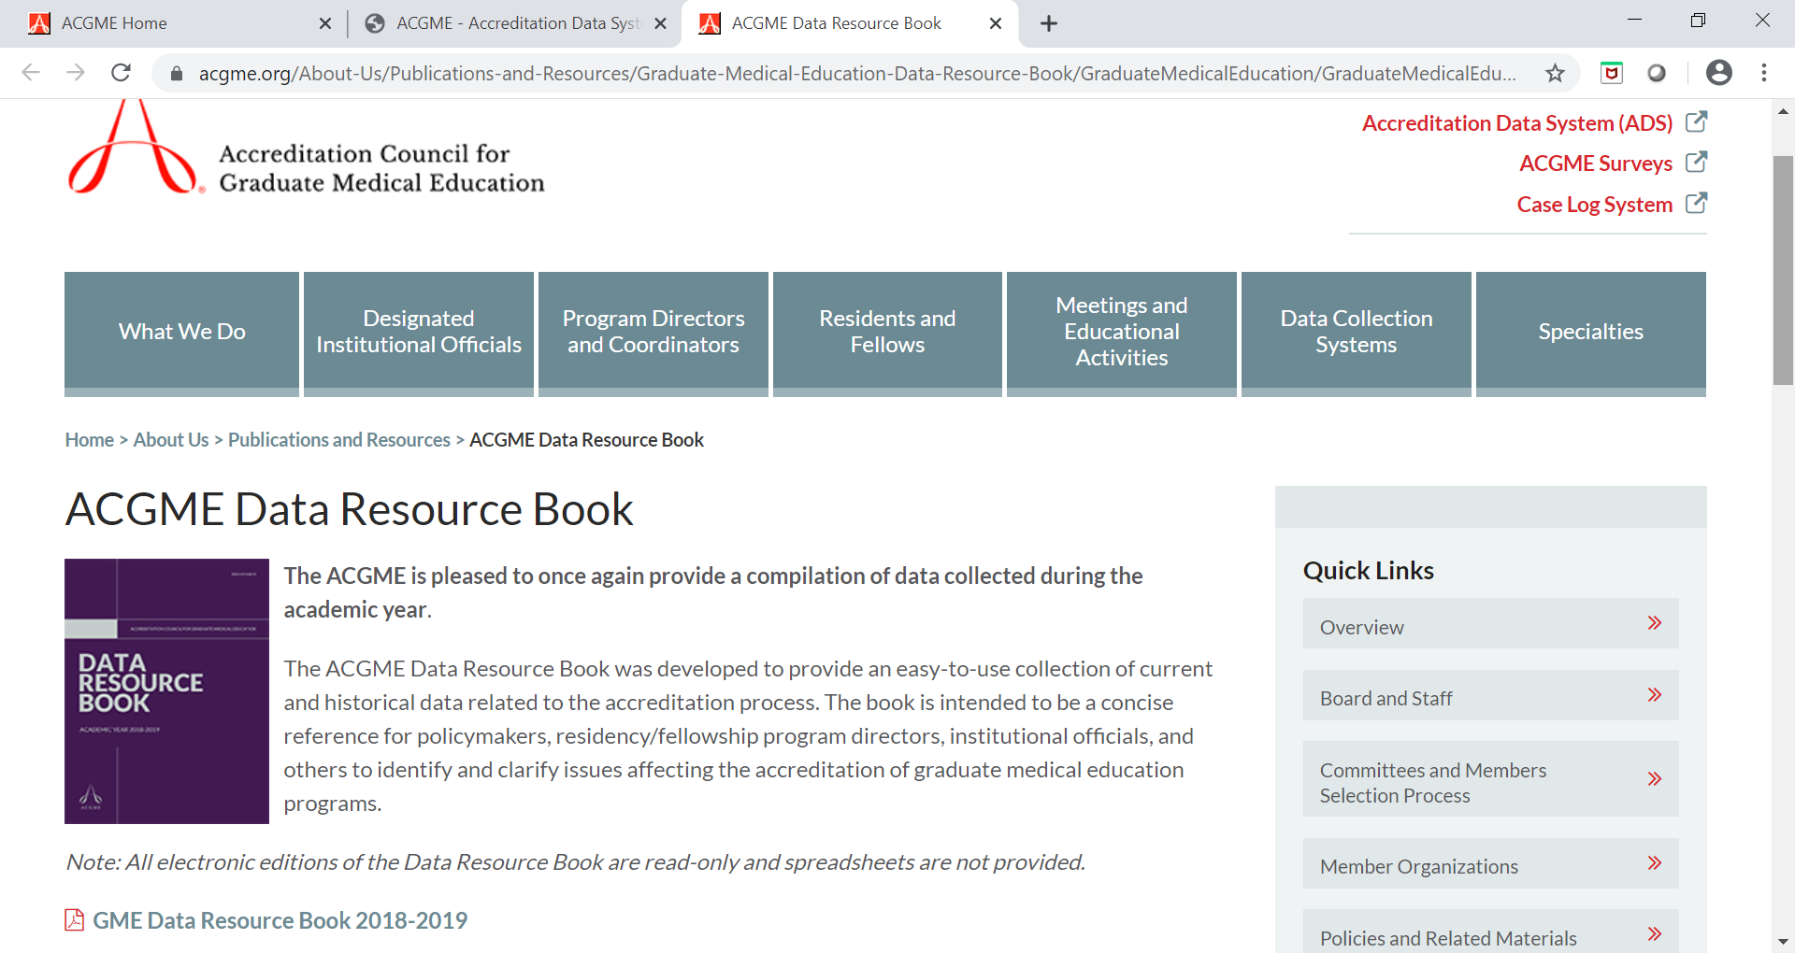
ACGME Data Resource Book

Slide 10
ACGME Data Resource Book
What can I do with this data?
Assemble a historical perspective of specialty
Resident characteristics
Track mix of residents entering specific specialty
Track residents leaving a specialty
Track attrition of DIO/PD

Slide 11
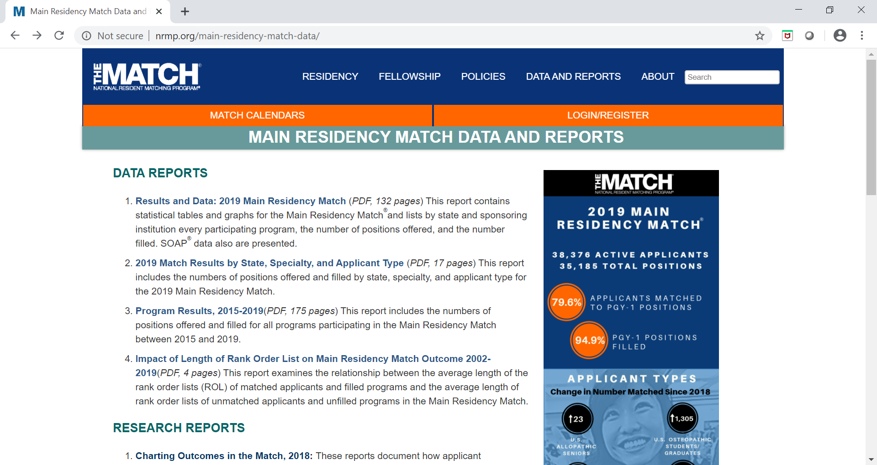
NRMP

Slide 12
NRMP
What can I do with this data?
Characteristics of matched residents by specialty
Mean USMLE scores
Research involvement
Work experiences
Characteristics of applicants
What is important in applying to a program
What is important in ranking a program
Interviews and ranking successes

Slide 13
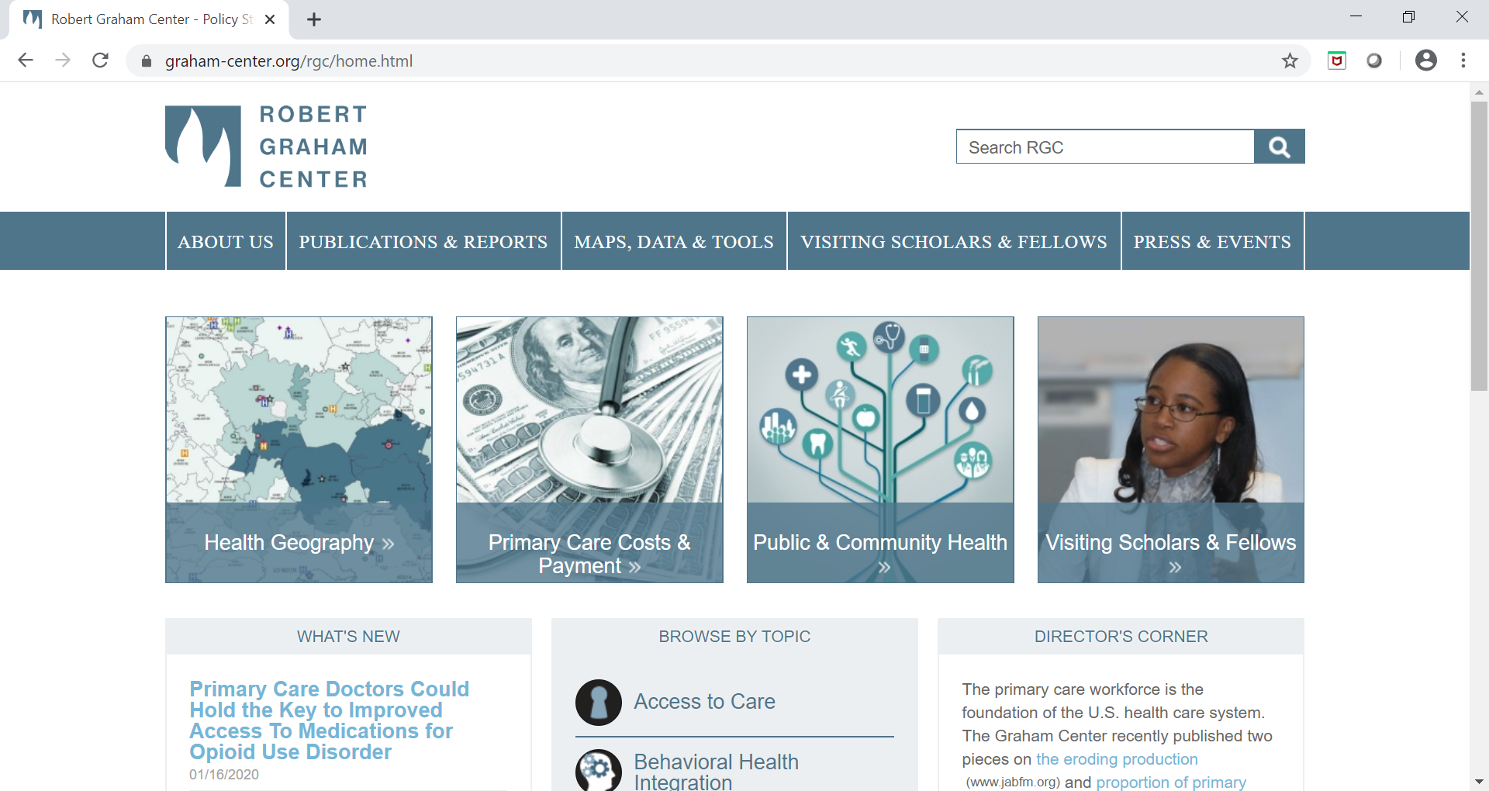
Robert Graham Center

Slide 14
Robert Graham Center
What can I do with this data?
Quantify impact of GME to institution
Family Medicine footprint maps
Primary Care Workforce projection by state

Slide 15
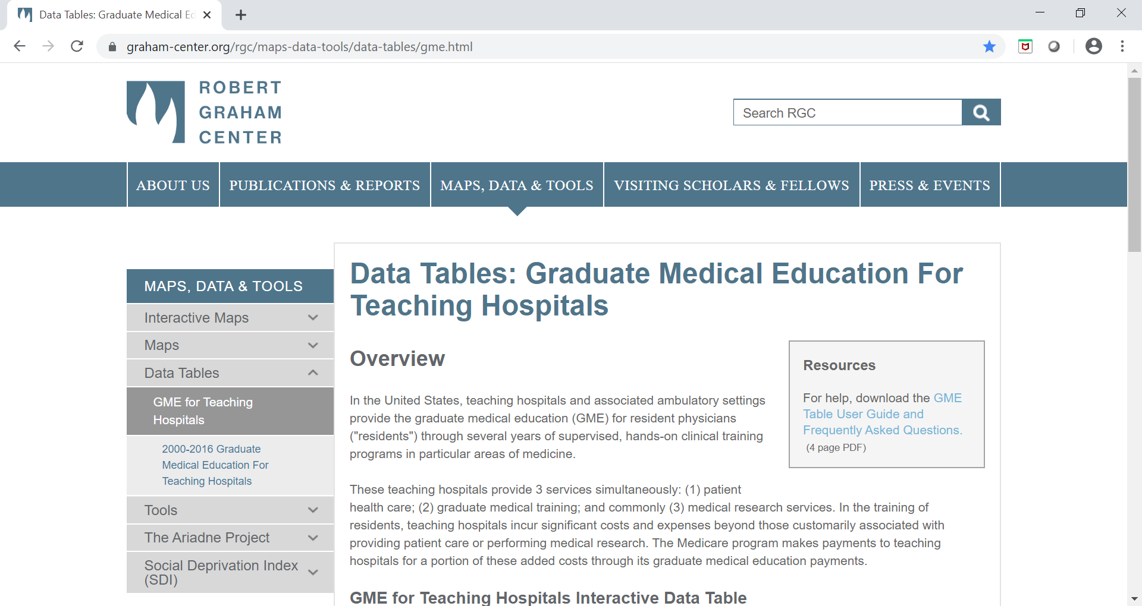
How much $ do we get for residents?

Slide 16
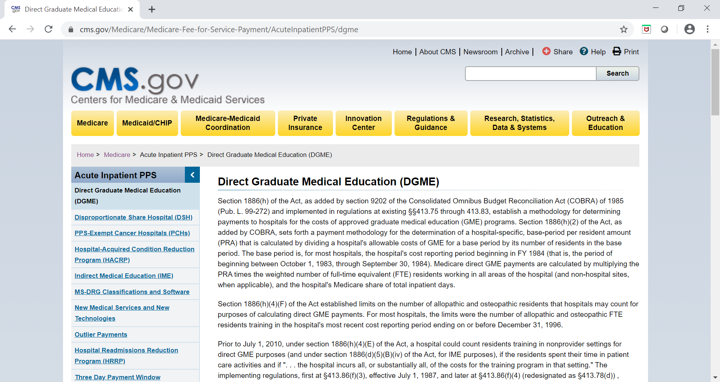
Centers for Medicare & Medicaid Services

Slide 17
Centers for Medicare & Medicaid Services
What can I do with this data?
Understand GME payments
Learn about new and proposed rules
Find cap distribution announcements
CMS Navigator

Slide 18
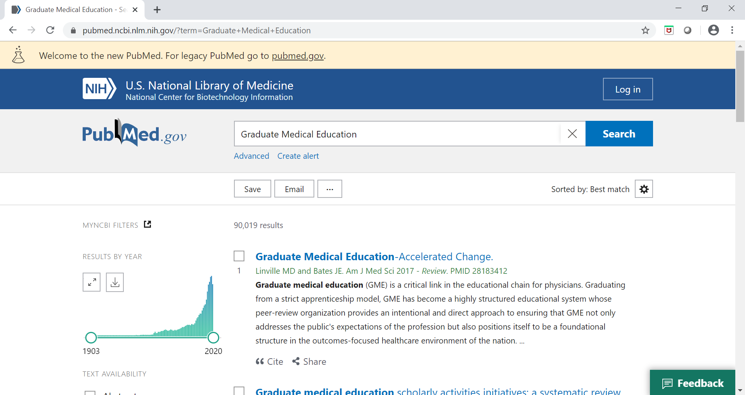
PubMed

Slide 19
PubMed
What can I do with this data?
Search for specific GME topics
Understand trends in GME
Discover new processes for GME
Reach out to potential collaborators

Slide 20
Homework

Slide 21
Practice 1
Put together a table of characteristics for your specialty based on last years data. Use NRMP and ACGME data.
How does your program compare to the national overview?
What changes could you potentially make to improve your programs success?

Slide 22
Practice 2
Review national data on resident program preferences. Use NRMP data.
Determine how your program fits into each of the categories.
Analyze your current recruitment strategy.
Do you emphasize items that are not important to candidates?
Do you skip items that are important?
What improvements can you make in your recruitment strategy?

Slide 23
Next Session
We’ll look at data that is GME related; but not necessarily specific to GME
Census and population data
Health disparity data
State benchmarks
General technology/social issue trends
I’ll share any questions (and answers!) that may come in between now and July

Slide 24
Upcoming Live Webinars
PEC: Best Practices Tuesday, February 4, 2020 12:00pm – 1:00pm EST
Research and Scholarly Process in a Nutshell: Getting Started Thursday, February 13, 2020 12:00pm – 1:00pm EST
Ask Partners – Spring Freebie Tuesday, March 10, 2020 12:00pm – 1:00pm EST
On-Demand Webinars
Special Reviews – Helpful not Hurtful
2019 CPR Part 3 of 4: Section IV & Section V
GME Is Not Just GME
SI 2025 Part 4 of 4: Strategic Planning
Understanding Practice Data
CPR 2019 Part 4 of 4: Putting It All Together
Crafting “Top Notch” Goals, Objectives and Evaluations
Feedback – From the Top Down
Evolving Resident Well-Being
We All Need Scholar Activity, Including Coordinators
NEW Faculty Development Series
15 Minutes to Effective Feedback
Toolbox for Teaching Millennials
Taking Supervision to the Next Level
Contact us today to learn how our Educational
Passports can save you time & money!
724-864-7320
www.PartnersInMedEd.com
24

Slide 25
Partners in Medical Education, Inc. provides comprehensive consulting services to the GME community.
Partners in Medical Education
724-864-7320 | info@PartnersInMedEd.com
Christine Redovan, MBA GME Consultant
Christine@PartnersInMedEd.com
www.PartnersInMedEd.com

