Slide 1
Partners Webinar Alert
Reminder…Because of the amount of individual logins for this webinar. Please DO NOT Unmute your Microphone after you enter this webinar.

Slide 2
Digging For Data Part II
Christine Redovan, MBA, MLIS -- GME Consultant

Slide 3
Introducing Your Presenter…
Christine Redovan, MBA, MLIS
GME Consultant
Seasoned Director of Medical Education and GME Operations
Accreditation and Management Expert For New and Established Institutions and Programs
ACGME-I Accreditation Expert
Successful GME Start-Up Implementation
Focused on Continuous Accreditation Readiness. Data Mining, and Useful GME Resources
20+ years GME experience

Slide 4
Learning Objectives
Discover freely available, authoritative data sources related to GME
Build on evaluation of data skills from Part I
Use data to improve SWOT, APE and program action plans

Slide 5
Data Explosion
= Data Driven Decisions
Notes:
1

Slide 6
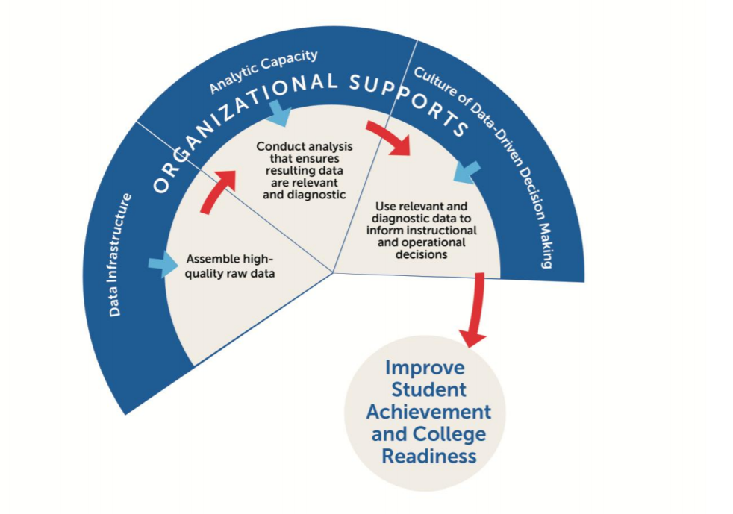
Data Driven Decision Making
Gill, B., Borden, B. & Hallgren,K. (2014). A conceptual framework for data-driven decision making. Mathematica Policy Research. Retrieved from https://www.mathematica.org

Slide 7
GME Related Data Sources

Slide 8
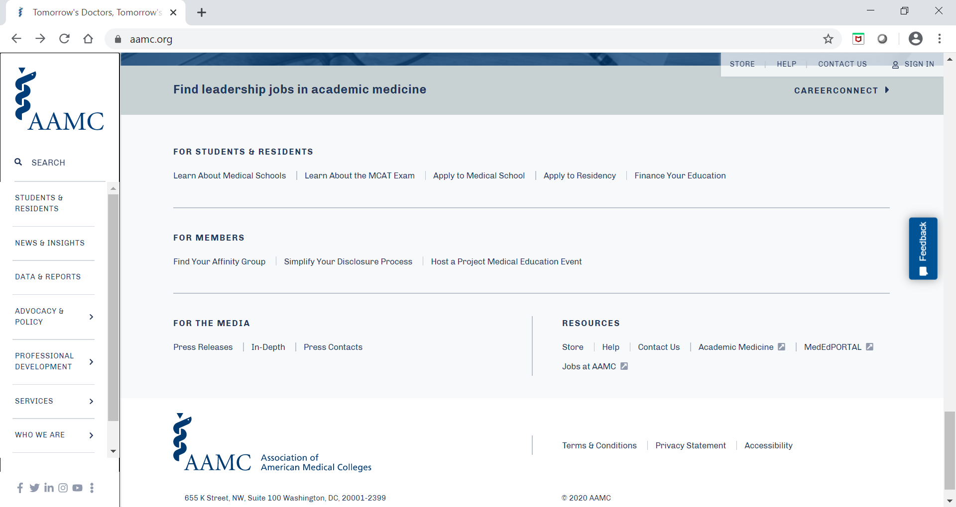
Association of American Medical Colleges (AAMC)

Slide 9
AAMC Public Data
What can I do with this data?
Understand candidate pool
Use national salary benchmarks
Diversity & Inclusion reports
Economic impact of teaching hospitals
Follow student trends and expectations
Improve recruitment outreach and outcomes

Slide 10
Agency for Healthcare Research and Quality (AHRQ)

Slide 11
AHRQ Public Data
What can I do with this data?
Research state characteristics for disparities
Access prepared reports & infographics
TeamSTEPPS training
Digital healthcare research grants

Slide 12
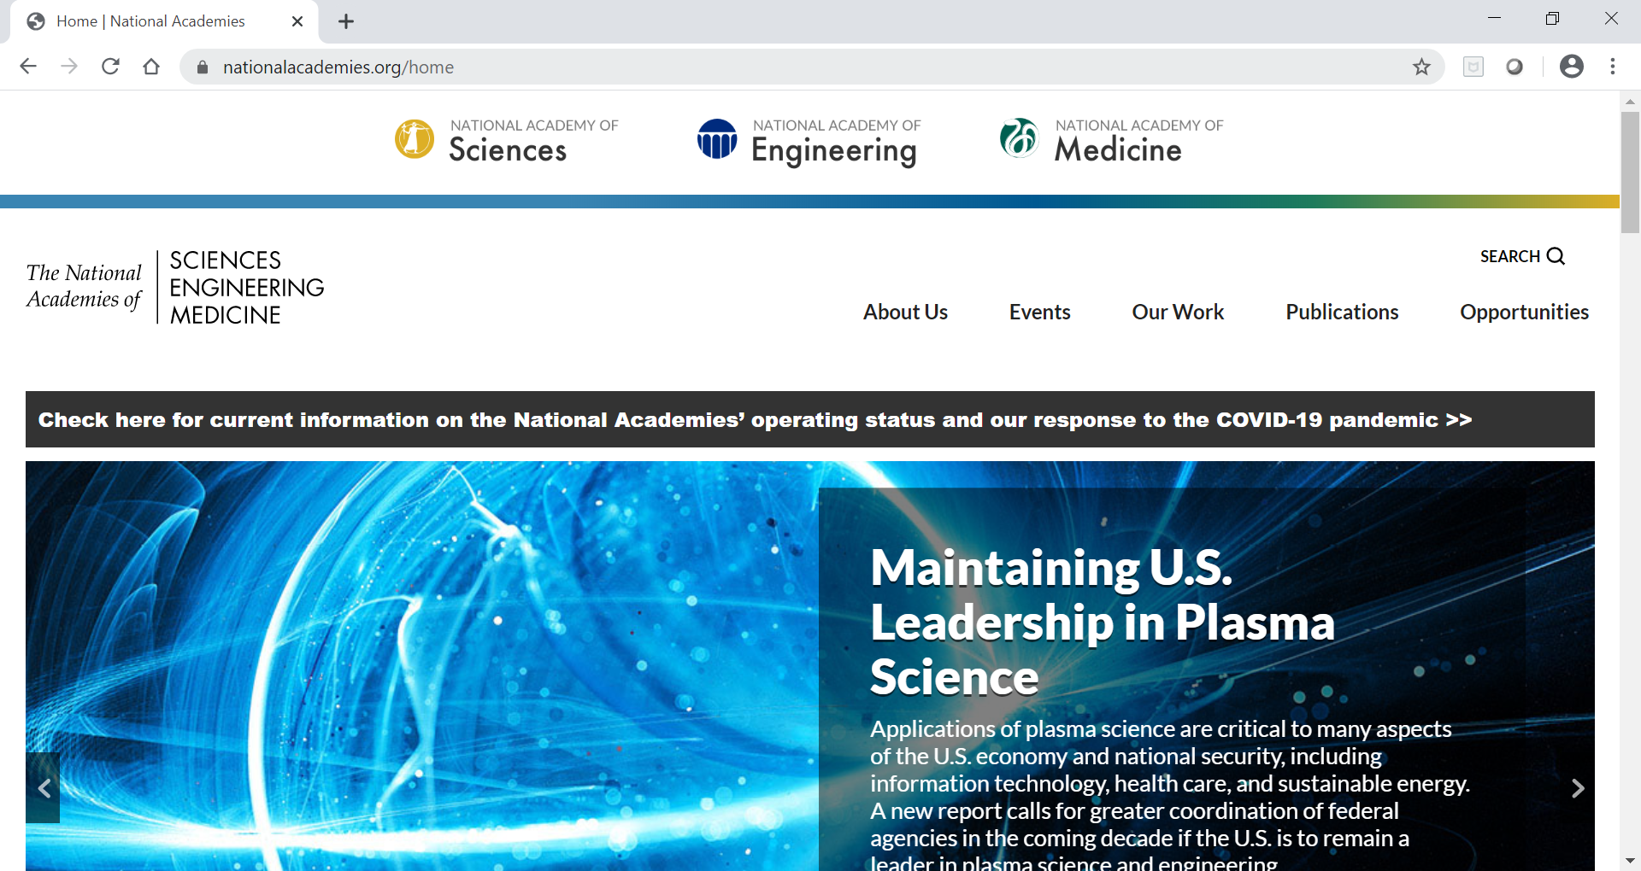
National Academies for Science, Engineering & Medicine

Slide 13
National Academies for Medicine
What can I do with this data?
Well-being resources including infographics, publications and validated assessments
Culture of health including disparities, health equity and case studies
Access Graduate Medical Education That Meets the Nations Health Needs
Useful for high-level view of GME and medicine

Slide 14
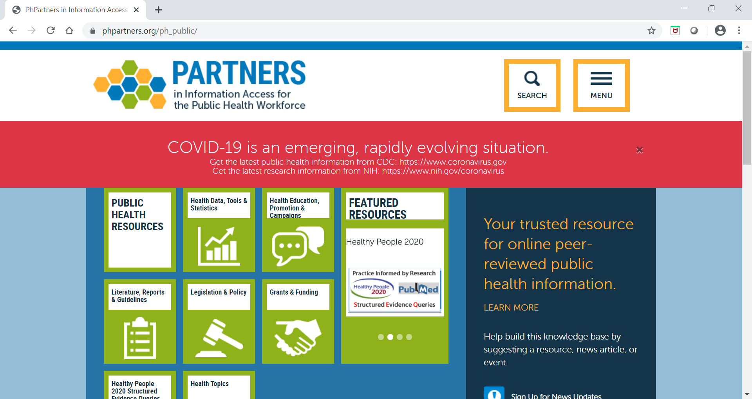
Partners in Information Access for the Public Health Workforce

Slide 15
Partners in Information Access for the Public Health Workforce
What can I do with this data?
One-stop shopping for multiple types of data and links to verified data
Multiple sources for public health data
Disparity data
Population/Community data
Extensive list of funding sources for public health research
Resident & Faculty projects

Slide 16
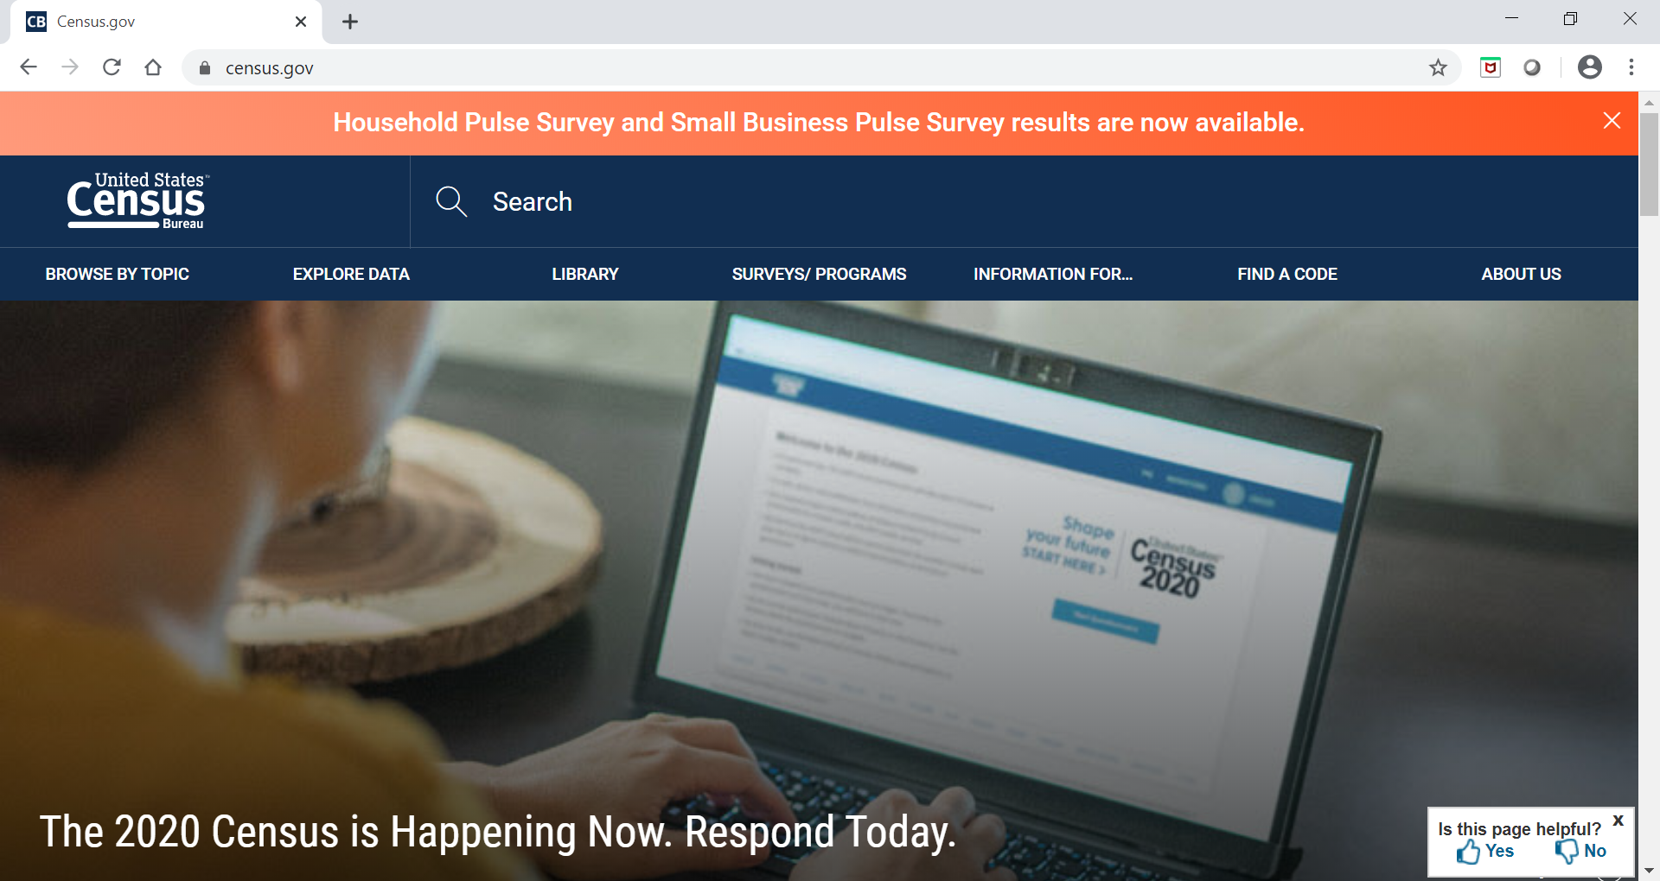
United States Census Bureau

Slide 17
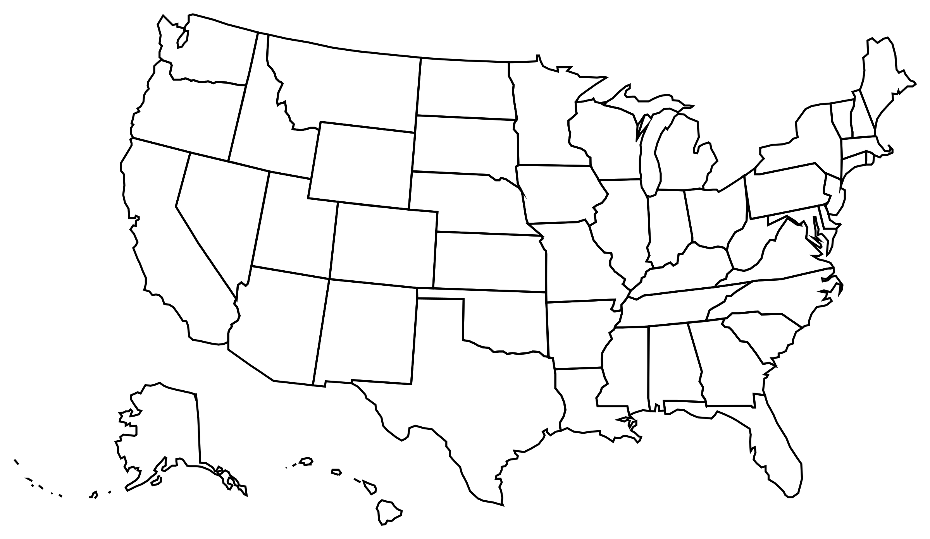
United States Census Bureau
What can I do with this data?
Track population trends and projections
Track economic indicators
Access reports on population projections
Deep dive into program demographics
Understand the community as a whole

Slide 18
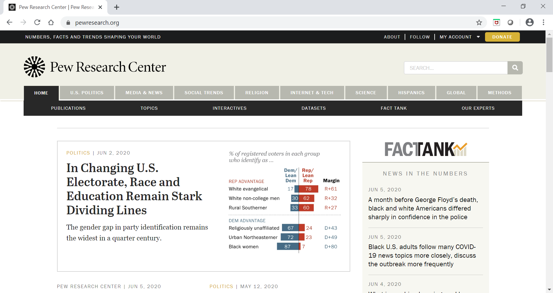
Pew Research Center

Slide 19
Pew Research Center
What can I do with this data?
Search for social and demographic trends
Explore internet and technology use; useful for understanding recruitment outreach
Follow current science trends
Generational trends; useful for highlighting benefits/perks

Slide 20
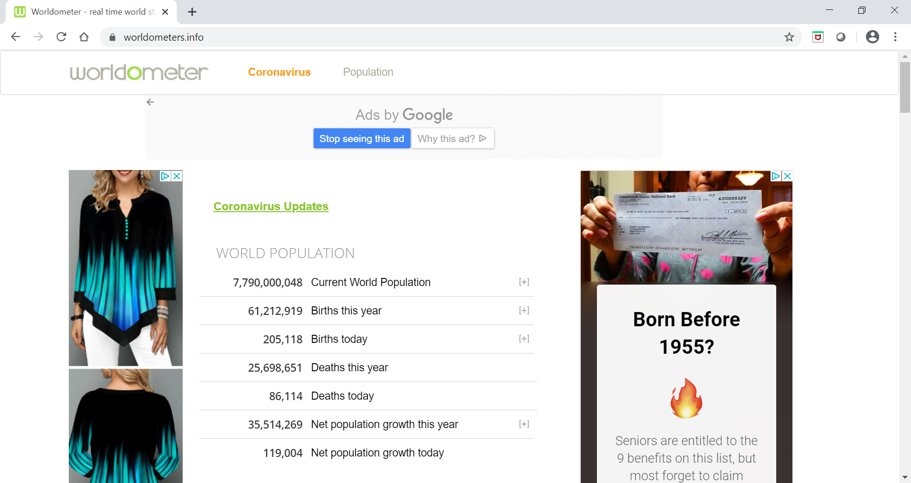
Worldometer – for fun!

Slide 21
Final Thoughts…
Use data to support:
Opportunities and Threats – real vs. perceived
Validate changes in curriculum
New program requests
Program resource requests
Pick a few data items that you, the program & the institution is interested in. Get the most out of the data that you can.
Use SMART technique to determine if the data points you are using will be useful

Slide 22
Final Thoughts…
Don’t be afraid of data; take in small bits
Practice reading, understanding and using data
Seek out instruction through your institution; medical school, QI department
Gale Courses, KnowledgeCity, Lynda.com (access through your public library for no charge)
Remember…always verify and validate any data source that you use

Slide 23
Final Thoughts…..

Slide 24
Questions

Slide 25
Upcoming Live Webinar
Demystifying Diversity Tuesday, July 7, 2020 12:00pm – 1:00pm EST
Faculty Development Planning: Sponsoring Institution Role Thursday, July 16, 2020 12:00pm – 1:00pm EST
ADS Annual Update: Best Practices Tuesday, July 28, 2020 12:00pm – 1:00pm EST
Graduate Medical Education Financing
Tuesday, August 11, 2020 12:00pm – 1:00pm EST
Latest On-Demand Webinars
Creating a Diverse Workforce
APE Reconstructed
Digging for Data 101
PEC: Best Practices Research and Scholarly Process in a Nutshell: Getting Started Ask Partners – Spring Freebie Lessons Learned: Accepting Displaced Orphan Residents
Is your Coordinator Well Enough: Coordinators as Role Models of Wellness
Research Proposal Development: Tips for Success Working with your Governing Board
NEW Faculty Development Series
15 Minutes to Effective Feedback
Toolbox for Teaching Millennials
Taking Supervision to the Next Level
Contact us today to learn how our Educational
Passports can save you time & money!
724-864-7320
www.PartnersInMedEd.com
25

Slide 26
Partners in Medical Education, Inc. provides comprehensive consulting services to the GME community.
Partners in Medical Education
724-864-7320 | info@PartnersInMedEd.com
Christine Redovan, MBA GME Consultant
Christine@PartnersInMedEd.com
www.PartnersInMedEd.com

