Slide 1
Please Note…
Please make sure your Start Video is OFF when logging into the WebEx platform.
Here is what it should look like
ALSO
It is NORMAL to not hear any sound until the webinar starts at 12:00 noon EST.
Your phone line is muted, but you can always chat to the host, BJ Schwartz, if you have any questions or concerns during this time.

Slide 2
Digging For Data IV
Christine Redovan, MBA, MLIS -- GME Consultant

Slide 3
Introducing Your Presenter…
Christine Redovan, MBA, MLIS
GME Consultant
Master’s degree in library and information science
Experienced in using data for program, GMEC and C-Suite reports
Twenty plus years of GME data interpretation

Slide 4
Learning Objectives
Discover various data sources for GME reports and projects
Discuss the pros and cons of big data and small data in GME
Apply data-driven performance improvement in GME

Slide 5
The Hastings Center

Slide 6
SIREN

Slide 7
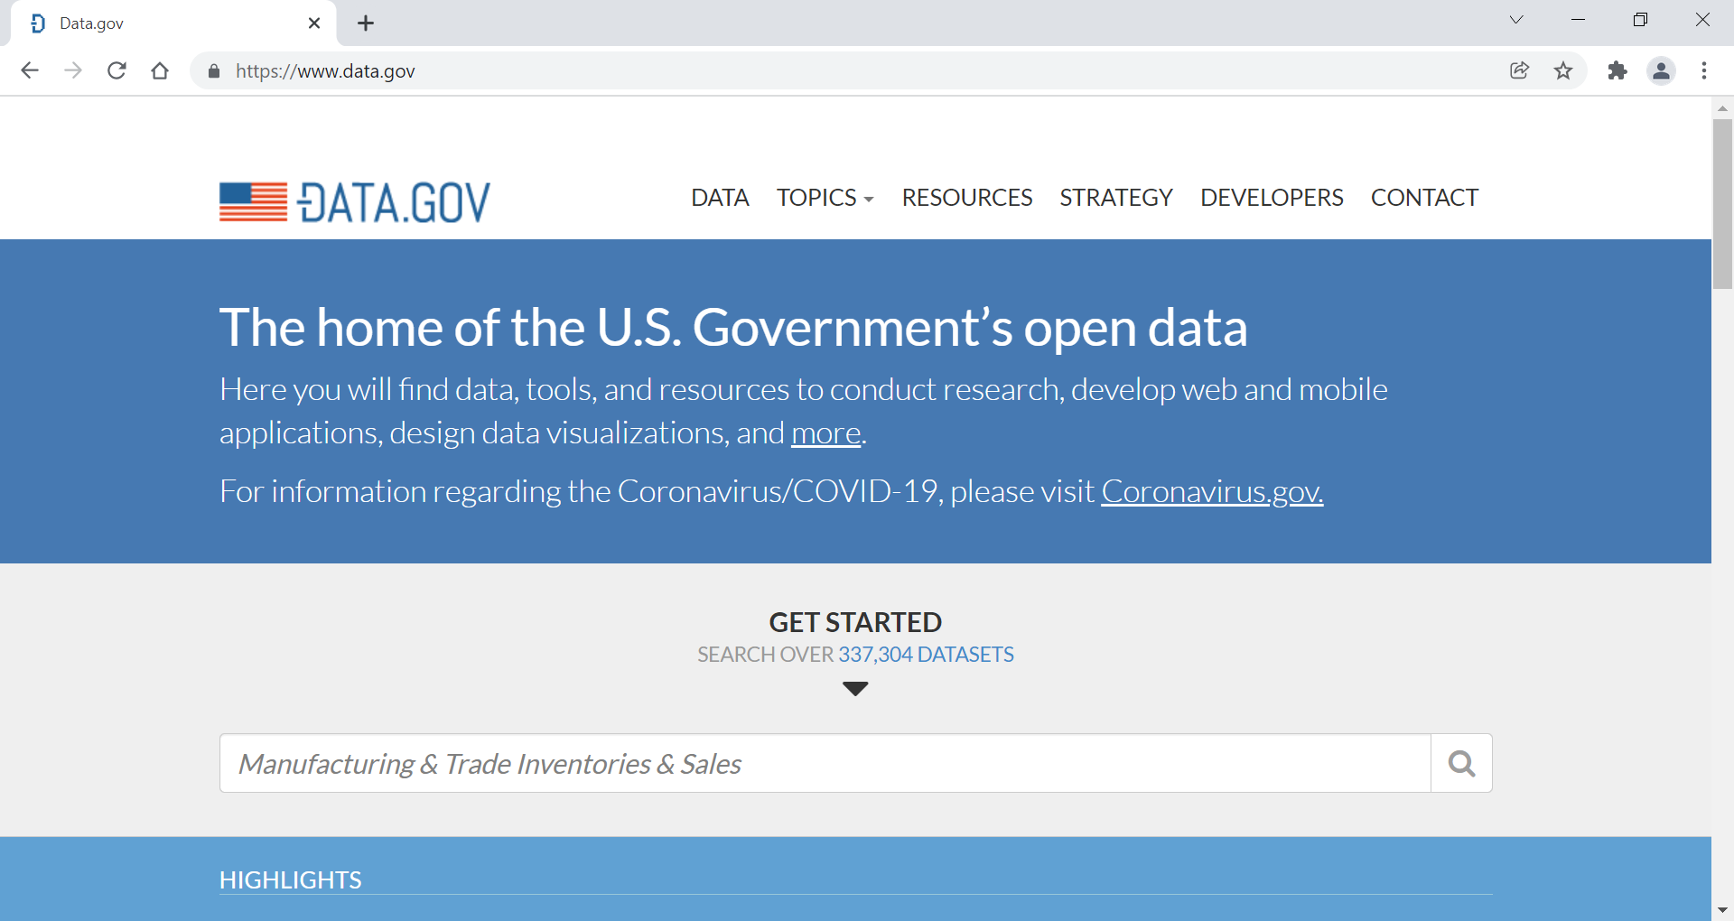
Data.gov

Slide 8
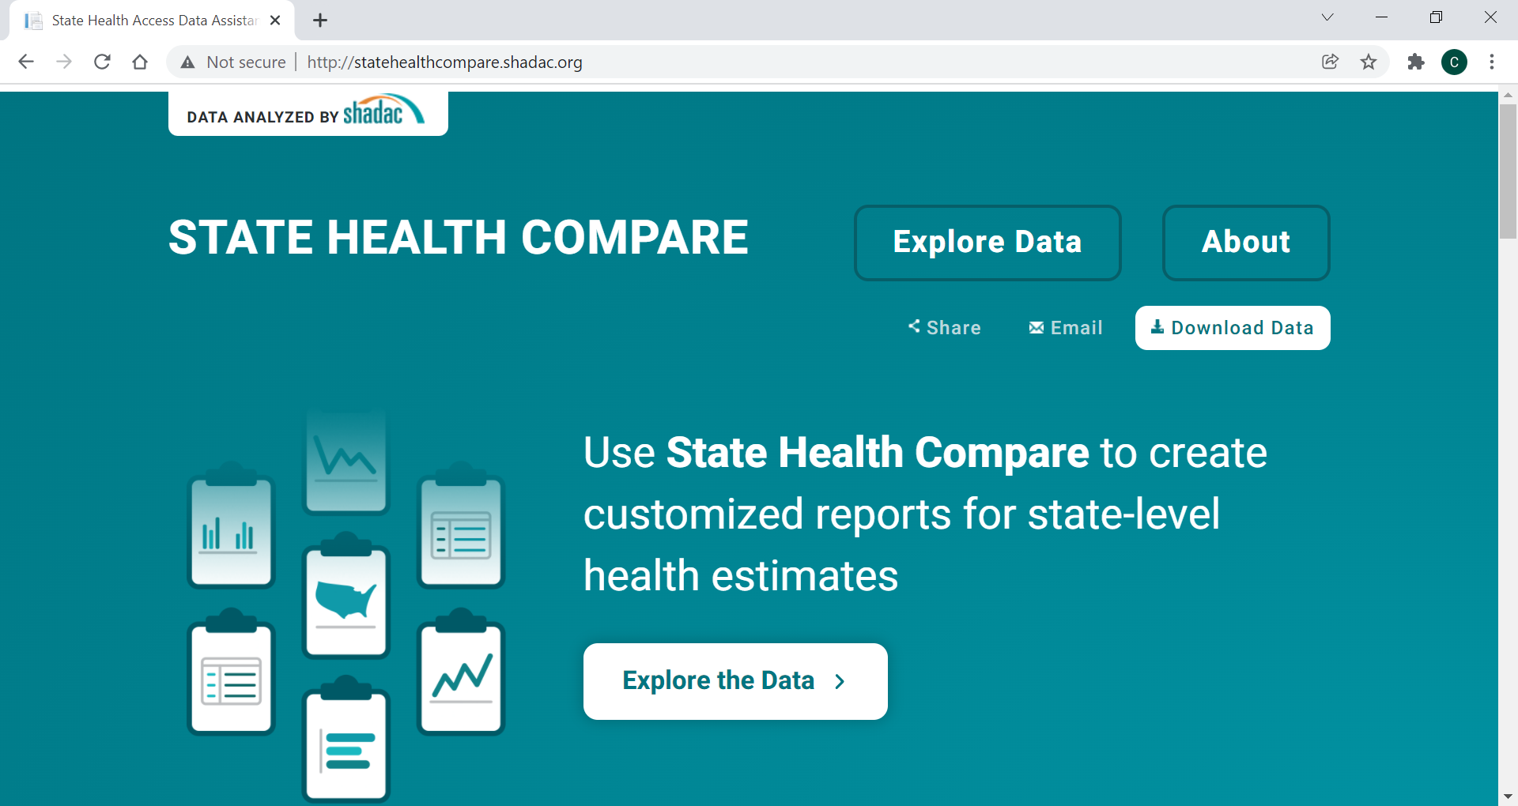
State Health Compare

Slide 9
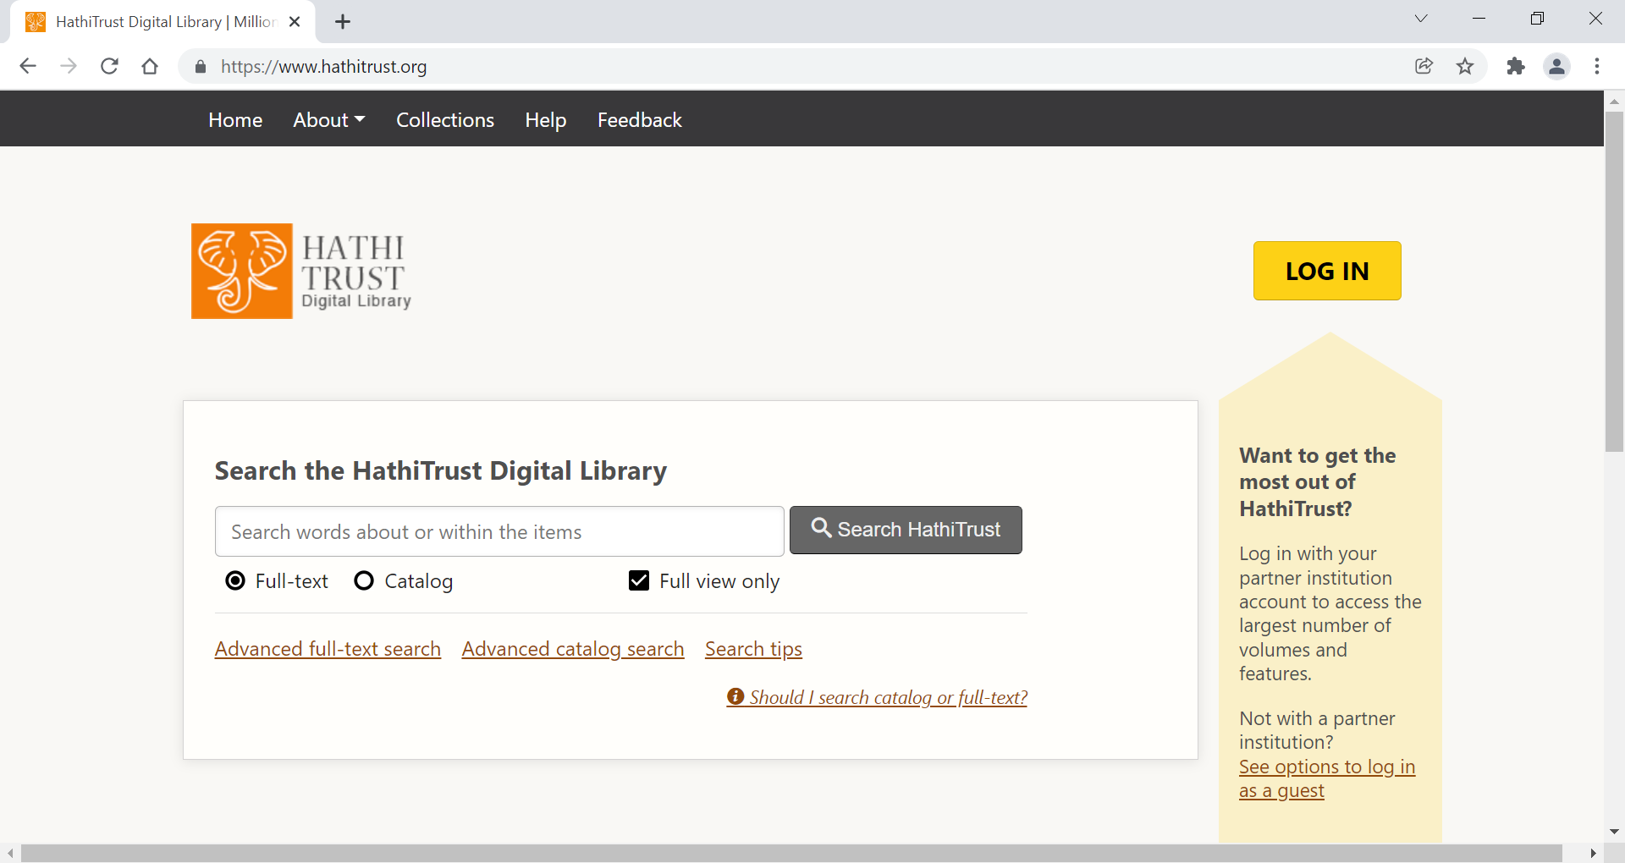
HathiTrust

Slide 10
Big Data vs. Small Data
Big Data
Small Data
Large, complex, data sets from new data sources
Velocity is fast
Analyzed for patterns
Lots of noise
Think “EMR”
Small, useable, data sets from current sources
Velocity is slower
Analyzed for individual predictions
Minimal noise
Think “Smart Phone”

Slide 11
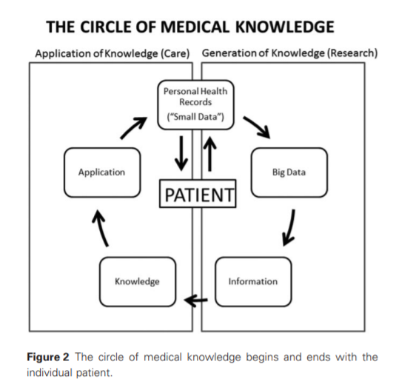
Where the data comes from
Sacristan, J., & Dilla, T. (2015). No big data without small data: learning health care systems begin and end with the individual patient, Journal of Evaluation in Clinical Practice (21), 1014–1017. doi: 10.1111/jep.12350

Slide 12
Big Data in Action
https://www.tableau.com/learn/articles/big-data-examples-use-cases

Slide 13
Small Data in Action
https://www.inc.com/focusvision/use-big-data-and-small-data-to-understand-your-customers.html.
https://research.cornell.edu/news-features/small-data-and-big-health-benefits
https://www.riders.org/
This Colorvision cake ad appeared in a 1952 edition of Family Circle magazine. Posted by Flickr user Classic Film, June 8, 2015. CC BY-NC 2.0.

Slide 14
Data-driven Improvement
Drive decisions with data, make incremental changes and evaluate the impact.
Step 1. Data
Step 2. ?
Step 3. Improvement
Prioritization of desired outcomes

Slide 15
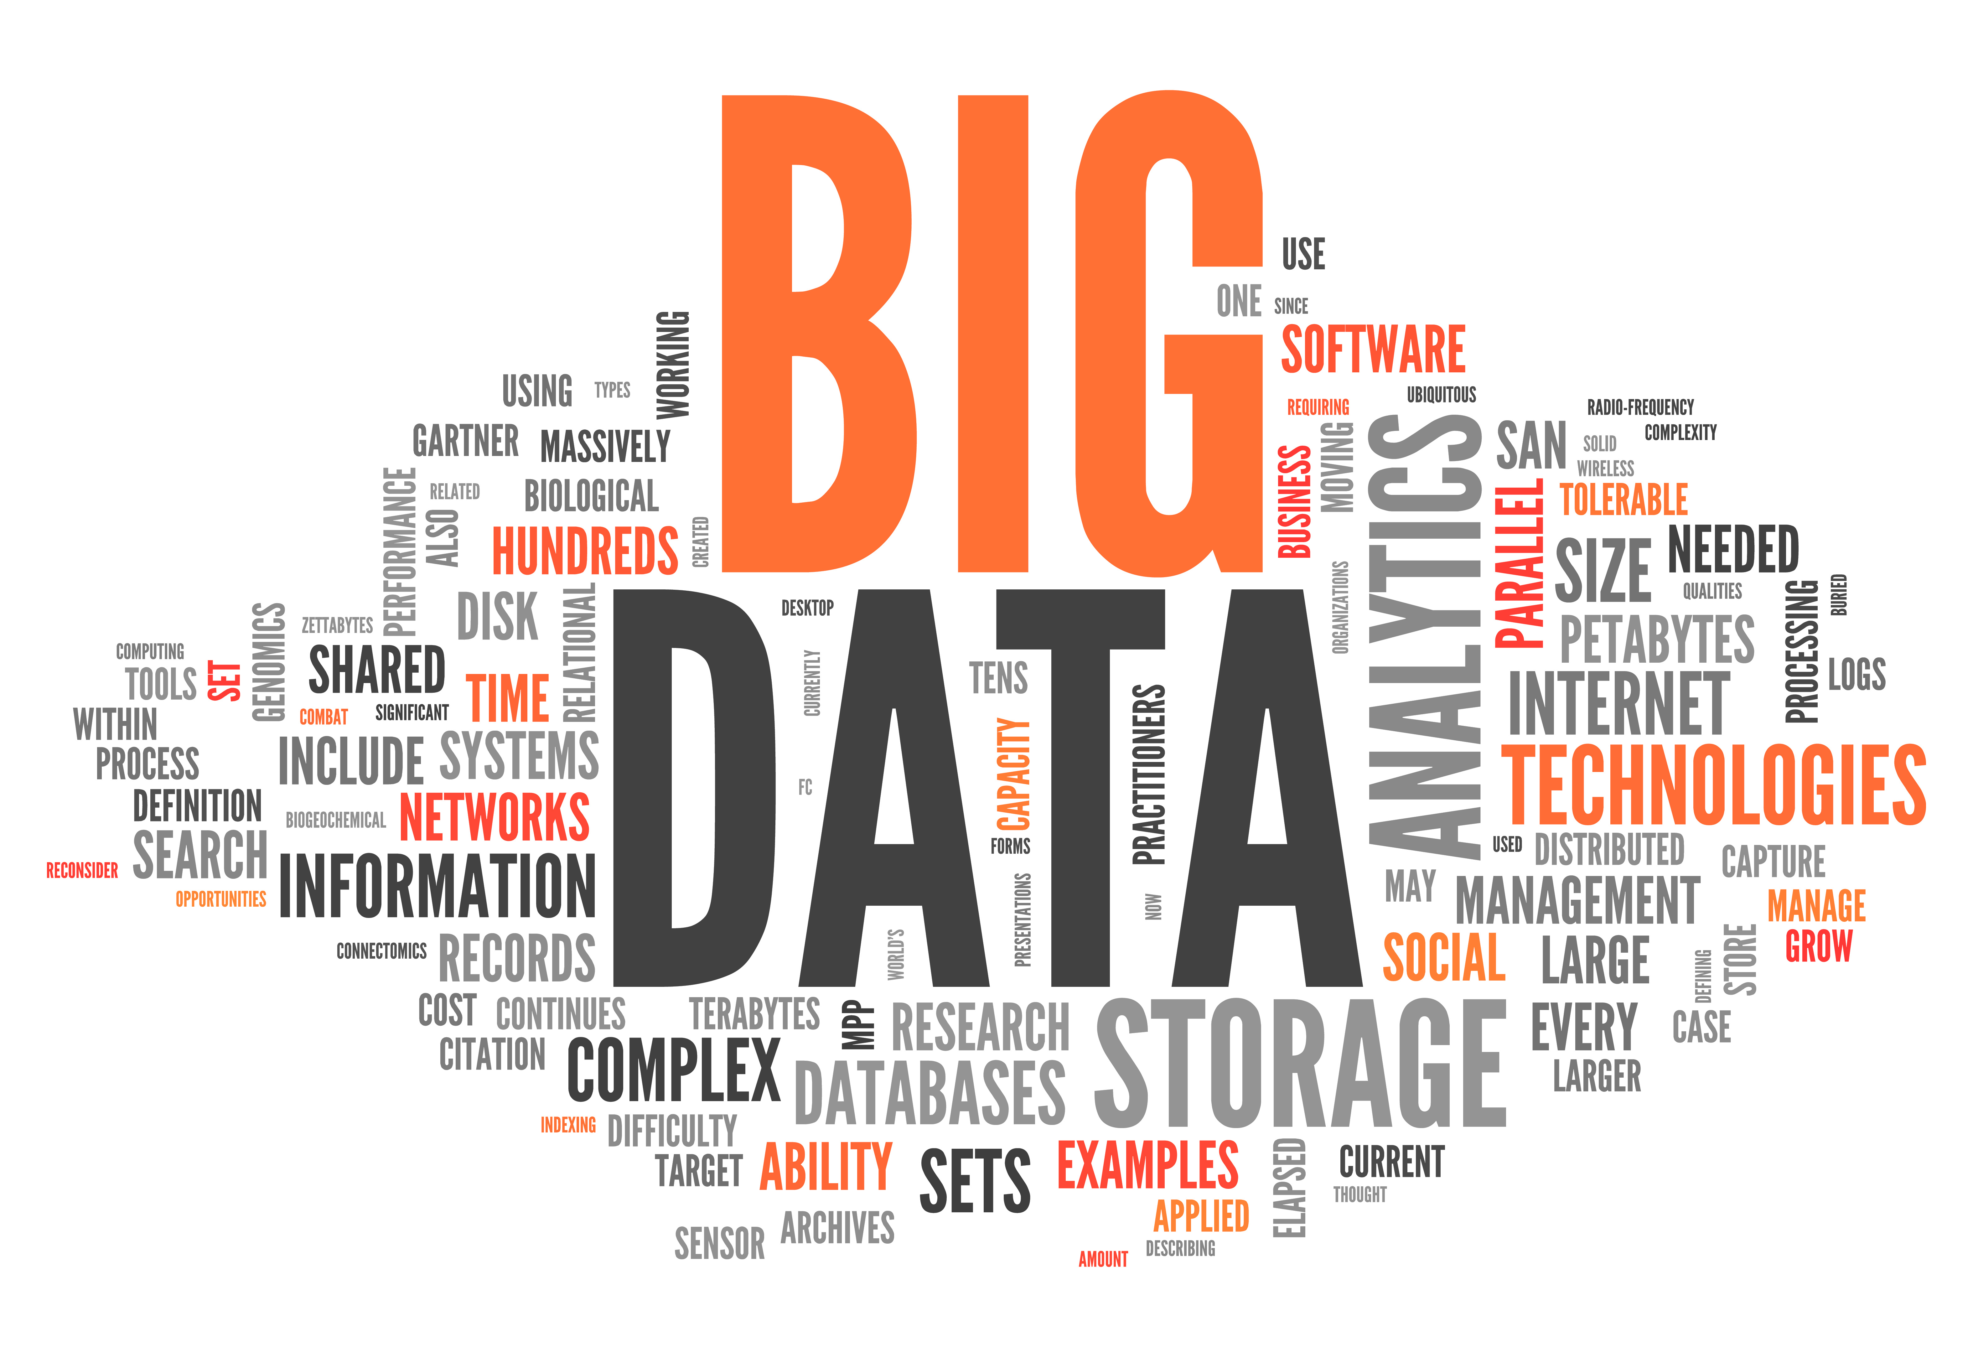
Tips
Data is a useful tool to focus on outcomes
Data can be informative across multiple levels (patients, program, hospital, community)
Data should be used to inform improvements horizontally and vertically
Data can be used to attract stakeholders internally and externally
This Photo by Unknown Author is licensed under CC BY-SA-NC

Slide 16
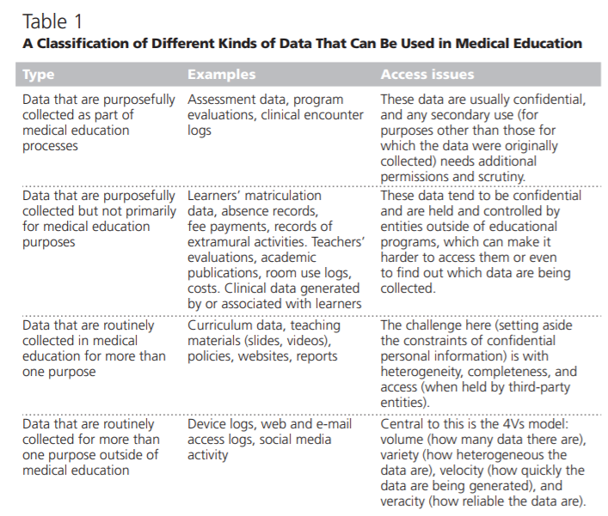
Data-driven Improvement in GME
Ellaway, R., Topps, D., & Martin, P. (2019). Data, big and small: emerging challenges to medical education scholarship. Academic Medicine 94(1), 31-36, doi: 10.1097/ACM.0000000000002465.

Slide 17
GME Examples
Assessment data informs instruction
ITE scores inform training/didactics
Evaluation data informs program design
Structure
Faculty
Rotations
Survey data informs program quality
GME data informs patient care outcomes
NYU Langone Health
https://nyulangone.org/news/using-big-data-strengthen-connection-between-medical-education-patient-care

Slide 18
Challenges
Evolving field
Information literacy
Cybersecurity
Information privacy
Technological capacity
This Photo by Unknown Author is licensed under CC BY

Slide 19
Final Thoughts…
Data’s impact can be felt in many areas
Patient outcomes
Staffing and operations
Product development
Strategic planning
Crime prevention
This Photo by Unknown Author is licensed under CC BY-SA-NC

Slide 20
References
Arora, V. (mmm), Harnessing the power of big data to improve graduate medical education: big idea or bust? Acad Med 93(6), 833-834 doi: 10.1097/ACM.0000000000002209
Ellaway, R., Topps, D., & Martin, P. (2019). Data, big and small: emerging challenges to medical education scholarship. Academic Medicine 94(1), 31-36, doi: 10.1097/ACM.0000000000002465.
Mohamed, B. & Fahy, B. (2021). The impact of data-driven learning on graduate medical education. Journal of Clinical Anesthesia (on-line) doi: 10.1016/j.jclinane.2021.110621
Sacristan, J., & Dilla, T. (2015). No big data without small data: learning health care systems begin and end with the individual patient, Journal of Evaluation in Clinical Practice (21), 1014–1017. doi: 10.1111/jep.12350

Slide 21
Questions

Slide 22
Upcoming Live Webinar
Back to Basics – GME for New Coordinators
Tuesday, February 8, 2022
Leveraging RMS Technology for the Medicare Cost Report
Thursday, February 17, 2022
The ABCs of GMEC: Part II
Thursday, March 10, 2022
Getting to the Next Stage – Program Improvement II
Thursday, March 24, 2022
Ask Partners – Spring Freebie
Tuesday, April 12, 2022
Latest On-Demand Webinars
Meet the Experts – Fall Freebie
A Successful Coordinator? You Must Be C-C-Crazy!
Planning and Tracking Scholarly Activity
GME Financing: The Basics, the Strategies, and the Upcoming Changes
The Role of Coaching
Resident Wellness in the Virtual World
A Day in the Life of A DIO
Site Visits – What to Expect in 2021
ADS Update 2021
GME Grants and Funding Sources
Survey Research
Impactful AIR & APE – Bridging Data & Action
Faculty Development Series
15 Minutes to Effective Feedback
Toolbox for Teaching Millennials
Taking Supervision to the Next Level
Contact us today to learn how our Educational
Passports can save you time & money!
724-864-7320
www.PartnersInMedEd.com
Presented by Partners in Medical Education, Inc. 2022
22

Slide 23
Partners in Medical Education, Inc. provides comprehensive consulting services to the GME community.
Partners in Medical Education
724-864-7320 | info@PartnersInMedEd.com
Christine Redovan, MBA, MLIS
Christine@PartnersInMedEd.com
www.PartnersInMedEd.com

