Slide 1
Digging For Data III
Christine Redovan, MBA, MLIS -- GME Consultant

Slide 2
Introducing Your Presenter…
Christine Redovan, MBA, MLIS
GME Consultant
Seasoned Director of Medical Education and GME Operations
Accreditation and Management Expert For New and Established Institutions and Programs
ACGME-I Accreditation Expert
Successful GME Start-Up Implementation
Focused on Continuous Accreditation Readiness. Data Mining, and Useful GME Resources
20+ years GME experience

Slide 3
Learning Objectives
Discover useful data sources for GME planning and improvement
Compare various GME data in action
Construct a data project for your program

Slide 4
Recap of Sessions I & II
Digging for Data I
Digging for Data II
John Hopkin’s evaluating information
ACGME
NRMP
Robert Graham Center
CMS
US National Library of Medicine
AAMC
AHRQ
National Academies
Info Access Public Health
US Census Bureau
Pew Research
Worldometer

Slide 5
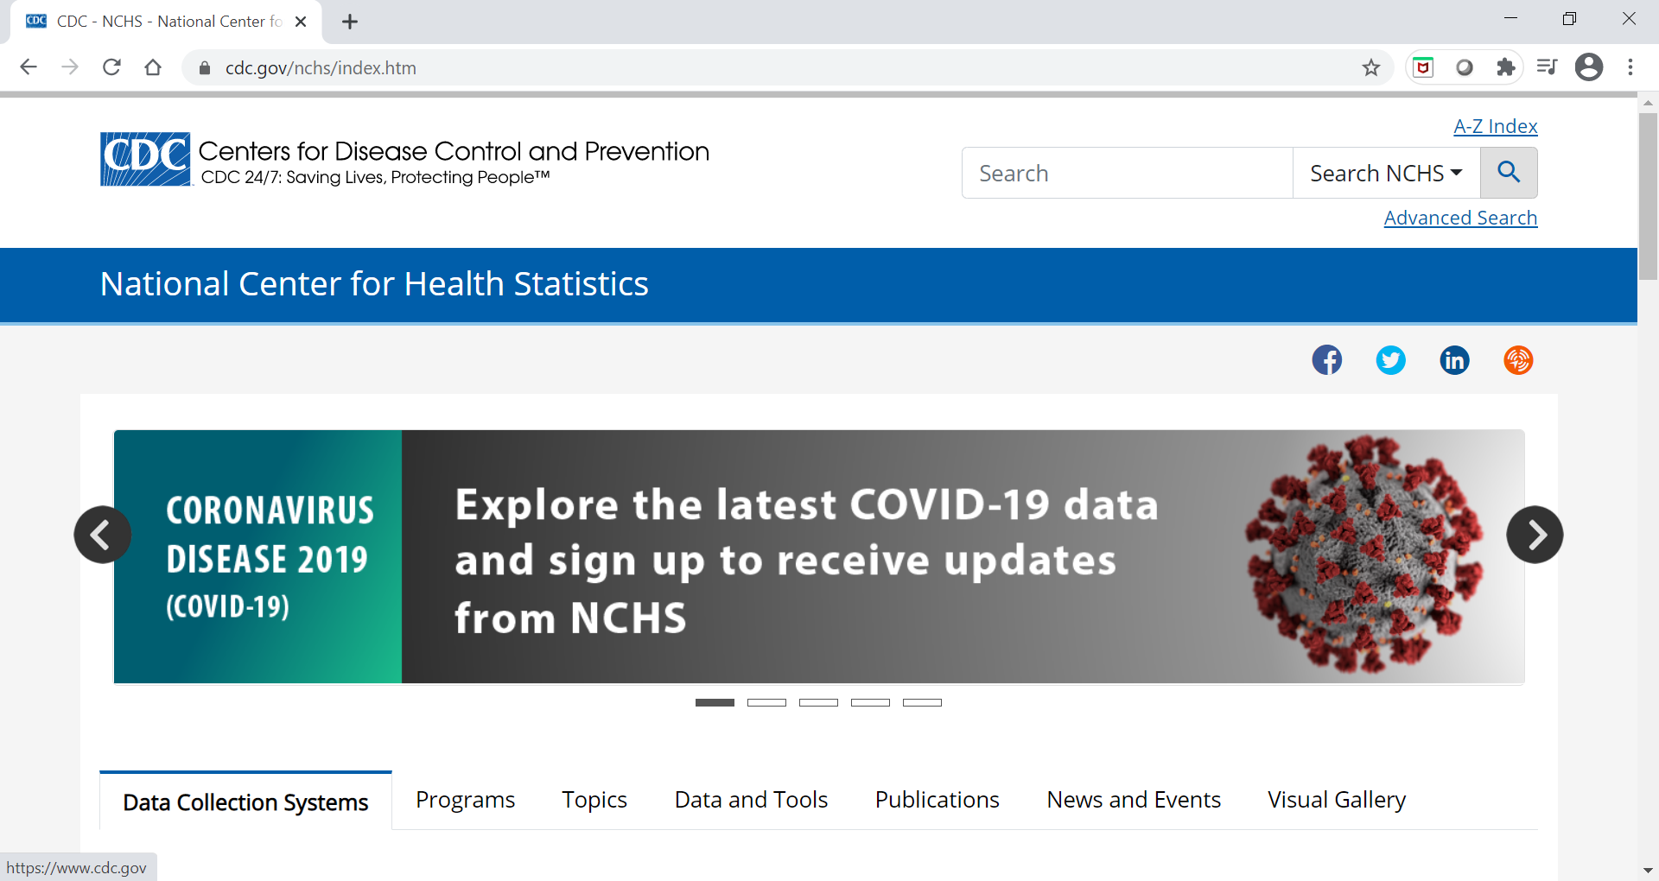
CDC – National Center for Health Statistics

Slide 6
Healthy People 2030

Slide 7
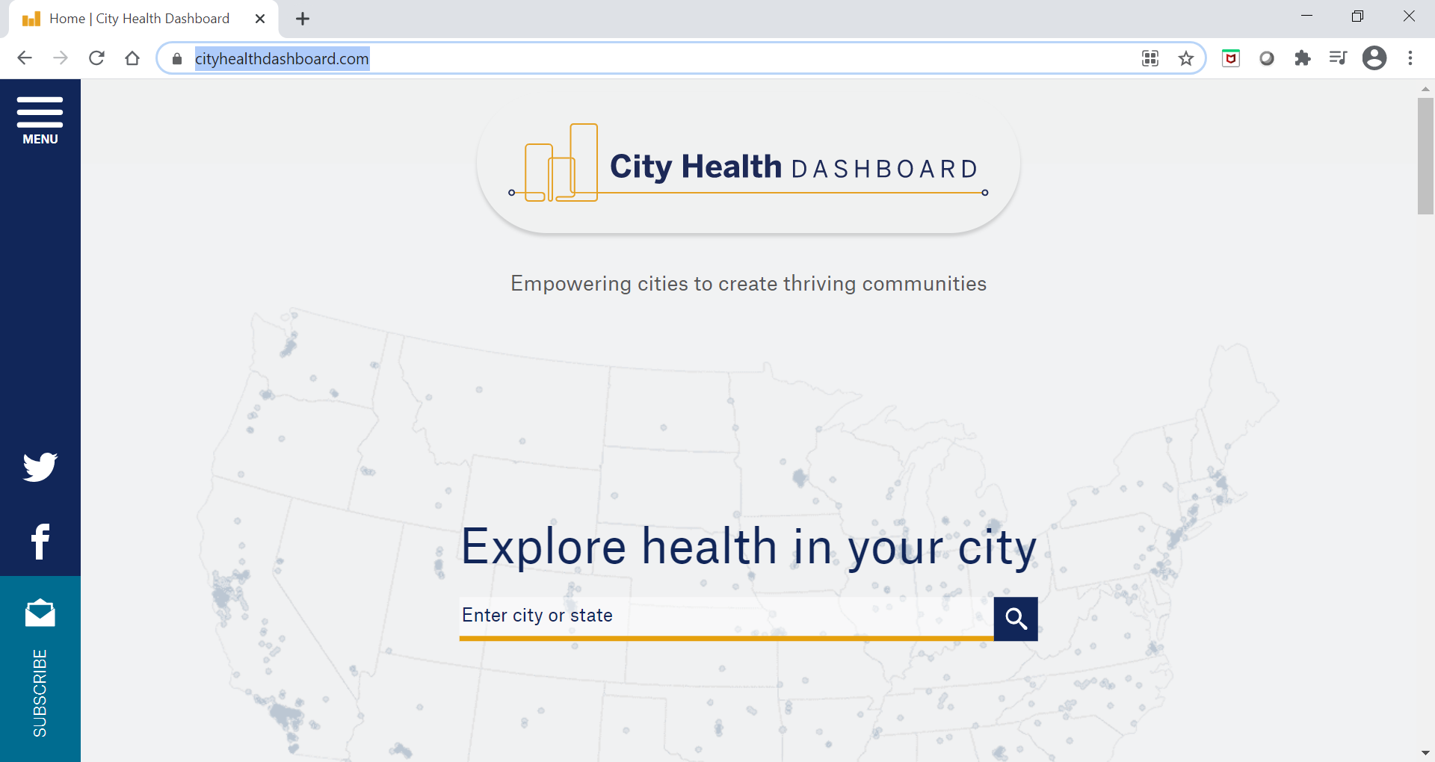
City Health Dashboard

Slide 8
Diversitydatakids.org

Slide 9
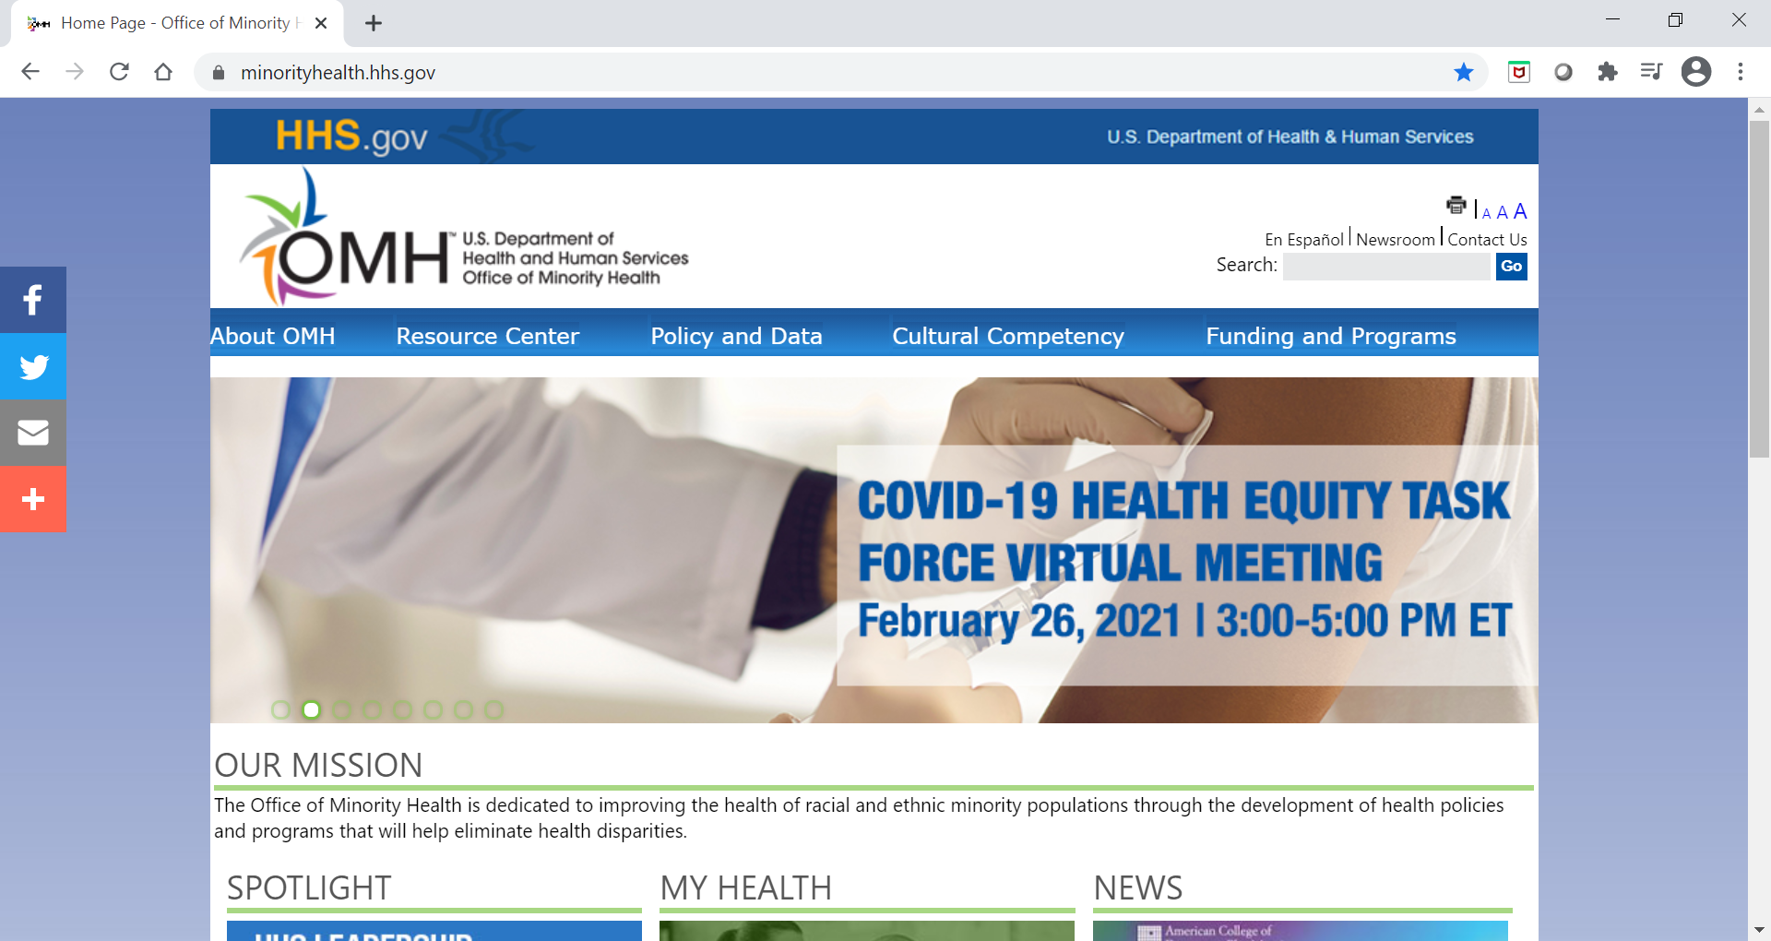
Office of Minority Health

Slide 10
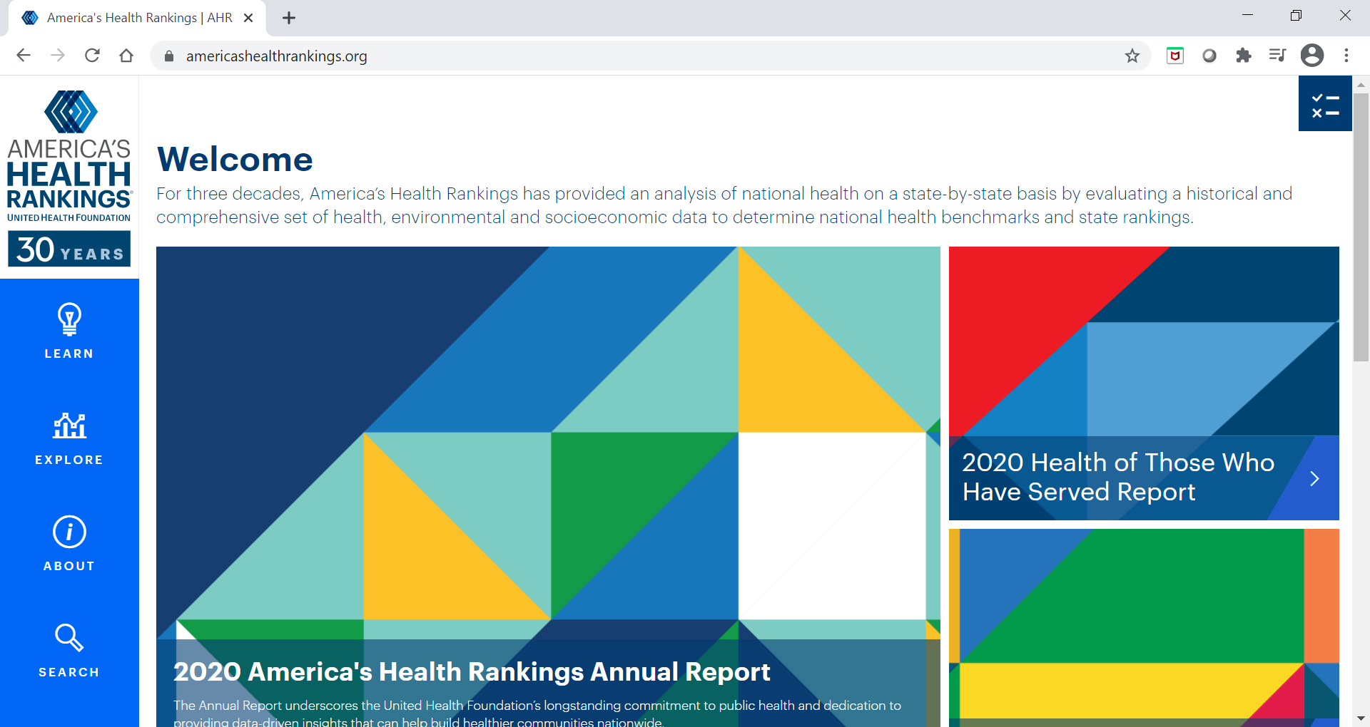
America’s Health Rankings

Slide 11
Let’s design a project
Identify needs and priority populations
Set targets
Find tools and resources
Monitor progress
(Adapted from https://health.gov/healthypeople/tools-action)

Slide 12
Identify Needs and Priority Populations
Community needs assessment
Quality improvement plans
Areas of low compliance on ACGME surveys
Program evaluations
Resident and patient feedback
Current projects

Slide 13
Sophie’s Hospital*
Community needs
Lack of access to affordable, healthy food
Food deserts
Poor transportation
Patient population
57% Hispanic; 22% Black; 20% Other, White and Asian
38% of Hispanic patients have a diagnosis of diabetes
(*fictional)

Slide 14
Why is this important?
Lack of food access and poor nutrition contributes to…
Diabetes
Heart disease
High blood pressure
Common medical concerns our residents encounter everyday

Slide 15
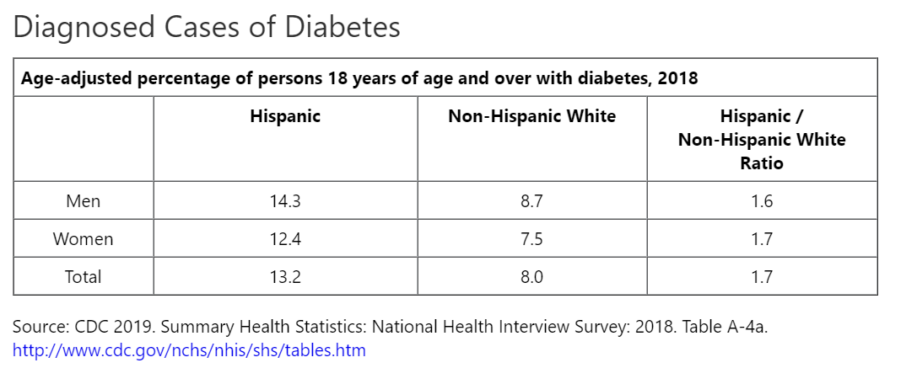
Set Targets - Diabetes
National Data

Slide 16
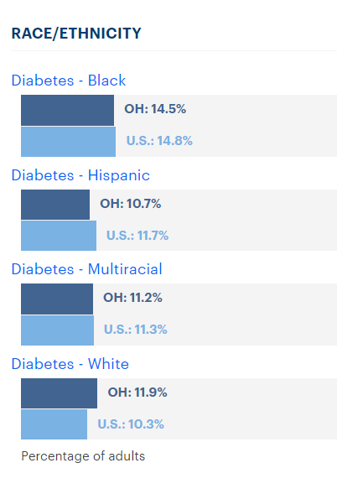
Set Targets - Diabetes
State Data (OH)
https://www.americashealthrankings.org/explore/annual/measure/Diabetes/state/OH

Slide 17
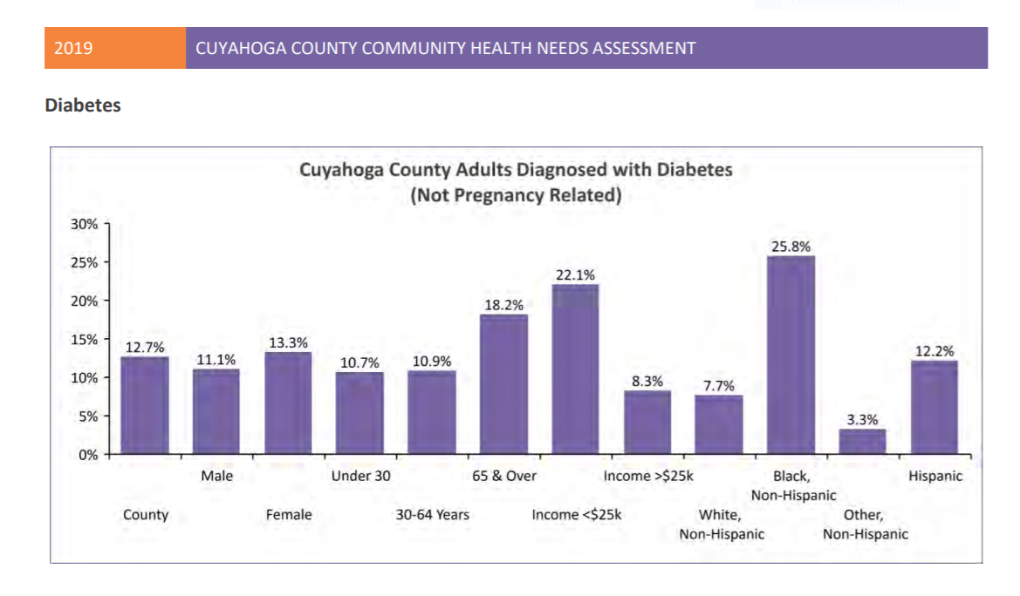
Set Targets - Local
County
Data
(Cuyahoga)
https://hipcuyahoga.org/wp-content/uploads/2019/10/2019_CHNA_10.25_Web_compressed-1.pdf; pg 43

Slide 18
Set Targets – Program
Diabetes and Hispanic Population
at Sophie’s Hospital
Reduce the prevalence of diabetes in the Hispanic patient population at Sophie’s Hospital to be at or below the national average in the next year.
National | State | County | Hospital
13% | 11% | 12% | 38%

Slide 19
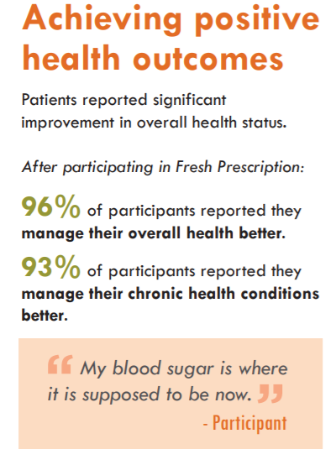
Tools & Resources- Existing Programs
Food Prescription Program
Food Banks
Farmer’s Markets
Local Grocers
Fresh Prescription
Recipe for a Healthy Detroit
https://www.ecocenter.org/sites/default/files/FreshRx_Report_2016_Final.pdf

Slide 20
Tools & Resources - Partnerships
Universities
Museums
Public Libraries
Hospital Programs
Non-profits/ Foundations
Social Organizations

Slide 21
Tools & Resources - EMR
http://clipart-library.com/newhp/HC-Medical-Records-Digital.jpg

Slide 22
Tools & Resources
Your own Residency Curriculum
Various rotations
Meeting common program requirements
II.A.4.a.2 – design program based on needs of community
IV.B.1.1.1.e – understand & respond to diverse patient population
IV.B.1.f.1.f – population-based care
IV.D.2.a – scholarship in population health
VI.A.1.b.2.a – practice data

Slide 23
Monitor Progress
Literature & initiative progress
Periodic data check-ins
Patient feedback
Resident feedback
How is it going?

Slide 24
Improvement All Around
Residency Program
Patient Population
Hospital
Patient Outcomes
Community

Slide 25
Final Thoughts…
Align projects with program, hospital and community needs
Focus on one area; avoid “rabbit hole”
National data can be used for benchmarking, source of current initiatives and general understanding
Stratify data in the beginning to gain further insight into disparities and inequities
Include IRB and/or other experts to ensure design, implementation and data collection is sound and publishable

Slide 26
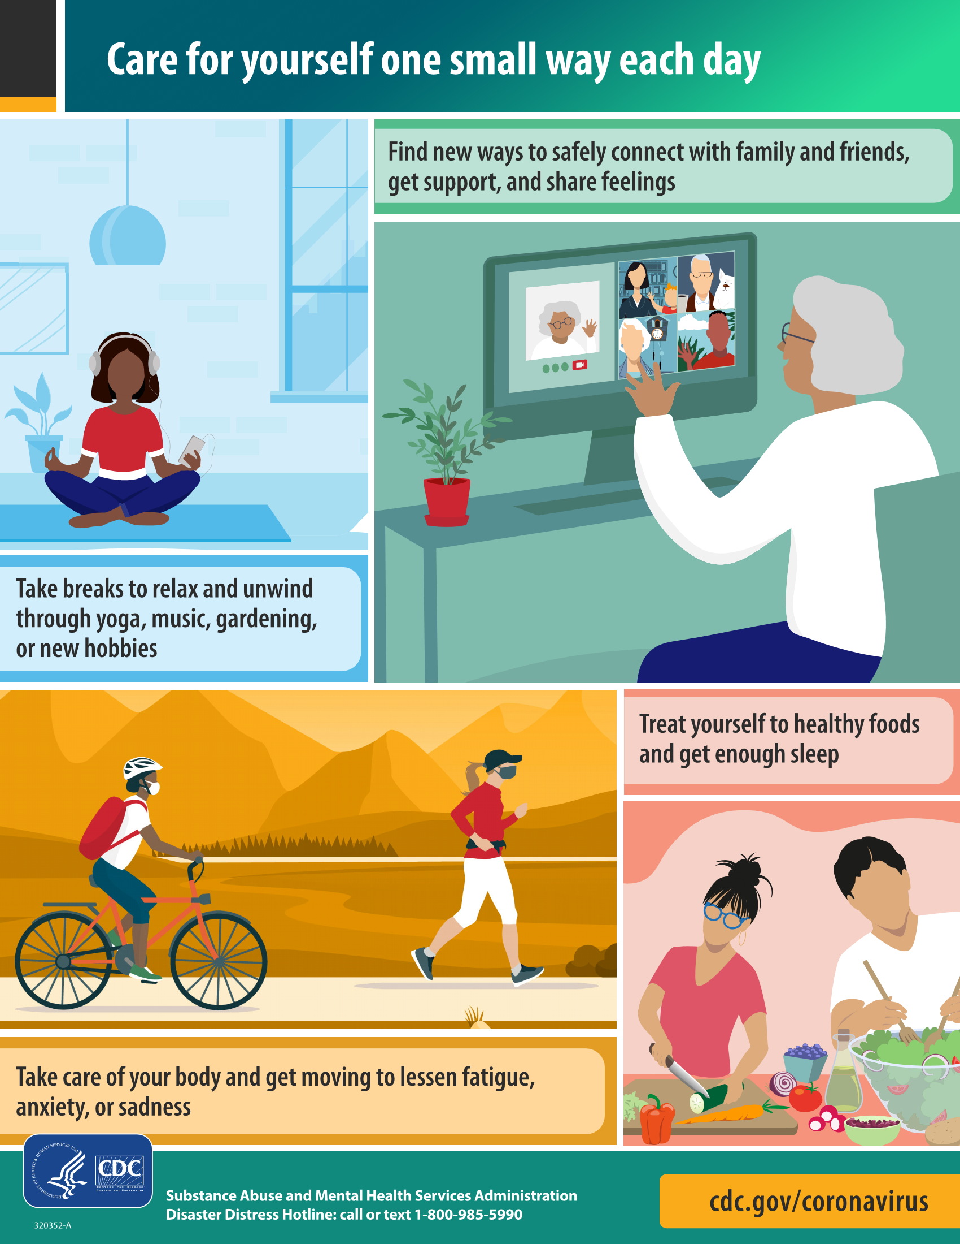
Take Care of YOU!
https://www.cdc.gov/coronavirus/2019-ncov/daily-life-coping/stress-coping/care-for-yourself.html

Slide 27
Questions

Slide 28
Upcoming Live Webinar
Ask Partners – Spring Freebie Thursday, March 11, 2021 12:00pm – 1:00pm EST
Lessons Learned from the Pandemic: Planning for the Next Disaster Thursday, April 8, 2021 12:00pm – 1:00pm EST
Other Approaches to CCC & Evaluation Thursday, April 27, 2021 12:00pm – 1:00pm EST
ACGME Surveys – What Now? Thursday, May 6, 2021 12:00pm – 1:00pm EST
Latest On-Demand Webinars
ADS Annual Update: Best Practices
Graduate Medical Education Financing
Artificial Intelligence in Medicine: Its Impact on GME
GME Workforce Planning
Working with a Statistician on your Research Project
Quality Improvement in GME: 5 years later
An Interdisciplinary Approach – Breaking Down the Wall
Meet the Experts – Fall Freebie
Working with Struggling Learners
DIO Role and Responsibilities: Keys to Success
NEW Faculty Development Series
15 Minutes to Effective Feedback
Toolbox for Teaching Millennials
Taking Supervision to the Next Level
Contact us today to learn how our Educational
Passports can save you time & money!
724-864-7320
www.PartnersInMedEd.com
Presented by Partners in Medical Education, Inc. 2021
28

Slide 29
Partners in Medical Education, Inc. provides comprehensive consulting services to the GME community.
www.PartnersInMedEd.com
Christine Redovan, MBA, MLIS
Christine@PartnersInMedEd.com

