Slide 1
Please Note…
Please make sure your Start Video is OFF when logging into the WebEx platform.
Here is what it should look like
ALSO
It is NORMAL to not hear any sound until the webinar starts at 12:00 noon EST.
Your phone line is muted, but you can always chat to the host, BJ Schwartz, if you have any questions or concerns during this time.

Slide 2
Digging For Data V
Christine Redovan, MBA, MLIS -- GME Consultant

Slide 3
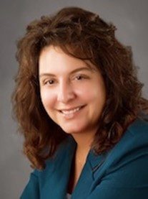
Introducing Your Presenter…
Christine Redovan, MBA, MLIS
GME Consultant
Master’s degree in library and information science
Experienced in using data for program, GMEC and C-Suite reports
Twenty plus years of GME data interpretation

Slide 4
Learning Objectives
Discover data sources for use in GME planning and analysis
Explore ways to use data to support GME goals
Understand the value of information literacy

Slide 5
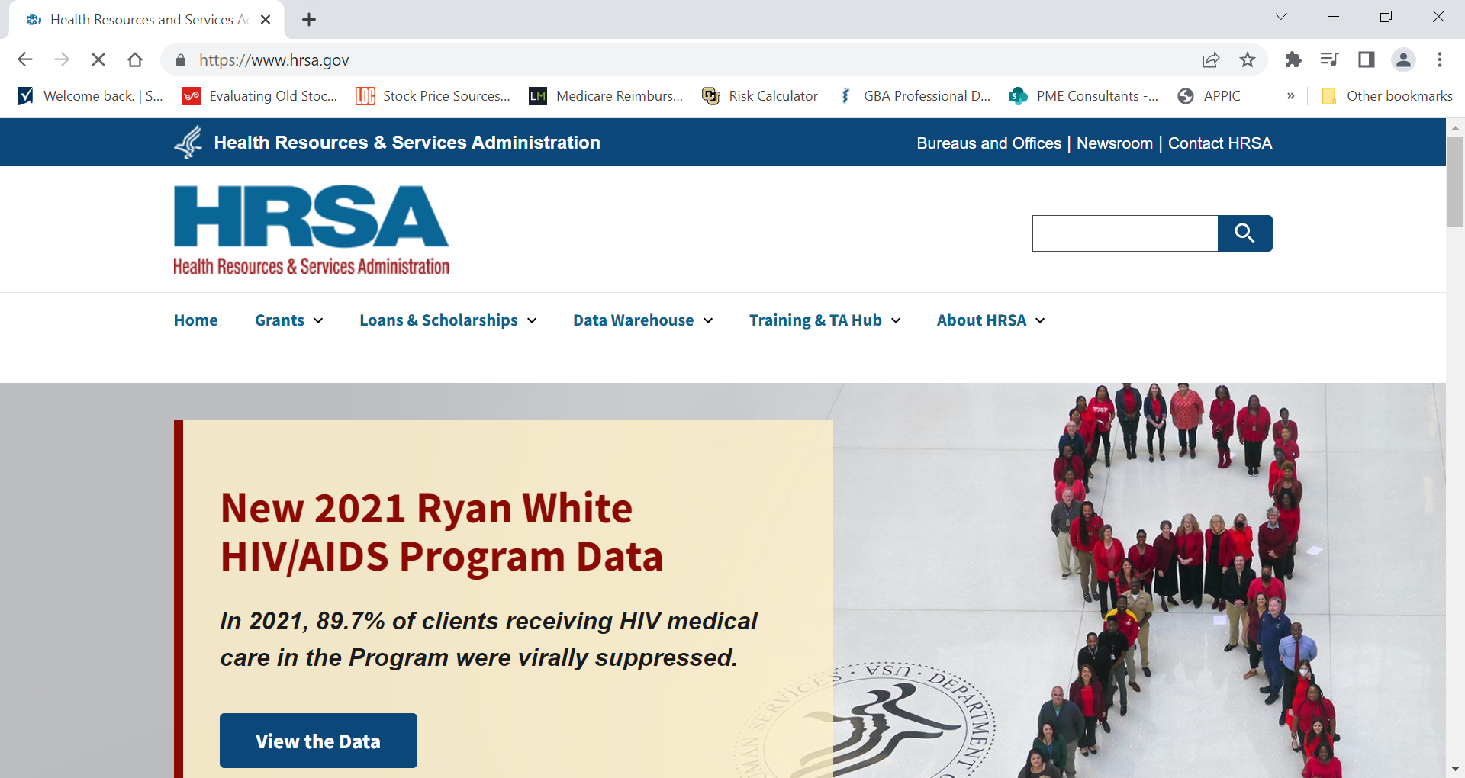
Health Resources & Service Administration (HRSA)

Slide 6
HRSA
Grants
Workforce Projections
This Photo by Unknown Author is licensed under CC BY-NC
Diversity

Slide 7
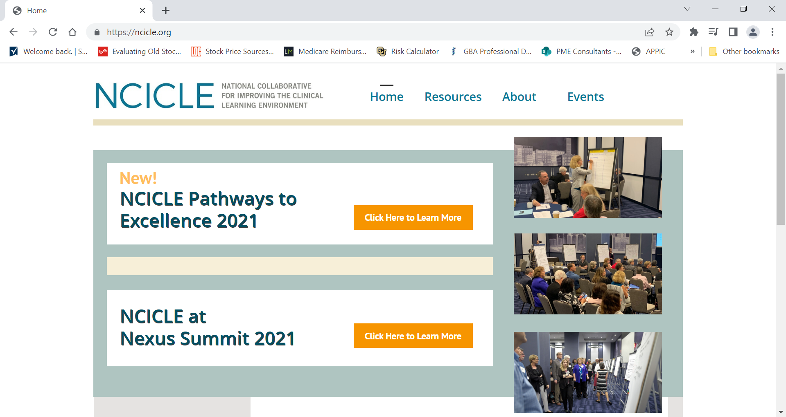
National Collaborative for Improving the Clinical Learning Environment (NCICLE)

Slide 8
NCICLE
Use with CLER Pathways document
Primer for GMEC
Reinforces importance of improvement processes for everyone in GME
This Photo by Unknown Author is licensed under CC BY-NC

Slide 9
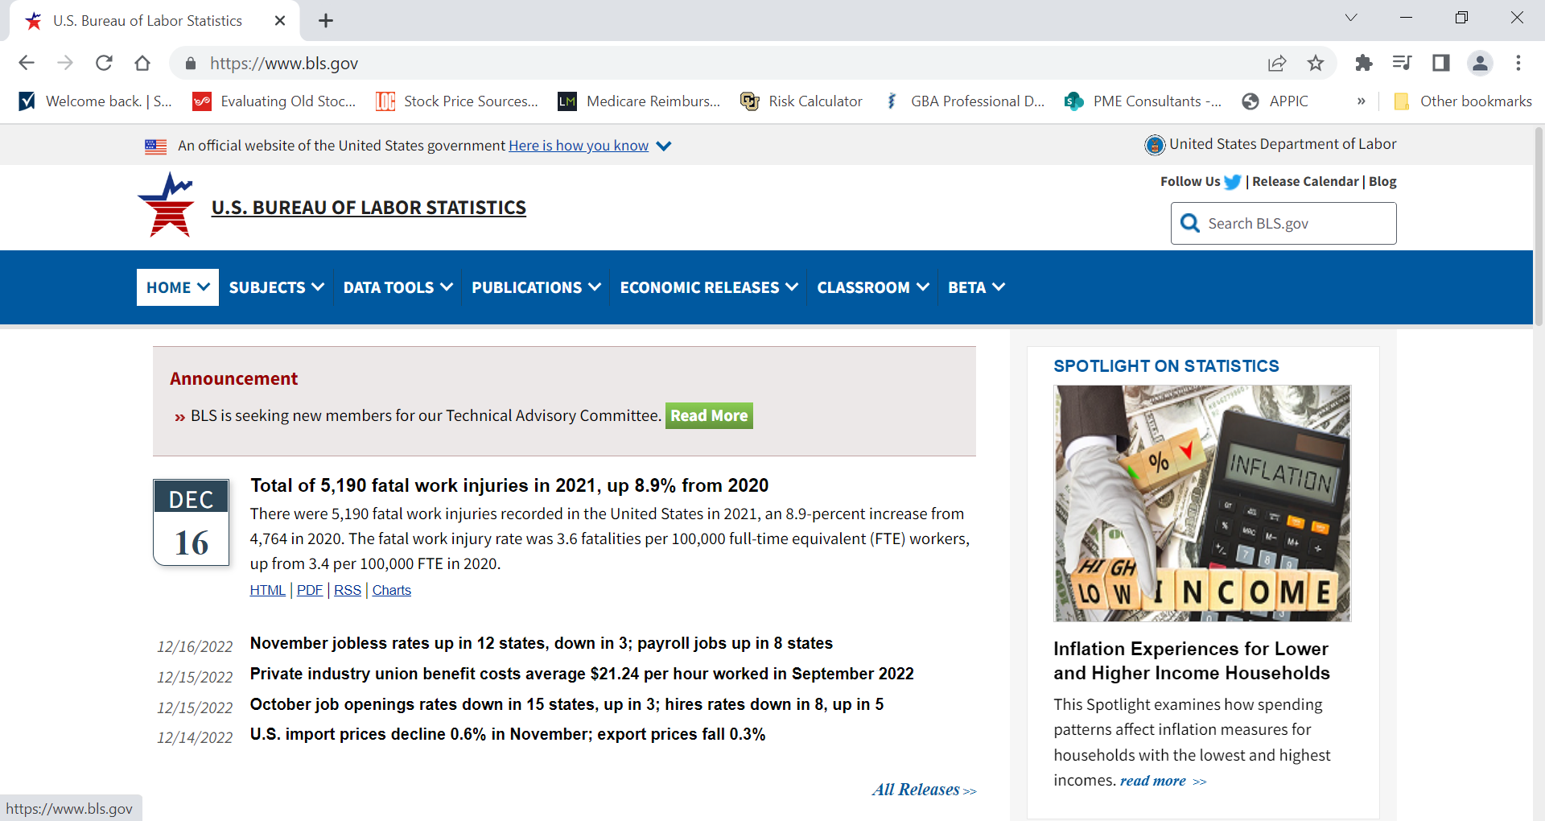
U.S. Bureau of Labor Statistics

Slide 10
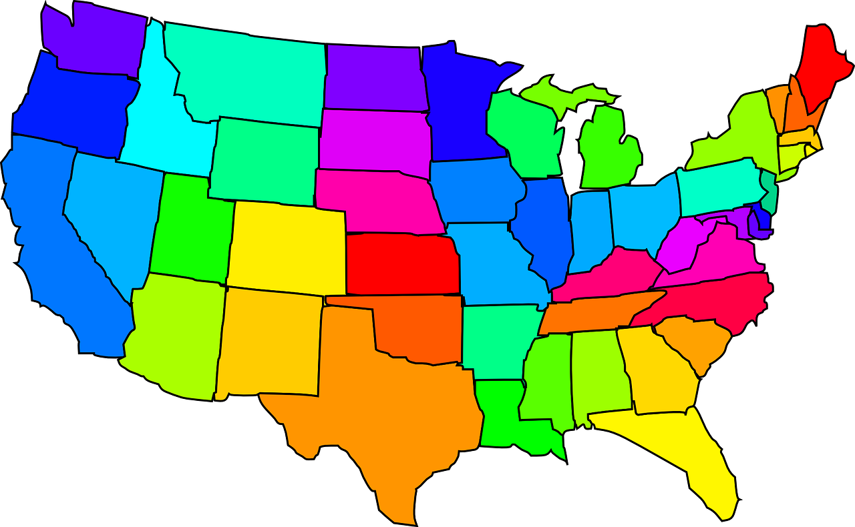
U.S. Bureau of Labor Statistics
Demand/Supply projections
Geographic employment/unemployment
Geographic economic data

Slide 11
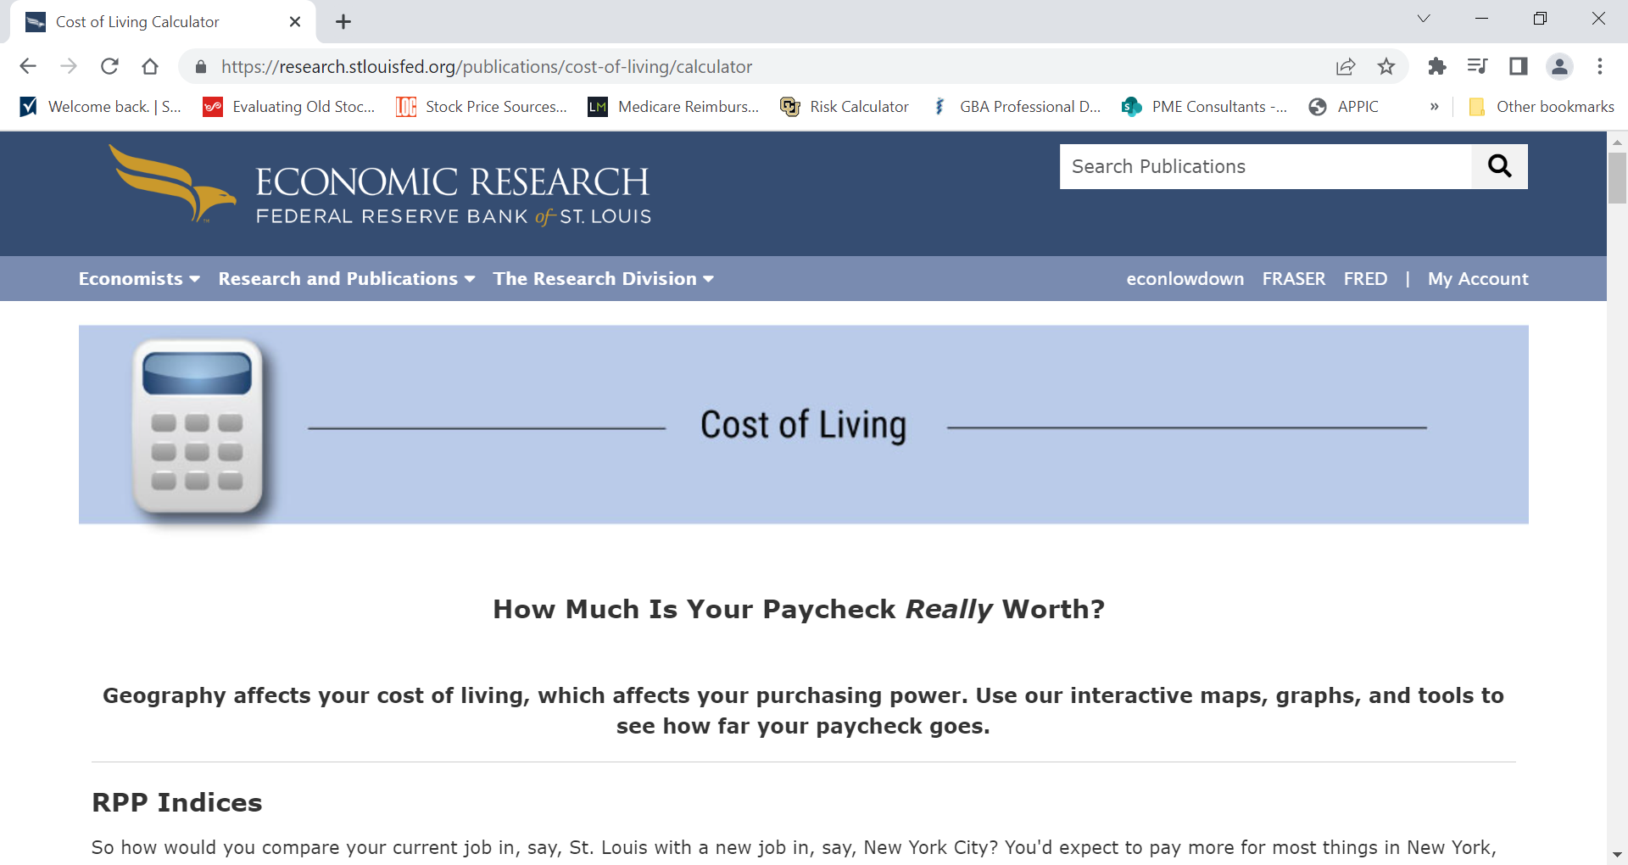
Cost of Living

Slide 12
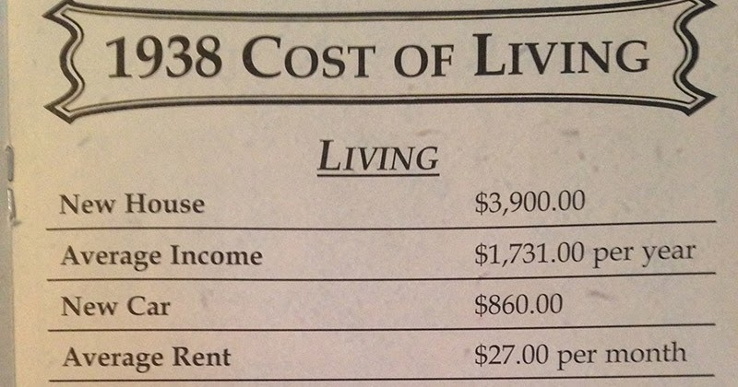
Cost of Living
Recruitment tool
Potential for use in salary survey
General idea of living costs if moving to new area
This Photo by Unknown Author is licensed under CC BY-NC-ND

Slide 13
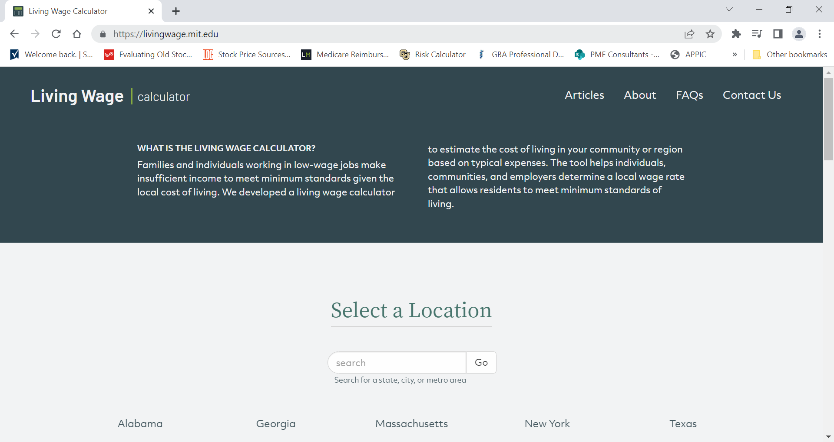
Living Wage

Slide 14
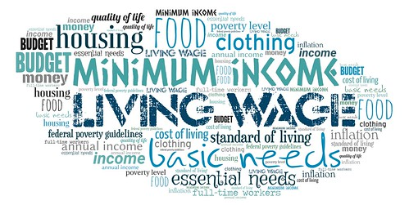
Living Wage
Updated annually in first quarter
Breaks down by family size and number of workers
This Photo by Unknown Author is licensed under CC BY

Slide 15
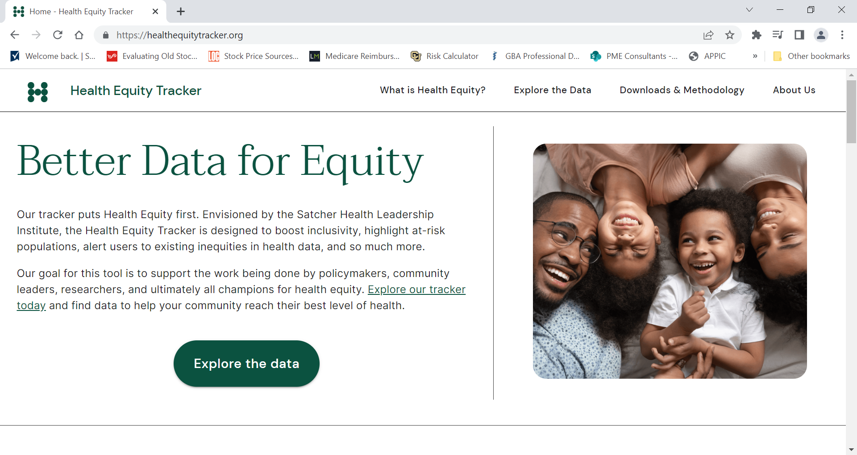
Health Equity Tracker

Slide 16
Health Equity Tracker
Investigates rates of selected health equity topics
Ability to break down data, if available, by state or region
Continually expanding data and improving access
This Photo by Unknown Author is licensed under CC BY-SA

Slide 17
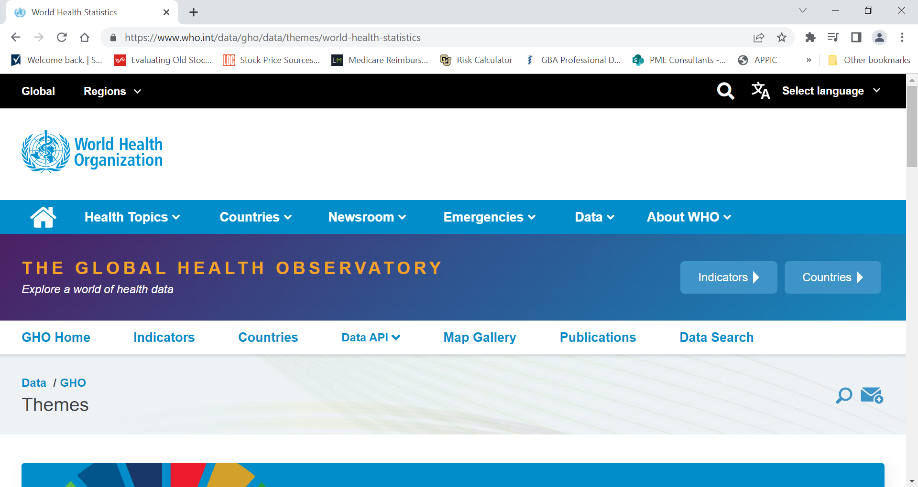
The Global Health Observatory

Slide 18
The Global Health Observatory
This Photo by Unknown Author is licensed under CC BY
Covers 17 global health goals for 191 member countries
Focus on women, children and poorest, most disadvantaged people
Training on data sources specific to health inequities (https://www.who.int/data/inequality-monitor/training)
Many toolkits for various inequities and chronic health conditions

Slide 19
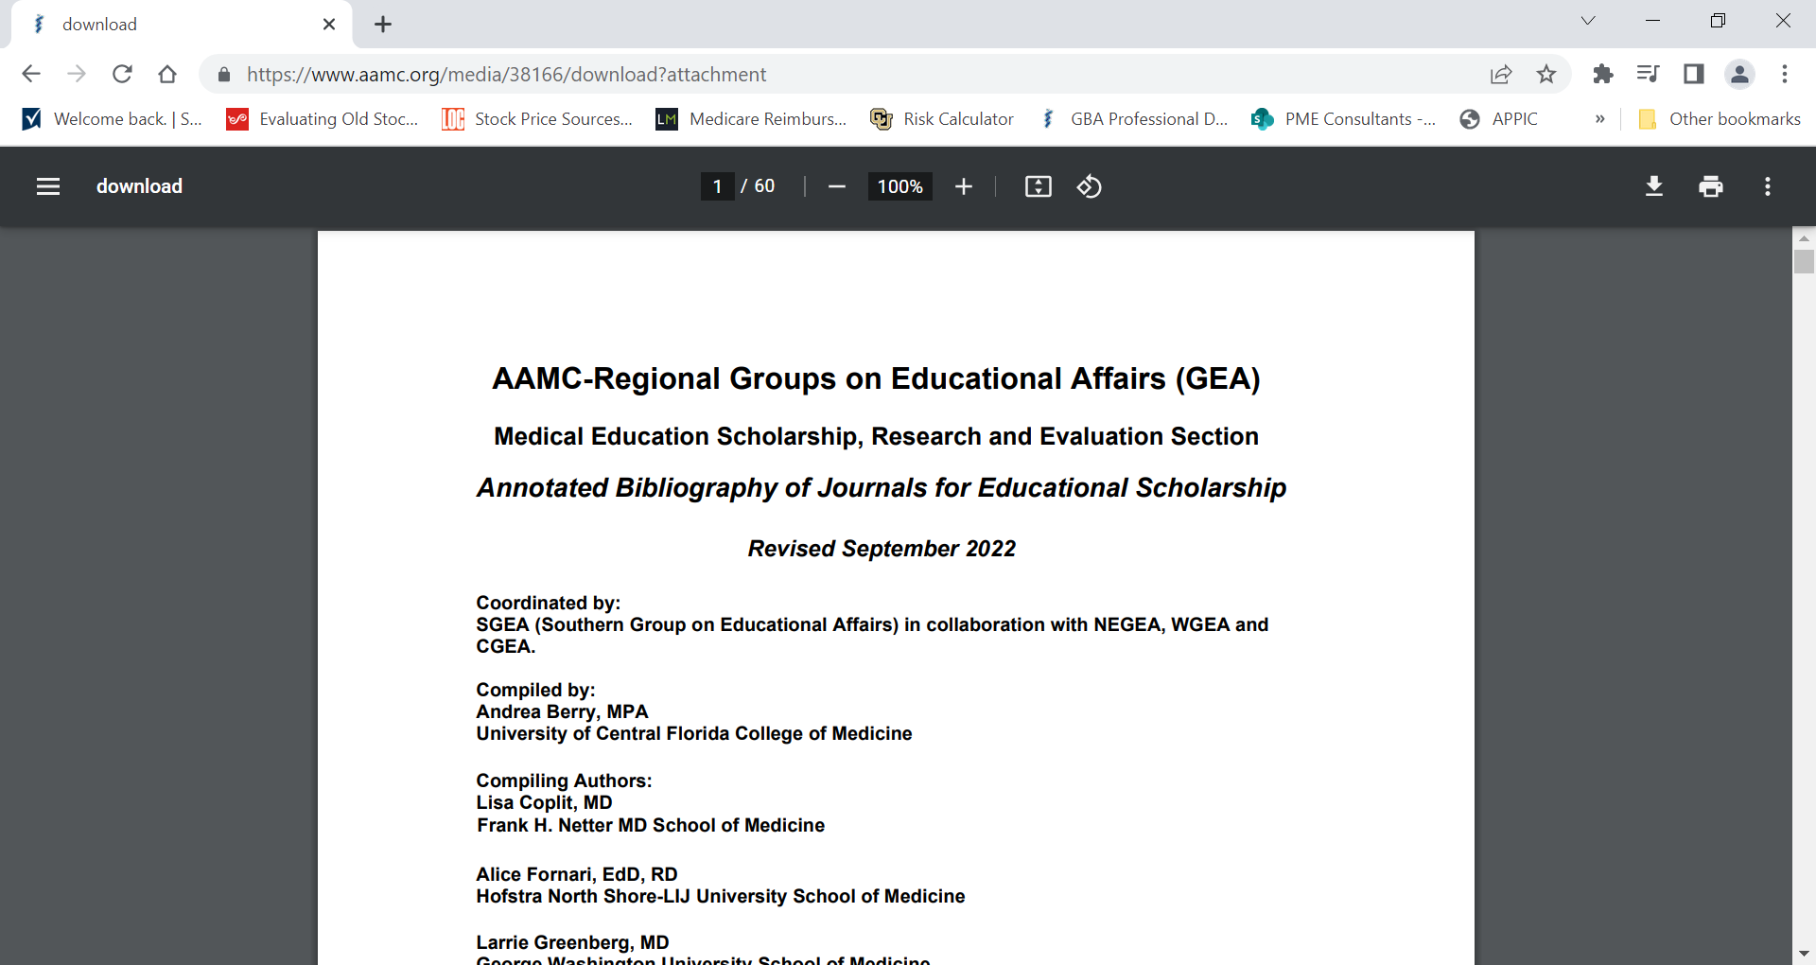
Medical Education Scholarship, Research and Evaluation (MESRE) Annotated Bibliography

Slide 20
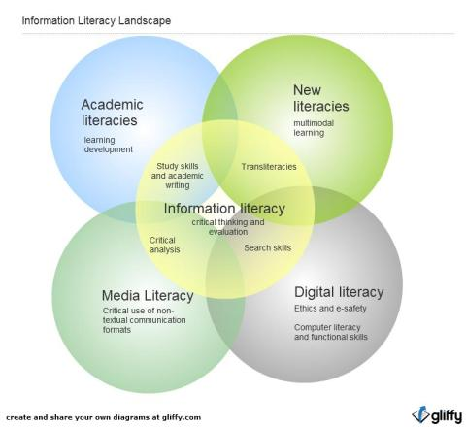
Information Literacy
Coonan, E., & Jane, S. (2014)

Slide 21
Information Literacy
“ Information Literacy lies at the core of lifelong learning. It empowers people in all walks of life to seek, evaluate, use and create information effectively to achieve their personal, social, occupational and educational goals. It is a basic human right in a digital world and promotes social inclusion of all nations.
Lifelong learning enables individuals, communities and nations to attain their goals and to take advantage of emerging opportunities in the evolving global environment for shared benefit. It assists them and their institutions to meet technological, economic and social challenges, to redress disadvantage and to advance the well being of all.”
Alexandria Proclamation on Information Literacy and Lifelong Learning. (2005). Information literacy | United Nations Educational, Scientific and Cultural Organization. Retrieved December 27, 2022.

Slide 22
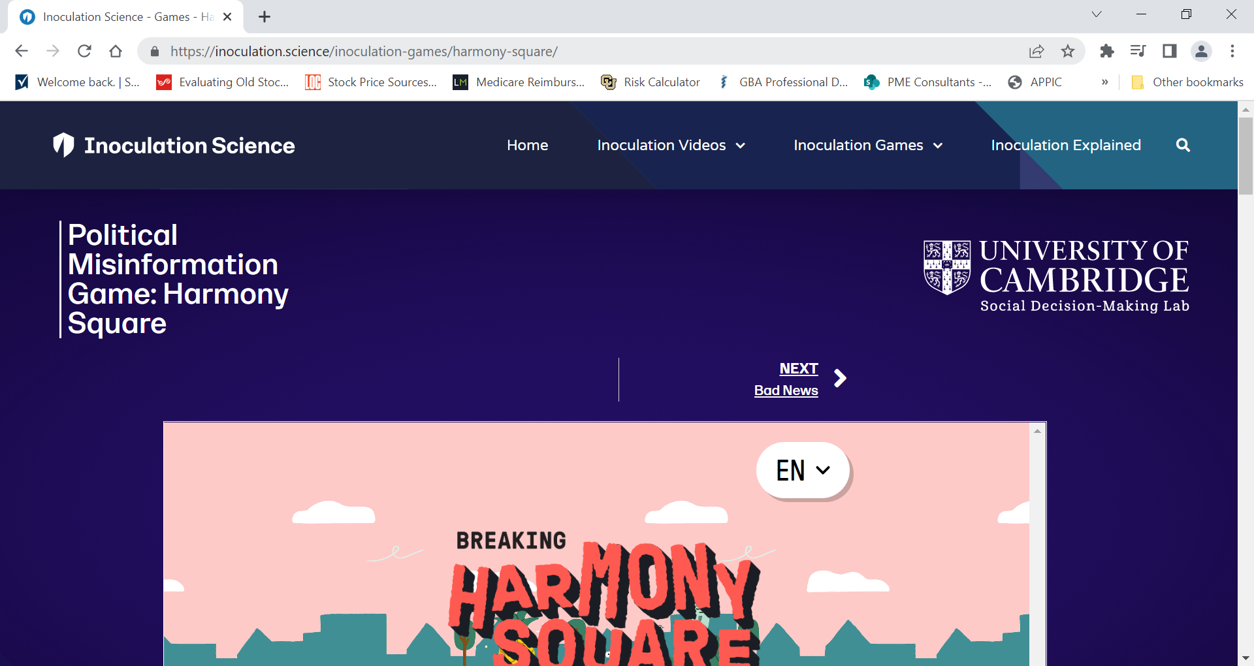
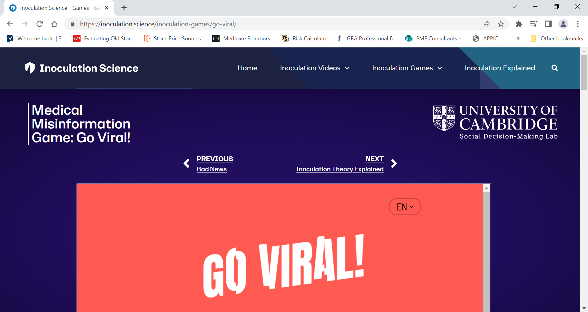
Information Literacy
https://inoculation.science/

Slide 23
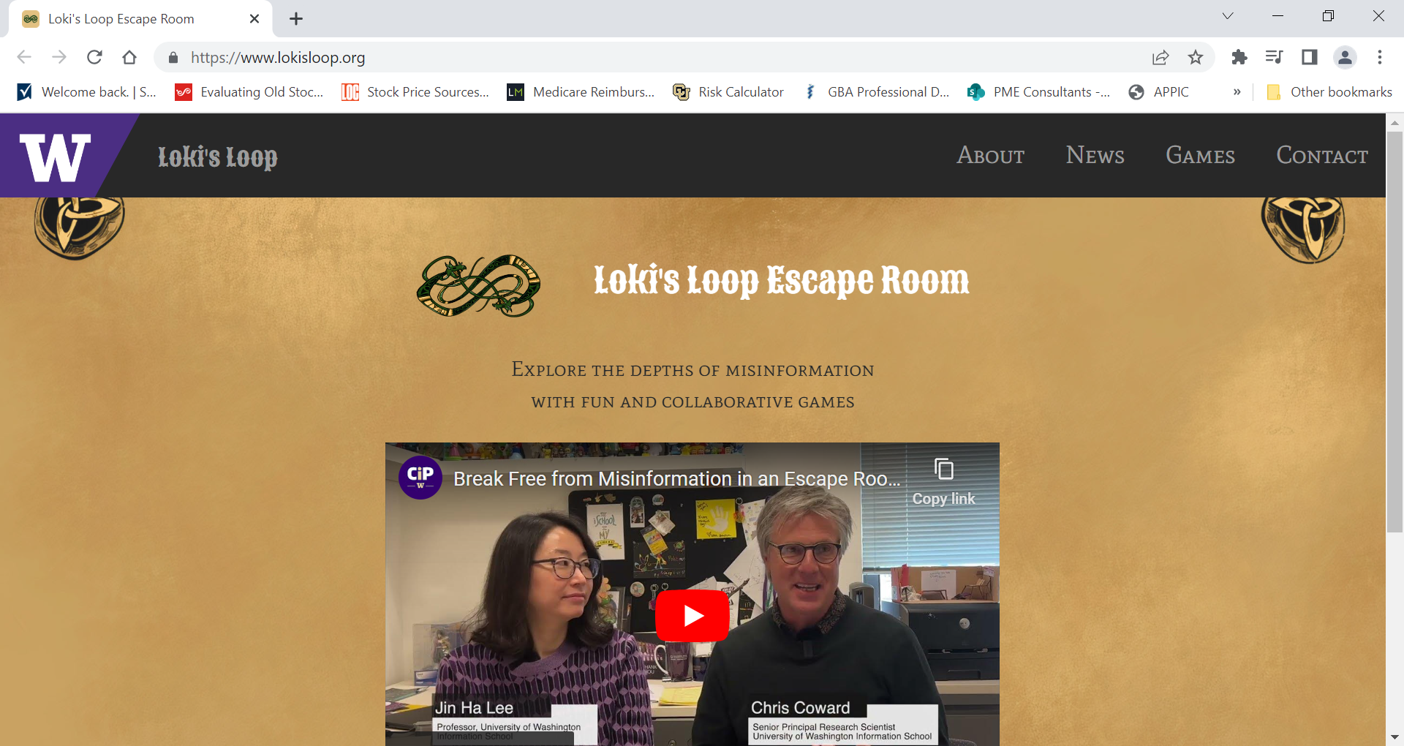
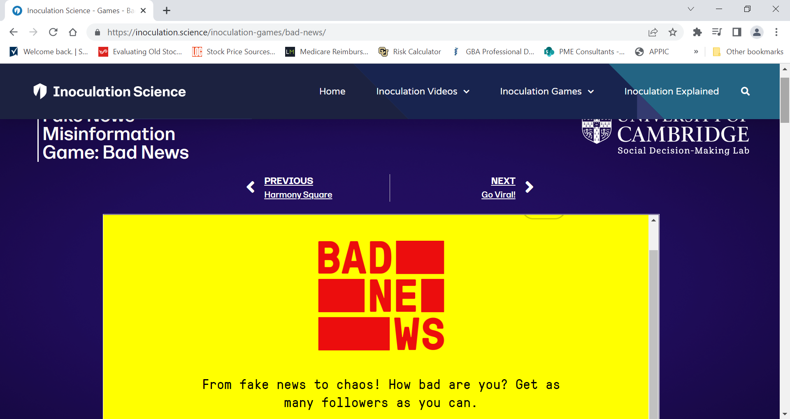
Information Literacy
https://www.lokisloop.org/
https://inoculation.science/

Slide 24
Final Thoughts…
Use of information & data impacts everything we do
Program outcomes
Curriculum planning
Strategic planning
Community planning
Personal planning
This Photo by Unknown Author is licensed under CC BY-SA-NC
Don’t forget the previous data resources!

Slide 25
References
International Federation of Library Associations and Institutions. (2005). Beacons of the Information Society: The Alexandria Proclamation on Information Literacy and Lifelong Learning. Information literacy: United Nations Educational, Scientific and Cultural Organization. Retrieved from https://www.ifla.org/publications/
Coonan, E. & Jane, S. (2014, April 29). “My dolly’s bigger than you dolly”, or why our labels no longer matter. [Web Blog]. Retrieved from https://librariangoddess.wordpress.com/2014/04/29/my-dollys-bigger/
Hoekzema, G. & Cagno, C. (2021). A wealth of data, a paucity of outcomes: What can we learn from the ACGME accreditation data system? Fam Med 53(7), 580-582 doi: 10.22454/FamMed.2021.277492

Slide 26
Questions

Slide 27
Upcoming Live Webinar
Developing Residency Budgets
Thursday, January 19, 2023
Onboarding Residents
Thursday, February 2, 2023
How Semi-Annual Evaluations Document, Educate, and Improve
Thursday, February 9, 2023
Ask Partners – Spring Freebie
Tuesday, March 21, 2023
GMEC Best Practices
Thursday, March 30, 2023
Latest On-Demand Webinars
SI Self Study 101
Motivating Faculty to Mentor & Do Reseach
Meet the Experts – Fall Freebie
Lights, Camera…Zoom!
GME Educational Program Design II
Site Visits Are Coming!
SI 2025: 2022 Check Up
Back To Basics: Intermediate Topics for New Program Coordinators
GME Educational Program Design I
Wellness is a Team Sport
Looking Behind the Current of CMS Reporting
ADS 2022: Part II
NEW Program Director Coaching Series
Jan – March Session – FULL
Next Session Starts April – June
6 one-hour group sessions over 12wks
2 one-on-one 30 min indiv. Sessions
Limited Enrollment for interactivity
Course Materials/GME Community Network
Email BJ@PartnersInMedEd.com for pricing and availability
Contact us today to learn how our Educational
Passports can save you time & money!
724-864-7320
www.PartnersInMedEd.com
Presented by Partners in Medical Education, Inc. 2023
27

Slide 28
Partners in Medical Education, Inc. provides comprehensive consulting services to the GME community.
Partners in Medical Education
724-864-7320 | info@PartnersInMedEd.com
Christine Redovan, MBA, MLIS
Christine@PartnersInMedEd.com
www.PartnersInMedEd.com

