Slide 1
DIO Competencies

Slide 2
Introducing Your Presenter
Amy Lefkovic, MHA
Received her Bachelors Degree in Health Information Management from Kean University
Began her career in Graduate Medical Education (GME) at Hospital for Special Surgery as the Radiology Fellowship Program Coordinator
Received her Masters degree in Healthcare Administration from Seton Hall University
Continued her career in GME at Lutheran Medical Center as the OB/GYN Residency Coordinator
Is currently the Manager of GME and Academic Affairs at Staten Island University Hospital

Slide 3
Goals and Objectives
To review the responsibilities and requirements of the Designated Institutional Official (DIO)
To determine what the competencies of a DIO are
To explore ways in which to fulfill these competencies

Slide 4
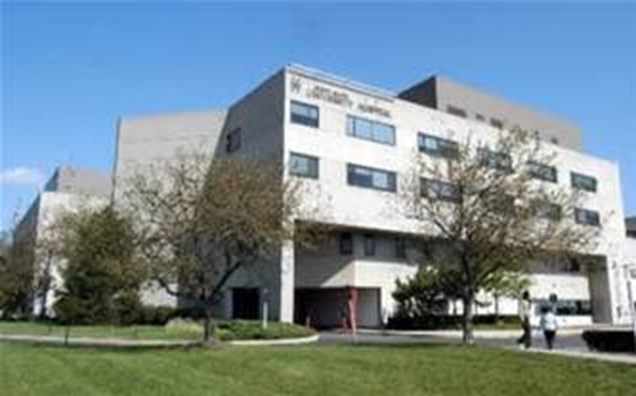
Staten Island University Hospital Northwell Health
Northwell Health
300 residents and fellows
16 programs

Slide 5
Requirements
Designated Institutional Official (DIO): The individual who, in collaboration with a Graduate Medical Education Committee (GMEC), must have authority and responsibility for the oversight and administration of each of the Sponsoring Institution’s ACGME accredited programs, as well as for ensuring compliance with the ACGME Institutional, Common, and specialty-/subspecialty specific Program Requirements I.A.5.a)

Slide 6
Requirements
The Sponsoring Institution must maintain its ACGME institutional accreditation. Failure to do so will result in loss of accreditation for its ACGME-accredited program(s) I.A.3.

Slide 7
Tall Order
GMEC Breakdown
One person
Many programs
Many institutions
Many futures in his/her hands

Slide 8
“In Collaboration with GMEC”
GMEC Breakdown
DIO
Minimum of two program directors
Minimum of two peer-selected residents/fellows
A Quality Improvement or patient safety officer

Slide 9
Responsible For
Accreditation status of institution
Accreditation status of all programs
Reductions and closures of programs

Slide 10
Responsible For
Number of trainees
Hospital reimbursement
Sufficient teaching
Policies and procedures

Slide 11
Responsible For
Common Program Requirements
Not just for the programs
Annual evaluations
Trainee stipends

Slide 12
Requests
Change in complement
New program
New Program Director
RRC requested progress reports
Appeals

Slide 13
Annual Institutional Review
The DIO must annually submit a written executive summary of the AIR to the Sponsoring Institution’s Governing Body. The written executive summary must include:
a summary of institutional performance on indicators for the AIR; and
action plans and performance monitoring procedures resulting from the AIR.

Slide 14
We know the what…but HOW??!!

Slide 15
Support
The Sponsoring Institution must ensure that:
the DIO has sufficient financial support and protected time to effectively carry out his or her educational, administrative, and leadership responsibilities;

Slide 16
Support
the DIO engages in professional development applicable to his or her responsibilities as an educational leader; and,
Sufficient salary support and resources are provided for effective GME administration

Slide 17
Support
Associate DIO
Large Health System
VP, Medical Education
Director of GME
Manager of GME

Slide 18
GMEC/GME/DIO
Many people vs. one person
Guidance from GMEC to fulfill requirements
OR guidance from DIO to fulfill requirements
Pre work done by GME
GMEC agenda

Slide 19
First Things First
Get familiar
Create foundation of knowledge
Institutional Requirements
Common Program Requirements
If it’s a requirements for all, it’s a requirement for you!

Slide 20
Breakdown
Requirements
Section by section check lists
Write down questions
Compare to policies and procedures
Are we doing this and how?
Confirm questions with policies and procedures

Slide 21
Large scale requirements…its either already checked off or you need to check in!

Slide 22
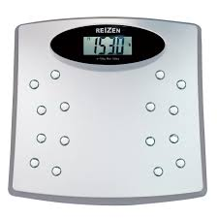
Large Scale Requirements
C-suite relationship
CLE-R
Importance of GME
Partnership
Chairmen

Slide 23
Large Scale Requirements
Resources
Available
Needed
Budget…who’s??
Up to date technology - Library
Call Rooms – Plant Operations

Slide 24
Large Scale Requirements
Food availability – cafeteria
Medical records access
Raise concerns without fear
Become known

Slide 25
Large Scale Requirements
Error reporting systems
Quality Improvement participation
Faculty development
Transitions in care
Feedback
Professionalism

Slide 26
Small scale requirements…day to day/annual operations

Slide 27
Smaller Scale Requirements
Change in Program Director/complement
Resident remediation/probation
Duty hour compliance
Template – Review - Distribute

Slide 28
Smaller Scale Requirements
Annual Program Evaluations
Program Report Card
Template – Review – Distribute – Peer Review

Slide 30
Get a Handle on It
Programs policies and procedures
Conference schedules
Goals and objectives
Maintain in GME Office

Slide 31
Get a Handle on It
Scholarly activity
Sign off on conference attendance requests
CCC and PEC meeting minutes

Slide 32
Surveys and Evaluations
ACGME Survey
Determine cut off point
Compare previous year
Request action plan
Special Reviews
Focused Reviews
Determine criteria
Site visits

Slide 34
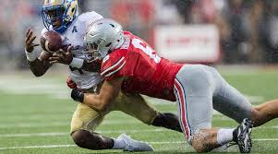
Tackling Requirements
Patient Safety
Quality Improvement
Resident Well-Being

Slide 35
Patient Safety
Patient Safety Officer at GMEC
Suggest rotations
Provide Hospital Wide patient safety goals
Research projects to focus and align

Slide 36
Quality Improvement
Representative at GMEC
Resident Quality Care Meetings
Representation from all programs
Quality tips
Quality methodologies
Faculty development – if they don’t know, we don’t know

Slide 37
Resident Well-Being
Subcommittee
Resident events
Difficulty in numbers
Don’t need to move mountains

Slide 38
Resident Well-Being
Mental Health Protocol
Anonymous survey with resources

Slide 39
DIO Presence
DIO or GME at all subcommittee meetings
Meetings with GME office regularly
Site visits and preparations

Slide 40
6 Core Competencies
Professional
Trustworthy
2. Interpersonal and communication skills
3. Systems based practice and improvement

Slide 41
6 Core Competencies
4. Leader
Role model
5. Delegate
6. Transparent

Slide 42
Utilize your army

Slide 43
GME Army
Subcommittees
Set expectations
Clearly defined job roles

Slide 44
GME Office
Onboarding
Visa’s
GMEC agenda
Coordinators meetings

Slide 45
GME Office
Budget
Cost report
Faculty development

Slide 46
Summary
Foundation of knowledge
Breakdown
Checklist
Determine gaps
GMEC/GME army

Slide 47
Upcoming Live Webinars
How to Prepare for your 10 Year Site Visit Tuesday, July, 10, 2018 12:00pm – 1:00pm EST Coordinator Development – How to Build a Team Tuesday, July 24, 2018 12:00pm – 1:00pm EST Responsiveness to Diverse Patient Populations Thursday, August 2, 2018 12:00pm – 1:00pm EST
Demystifying the Resident and Faculty ACGME Survey Thursday, August 16, 2018 12:00pm – 1:00pm EST
www.PartnersInMedEd.com
On-Demand Webinars Self-Study…Have You Analyzed Your Data Yet? Creating a Robust Resident Evaluation System
Institutional Site Visit Prep Process
From APE to Self-Study… and Everything in Between
Healthcare Disparities in GME Institutions
AOA to ACGME Accreditation: Best Practices and Challenges
Transitioning from Residency to Practice
Contact us today to learn
how our Educational Passports can save you time & money!
724-864-7320

Slide 48
Partners in Medical Education, Inc. provides comprehensive consulting services to the GME community.
Partners in Medical Education
724-864-7320 | info@PartnersInMedEd.com
Amy Lefkovic, MHA GME Consultant
Amy@PartnersInMedEd.com
www.PartnersInMedEd.com
Presented by Partners in Medical Education, Inc. 2018

