Slide 1
Partners Webinar Alert
Reminder…Because of the amount of individual logins for this webinar. Please DO NOT Unmute your Microphone after you enter this webinar.

Slide 2
DIO Roles & Responsibilities: Keys to Success
Tori Hanlon, MS, CHCP
GME Consultant
Cheryl Haynes, C-TAGME
Residency Manager

Slide 3
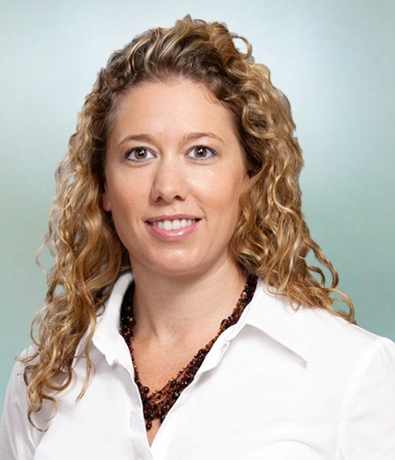
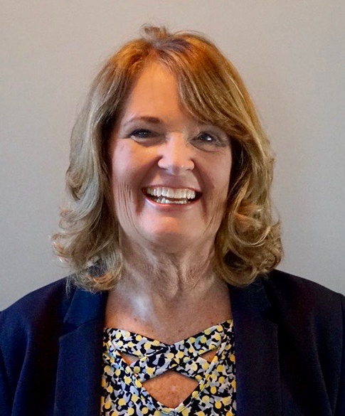
Introducing Your Presenter…
Tori Hanlon, MS, CHCP
GME Consultant
Over 13 years working in Medical Education
Bachelor’s in Health Services Administration
Master’s in Health Administration and Policy
Designated Institutional Official
Experienced in GME at a large academic medical center
Cheryl Haynes, BA, C-TAGME
Guest Speaker
Seasoned residency manager/institutional coordinator
Board of Directors, Association of Family Medicine Administration
Seasoned speaker/presenter for ACGME, AAFP, AFMA
Published research related to coordinator well-being
21 years GME experience

Slide 4
Objectives
Identify best practices for DIOs and institutional GME leaders for effective leadership of GME
Understand why communication between the DIO/GME office and programs is important and necessary
Recognize program needs in communicating with the DIO/GME office
Explore how programs and DIOs/GME leaders can better work together collaboratively in today’s GME environment

Slide 5
Who is the DIO?
The individual who, in collaboration with a GMEC, must have authority and responsibility for the oversight and administration of each of the SI’s ACGME-accredited programs, as well as for ensuring compliance with the ACGME Institutional, Common, and specialty-/subspecialty-specific Program Requirements. (I.A.5.a)

Slide 6
Roles of the DIO
DIO
Leader
Educator
Operator
Conceptualizer
Advocate
Communicator
Facilitator

Slide 7
Key to Success of a DIO
Excellent Coordinators at the program level
Happy
Prepared
Valued

Slide 8
DIO/GME Office Communication Survey
Survey Monkey
November 2020
GME Coordinators Facebook Group
39 Coordinators Responded

Slide 9
How does your DIO/GME typically communicate?*
Email 94.87%
Meetings 71.79%
Retreats 17.95%
Other 7.69% (Newsletters, Teams)
*Check all that apply

Slide 10
What type of information do you rely on most from your DIO/GME?
ACGME Updates 10.53%
Institutional GME Updates 76.32%
Professional Development 5.26%
Other (Budget) 7.89%
“I do not rely on them, the only time I hear from them is when they need something.”

Slide 11
What kind of information do you wish your DIO/GME office shared more of?
Responses were varied
“They do a great job”
“Resending me the ACGME newsletter is useless.”
“There is minimal communication coming from my GME/DIO until it is too late”
“Processes - they always assume everyone should know everything, when we get zero training”

Slide 12
Common Desired Information
Relevant, timely information, specific to program
Professional development opportunities
Processes/expectations
Shared best practices

Slide 13
Barriers to Effective Communication
DIO/GME leadership not approachable
Micromanaging
Unclear division of duties
Respond when assistance is requested

Slide 14
How could your DIO/GME office better serve the needs of your program?
Understand needs of individual programs
Allow PD’s to be PD’s
Recognize coordinators as members of the program leadership team
Provide professional development
Allow programs to be part of decision making when program is affected
Be open to innovation and new ideas, share the “why”

Slide 15
Roles
Advocate - be an advocate for your coordinators, listen to them, give them a voice, treat them as members of the leadership team, include them in your well-being initiatives.

Slide 16
How well do you know your Coordinators?
2017 Association of Family Medicine Administration partnered with University of Kansas-Wichita Dept of Family & Community Medicine
Surveyed 407 members, 75.4% response rate
Job satisfaction
44% high
56% average
95% reported a moderate level of burnout

Slide 17
Conceptualizer - Involve your coordinators in your vision, long term plans, will be surprised at how resourceful they can be
Communicator – be clear, concise and thoughtful
Educator - provide appropriate training for coordinators, be actively involved in their training and development
Facilitator – assure coordinators have the training and resources needed for effective performance of their jobs

Slide 18
AFMA/KU-Wichita Professional Development Survey
2nd survey 2018
60% response rate
64% reported they had received training for their positions
92% reported they receive financial support for professional development

Slide 19
“It’s not the money, it’s the time and lack of support. No one does my work when I am away.”
“It’s not worth being
gone.”

Slide 20
Roles
Leader - lead by example, don't sit in the admin/GME office for everyone to come to you, get out, be seen, be known at the program level, be approachable. Be well, model wellness!
Operator – roll up your sleeves, be seen as someone who gets things done, not just directs things to be done.

Slide 21
AAMC Institutional
GME Leadership
Competency Domains

Slide 22
Relationships with Programs
Meet with programs regularly (PDs, faculty, coordinators, residents)
Share information
Empower programs
Follow-up
Communicate what is realistic vs. what isn’t
Be honest
Ask for feedback

Slide 23
Best Practices
Keep up with ACGME Requirements and educate PDs and coordinators on revisions
Help prepare programs for site visits
Network with other DIOs
Create/maintain bridge between education and clinical care
Share institutional ACGME survey results at GMEC and with programs
Maintain a pulse on CLE and engage C-suite

Slide 24
Oversight
AIR
APE
Special Review
Annual Update
Being aware of
Reviewing
Tracking
Measuring
Documenting

Slide 25
Oversight
AIR
Write AIR Executive Summary
Be engaged in development of AIR action plans
APE
Standardize APEs
Use data for AIR
Special Review
Reviewed by DIO prior to submission
Addresses ACGME survey concerns
Annual Update
Monitor AIR action plans at GMEC at least quarterly
Monitor programs’ APE action plans at GMEC
Identification of underperforming programs
Hold programs accountable
Monitor corrective actions and outcomes at GMEC
Addresses progress made on citations

Slide 26
Resources
AAMC Institutional GME Leadership Competencies https://www.aamc.org/system/files/c/2/441248-institutionalgmeleadershipcompetencies.pdf
Competencies, Essential Training, and Resources Viewed by DIOs as Important to the Position in GME http://216.92.22.76/discus/messages/21/ACADEMIC_MED_Reisenberg-723.pdf

Slide 27
Resources
Characteristics, Roles and Responsibilities of the DIO Position in GME http://216.92.22.76/discus/messages/21/Riesenberg_DIO_article-1955.pdf
Ofei-Dodoo S, Scripter C, Kellerman R, Haynes C, Marquise ME, & Bachman CS, Burnout and Job Satisfaction among Family Medicine Residency Coordinators: Results from a National Survey. Family Medicine STFM. October 2018 Volume 50, Issue 9

Slide 28
Resources
Haynes C, Freelove R, & Ofei-Dodoo S. Assessing Family Medicine Residency Coordinators’ Work Stress and Wellbeing. Paper presented at the PDW and RPS Residency Education Symposium at the Sheraton Kansas City Hotel at Crown Center. Kansas City, MO. March 26, 2018.

Slide 29
Upcoming Live Webinar DIO Role and Responsibilities: Keys to Success
Thursday, December 17, 2020 12:00pm – 1:00pm EST
How to Manage Virtual Site Visit Tuesday, January 5, 2021 12:00pm – 1:00pm EST
How to Maximize Virtual Learning Part 1 Thursday, January 21, 2021 12:00pm – 1:00pm EST
DIO Role and Responsibilities: Keys to Success Thursday, December 17, 2021 12:00pm – 1:00pm EST
Latest On-Demand Webinars
Working with your Governing Board
Recognizing & Addressing Precursors of Burnout: The Value of Shame Resiliency Training to Support Resident Well-Being
Working with your IRB
Digging for Data II
Demystifying Diversity
Faculty Development Planning: Sponsoring Institution Role
ADS Annual Update: Best Practices
Graduate Medical Education Financing
Artificial Intelligence in Medicine: Its Impact on GME
Faculty Development – A More Specific Approach
NEW Faculty Development Series
15 Minutes to Effective Feedback
Toolbox for Teaching Millennials
Taking Supervision to the Next Level
Contact us today to learn how our Educational
Passports can save you time & money!
724-864-7320
www.PartnersInMedEd.com
Presented by Partners in Medical Education, Inc. 2020
29

Slide 30
Partners in Medical Education, Inc. provides comprehensive consulting services to the GME community.
Partners in Medical Education
724-864-7320 | info@PartnersInMedEd.com
Tori Hanlon, MS, CHCP
tori@partnersinmeded.com
Cheryl Haynes, BA, C-TAGME
Cheryl.Haynes@sr-ahec.org
www.PartnersInMedEd.com

