Slide 1
Partners Webinar Alert
Reminder…Because of the amount of individual logins for this webinar. Please DO NOT Unmute your Microphone after you enter this webinar.

Slide 2
Faculty Development – A More Specific Approach

Slide 3
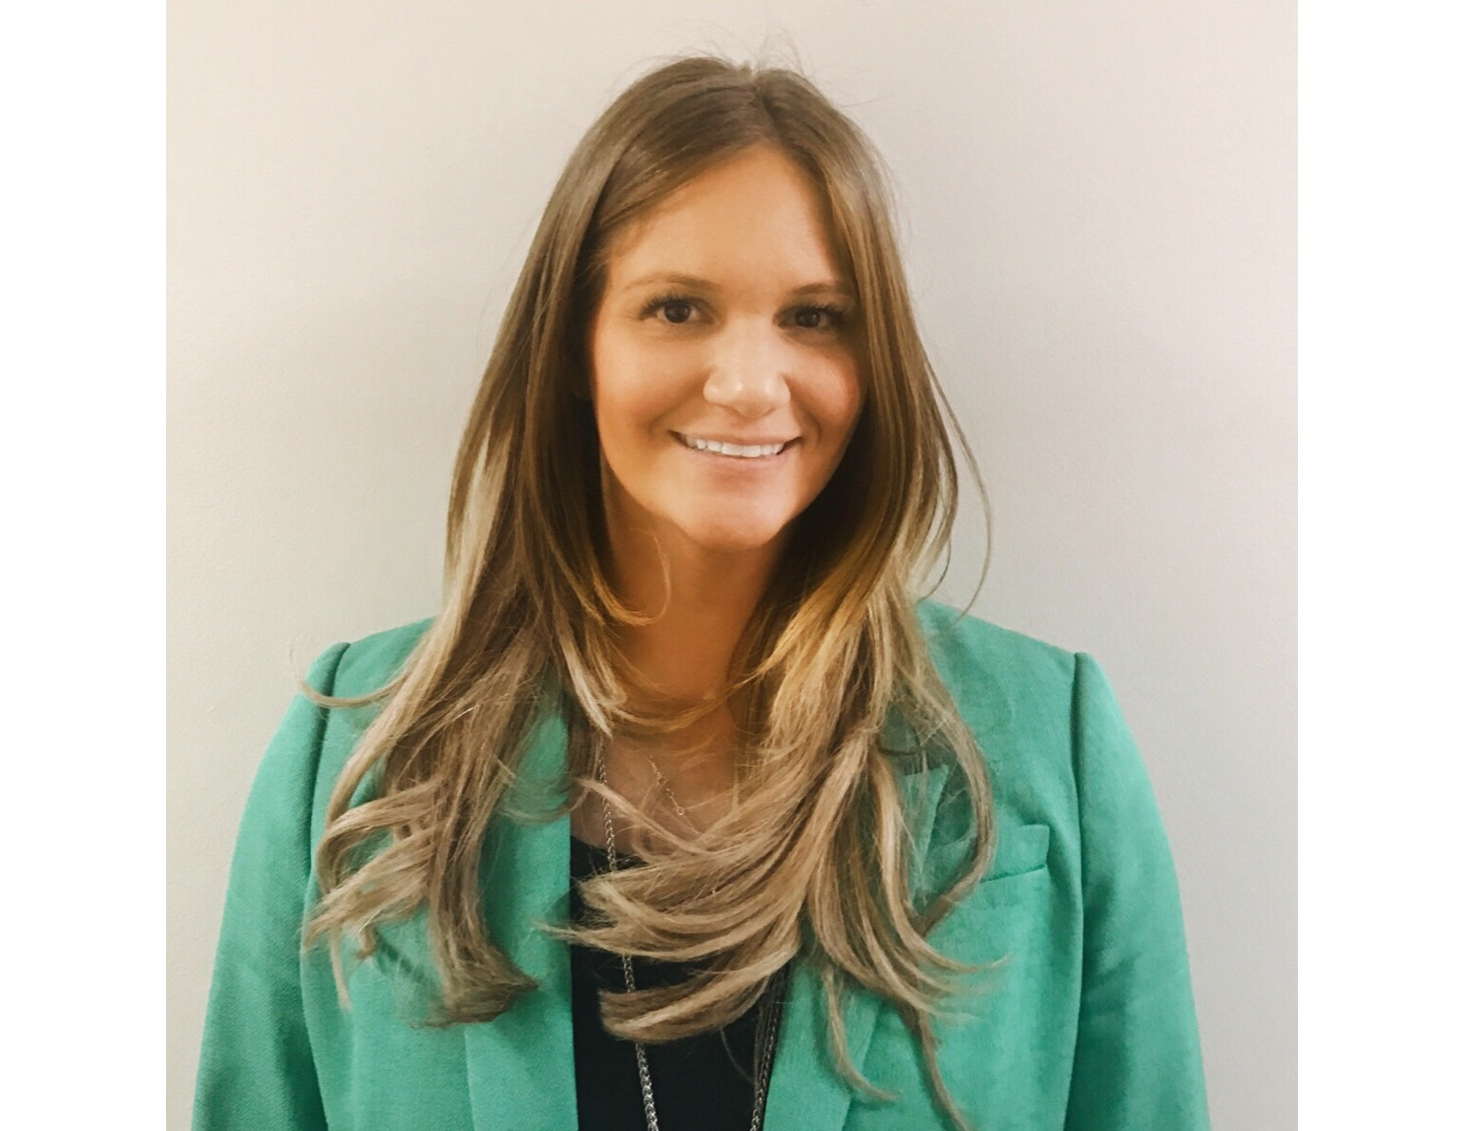
Introducing Your Presenter
Amy Lefkovic, MHA
Received her Bachelors Degree in Health Information Management from Kean University
Began her career in Graduate Medical Education (GME) at Hospital for Special Surgery as the Radiology Fellowship Program Coordinator
Received her Masters degree in Healthcare Administration from Seton Hall University
Continued her career in GME at Lutheran Medical Center as the OB/GYN Residency Coordinator
Is currently the Manager of GME and Academic Affairs at Staten Island University Hospital

Slide 4
Goals and Objectives
To review the requirements pertaining to faculty development
To examine approaches to fulfilling the requirement
To review the approaches related to all areas of faculty development

Slide 5
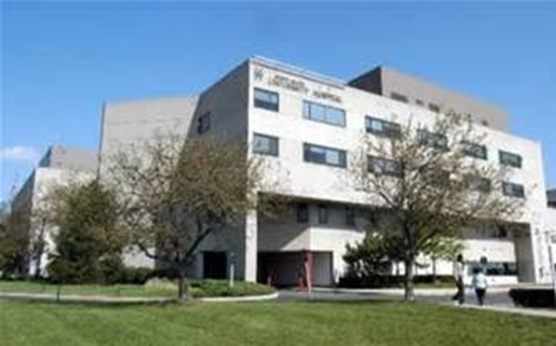
Staten Island University Hospital Northwell Health
Northwell Health
315 residents and fellows
16 programs

Slide 6
Requirements
Look at often
No pop quiz questions
Web ADS
ACGME faculty survey

Slide 7
Requirements
Background and Intent:
Structured programming
Transference of knowledge, skill, and behavior from the educator to the learner

Slide 8
Requirements
Faculty development may occur in a variety of configurations (lecture, workshop, etc.) using internal and/or external resources. Programming is typically needs-based (individual or group) and may be specific to the institution or the program

Slide 9
Requirements
Pursue faculty development designed to enhance their skills at least annually
as educators
in quality improvement and patient safety
in fostering their own and their residents’ well-being
in patient care based on their practice-based learning and improvement efforts

Slide 10
Practice-based Learning
Through a systematic analysis of one’s practice and review of the literature, one is able to make adjustments that improve patient outcomes and care.
Thoughtful consideration to practice-based analysis improves quality of care, as well as patient safety. This allows faculty members to serve as role models for residents in practice-based learning.

Slide 12
Approach
Program specific
GME office
Subcommittee(s)
Toolkit

Slide 13
Faculty Development Toolkit
GME office created subcommittees for each topic to create a toolkit for each program

Slide 14
GME Office
Pertaining to all residents
Know all the players
Sent requests out to Associate Program Directors
Want interest
Participated as subcommittee member for all

Slide 15
Subcommittee Responsibilities
Assign chair
Determine workshops, suggestions or tips to be used
Enter information into toolkit
Be available for questions
2-3 meetings

Slide 17
As Educators
Discussions/updates at each faculty meeting
Department of Academic Affairs workshop
Other faculty development sessions occurring in your institution
Quick and meaningful texts

Slide 18
As Educators
Grand Rounds
Invite other programs
Interdisciplinary or interdepartmental
Podcasts
ASK THEM!

Slide 19
In Fostering Well- Being
Your own as well as residents/fellows
Faculty meeting agenda item – residents signs
Recognition
Physician of the month/quarter and advertise
Suggestion box with Town Hall review

Slide 20
In Fostering Well- Being
Hospital ombudsperson
Separate or same as residents/fellows
Interesting if same
Hospital wide resources
Employee Assistance Program (EAP)
Connect the docs
Lunch in the attending lounge
Discounts

Slide 21
In Fostering Well- Being
Reading suggestions
Resources for physicians with substance abuse
Mental health protocol for residents, perhaps faculty
Balint groups

Slide 22
Practice Based Learning
Attendings must demonstrate the ability to investigate and evaluate their care of patients, to appraise and assimilate scientific evidence, and to continuously improve patient care based on constant self-evaluation and lifelong learning
Different from “as educators”

Slide 23
Practice Based Learning
Investigation and evaluation of patient care
Chart review
Departmental PI meetings
Following 1-2 patients a month after they leave to understand impact of decisions
Appraisal of evidence
Appropriate and trusted sources
Use of librarian

Slide 24
Practice Based Learning
Journal club
Self-evaluation and practice improvement
Bring to attention
If they cant do it, how can they teach it?

Slide 25
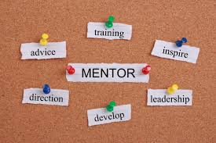
Practice Based Learning
Patient safety institute
Mentorship
Share with residents and model behaviors

Slide 26
Inclusive Work Environment
Unconscious bias sessions
Resident and fellow recruitment (ACGME survey)
Implement process to filter
Already doing it? Share and ask for feedback

Slide 27
Inclusive Work Environment
Grid showing statistics about diversity in program of faculty
Journal club
On “pop quiz”

Slide 28
Toolkit
One page per topic
Names and contact information of subcommittee members
Vague to let programs create for their departments
Beware of “Academic Affairs hosts”

Slide 29
Roll Out
GMEC
Faculty development champions
Faculty retreat
Housed on intranet and distributed

Slide 30
Common Themes
Faculty meetings agenda item
Journal club
ASK THEM!!

Slide 31
Advantages
Provide information for those who are struggling
Vague information allows program to customize
Fulfill requirements

Slide 32
Advantages
Faculty development for those in subcommittee
Interdepartmental collaboration
Engage APD or faculty members

Slide 33
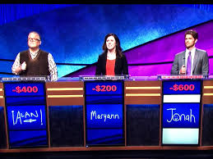
Disadvantages
Programs still receive negative scores
Programs don’t customize
Programs don’t utilize

Slide 34
Other Suggestions
Review ACGME faculty and resident/fellow surveys with faculty
Bring back information from conference
Assign topics to faculty members for lecture or faculty meeting discussion

Slide 35
Other Suggestions
Don’t check all boxes if cant produce proof, they are watching (aka asking)
ASK THEM!

Slide 36
Upcoming Live Webinar
GME Workforce Planning
Thursday, September 24, 2020 12:00pm – 1:00pm EST
Working with a Statistician on your Research Project
Thursday, October 8, 2020 12:00pm – 1:00pm EST Quality Improvements in GME: 5 years later
Thursday, October 22, 2020 12:00pm – 1:00pm EST
An Interdisciplinary Approach – Breaking Down the Wall
Thursday, November 5, 2020 12:00pm – 1:00pm EST
Latest On-Demand Webinars
Research and Scholarly Process in a Nutshell: Getting Started
Ask Partners – Spring Freebie Lessons Learned: Accepting Displaced Orphan Residents
Is your Coordinator Well Enough: Coordinators as Role Models of Wellness
Research Proposal Development: Tips for Success Working with your Governing Board
Recognizing & Addressing Precursors of Burnout: The Value of Shame Resiliency Training to Support Resident Well-Being
Working with your IRB
Digging for Data II
NEW Faculty Development Series
15 Minutes to Effective Feedback
Toolbox for Teaching Millennials
Taking Supervision to the Next Level
Contact us today to learn how our Educational
Passports can save you time & money!
724-864-7320
www.PartnersInMedEd.com
Presented by Partners in Medical Education, Inc. 2020
36

Slide 37
Partners in Medical Education, Inc. provides comprehensive consulting services to the GME community.
Partners in Medical Education
724-864-7320 | info@PartnersInMedEd.com
Amy Lefkovic, MHA GME Consultant
Amy@PartnersInMedEd.com
www.PartnersInMedEd.com

