Slide 1
Partners Webinar Alert
Reminder…Because of the amount of individual logins for this webinar. Please DO NOT Unmute your Microphone after you enter this webinar.

Slide 2
Faculty Development Planning: Sponsoring Institution Role
Heather Peters, M.Ed, Ph.D
GME Consultant

Slide 3
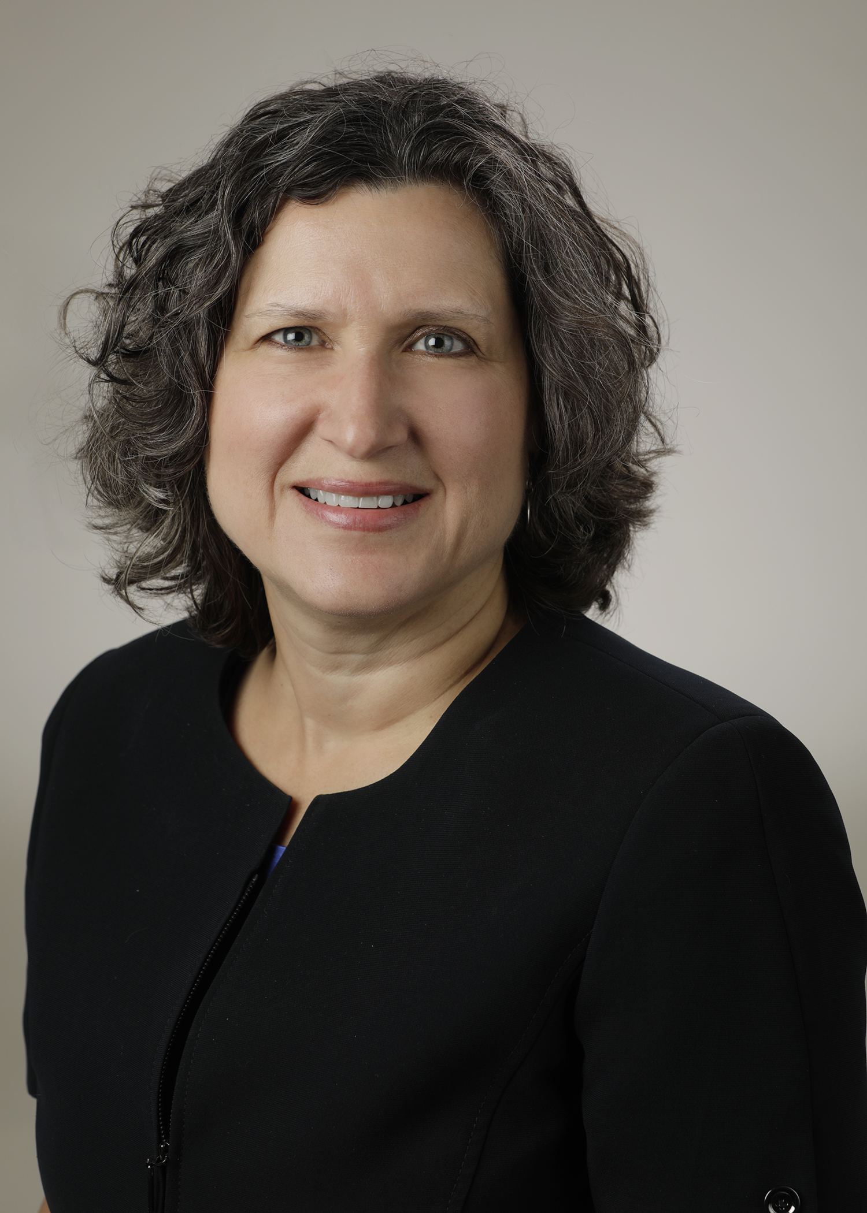
Introducing Your Presenter…
Heather Peters, M.Ed, Ph.D
GME Consultant
Former GME Director & DIO
Seasoned speaker at ACGME & subspecialty national meetings
Areas of Expertise: GME Strategic Planning; Program Evaluation; and Faculty Development
3 decades in education; Masters of Education in curriculum & evaluations, PhD concentration in secondary education & adult learning theories
Presented by Partners in Medical Education, Inc. 2020

Slide 4
Learning Objectives
DEVELOP the concept of Faculty Development according to the 2019 Common Program Requirements
DEFINE the different types of faculty development activities available
DISCUSS practical guidelines for planning, tracking and keeping faculty accountable across the organization
Hand-outs:
1. Individual tracking documents for faculty members
2. Guidelines for building Sponsoring Institution tracking mechanisms
Presented by Partners in Medical Education, Inc. 2020

Slide 5
2025 Faculty Roles
Diagnostic Assessor: Use data to identify performance gaps to individualize training
Learning Environment Designer, Engineer, Architect, and Implementer: Design “space” to optimize learning
Content Curator: Access, select, sequence, and deliver high-quality evidence-based content
Technology Adopter: Be an early adopter, fluent in selecting and using technology tools
Learner-Centered Navigator and Professional Coach: Guide learners to achieve identified performance targets
Clinician Role Model: Act as an exemplar for the various 2025 physician job roles
Simpson D, Marcdante K, Souza KH, Anderson A, Holmboe E. Job roles of the 2025 medical educator. JGME. 2018;10(3);243-246.
Presented by Partners in Medical Education, Inc. 2020

Slide 6
How to Frame Faculty Development for 2025 Roles
FRAME AND SUPPORT educator role change as an evolution from existing roles;
EXPLICITLY ATTEND TO educator transition challenges: purpose, sense of identity, and support network;
EMPLOY a growth mindset as optimal strategy to achieve one’s core purpose and goals as an educator; and
ESTABLISH visible organization and leadership support for faculty development
Simpson D, Marcdante K, Souza KH. How to
frame faculty development for 2025 roles.
JGME. 2018; 11(5):509-512.
Presented by Partners in Medical Education, Inc. 2020
This Photo by Unknown Author is licensed under CC BY-SA-NC

Slide 7
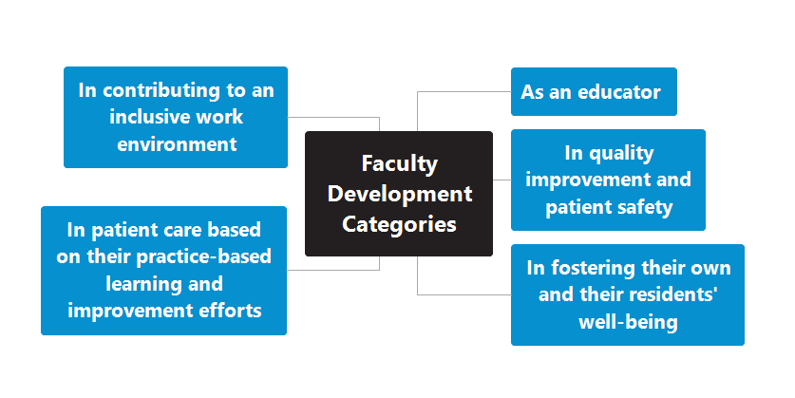
FACULTY DEVELOPMENT: 2019 Common Program Requirements
Presented by Partners in Medical Education, Inc. 2020

Slide 8
Faculty Development Categories (2019)
In quality improvement and patient safety:
Metrics of patient safety
Quality improvement education
RCA
Developing action items
Supervision of QI projects
As an educator:
Supervision
Giving feedback
Teaching skills
Bedside teaching
1-minute preceptor
Presented by Partners in Medical Education, Inc. 2020

Slide 9
Faculty Development Categories (2019)
In patient care based on their practice-based learning and improvement efforts:
Patient care metrics
Clinical outcomes
How to evaluate practice habits
In fostering their own and their residents’
well-being:
Well-being components
Work/life balance
modeling
Presented by Partners in Medical Education, Inc. 2020

Slide 10
Faculty Development Categories (2019)
In contributing to an inclusive work environment:
Understanding URM (underrepresented minorities) in medicine
Recruitment strategies
Hidden biases
Others:
Scholarly activity for faculty
Continuous Program improvement
Presented by Partners in Medical Education, Inc. 2020

Slide 11
Year One – With multiple educational touchpoints
All Faculty
Providing feedback
Supervision
Scholarly Activity
Generations of Learners
Challenging Residents
Core Faculty
All faculty topics
PEC
CCC
Role of Core Faculty
Activities:
Goal-setting
Educator Portfolio
Preparing for the educator review by program director
Role-Specific
Outpatient
Inpatient
Site/Service Director Responsibilities
Presented by Partners in Medical Education, Inc. 2020

Slide 12
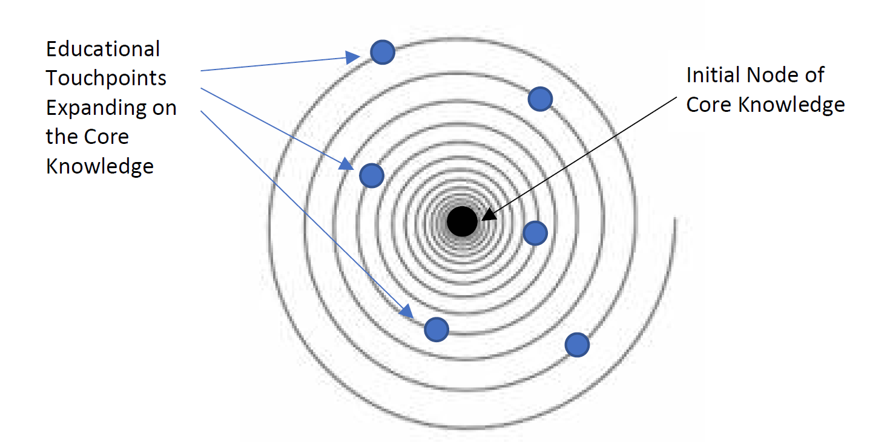
Educational Touchpoints
The goal of the educational touchpoints should be to encourage active learning—
self-assessment,
reflection,
self-directed learning,
problem-based learning,
learner interaction, and
feedback.
Presented by Partners in Medical Education, Inc. 2020

Slide 13
Intermediate Topics
Patient safety and residents
Well-being
Practice-based learning and residents
Mentoring quality improvement projects with residents
Developing a network of support
Common program requirements
Activities
Goal-setting
Finding a mentor
Presented by Partners in Medical Education, Inc. 2020

Slide 14
Advanced Topics
Career planning
Mentoring others
Preparation for the future of GME
Leadership in GME
Growing your program
Succession planning
GME finance
GME legislation & advocacy
Presented by Partners in Medical Education, Inc. 2020

Slide 15
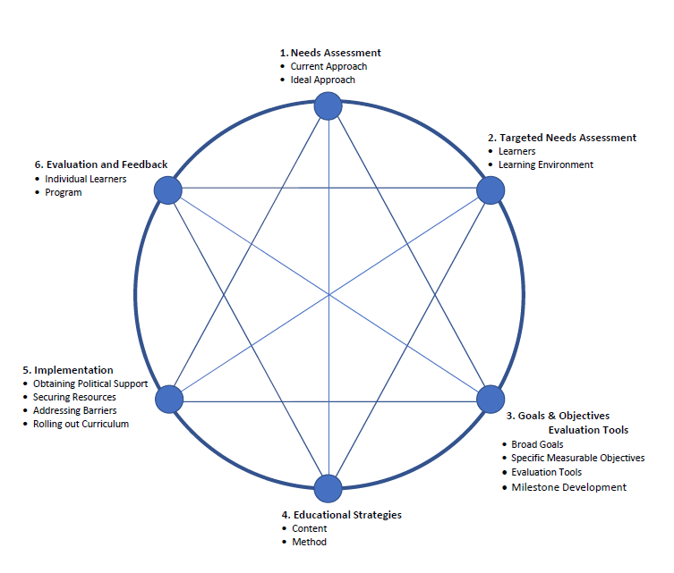
Medical Education Curriculum Framework
Adapted from Curriculum Development for Medical Education: A Six-step Approach. Editors: Thomas, PA; Kern DE; Hughes MT; Chen, BY. John Hopkins University Press; Baltimore, MD; 2016.
Presented by Partners in Medical Education, Inc. 2020

Slide 16
Framework Considerations
Adult Learning Principles
1. Choice
2. No one size
3. Goals
4. Reflections
Evaluation by Learner
Assessment
1. Reflection
2. Goal-setting
Presented by Partners in Medical Education, Inc. 2020

Slide 17
Format Options
Small Group
Large Group
Ideal for difficult topics
Multiple voices = opportunities for social learning
Finding time for faculty to meet
Finding time for faculty to meet
Online
Retreats
Easy to fit into schedule
Easy to fit into schedule
Not always the best way to learn
Sometimes this only attracts the core faculty
Presented by Partners in Medical Education, Inc. 2020

Slide 18
Accountability & Tracking
Individual Learning Plan for faculty
Tracking Guidelines for Faculty Development across the Sponsoring Institution
Presented by Partners in Medical Education, Inc. 2020

Slide 19
Repository of FD Activities
OHIO State Modules (https://fd4me.osu.edu/)
ACGME Learn (https://dl.acgme.org/learn/dashboard)
HC Pro (https://www.hcpro.com/residency)
NRMP (http://www.nrmp.org/)
AAMC (https://www.aamc.org/news-insights/gme)
Greater New York Hospital Association (GNYHA)
GME Finance (members of GNYHA hospitals only)
“Partners on Demand” Webinars (https://partnersinmeded.com/on-demand-webinars/)
Google (“Graduate Medical Education” ….)
Presented by Partners in Medical Education, Inc. 2020

Slide 20
RD4ME
Presented by Partners in Medical Education, Inc. 2020

Slide 21
NEW! Resources Available in Learn at ACGME
Guidebook for Promoting Well-Being during the COVID-19 Pandemic
This guidebook was written by experts in graduate medical education (GME) and well-being, and reviewed by leaders in these fields. Recommendations are evidence-informed and drawn from existing guidance and already available well-being resources.
These recommendations reflect what was known in late spring 2020. The authors and reviewers recognize that information on COVID-19 overall and its impact on GME is “rapidly evolving and fluid” and were mindful of this as they developed this guidance. The intent is to offer a framework that can be applied across a range of specific local contexts and changing situations.
Institutions across the nation are experiencing different levels of the pandemic, with various degrees of impact on their health and education systems. The authors and the ACGME trust in the ingenuity of the medical education community and its ability for continuous improvement, and hope that this guidance can serve as a foundation for future adaptation.
Managing Stress and Distress in the COVID-19 Era: A Webcast for Coordinators
This webcast focuses on strategies and techniques that coordinators can use to manage their stress during the COVID-19 pandemic.
Presented by Partners in Medical Education, Inc. 2020

Slide 22
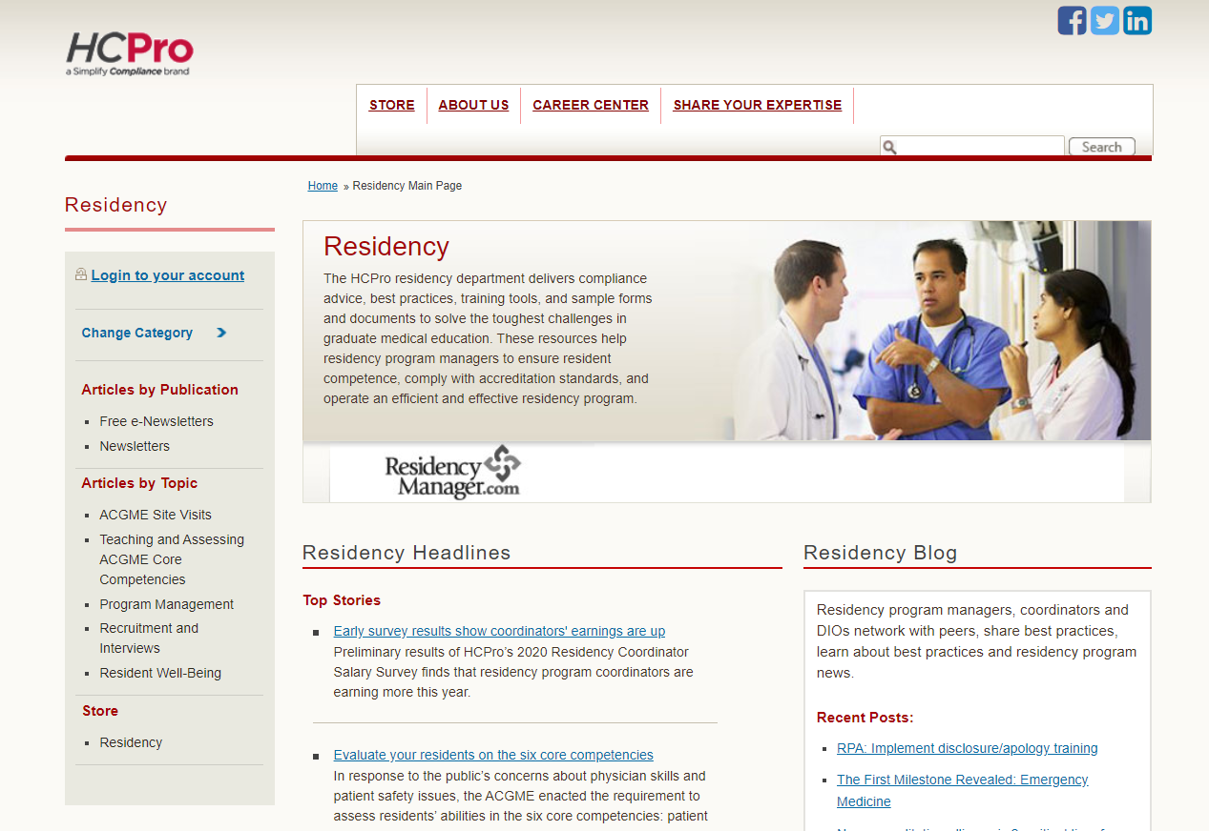
HCPro
Presented by Partners in Medical Education, Inc. 2020

Slide 23
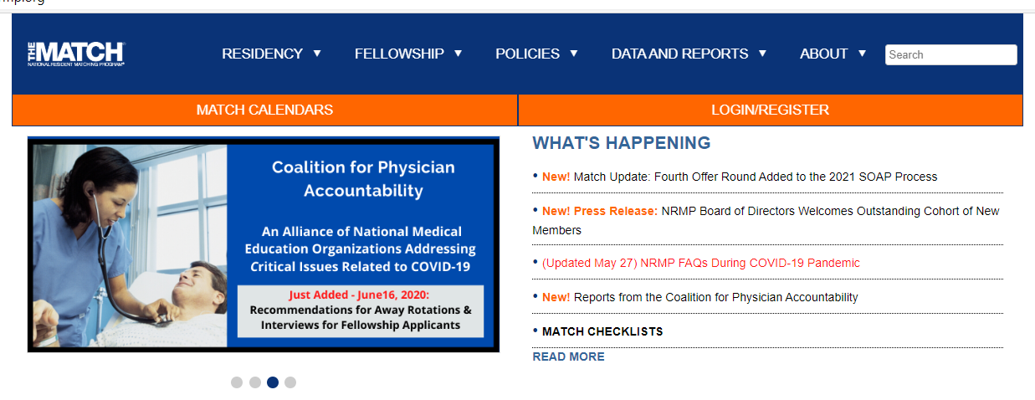
NRMP
Presented by Partners in Medical Education, Inc. 2020

Slide 24
Presented by Partners in Medical Education, Inc. 2020

Slide 25
References
Simpson D, Marcdante K, Souza KH, Anderson A, Holmboe E. Job roles of the 2025 medical educator. JGME. 2018;10(3);243-246.
Simpson D, Marcdante K, Souza KH. The power of peers: faculty development for medical educators of the future. JGME. 2019; 11(5); 509-512.
Curriculum Development for Medical Education: A Six-step Approach. Editors: Thomas, PA; Kern DE; Hughes MT; Chen, BY. John Hopkins University Press; Baltimore, MD; 2016.
Presented by Partners in Medical Education, Inc. 2020

Slide 26
2025 Faculty Roles
Diagnostic Assessor: Use data to identify performance gaps to individualize training
Learning Environment Designer, Engineer, Architect, and Implementer: Design “space” to optimize learning
Content Curator: Access, select, sequence, and deliver high-quality evidence-based content
Technology Adopter: Be an early adopter, fluent in selecting and using technology tools
Learner-Centered Navigator and Professional Coach: Guide learners to achieve identified performance targets
Clinician Role Model: Act as an exemplar for the various 2025 physician job roles
Simpson D, Marcdante K, Souza KH, Anderson A, Holmboe E. Job roles of the 2025 medical educator. JGME. 2018;10(3);243-246.
Presented by Partners in Medical Education, Inc. 2020

Slide 27
Final Thoughts…
Faculty development for the next decade will require
multi-layered programs
revised job descriptions for medical educators
faculty development experts/consultants to guide the process
Presented by Partners in Medical Education, Inc. 2020

Slide 28
Upcoming Live Webinar
ADS Annual Update: Best Practices Tuesday, July 28, 2020 12:00pm – 1:00pm EST
Graduate Medical Education Financing
Tuesday, August 11, 2020 12:00pm – 1:00pm EST
Artificial Intelligence in Medicine: Its Impact on GME
Thursday, August 27, 2020 12:00pm – 1:00pm EST
Faculty Development – A More Specific Approach
Thursday, September 3, 2020 12:00pm – 1:00pm EST
Latest On-Demand Webinars
Research and Scholarly Process in a Nutshell: Getting Started
Ask Partners – Spring Freebie Lessons Learned: Accepting Displaced Orphan Residents
Is your Coordinator Well Enough: Coordinators as Role Models of Wellness
Research Proposal Development: Tips for Success Working with your Governing Board
Recognizing & Addressing Precursors of Burnout: The Value of Shame Resiliency Training to Support Resident Well-Being
Working with your IRB
Digging for Data II
NEW Faculty Development Series
15 Minutes to Effective Feedback
Toolbox for Teaching Millennials
Taking Supervision to the Next Level
Contact us today to learn how our Educational
Passports can save you time & money!
724-864-7320
www.PartnersInMedEd.com
Presented by Partners in Medical Education, Inc. 2020
28

Slide 29
Partners in Medical Education, Inc. provides comprehensive consulting services to the GME community.
Partners in Medical Education
724-864-7320 | info@PartnersInMedEd.com
Heather Peters, M.Ed, Ph.D
Heather@PartnersInMedEd.com
www.PartnersInMedEd.com
Presented by Partners in Medical Education, Inc. 2020

