Slide 1
Feedback – From the Top Down

Slide 2
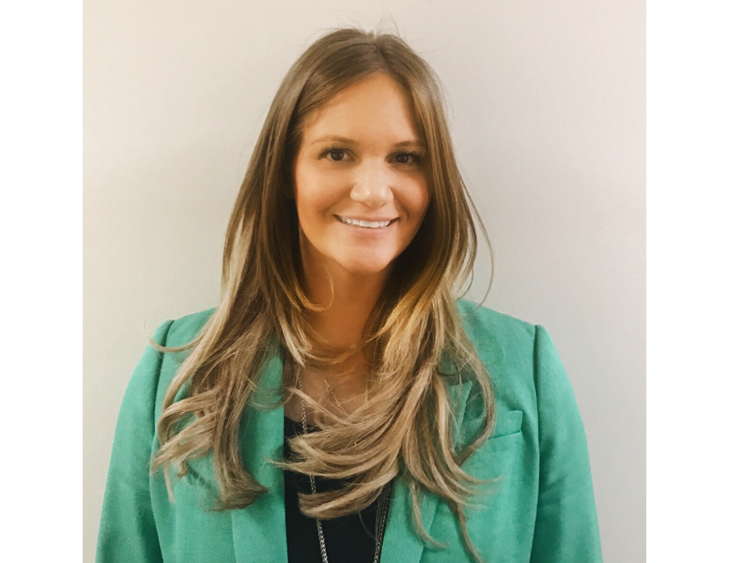
Introducing Your Presenter
Amy Lefkovic, MHA
Received her Bachelors Degree in Health Information Management from Kean University
Began her career in Graduate Medical Education (GME) at Hospital for Special Surgery as the Radiology Fellowship Program Coordinator
Received her Masters degree in Healthcare Administration from Seton Hall University
Continued her career in GME at Lutheran Medical Center as the OB/GYN Residency Coordinator
Is currently the Manager of GME and Academic Affairs at Staten Island University Hospital

Slide 3
Goals and Objectives
To review the requirements of providing effective feedback
To determine what the cause of the disconnect in giving feedback is
To explore ways to educate faculty in providing effective feedback

Slide 4
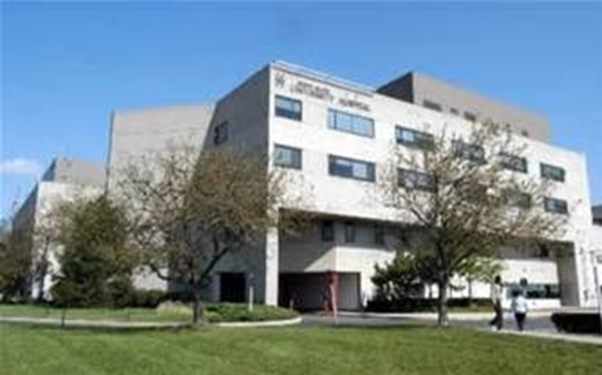
Staten Island University Hospital Northwell Health
Northwell Health
315 residents and fellows
16 programs

Slide 5
ACGME Resident Survey
Sufficient Instruction – 86% national compliance
2. Faculty and Staff create an environment of inquiry 80% national compliance
3. Satisfied with feedback after assignments 73% national compliance

Slide 6
ACGME Resident Survey
4. Provided data about practice habits 71% national compliance
5. Access to evaluations 99% national compliance

Slide 7
ACGME Faculty Survey
Faculty satisfied with personal performance feedback 89% national compliance
2. Satisfied with faculty development to supervise
and educate residents/fellows 96% national
compliance

Slide 8
ACGME Web ADS
Provide an example of the programs faculty development activities in each of these areas in the past year:
As educators

Slide 10
We Asked Them
Get them involved – they know A LOT
Formed small group
Chief Residents and Interns
Afraid to ask – No news is good news
Afraid to give feedback – but they are the educators
Find out at end of rotation IF there are comments

Slide 12
Practice Makes Perfect
Need to brush up on skills
Out of comfort zone
Provided with tools
We created a workshop

Slide 13
Lets Get Started
Formed a subcommittee of Program Directors
If they don’t know…we are all in trouble
Will this even help?
See one, do one, teach one
Simulation lab
Actors
Who better than the real thing?

Slide 14
Scenario Creation
Create scenario to stay on track
Detailed or vague
Detailed
Age, gender, background, marital status, hobbies
No medical knowledge
If they say this…you say that

Slide 15
Scenario Creation
Kill two birds with one stone
Frequent occurrences
More detailed for residents
Door chart for participants

Slide 16
Door Chart
Less information
Opportunity for various directions
Reinforce no medical knowledge

Slide 18
Scenario
Could be less extensive
Pertain to your residents
Defensive residents…ring a bell?

Slide 19
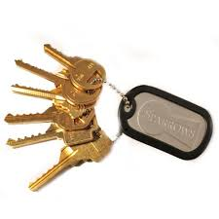
Checklist
Determined need
Asked the relevant people
Created scenarios
Now on with the show!

Slide 20
The Workshop
Need experts to watch and debrief
Need participants
Need resident actors
Need tools

Slide 21
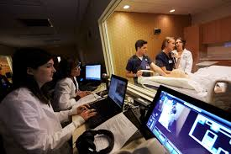
How We Did It
Determined location
Simulation lab
Private classrooms – break out room
4 rooms with one way view
Accommodate 4 to 8 “learners”
Learners are attendings

Slide 22
How We Did It
4 resident actors
Content experts
DIO
Program Directors
Awarded faculty
SFED model

Slide 23
SFED Model

Slide 24
Agenda
8:30am – 9:00am – Resident training
They teach us!
9:00am – 9:30am – Review of workshop agenda and door charts with all participants
9:30am – 10:00am – Scenario’s and resident feelings feedback

Slide 25
Agenda
10:00am – 10:45am – Didactic session on SFED model
10:45am – 11:15am – Scenario’s and resident as well as expert feedback
11:15am – 12:00pm – Debrief with ALL participants

Slide 26
Scenario’s and Resident Feelings Feedback
Faculty member A to perform scenario 1 on resident
while faculty member B observes
2. Resident will debrief with faculty member A on how
he/she felt during the session
Faculty member B to perform scenario 2 on resident while faculty member A observes
Resident will debrief with faculty member B on how he/she felt during the session
5. Didactic session

Slide 28
Important to Note
Do not put residents with learners from same specialties
Residents “feelings”
Hurt
Defensive
Yelled at
All participants learn from the experience
Hesitant at first but enjoy in the end

Slide 29
Advantages
Using 4 rooms and including observers allows for 8 learners
Learn from each workshop
Previously didn’t do same scenario
Attendings have ability to practice and learn in a safe environment and take back tools

Slide 30
Disadvantages
Participation
½ day event
Need 4 residents and experts as well as 4 to 8 learners but asking all of the same time

Slide 31
To Date
Educated over 30 learners
Held quarterly
Repeat residents
CME approval
Surgeon buy in!!

Slide 32
Upcoming Live Webinars
Evolving Resident Well-Being Tuesday, October 8, 2019 12:00pm – 1:00pm EST
We All Need Scholarly Activity, Including Coordinators Thursday, October 24, 2019 12:00pm – 1:00pm EST
Preparing For The 10 Year Site Visit Tuesday, November 5, 2019 12:00pm – 1:00pm EST
Meet the Experts – Fall Freebie Thursday, November 21, 2019 12:00pm – 1:00pm EST
On-Demand Webinars
2019 CPR Part 1 of 4: Overview
Aims and Action Plans
SI 2025 Part 2 of 4: Changes on the Horizon
Ask Partners – Spring Freebie
Understanding the CLE
CPR 2019 Part 2 of 4: Section I & Section II
SI 2025 Part 3 of 4: GME Evolution, Funding & Future
Building Your Sponsoring Institution – The First 2 Years
Special Reviews – Helpful not Hurtful
2019 CPR Part 3 of 4: Section IV & Section V
NEW Faculty Development Series
15 Minutes to Effective Feedback
Toolbox for Teaching Millennials
Contact us today to learn how our Educational
Passports can save you time & money!
724-864-7320
www.PartnersInMedEd.com
32

Slide 33
Partners in Medical Education, Inc. provides comprehensive consulting services to the GME community.
Partners in Medical Education
724-864-7320 | info@PartnersInMedEd.com
Amy Durante, MHA GME Consultant
Amy@PartnersInMedEd.com
www.PartnersInMedEd.com

