Slide 1
From APE to
Self Study
MASTERING THE BASICS OF PROGRAM IMPROVEMENT
HEATHER PETERS, M.ED, PH.D
PARTNERS IN MEDICAL EDUCATION Consultant
DIO & GME SPECIALIST

Slide 2
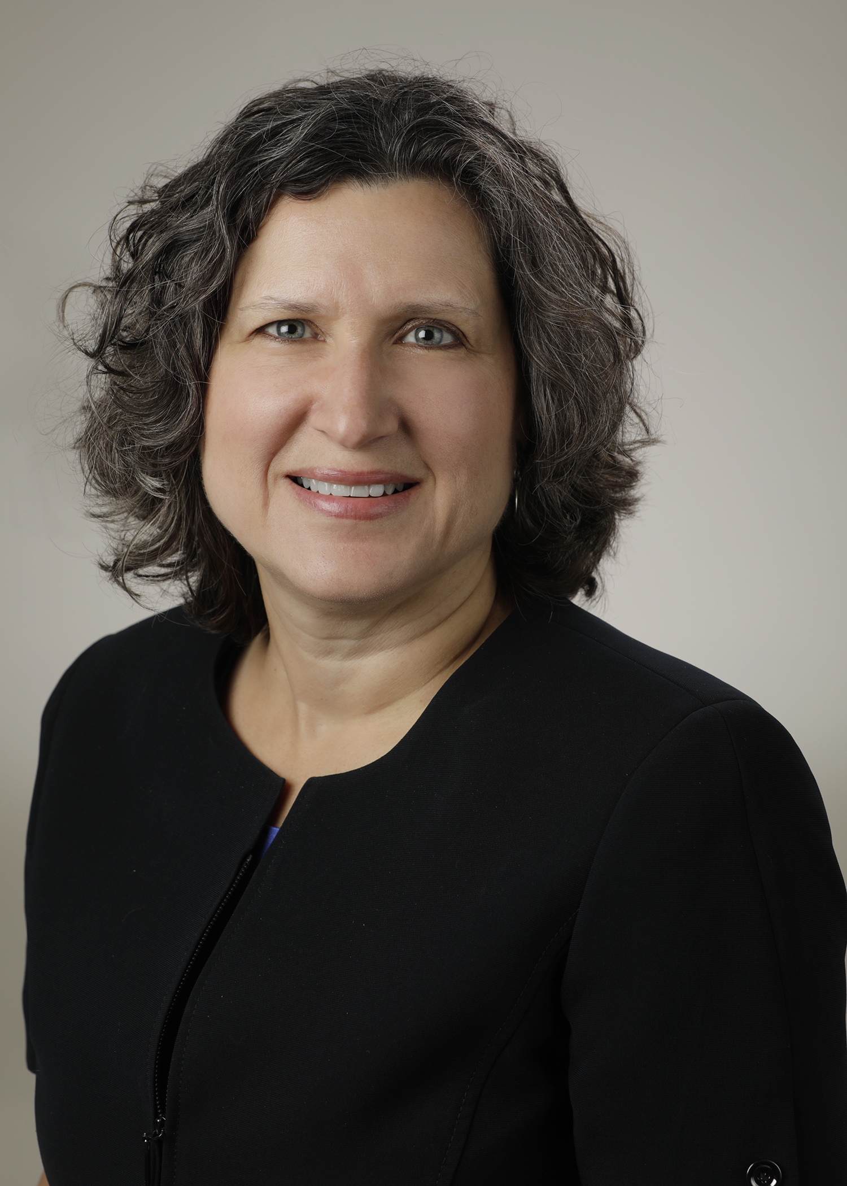

Introducing Your Presenter…
Heather Peters, M.Ed, Ph.D
GME Consultant
DIO & GME Specialist
Seasoned speaker at ACGME & sub-specialty national meetings
Areas of Expertise: Institutional and Program accreditation experience; Strategic planning; Annual Program Evaluation processes; Evaluation processes; and more
3 decades in education; Masters of Education in curriculum & evaluations, PhD concentration in secondary education & adult learning theories

Slide 3
OBJECTIVES
Discuss the following elements:
Annual Program Evaluation (APE)
Program Evaluation Committee (PEC)
Action Items
Self Study
Explore the following elements:
Tools for optimizing the APE, PEC, Action Items and the Self Study
Discuss challenges and provide best practices for the APE, PEC, Action Plan and the Self Study

Slide 4
ANNUAL PROGRAM EVALUATION

Slide 5
ACGME REQUIREMENTS
V.C. Program Evaluation and Improvement
The program must monitor and track each of the following areas:
resident performance;
faculty development;
graduate performance, including performance of program graduates on the certification examination;
program quality; and,
progress on the previous year’s action plan(s).

Slide 6
ACGME REQUIREMENTS
  Residents and faculty must have the opportunity to evaluate the program confidentially and in writing at least annually, and
  The program must use the results of residents’ and faculty members’ assessments of the program together with other program evaluation results to improve the program.

Slide 7
AIR
(ANNUAL INSTITUTIONAL REVIEW)
List Accredited Programs | Trainees Filled/ Approved | Match Fill Rate 2016/17 AY | % filled | Status Effective Date | Site Visit Date | ACGME Accred Status | Decision(s): Program Commended/Areas for Improvement/ Concerning trends | Cert Exam Pass Rate (Board report) | # of Citations | ACGME Resident Survey | ACGME Faculty Survey | Duty Hour Comp: Total # Violations
Institution |  |  |  | 4/27/2016 | Not sched | CA | Commended; Citation: oversight of Residencies |  | 1
Int. Med. - Cat/Prelim | 80/92 | 97% | 100% | 1/15/2016 | Not sched | CA | Commended; Citation: concern for duty hr. compliance | 86% | 0 |  |  | 41
IM – Endocrinology | 2/3 | 100% | 67% | 7/1/2015 | Not sched | CA | -- | 100% | 0 |  |  | 0
IM – Gastroenterology | 6/6 | N/A | 100% | 7/1/2015 | Not sched | CA | -- | 86% | 0 |  |  | 0
IM – Nephrology | 4/4 | 0% | 100% | 7/1/2015 | Not sched | CA | -- | 86% | 0 |  |  | 0
OB/GYN | 17/17 | 80% | 100% | 2/19/2016 | Not sched | CAW | Citations: volume-Inadequate experience vh,lh,cystos; evaluation of residents; duty hours; Responsibility of PD | 61%/50% Written/oral | 7 |  |  | 2
Ophthalmology | 13/12 | 100% | 108% | 3/31/2016 | 2/22/2016 | CAW | Citation: Board scores; Concern for Clinical Experience | 35% | 1 |  |  | 0
Pediatrics | 29/30 | 100% | 97% | 1/28/2016 | 3/18/2015 | CA | Citation: Board pass rate 45.45%, | 45% | 1 |  |  | 13

Slide 8
ACTIVITY:
Data? What Data?
Determining the data that is useful for your program
Activity: Data? Which Data?
Directions:
During the review of possible data points on the activity sheet, make a list of other program-specific data that you currently use or could use in your APE

Slide 9
CHALLENGES CONTINUED
Providing enough time to gather data (particularly survey data)
Changing the format and items collected each year
Not following up on action items during the year
Not involving the entire program in the APE process
Unwilling to discuss program needs at GMEC

Slide 10
BEST PRACTICES
Using the APE to highlight successes as well as determine program needs
Involving the entire program (residents, faculty, staff, other departments)
Creating a mission and key distinguishing AIM statements (we will discuss this more during the Self Study piece) to drive the data collection
Taking the long view to program improvement
Following up with the PEC throughout the academic year to ensure that progress is being made on action items

Slide 11
INTERNAL SURVEYS
Why do internal surveys?
Who should be queried?
What should comprise an internal survey?
How to trend internal survey data
Be careful who sees “raw comments”
Don’t get distracted by “one off” comments
Beware of the “soapbox”

Slide 12
SCHEDULING the APE
APEs take several months to put together
Someone in your program has to be the “one in charge” (Program Director & Coordinator Team)
Handout: Sample timeline

Slide 13

TOOLS FOR THE APE
Getting to the Root Cause:
The 5 Whys
The Fishbone diagram (Ishikawa)

Slide 14
TOOL: USING THE 5 WHYS
Problem Statement: My car ran stopped in the middle of the road yesterday
1. Why did your car stop?
I ran out of gas
2. Why did you run out of gas?
I did not get gas on the way to work this morning
3. Why didn’t you get gas on the way to work?
I didn’t have my gas credit card when I looked in my purse
4. Why didn’t you have your credit card?
My daughter forgot to give me back my card after she borrowed it
5. Why did your daughter forget to give you back your gas credit card?
She is mad at me because I grounded her for missing curfew

Slide 15
USING THE 5 WHYS
Problem Statement: The residents are violating work hours on the inpatient service.
1. Why are the residents violating work hours on the inpatient service?
The attending's are not paying attention to the work hour limits
2. Why are the attending not paying attention to the work hour limits?
Many of them are new and they aren’t aware of the work hour restrictions.
3. Why aren’t the new attending's aware of the work hour restrictions?
They are not receiving any education about the work hour restrictions are part of the onboarding process from the hospital
4. Why aren’t they receiving any education from the hospital about work hour restrictions?
HR is not aware that they need this education and so it is not included in the onboarding process
5. Why isn’t HR aware of the need for this education?
HR does not have anyone who is knowledgeable about the specific needs of GME

Slide 16
TOOL: FISHBONE DIAGRAM (Ishikawa)
An important tool for the analyze phase
What is contributing to the current situation?
Use six categories (e.g., environment, methods, process, people, paperwork, management, mindset)
Use the “5 whys” method

Slide 17
PROGRAM EVALUATION COMMITTEE

Slide 18
ACGME REQUIREMENTS
The program director must appoint the Program Evaluation Committee (PEC)
Must have a written description of its responsibilities; and, should participate actively in:
Must be composed of at least two program faculty members and should include at least one resident;
planning, developing, implementing, and evaluating educational activities of the program;
reviewing and making recommendations for revision of competency-based curriculum goals and objectives;
addressing areas of non-compliance with ACGME standards; and,
reviewing the program annually using evaluations of faculty, residents, and others

Slide 19
PURPOSE OF PEC
A venue for implementing change
Guides the APE
  Contents in the APE
  When/how is it conducted
  Reviews the data
Follows up on the action items
Keeps an eye on the curriculum (goals and objectives, comments from residents about rotations/services, procedural numbers obtained on the rotation)

Slide 20
Challenges
Too much to do for one meeting a year
Can lose focus if not directed
Can become a “gripe session”
Does not represent the major services

Slide 21
BEST PRACTICES
Meet as many times a year as necessary to review the curriculum and rotations on a regular basis
Have a schedule for the reviews
  Service chiefs or Rotation directors can attend the meeting that discusses their service/rotation
  Create a template for reporting on rotations/services so that the data is collected and reviewed consistently
Use the action items as the agenda for the meeting or at least the first item on the agenda so that they are looked at frequently

Slide 22
ACTION PLANS

Slide 23
ACGME REQUIREMENTS
ACGME REQUIREMENTS
V.C. Program Evaluation and Improvement
The PEC must prepare a written plan of action to document initiatives to improve performance in one or more of the areas listed in section V.C.2., as well as delineate how they will be measured and monitored.
The action plan should be reviewed and approved by the teaching faculty and documented in meeting minutes.

Slide 24
ENSURING ROBUST
ACTION PLANS
The categories of the APE should be reflected in the action plans
  Resident performance (milestone data, rotation data, in-training examination data)
  Graduate performance (board examination data, alumni surveys, placement of graduates)
  Faculty development (faculty surveys, faculty development activities)
  Program quality (ACGME surveys, internal surveys)
Do your actions plans include at least one from each category?

Slide 25
BEST PRACTICES
Don’t choose too many – it’s better to make progress on few items, than accomplish nothing because you are going in too many directions
Measurements – it’s essential to think about how to measure success
PECs should review the action items throughout the year – use it as your agenda for PEC meetings

Slide 26
TOOL: VOICE of the…
Trainee Comment (What are they saying?) | Gathering More Understanding (Why are they saying it?) | Trainee Needs (What do they want/need?)
The residents stated on the program evaluation survey that the supervision is only sufficient “sometimes” | A focus group was held to discuss why the residents stated that supervision was sufficient “sometimes.” Comments made during the focus groups include: Some faculty do not provide supervision and residents are often left on their own; this seems to be faculty that are also more disengaged in teaching overall Some rotations (PICU, NICU and wards) do not have consistent supervision Most of the core faculty provide more than adequate supervision | The residents need supervision that is consistent across rotations and faculty members, whether core or non-core. The supervision policy needs to be reinforced and faculty need to be accountable for patient safety reasons as well as resident well-being reasons.

Slide 27
SELF STUDY

Slide 28
Purpose
The 10 year Self-Study visit is based on a comprehensive self-study, which includes a description of how the program or sponsoring institution creates an effective learning and working environment, and how this leads to desired educational outcomes, and an analysis of strengths, weaknesses, and plans for improvement.
Rationale: A standards and citation-based approach offers limited benefits for the majority of programs on Continued Accreditation¹
¹Excerpted from: Byrne LM, Miller SM, Nasca TJ. Implementing the Next Accreditation System: Results of the 2014-2015 Annual Data Review. J Grad Med Educ. 2016 Feb;8(1):118-123

Slide 29
Elements of the self study:
A 5 year “look back” and a 5 year “look forward”
What will take this program to the next level?
Program Description
Succinct description of the program
Program AIMS
Goals of the program
What does the program strive to “produce”
Activities to further the AIMs
Listing of actions or projects aligned with AIMs
An environmental assessment
SWOT

Slide 30
A WORD about
AIMs
Makes the self-study process and planning more relevant:
  Types of graduates produced for specific community needs
  Practice settings and roles
Allows for a more “tailored” approach to creating a learning environment
  Focus on a specific AIMs can produce highly desirable “graduates” that match patients and health system needs¹
Enhances the focus on functional capabilities of graduating residents
  Fits in with a milestone-based approach to assessment
¹ Hodges BD “A Tea-Steeping or i-DOC Model for Medical Education?” Acad Med 85(9) Sept Supple 2010. pp. S34-S44

Slide 31
Challenges
Best Practices
Involves strategic planning
Feeling of “tremendous burden”
Programs could identify AIMs but had difficulty with metrics
Obtain training in strategic planning
The more collaboration the better
Metrics are essential

Slide 32
Timeline for Self Study/
10 Year Site Visit
 | J | F | M | A | M | J | J | A | S | O | N | D | J | F | M | A | M | J | J | A | S | O | N | D
Ph.1
Ph.2
Ph.3
Phase 1: Self Study Process
Phase 2: Preparation for 10 Year Site Visit
Phase 3: 10 Year Full Accreditation Visit

Slide 33
Timeline for Self Study
IM Residency Program | Responsible Person(s) | August - September 2017 | Oct-17 | Nov-17 | Dec-17 | Jan-18 | Feb-18
Phase I
Identify Stakeholders | JB, CR | X
Review APEs/ACGME Surveys/LONs | HP | X
Form self-study committee | JB, CR | X
Develop timeline | HP
Phase II
Finalize timeline | JB, CR | X
Schedule meetings | CR | X
Phase III: Meeting 1
SWOT | HP, JB, SS Com | X
Phase IV: Meeting 2
Program AIMS | HP, JB, SS Com |  | X
Phase V
Develop surveys | HP |  |  | X
Send surveys | CR |  |  | X
Phase VI
Focus groups interviews | TBD |  |  |  | X
Phase VII
Analysis | HP, JB, CR |  |  |  | X
Meeting 3: Confirm with stakeholders | SS Comm |  |  |  | X
Draft Self-study summary | HP |  |  |  | X
Phase VIII
Complete self-study summary | HP, JB, CR |  |  |  | X
Submit to ACGME | CR |  |  |  |  | X
Phase IX
Develop timeline for continued tracking of action items | HP |  |  |  |  |  | X

Slide 34
Reflections &
Next Steps

Slide 35

A-HA MOMENTS

Slide 36


Slide 37






Upcoming Live Webinars
Healthcare Disparities
in GME Institutions
Thursday, February 8, 2018
12:00pm – 1:00pm EST
AOA to ACGME Accreditation:
Best Practices and Challenges
Tuesday, February 20, 2018
12:00pm – 1:00pm EST
Transitioning from Residency
to Practice
Thursday, March 1, 2018
12:00pm – 1:00pm EST
Ask Partners – Spring Freebie
Tuesday, March 20, 2018
12:00pm – 1:00pm EST
www.PartnersInMedEd.com
Partners® Snippets
On-Demand Webinars
Can I Do That? Becoming an
Integral Member of the
GME Education Team - INST
Getting the Most Out of Your Resident Interview – INST
APE for New Programs & AOA Transitional Programs
The Millennial Learner
Quality Improvement: Are You Meeting the New Requirements
2017 Common Program Requirements Update
Bullying in the Workplace
Meet the Experts - Fall Freebie
Contact us today to learn
how our Educational Passports can save you time & money!
724-864-7320

Slide 38

Partners in Medical Education, Inc. provides comprehensive
consulting services to the GME community.
Partners in Medical Education
724-864-7320 | info@PartnersInMedEd.com
Heather Peters, M.Ed, Ph.D
heather@partnersinmeded.com
www.PartnersInMedEd.com

