Slide 1
Please Note…
Please make sure your Start Video is OFF when logging into the WebEx platform.
Here is what it should look like
ALSO
It is NORMAL to not hear any sound until the webinar starts at 12:00 noon EST.
Your phone line is muted, but you can always chat to the host, BJ Schwartz, if you have any questions or concerns during this time.

Slide 2
Getting to the Next Stage – Program Improvement I
Presented by: Heather Peters, M.Ed., Ph.D.,
And
Carmela Meyer, MBA, Ed.D

Slide 3
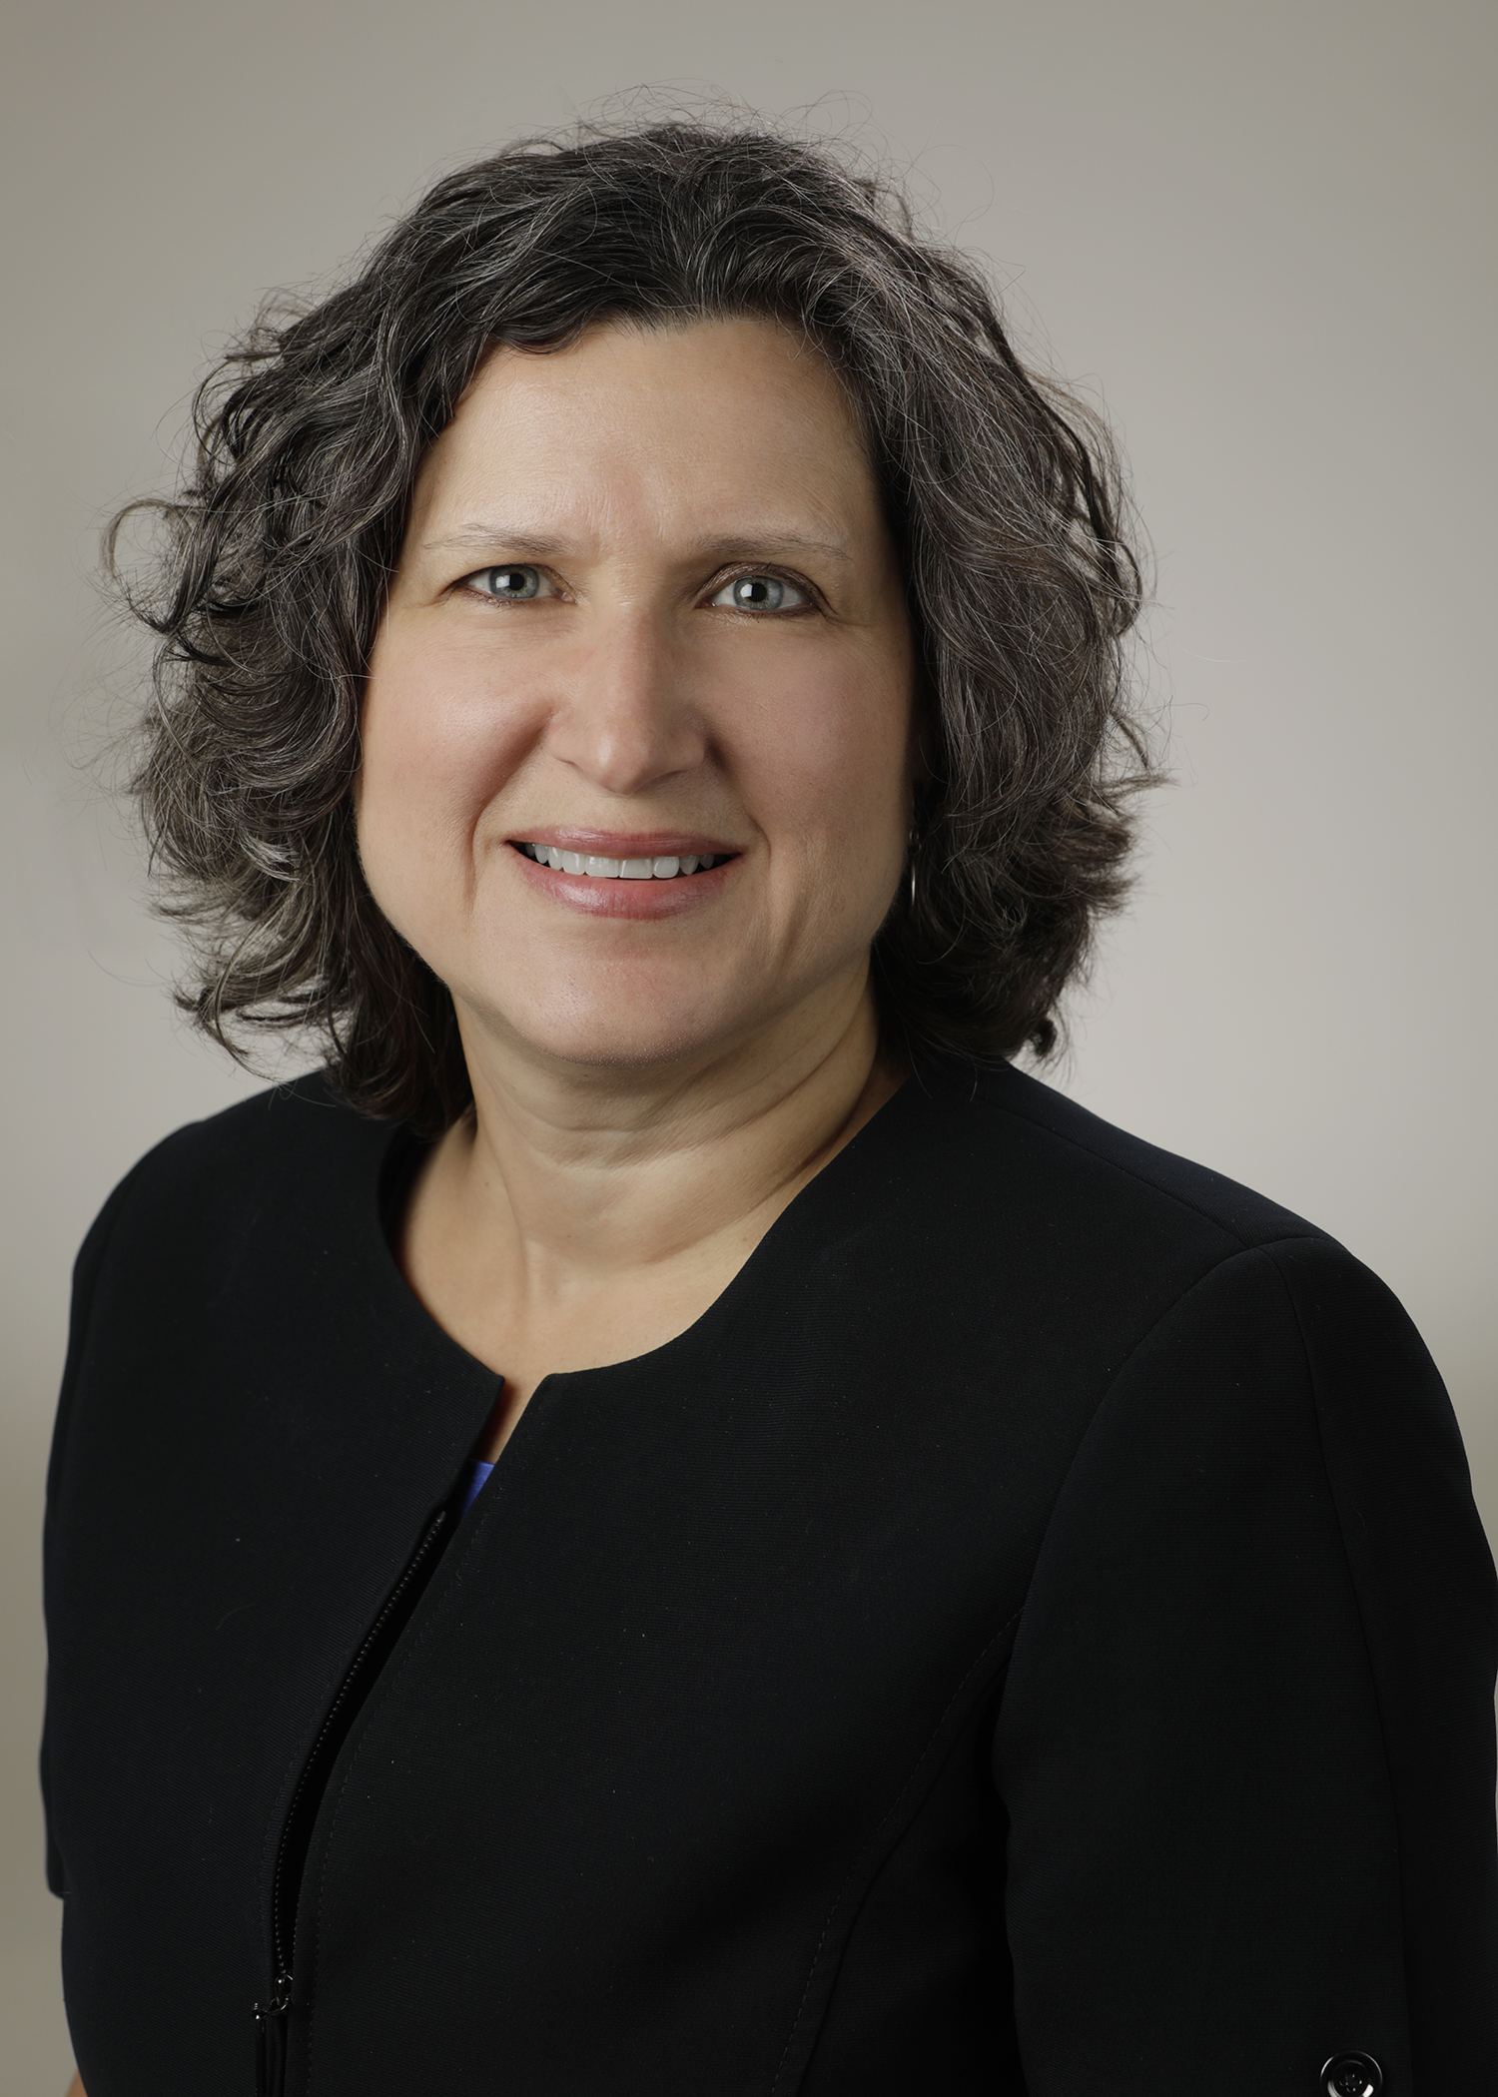
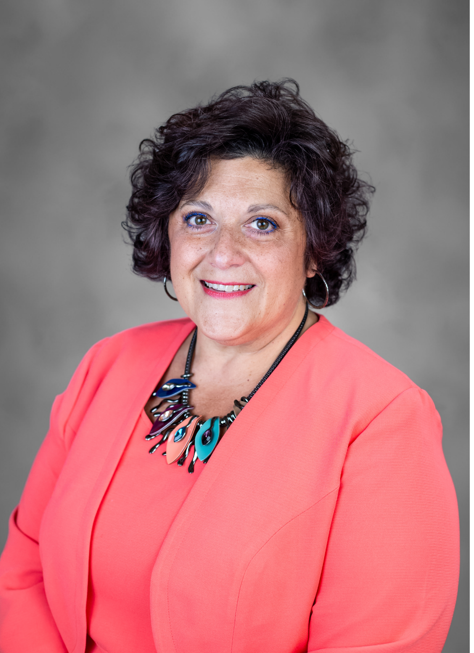
Introducing Your Presenters…
Heather Peters, M.Ed, Ph.D
GME Consultant
Carmela Meyer, MBA, Ed.D
GME Consultant
35 years of educational program design experience
Developed webinars and presentations on the Program Evaluation Committee (PEC)
Provided support to programs with accreditation concerns
25 years of experience in medical education.
Presented at national and regional conferences on subjects such as GME finance, CQI, and organizational development.
Taught quality improvement models in MBA, MSM and MSOD programs.

Slide 4
LEARNING OBJECTIVES
DISCUSS the role of the Program Evaluation Committee (PEC) in promoting continuous program improvement
OUTLINE the elements of quality action plans, including suggested quality measures and best practices for implementation
DISCOVER opportunities to engage your Patient Safety and Risk Management team
DISCUSS CQI Tools for GME
Tools:
SMART Goals Samples
Timetable for the Annual Program Evaluation (APE)
PowerPoint Templates for PEC Meetings
How to Leverage the PEC in 2022
APE section from Program Director’s Guide to the Common Program Requirements

Slide 5
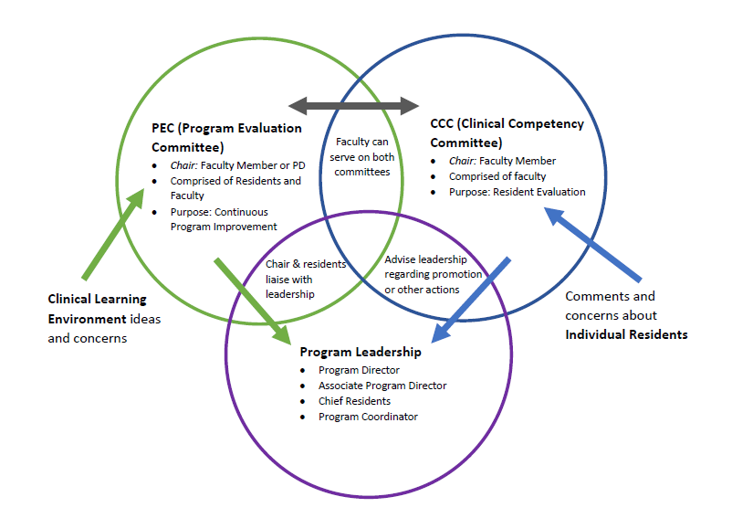
PROGRAM STRUCTURE

Slide 7
DMAIC Template for Change
Define
Measure
Analyze
Improve
Control
Define the problem by developing a “Problem Statement”
Map out current process or review current data
Ensure your data is reliable
Identify the cause of the problem
Select a solution to trial
Measure Improvement
Continue to monitor the change and continue to review data (measure) for a period of time after completion of project
Further Learning
Further Reading: DMAIC: The 5 Phases on Lean Six Sigma

Slide 8
Rotation/Service Presentations at PEC
Define
ACT
COLLECT DATA
PEC PRESENTATION BY ROTATION DIRECTOR
PEC PRESENTATION BY ROTATION DIRECTOR
COLLECT DATA
ACT

Slide 9
Rotation/Service Presentations at PEC
Measure
ACT
COLLECT DATA
Collecting Data:
End of rotation evaluations
Invite residents to PEC meeting
PEC PRESENTATION BY ROTATION DIRECTOR
PEC PRESENTATION BY ROTATION DIRECTOR
COLLECT DATA
ACT

Slide 10
Rotation/Service Presentations at PEC
Analyze
ACT
COLLECT DATA
Provide data to Rotation Director
Provide slide templates to Rotation Director
Invite residents who recently completed the rotation
Rotation Director should provide improvement items
PEC PRESENTATION BY ROTATION DIRECTOR
PEC PRESENTATION BY ROTATION DIRECTOR
COLLECT DATA
ACT

Slide 11
Rotation/Service Presentations at PEC
Improve
ACT
COLLECT DATA
Give time to implement improvement plans
Include the improvement items in follow-up reports
Possibly add the items to the end of rotation evaluations
PEC PRESENTATION BY ROTATION DIRECTOR
PEC PRESENTATION BY ROTATION DIRECTOR
Further Learning
COLLECT DATA
ACT

Slide 12
Standing Reports
Control
Add to PEC Standing Reports
Compliance trends
Review data on a regular basis (update goals to include intervals for reviewing data)

Slide 13
DO
Reminder about role of the PEC and PEC members’ expectations (add the slide to the template so you never forget)
If anyone gets out of hand, preempt quickly
Educate PEC members about their role and responsibilities
Follow up on APE action items as part of your standing PEC agenda
Have multiple residents on the PEC to give them a voice in program improvement (one or more per training year)
Invite representatives from the hospital to PEC meetings to discuss the issues

Slide 14
DO
This will allow the program to keep the action items from the APE in the forefront.
Each meeting some updates on the action plans can be provided.
This does not need to be a long part of the meeting.
Educate PEC members about their role and responsibities
Follow up on APE action items as part of your standing PEC agenda
Have lots of residents on the PEC to give them a voice in program improvement (one or more per training year)
Invite representatives from the hospital to PEC meetings to discuss the issues

Slide 15
DO
Educate PEC members about their role and responsibities
This is the place to have the discussions with those that represent the “other side” of the situation
Residents need to understand that their perspectives need to be tempered by the perspective of the other side of the situation.
Follow up on APE action items as part of your standing PEC agenda
Include as many of the residents on the PEC to give them a voice in program improvement (one or more per training year)
Invite representatives from the hospital to PEC meetings to discuss the issues

Slide 16
DO
More residents will provide a deeper level of resident perspective
At least one per training year and an alternate in case the resident off-site, on vacation or post-call
Invite residents who just completed the rotation on the agenda to be discussed
Open meetings for all residents, even those not selected to be voting members, are appreciated by the residents
Educate PEC members about their role and responsibities
Follow up on APE action items as part of your standing PEC agenda
Include as many of the residents on the PEC to give them a voice in program improvement (one or more per training year)
Invite representatives from the hospital to PEC meetings to discuss the issues

Slide 17
DON’T
Without an agenda, these meetings can devolve into whine sessions.
Conduct a PEC meeting without an agenda
Expect that all issues will be resolved in one PEC meeting – that’s the nature of change – it takes time
Require the PD to chair the PEC – this is a great opportunity to train a fledging leader

Slide 18
DON’T
Conduct a PEC meeting without an agenda
Chronic issues are difficult and complex. Accept that it will take more than one meeting to resolve these issues.
Expect that all issues will be resolved in one PEC meeting – that’s the nature of change – it takes time
Require the PD to chair the PEC – this is a great opportunity to train a fledging leader

Slide 19
DON’T
Conduct a PEC meeting without an agenda
Expect that all issues will be resolved in one PEC meeting – that’s the nature of change – it takes time
Succession planning is essential to the continued health of a program
Require the PD to chair the PEC – this is a great opportunity to train a fledging leader

Slide 20
Data-driven Decision Making
Benefits:
promotes continuous growth/development
increase knowledge and innovation
enhances communication
provides potential opportunities not visible otherwise
guards against unconscious bias
facilitates identifying trends and patterns
facilitates establishing measurable goals

Slide 21
Improve
Get SMART about goals
S
M
A
R
T
Specific | Measurable | Attainable | Relevant | Time-bound
Goals should be focused and identify a tangible outcome. It is difficult to assess success if goals are vague. Be clear about what you want to achieve. Identify resources that will be leveraged. | Include a definition of what success will look like. This enables evaluation of achievement. Answer the questions “how much” or “how many.” Again, be specific about your measurement (increase by 10% over last year) | Goals should be challenging, but attainable. Also, identify barriers that need to be addressed. Outline steps to achieve your goal. | Is the intended goal what you really want and is it relevant to your organization? Does the goal align with your mission and priorities. Answers the question of why. | What time frame will you achieve your goal? Answers the question when. Be sure to be realistic about the time frame.

Slide 22
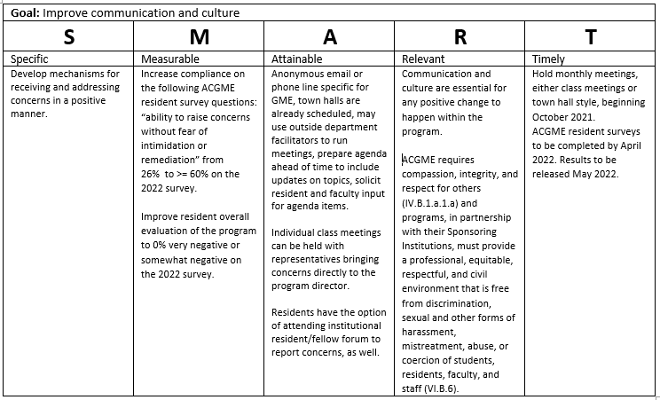
Example
Improve

Slide 23
SMART Goal
Improve
Improve the culture of the Family Medicine Residency program by developing a mechanism of communication to receive concerns in a positive manner. The process developed by the PEC will be in place and communicated to residents and faculty by April 30, 2022.

Slide 24
Action Plans
Improve
Goal | Action Items | Responsible Person | Due Date | Resources needed | Evaluation
Improve the culture of the Family Medicine Residency program by developing a mechanism of communication to receive concerns in a positive manner. The process developed by the PEC will be in place and communicated to residents and faculty by April 30, 2022. | PEC recommends mechanism for receiving concerns in a positive manner. Hold monthly class meetings with outside facilitator. PD approves process. PD educates residents and faculty. Residency Coordinator will develop process tracking usage and maintain anonymity. | PEC: Develop process. Program Director: Educate residents and faculty. Program Coordinator: track/analyze data. develop/track attestation form. Ensure anonymity. Plan monthly class meetings. | PEC finalize process: 3/30/2022 Class meetings to start 1/1/2022 Resident training at April house staff meeting: 4/15/2022 Faculty training at faculty meeting: 4/25/2022 Project completion: 4/30/2022 | Time on each calendar PEC Committee House staff meeting Faculty meeting Attestation of information form | Receive >80% satisfaction on a question regarding ability to report concerns anonymously added to program evaluation. Increase 2022 ACGME survey results for “ability to raise concerns without fear of intimidation or remediation” from 26% to >/= 60%. Improve resident overall evaluation of the program to 0% very negative or somewhat negative on the 2022 ACGME survey. 95% compliance on signed attestation. > than 80% satisfaction of residents regarding class meetings on a resident survey in RMS.

Slide 25
Do…Don’t
Improve
DO be transparent: Educate ALL stakeholders and elicit support…executive leaders, nursing, outside preceptors
DO follow up on action items
DON’T underestimate the resources needed and challenges that will be faced
DON’T worry about change…you may need to adjust the plans.

Slide 26
Patient Safety and Risk Management
- the QI specialists
“A cornerstone of the discipline is continuous improvement based on learning from errors and adverse events. Patient safety is fundamental to delivering quality essential health services.”
Having them teach the residents about hospital metrics better prepares your residents for the health care system they will work in.
Ties to the organization help to garner executive leadership support - speak their language.

Slide 27
Invite to the PEC
establish metrics
engage with the GME program
align GME goals with organizational priorities
promote GME activities throughout the organization
assist trainees with QI projects

Slide 28
Trainee QI Projects
PS/RM mentor for trainee QI projects can facilitate data collection.
PS/RM can assist trainees with question development to ensure the project isn’t too broad for appropriate analysis.
Relieves some of the responsibility of the PD while maintaining oversight.
Provides trainees with a different perspective and facilitates understanding of hospital administration.

Slide 29
Annual Program Evaluation
Curriculum
Outcomes from previous APE
ACGME letters of notification, citations, AFIs
Quality and safety of patient care
Aggregate trainee and faculty:
well-being
recruitment & retention
workforce diversity
engagement in QI and PS
scholarly activity
ACGME trainee and faculty surveys
written evaluations of the program
Aggregate trainee:
achievement of the Milestones
in-training exams
board pass and certification rates
graduate performance
Aggregate faculty:
evaluation
professional development
Conduct SWOT Analysis
Review Mission Statement
Review Progress/Data on Aim Statements
Further Learning

Slide 30
CQI for GME &
Resources
5 Ways to Leverage your PEC in 2022
SMART Goal Samples
Sample APE Timetable for the PEC
Sample PEC Slide Sets
SMART Goal Samples
Program Director’s Guide to the Common Program Requirements (ACGME.org) The Program Directors’ Guide to the Common Program Requirements (Residency) E-Book - E-Book | Accreditation Council for Graduate Medical Education (acgme.org)
Caniano, D, Martinez, S., Nace, C., & Hogan, S. (2021). Reasons for data-prompted site visits: Field staff findings and review committee decisions. J. Grad Med Educ 13(3), 447-454. Doi: 10.4300/JGME-D-21-00435.1
Accreditation Council for Graduate Medical Education. (2022). ACGME institutional requirements. Available at acgme.org.
Calzon, Bernardita. (November 24, 2021) Datapine. A Complete Guide to Data Driven Decision-making. https://www.datapine.com/blog/data-driven-decision-making-in-businesses/#importance
World Health Organization. (September 2019). Health Topics, Patient Safety. https://www.who.int/news-room/fact-sheets/detail/patient-safety

Slide 31
Closing
PEC’s main goal is to promote continuous program improvement
It will take multiple meetings to meet the updated expectations discussed in the 2019 requirements
Data Driven Decision-making follows premises of EBM.
Leveraging resources in PS/RM can benefit the QI efforts of the program.

Slide 32
Upcoming Live Webinar
Digging for Data IV
Tuesday, January 18, 2022
Back to Basics – GME for New Coordinators
Tuesday, February 8, 2022
Leveraging RMS Technology for the Medicare Cost Report
Thursday, February 17, 2022
The ABCs of GMEC: Part II
Thursday, March 10, 2022
Latest On-Demand Webinars
Meet the Experts – Fall Freebie
A Successful Coordinator? You Must Be C-C-Crazy!
Planning and Tracking Scholarly Activity
GME Financing: The Basics, the Strategies, and the Upcoming Changes
The Role of Coaching
Resident Wellness in the Virtual World
A Day in the Life of A DIO
Site Visits – What to Expect in 2021
ADS Update 2021
GME Grants and Funding Sources
Survey Research
Impactful AIR & APE – Bridging Data & Action
Faculty Development Series
15 Minutes to Effective Feedback
Toolbox for Teaching Millennials
Taking Supervision to the Next Level
Contact us today to learn how our Educational
Passports can save you time & money!
724-864-7320
www.PartnersInMedEd.com
Presented by Partners in Medical Education, Inc. 2022
32

Slide 33
Partners in Medical Education, Inc. provides comprehensive consulting services to the GME community.
Partners in Medical Education
724-864-7320 | info@PartnersInMedEd.com
Heather Peters, M.Ed. Ph.D.
Heather@PartnersInMedEd.com
And
Carmela Meyer, MBA, Ed.D
Carmela@PartnersInMedEd.com
www.PartnersInMedEd.com

