Slide 1
Please Note…
Please make sure your Start Video is OFF when logging into the WebEx platform.
Here is what it should look like
ALSO
It is NORMAL to not hear any sound until the webinar starts at 12:00 noon EST.
Your phone line is muted, but you can always chat to the host, BJ Schwartz, if you have any questions or concerns during this time.

Slide 2
Getting to the Next Stage: Program Improvement II
Carmela Meyer, MBA, EdD – GME Consultant
Heather Peters, MEd, PhD – GME Consultant

Slide 3
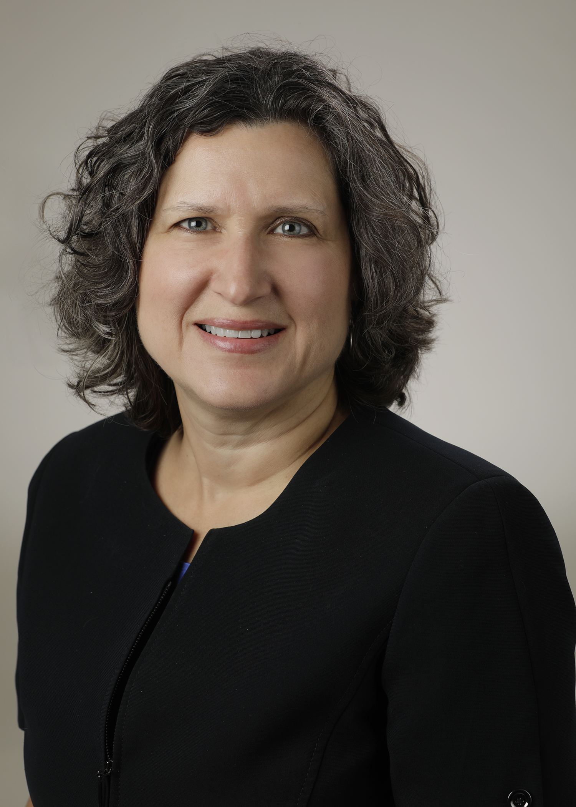
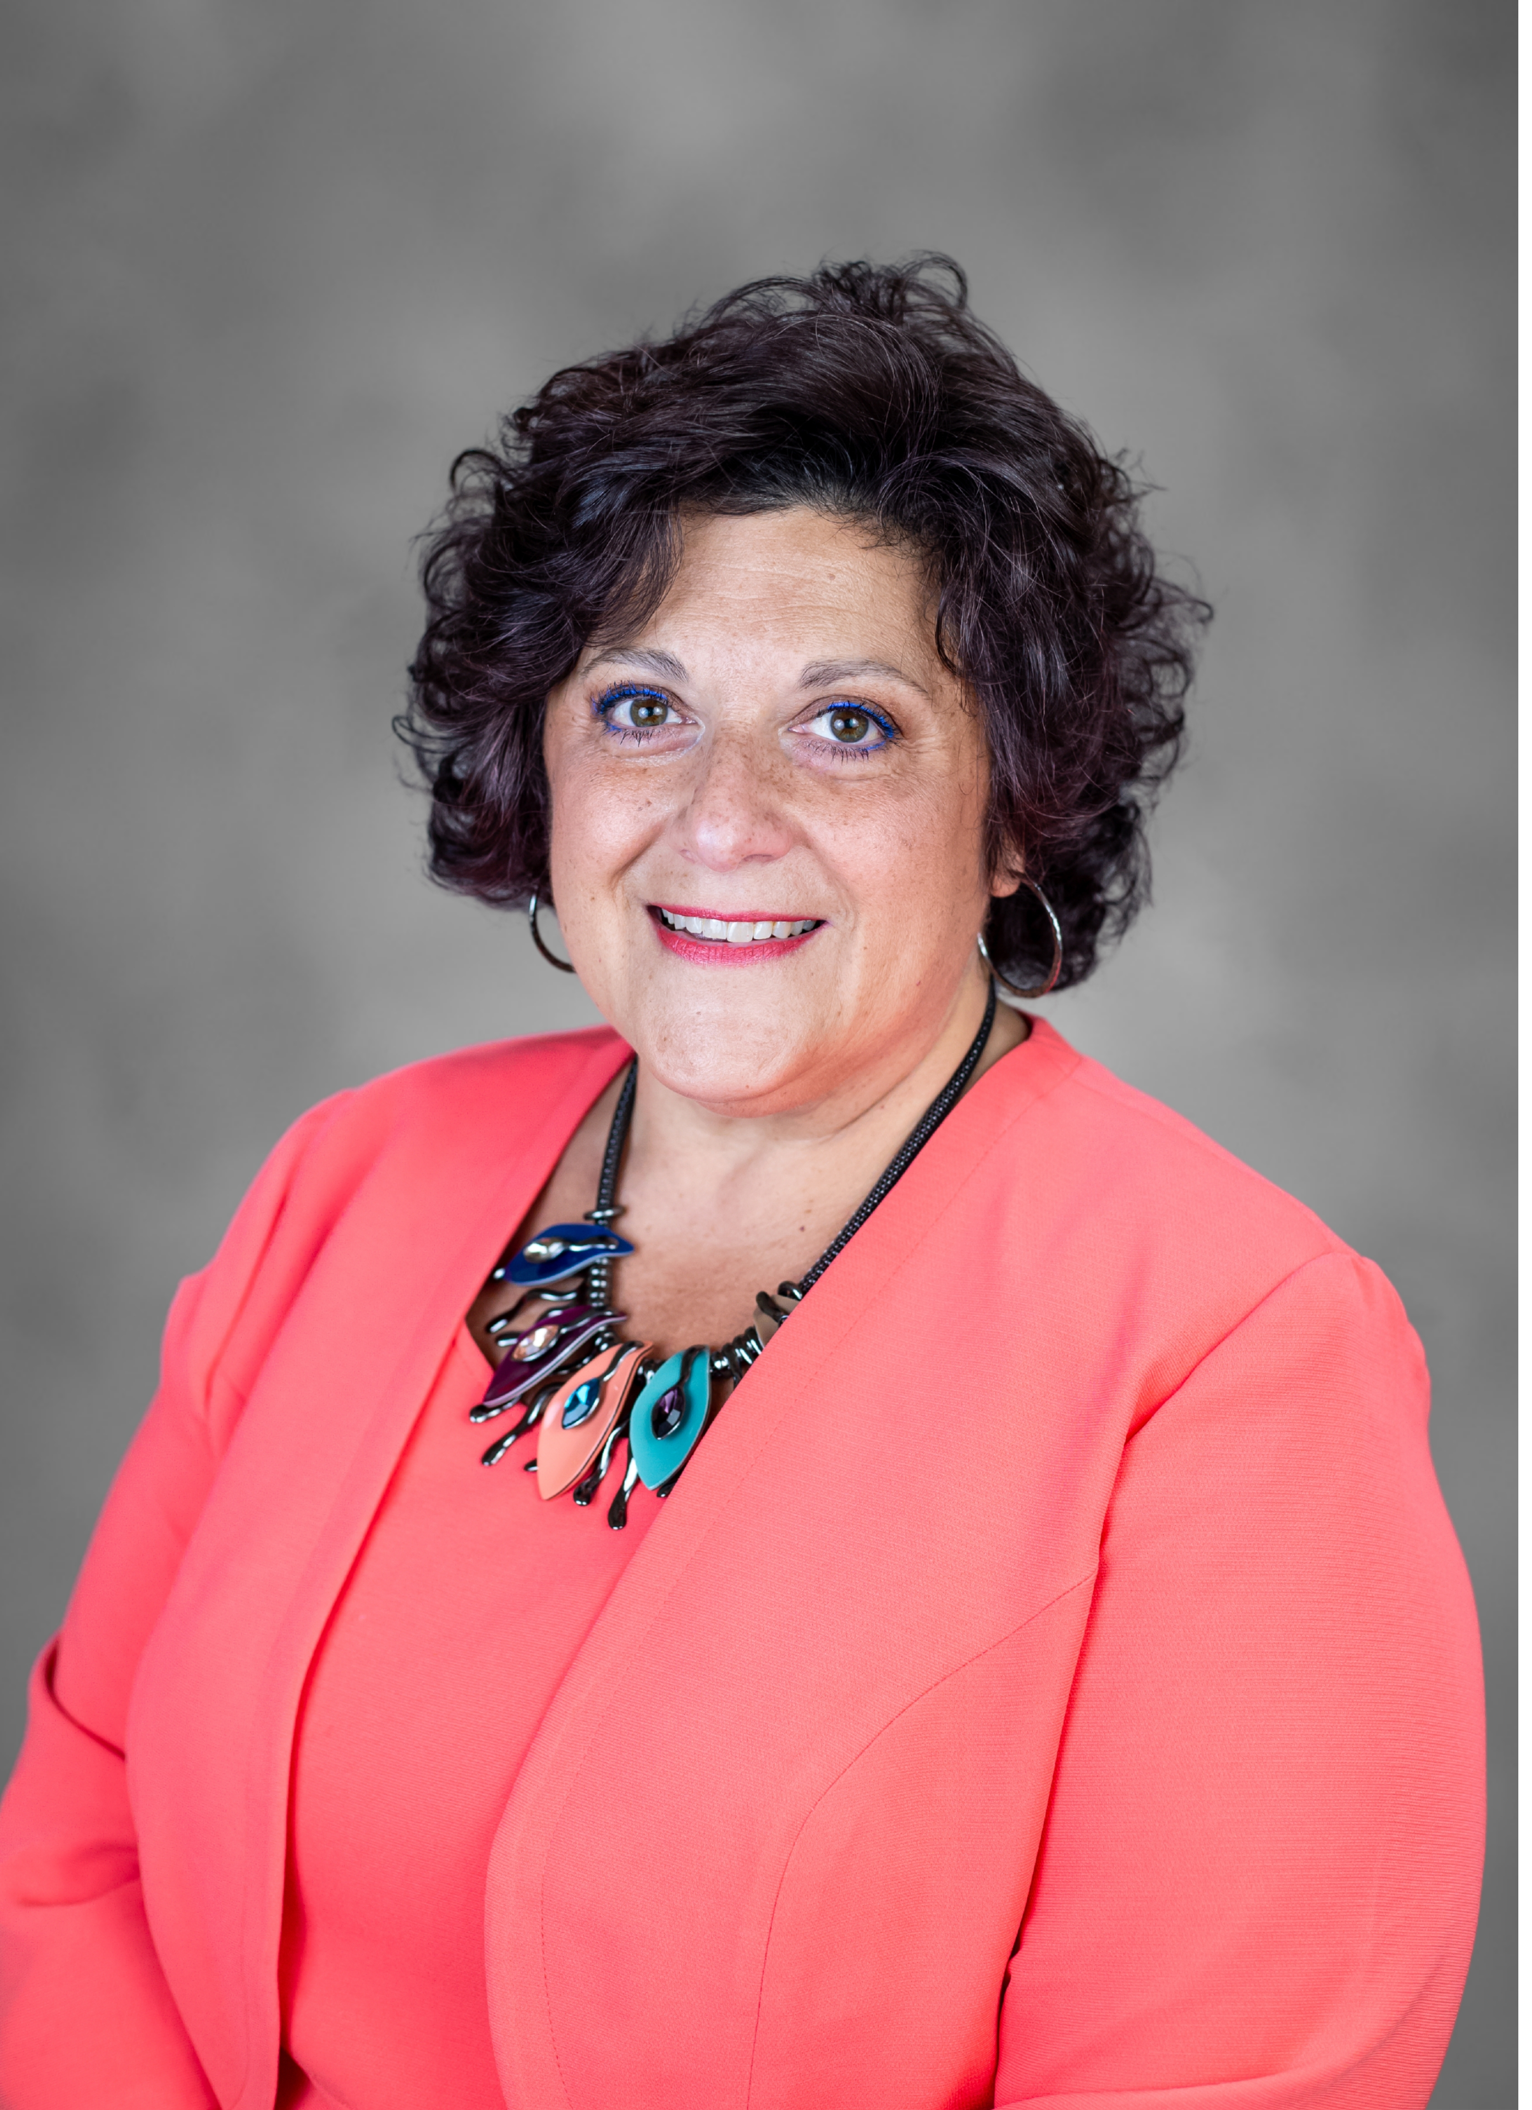
Introducing Your Presenters…
Heather Peters, M.Ed, Ph.D
GME Consultant
Carmela Meyer, MBA, Ed.D
GME Consultant
35 years of educational program design experience
Developed webinars and presentations on the Program Evaluation Committee (PEC)
Provided support to programs with accreditation concerns in the area of continuous improvement
25 years of experience in medical education.
Presented at national and regional conferences on subjects such as GME finance, CQI, and organizational development.
Taught quality improvement models in MBA, MSM and MSOD programs.

Slide 4
LEARNING OBJECTIVES
REVIEW data-driven decision-making process with an actual GME situation
DISCUSS how to leverage stakeholders support to further continuous program improvement (CPI)
ANALYZE current institutional initiatives to maximize their impact on continuous program improvement (CPI)
REVISIT the role of the Program Evaluation Committee (PEC) and delve into how to resolve “thorny issues” in GME programs
Tools:
Data-driven Decision-Making in GME
PEC Responsibilities – 2022 Update
Rotation/Service Discussion – sample agenda

Slide 5
TEMPLATE FOR CHANGE
05
CONTROL:
Continue to monitor the change and continue to review data (measure) for a period of time after completion of project
04
IMPROVE:
Select a solution to trial
Measure Improvement
03
ANALYZE:
Identify the cause(s) of the problem
.
02
MEASURE:
Map out current process or review current data
Ensure your data is reliable
01
DEFINE: Define the problem by developing a “Problem Statement”

Slide 6
Case Discussion
Background: Internal Medicine on “Continued Accreditation with Warning” for ICU supervision concerns
Situation: Residents have noted that they are completing more weeks of Critical Care Medicine than allowed by requirements (24 weeks/6 blocks)

Slide 7
Define
Define
Define the problem by developing a “Problem Statement”
The residents believe they have maximized the number of weeks allowed for critical care medicine because their night float in years 2 and 3 have been majority ICU patient care (<75%)

Slide 8
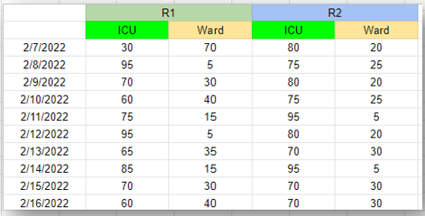
Measure
Measure
Map out current process or review current data
Ensure your data is reliable
Current process: PGY-2s and PGY-3s are assigned “night float.” The residents are stationed in the ICU. The residents are required to provide care to ICU patients.
Data Sampling: 2 weeks of night float data. Each morning they were asked the percentage of ICU and wards patients.

Slide 9
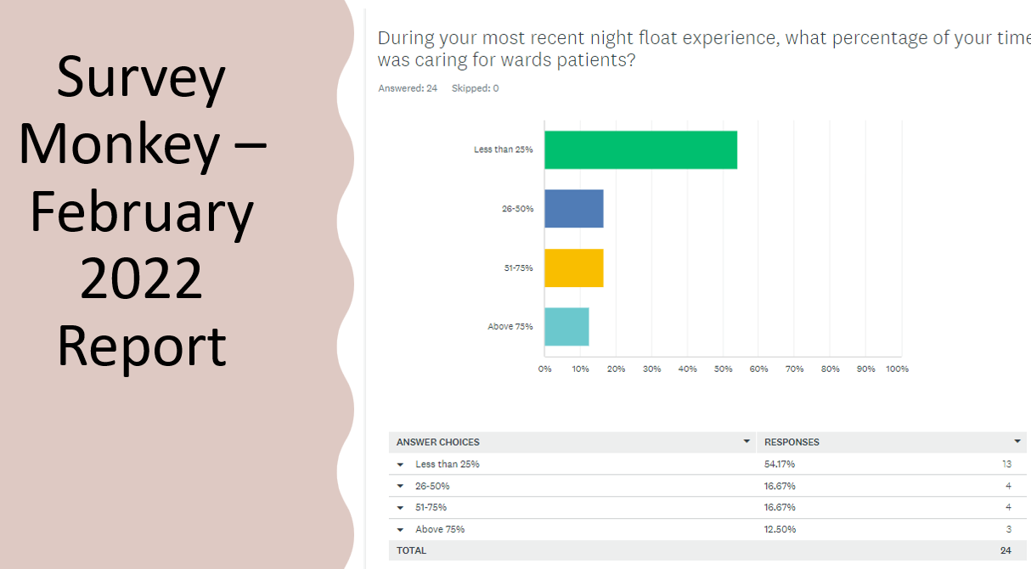
Verification of Data: Survey Monkey Survey
New information: PGY-1s are responsible for wards patients.

Slide 10
Analyze
Analyze
Identify the cause(s) of the problem
Why do they complete so much CCM in this program?
Not aware of the requirements
Lack of understanding about night float with too much focus on CCM
“Night float” is too easily mismanaged due to lack of specificity of rotation title
Residents have misunderstanding of the role of an internal medicine resident vs CCM fellowship

Slide 11
Improve
Improve
Select a solution to trial
Measure Improvement
Solution: Audit PGY-2s and PGY-3s via scheduling program (AMION) and add night float to CCM weeks.
1st Audit:
PGY-3s had 33-36 weeks of CCM
PGY-2s had 26-28 weeks of CCM
2nd Audit: Excluded “Emergent Declaration” time periods from residents who were on ICU or had night float at that time
3rd Audit: Chief residents conducted audit to verify initial audit

Slide 12
Leveraging Stakeholders in a Community-based Institution (CBI)
Prepare the way -- Bring the leadership in as soon as you have an inkling of an issue
Tie it back to institutional initiatives
Schedule formal meetings between GME leadership and institutional leadership
CLER is a good way to start these discussions, but its essential to continue them
Involve department chairs/chiefs
Develop advocates in the leadership – you will need them sooner or later
Further Reading: Manage Up!

Slide 13
Control
Control
Continue to monitor the change and continue to review data (measure) for a period of time after completion of project
Future
Steps
Defining night assignments by area (i.e., ICU Nights and Wards Nights) on the 22-23 block diagram
Rotation/Service evaluations to ensure there is no mixing of patient care types at night
Audit number of CCM weeks at each semi-annual evaluation (Road Map for Internal Medicine).

Slide 14
Data-driven Decision-Making
Tool: Data-driven Decision-Making Cycle
Benefits:
promotes continuous growth/development
increase knowledge and innovation
enhances communication
provides potential opportunities not visible otherwise
guards against unconscious bias
facilitates identifying trends and patterns
facilitates establishing measurable goals

Slide 15
Maximizing Institutional Initiatives for Program Improvement
Strategic Planning
GME Strategic Planning
AIR
Use Common Language
CLER
Adding Value
Get a “seat at the table”
Have hospital leadership at “your table”
Discuss alignment with institutional initiatives
Make all trainees, faculty and administrative staff aware of institutional initiatives
Focus of site visit is alignment of institutional initiatives
Implementing institutional initiatives is a way that C-suite will see benefit

Slide 16
Role of the PEC
Continuous Program Improvement
Resident/Fellow voice
Rotation Evaluations
Program Evaluations
Work hour concerns
Evaluation Compliance
Tool: PEC Responsibilities - 2022

Slide 17
Rotation = Core Educational Unit
How do you ensure quality?
How do you validate that quality annually?
How do you know when there are issues with a particular rotation in a timely manner?
How can you compare all your rotations across a program?

Slide 18
Rotation/Service Presentations at PEC
ACT
COLLECT DATA
PEC PRESENTATION BY ROTATION DIRECTOR
PEC PRESENTATION BY ROTATION DIRECTOR
COLLECT DATA
ACT
Service Agenda sample

Slide 19
Closing
Change is a constant in GME
It’s necessary to have a process for dealing with change
Maximize the PEC role for program improvement
Build relationship(s) before the change is needed

Slide 20
Resources
Program Improvement - Part I
5 Ways to Leverage your PEC in 2022
SMART Goal Samples
Sample APE Timetable for the PEC
Sample PEC Slide Sets
SMART Goal Samples
Program Director’s Guide to the Common Program Requirements (ACGME.org) The Program Directors’ Guide to the Common Program Requirements (Residency) E-Book - E-Book | Accreditation Council for Graduate Medical Education (acgme.org)
Program Improvement - Part II
GME Data-Driven Decision-Making
PEC Responsibilities – 2022
Sample Agenda – Service/Rotation Meeting
Caniano, D, Martinez, S., Nace, C., & Hogan, S. (2021). Reasons for data-prompted site visits: Field staff findings and review committee decisions. J. Grad Med Educ 13(3), 447-454. Doi: 10.4300/JGME-D-21-00435.1
Accreditation Council for Graduate Medical Education. (2022). ACGME institutional requirements. Available at acgme.org.
Calzon, Bernardita. (November 24, 2021) Datapine. A Complete Guide to Data Driven Decision-making. https://www.datapine.com/blog/data-driven-decision-making-in-businesses/#importance
World Health Organization. (September 2019). Health Topics, Patient Safety. https://www.who.int/news-room/fact-sheets/detail/patient-safety

Slide 21
Upcoming Live Webinar
Ask Partners – Spring Freebie
Tuesday, April 12, 2022
ADS 2022: Part I
Thursday, April 28, 2022
The ABCs of GMEC: Part II
Thursday, May 19, 2022
Here We Grow Again – And With Our Community
Tuesday, May 24, 2022
ACGME Complaint Letter: Now What?
Thursday, June 9, 2022
JEDI Warriors in GME: Guardians of Justice, Equity, Diversity, and Inclusion
Thursday, June 23, 2022
Latest On-Demand Webinars
Moral Injury in Healthcare
Streamlining Your Special Review
Getting to the Next Stage - Program Improvement I
Digging for Data IV
Back to Basics – GME for New Coordinators
Leveraging RMS Technology for the Medicare Cost Report
Meet the Experts – Fall Freebie
A Successful Coordinator? You Must Be C-C-Crazy!
Planning and Tracking Scholarly Activity
GME Financing: The Basics, the Strategies, and the Upcoming Changes
The Role of Coaching
Faculty Development Series
15 Minutes to Effective Feedback
Toolbox for Teaching Millennials
Taking Supervision to the Next Level
Contact us today to learn how our Educational
Passports can save you time & money!
724-864-7320
www.PartnersInMedEd.com
Presented by Partners in Medical Education, Inc. 2022
21

Slide 22
Partners in Medical Education, Inc. provides comprehensive consulting services to the GME community.
Partners in Medical Education
724-864-7320 | info@PartnersInMedEd.com
Carmela Meyer, MBA, Ed.D
Carmela@partnersinmeded.com
Heather Peters, M.Ed., Ph.D
Heather@partnersinmeded.com
www.PartnersInMedEd.com

