Slide 1
Please Note…
Please make sure your Start Video is OFF when logging into the WebEx platform.
Here is what it should look like
ALSO
It is NORMAL to not hear any sound until the webinar starts at 12:00 noon EST.
Your phone line is muted, but you can always chat to the host, BJ Schwartz, if you have any questions or concerns during this time.

Slide 2
GME Program Design Part I
Heather Peters, M.Ed, Ph.D
Carmela Meyer, MBA, Ed.D

Slide 3
Learning Objectives
After the webinar, the participants will be able to:
ARTICULATE the building blocks of GME program design
DESCRIBE the components of a block diagram
CREATE curriculum goals & objectives for any rotation/experience that incorporate milestones and procedures
DEVELOP evaluations that align with curriculum and inform the CCC
Tools:
ACGME Block Diagram Instructions
Template: Curriculum Goals & Objectives – Partners ®
Template: Evaluations that Align with Goals & Objectives – Partners ®

Slide 4
Building Blocks for GME Programs
Professional Development
Evaluations
Curriculum
Program Design (Block Diagram)
Mission & Aims

Slide 5
360-Degree View of “Curriculum”
Block Diagram
Scholarly
Activity
Competency-Based Goals & Objectives/Aligned Evaluations
Didactics
Rotations (CLE)
Presented by Partners in Medical Education, Inc. 2022

Slide 6
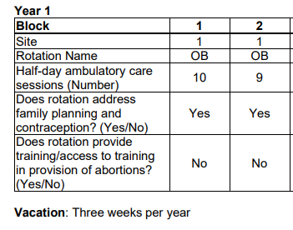
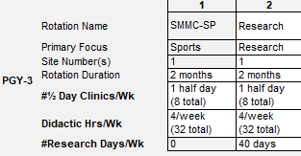
Block Diagram
Specialty Requirements
Review your specialty requirements – many revisions are in place as of July 2022!
Templates/Instructions
ACGME provides instructions for Block Diagrams (link on sites page)
RC's starting to incorporate required templates
Orthopedic Surgery, OBGYN, and TY

Slide 7
Block Diagram
Block Diagram = Design of the Program - grouping
Do not include vacation as a block
Include notes for further clarification
Vacation – what rotations
Longitudinal Experiences - clinic

Slide 8
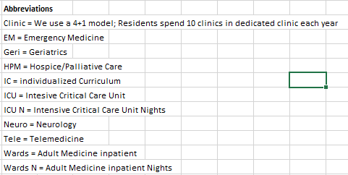
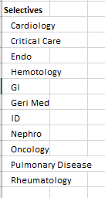
Abbreviations and Selectives
Include all abbreviations used
Include all selectives that are available in your program.
Do not include selectives that are not available
Ensure you have all required rotations (requirements)
Don't use Abbreviations in selectives (best practice)

Slide 9
Rotation Goals and Objectives – Key Components
Key items for every rotation goals and objectives document:
1. Name of rotation
2. Rotation Director
3. Location
4. Length/duration
5. Training Year
Competency-based goals and objectives
Preferred: Each competency has their own objectives using milestone sub-competency language
Non-standard: each objective has competencies noted after the objective
Reference to milestones, if not incorporated into objectives
Evaluation Methods
Procedures expected during this rotation
Teaching Methods
First day information
Competency-Based Goals & Objectives
Template: Goals & Objectives – Partners®
Presented by Partners in Medical Education, Inc. 2022

Slide 10
Purpose of Milestones
A
B
C
D
E
Articulate shared understanding of expectations
Describe a trajectory -- beginner to exceptional resident or practitioner
Organized under six domains of clinical competency
Represent a subset of all
sub-
competencies
Set aspirational goals of excellence
Source: Yangmour N. Coordinator Role in Assessment and Milestones. ACGME. July 2018.
Presented by Partners in Medical Education, Inc. 2022
10

Slide 11
Sub-competency
PC1. History (Appropriate for age and impairment)
Level 1 | Level 2 | Level 3 | Level 4 | Level 5
Acquires a general medical history | Acquires a basic physiatric history including medical, functional, and psychosocial elements | Acquires a comprehensive physiatric history integrating medical, functional, and psychosocial elements Seeks and obtains data from secondary sources when needed | Efficiently acquires and presents a relevant history in a prioritized and hypothesis driven fashion across a wide spectrum of pages and impairments Elicits subtleties and information that may not be readily volunteered by the patient | Gathers and synthesizes information in a highly efficient manner Rapidly focuses on presenting problem, and elicits key information in a prioritized fashion Models the gathering of subtle and difficult information from the patient
General Competency
Developmental Progression or Set of Milestones
Milestone
Presented by Partners in Medical Education, Inc. 2022
11
Notes:
To begin with, let’s identify all the parts of the milestone system.

Slide 12
Dreyfus & Dreyfus Model
Novice
Advanced Beginner
Competent
Proficient
Expert
Dreyfus, S.E. (2004). The five-stage model of adult skill acquisition. Bulletin of Science, Technology & Society, 24(3), 177-181, doi: 10.1177/0270467604264992
Presented by Partners in Medical Education, Inc. 2022

Slide 13
Dreyfus & Dreyfus Development Model
Expert/
Master
Proficient
Competent
Advanced Beginner
Novice
In reality, this is how a resident grows and improves during residency…
Presented by Partners in Medical Education, Inc. 2022
13

Slide 14
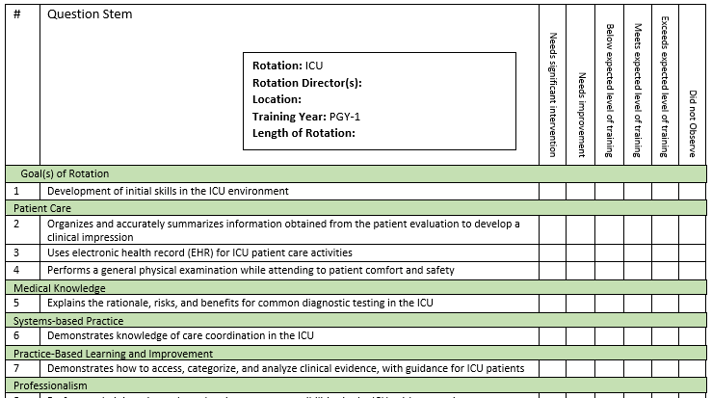
Evaluations to Align with Rotation Goals & Objectives
Presented by Partners in Medical Education, Inc. 2022

Slide 15
Rotations (CLE)
Supervision: Consider the different environments in your supervision policy
Procedural competence: How will track and manage this data?
Promotion criteria: Progressive responsibility for patient management happens in situ
Key Point:
Rotations are the core element of graduate medical education
Presented by Partners in Medical Education, Inc. 2022

Slide 16
Elements to keep in mind regarding your didactics program:
The requirement is not very explicit
The quality of didactics is something that should be asked about on your program’s annual evaluation of both trainees and faculty
It must be “protected time”
Focus on adult learning principles – case-based discussion
Didactics
IV.A.3.
Regularly scheduled didactic sessions
Presented by Partners in Medical Education, Inc. 2022

Slide 17
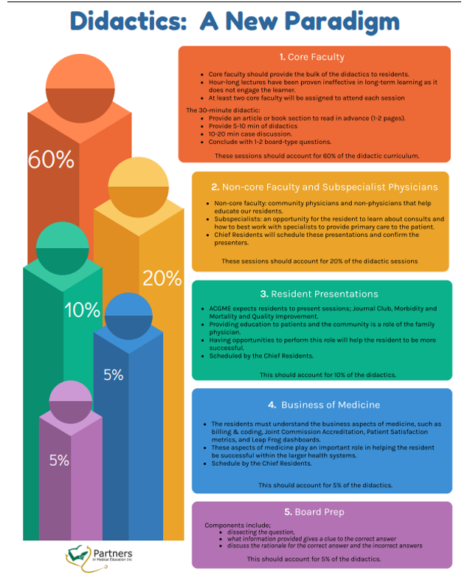
One Model
Presented by Partners in Medical Education, Inc. 2022

Slide 18
IV.B.1. The curriculum must advance residents’ knowledge of the basic principles of research, including how research in conducted, evaluated, explained to patients, and applied to patient care.
Scholarly Activity
IV.B.2. Residents should participate in scholarly activity.
Key Points:
Proxy for quality in the eyes of the ACGME
Most common citation is for “lack of scholarly activity”
This responsibility is shared by the sponsoring institution as research needs an infrastructure – often you see multiple programs receive the same citation
IV.B.3. The sponsoring institution and program should allocate adequate educational resources to facilitate resident involvement in scholarly activities.
Presented by Partners in Medical Education, Inc. 2022

Slide 19
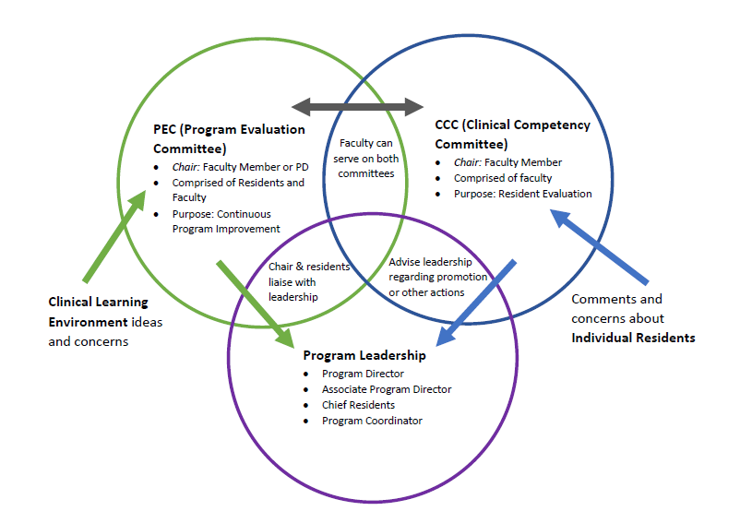
NEXT TIME PROGRAM STRUCTURE TO EFFECTIVELY IMPLEMENT AND MONITOR CURRICULUM
Presented by Partners in Medical Education, Inc. 2022

Slide 20
Questions?
Presented by Partners in Medical Education, Inc. 2022

Slide 21
References
Dreyfus, S.E. (2004). The five-stage model of adult skill acquisition. Bulletin of Science, Technology & Society, 24(3), 177-181, doi: 10.1177/0270467604264992
Ericsson KA. Deliberate practice and the acquisition and maintenance of expert performance in medicine and related domains. Acad Med 2004;79.
Sandhu, Magas et al. Progressive entrustment to achieve autonomy in the operating room: a national qualitative study with general surgery faculty and residents. Annals Surg. 265(6): June 2017.
Yangmour N. Coordinator Role in Assessment and Milestones. ACGME. July 2018.

Slide 22
Upcoming Live Webinar
Back to Basics: Intermediate Topics for New Coordinators
Thursday, September 29, 2022
Sponsoring Institution 2025: 2022 Check-up
Thursday, October 6, 2022
Site Visit Are Coming!
Thursday, October 20, 2022
GME Educational Program Design II
Thursday, November 3, 2022
Lights, Camera…Zoom!
Thursday, November 17, 2022
Meet the Experts – Fall Freebie
Tuesday, November 29, 2022
Latest On-Demand Webinars
ACGME Complaint Letter: Now What?
Here We Grow Again – And With Our Community
The ABCs of GMEC: Part II
ADS 2022: Part I
Ask Partners – Spring Freebie
Getting to the Next Stage – Program Improvement II
The ABCs of GMEC: Part I
Leveraging RMS Technology for the Medicare Cost Report
Back to Basics – GME for New Coordinators
Digging for Data IV
Getting to the Next Stage - Program Improvement I
Faculty Development Series
15 Minutes to Effective Feedback
Toolbox for Teaching Millennials
Taking Supervision to the Next Level
Contact us today to learn how our Educational
Passports can save you time & money!
724-864-7320
www.PartnersInMedEd.com
Presented by Partners in Medical Education, Inc. 2022
22

Slide 23
Partners in Medical Education, Inc. provides comprehensive consulting services to the GME community.
Partners in Medical Education
724-864-7320 | info@PartnersInMedEd.com
Carmela Meyer, MBA, EdD
Carmela@PartnersInMedEd.com
Heather Peters, M.Ed., PhD
Heather@PartnersInMedEd.com
www.PartnersInMedEd.com

