Slide 1
Please Note…
Please make sure your Start Video is OFF when logging into the WebEx platform.
Here is what it should look like
ALSO
It is NORMAL to not hear any sound until the webinar starts at 12:00 noon EST.
Your phone line is muted, but you can always chat to the host, BJ Couch, if you have any questions or concerns during this time.

Slide 2
GME Grants and Funding Sources
Grace Brannan, PhD
Christine Redovan, MBA, MLIS

Slide 3
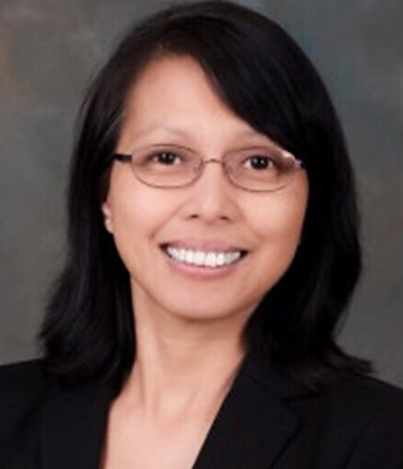
Introducing Your Presenter(s)…
Grace Brannan, PhD GME QI and Research Consultant Partners Consulting Member
15 years in GME Research and QI Leadership and 3 decades in population-based research.
Seasoned in setting QI and Research Strategy.
ACGME success in QI and scholarly requirements for multiple residencies.
Experienced in making research doable and feasible.
Focused on high value care, patient safety, embedding GME scholarly activities in hospital initiatives.

Slide 4
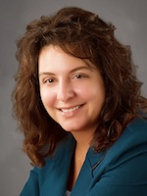
Introducing Your Presenter(s)…
Christine Redovan, MBA, MLIS
GME Consultant
Seasoned Director of Medical Education and GME Operations
Accreditation and Management Expert For New and Established Institutions and Programs
ACGME-I Accreditation Expert
Successful GME Start-Up Implementation
Focused on Continuous Accreditation Readiness. Data Mining, and Useful GME Resources
20+ years GME experience

Slide 5
Goals
Discuss the grants process
Explain the importance of grants for scholarly activity
Identify GME grants and funding sources

Slide 6
ACGME Requirements
Scholarship
Community Needs Assessment

Slide 7
Types of Grants
Sources
External
Federal
Non-Federal (private/public)
Internal
Hospital/Institution
Topic
Research
Programmatic
This Photo by Unknown Author is licensed under CC BY
https://www.grants.gov/learn-grants/grant-programs.html

Slide 8
How Do you Find Grants?
Work with institution/medical school
Grant databases
Search engine
Direct contact
Newsletters
This Photo by Unknown Author is licensed under CC BY-NC-ND

Slide 9
Grant Database Examples
Paid Services
Free Services
Candid*
GrantStation
Instrumentl
GrantForward
Grants.gov
Search engines
Accessible foundations, societies and other organizations
* Free through over 400 public libraries across the US.

Slide 10
Let’s visit grants.gov

Slide 11
Let’s visit the Gold Foundation

Slide 12
Choosing a database
Where is your focus?
Specific or All
2. What information do you want?
Opportunities/Open funding
Grantmaker
Information only or whole kit and kaboodle
3. Budget
4. Ease of use
5. One time or part of overall GME strategy
This Photo by Unknown Author is licensed under CC BY-SA

Slide 13
Do you need a grant database?
Pros
Cons
Generate many leads
Identify major funders in your area of interest
Automatic search tracking/saving
Identification of smaller foundations/grant makers that do not have an internet presence
Subscription rates are costly
Learning curve may be high
Finding the right one can be time consuming

Slide 14
Grant Process
Request for Proposal
Team

Slide 15
Grant Information
Expertise
Knowledge of Grant Language
Knowledge of Grant Process
Budget Creation
Files et al., 2020

Slide 16
Collaboration
Potential Partners
Resources
Who is doing what?
This Photo by Unknown Author is licensed under CC BY-SA

Slide 17
Things to Consider
Grant Readiness
IRB Approval
Timeline

Slide 18
Elements of Success
Objective/Aim
Justification
Uniqueness of Idea
Relevance of Idea
Strong Investigators
Pilot Data
Files et al., 2020; Arthurs, 2014

Slide 19
Tips…
Think outside the box
Wellness initiatives
Community initiatives
Non-traditional sources
Start small (a few hundred dollars can do a lot!)
Start local (institution, city, county). National grants are much more competitive.
Read all instructions thoroughly (3+ times!); are there any special conditions
This Photo by Unknown Author is licensed under CC BY-ND

Slide 20
Tips…
Align with institutional, program and grant maker goals
Prepare a budget; it will give you an idea of how much of a grant to seek out
What are your measurable goals? What is your outcome and how will you demonstrate it?
Educate yourself. Many classes are free or low-cost on-line or through local providers.
If not funded, ask why so you can learn from the process and improve your next application.

Slide 21
References
Files DC, Hume PS, Krall J, Montemayor K, Schmidt EP, King LS. Grant Writing for Clinicians in Training: An Important Career Development Exercise. Chest. 2020 Apr;157(4):932-935. doi: 10.1016/j.chest.2019.10.024. Epub 2019 Nov 12. PMID: 31730834; PMCID: PMC7926992.
Arthurs OJ. Think it through first: questions to consider in writing a successful grant application. Pediatr Radiol. 2014 Dec;44(12):1507-11. doi: 10.1007/s00247-014-3053-6. Epub 2014 Nov 19. PMID: 25408132; PMCID: PMC4236603.

Slide 22
Questions
This Photo by Unknown Author is licensed under CC BY

Slide 23
Upcoming Live Webinar
ADS Update 2021 Thursday, July 29, 2021 12:00pm – 1:00pm EST
Site Visits – What to Expect in 2021 Thursday, August 12, 2021 12:00pm – 1:00pm EST
Holistic Review Thursday, August 26, 2021 12:00pm – 1:00pm EST
A Day in the Life of a DIO
Thursday, September 9, 2021
12:00pm – 1:00pm EST
Latest On-Demand Webinars
Survey Research
Impactful AIR & APE – Bridging Data & Action
GMEC Checkups – QIPS Edition
ACGME Surveys – What Now?
Other Approaches to CCC & Evaluation
Lessons Learned from the Pandemic: Planning for the Next Disaster
Ask Partners – Spring Freebie
Digging for Data Part 3
How to Maximize Virtual Learning Part 2
Scholarly Work in Pandemic Times
How to Maximize Virtual Learning Par 1
Quality Improvement in GME: 5 years later
NEW Faculty Development Series
15 Minutes to Effective Feedback
Toolbox for Teaching Millennials
Taking Supervision to the Next Level
Contact us today to learn how our Educational
Passports can save you time & money!
724-864-7320
www.PartnersInMedEd.com
Presented by Partners in Medical Education, Inc. 2021
23

Slide 24
Thank You!

Slide 25
Partners in Medical Education, Inc. provides comprehensive consulting services to the GME community.
Partners in Medical Education
724-864-7320 | info@PartnersInMedEd.com
Grace Brannan, PhD
gdbconsulting@outlook.com
Christine Redovan, MBA, MLIS
christine@partnersinmeded.com
www.PartnersInMedEd.com

