Slide 1
GME Is Not Just GME
Christine Redovan, MBA -- GME Consultant

Slide 2
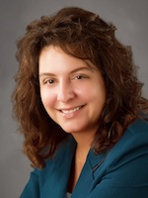
Introducing Your Presenter…
Christine Redovan, MBA
GME Consultant
Seasoned Director of Medical Education and GME Operations
Accreditation and Management success for both ACGME & AOA Programs
ACGME-I Accreditation Expert
Successful Continued Accreditation & New Start-Up Implementation
Focused on continual readiness and offering timely and useful GME resources
19 years GME experience

Slide 3
Learning Objectives
Understand the UME – GME – CME continuum
Discover GME influencers
Organizational Think Tanks
Policy/Industry Makers
Health Care Systems
Apply lessons learned to the future of your GME programs

Slide 4
Medical Education – Brief History
1100 – European medicine emerged
1765 – College of Philadelphia; morphed into University of Pennsylvania in 1791
1892 – William Osler (coined “resident”)
1892 – A.T. Still (American School of Osteopathy)
1890’s - Residency concept introduce
Notes:
1

Slide 5
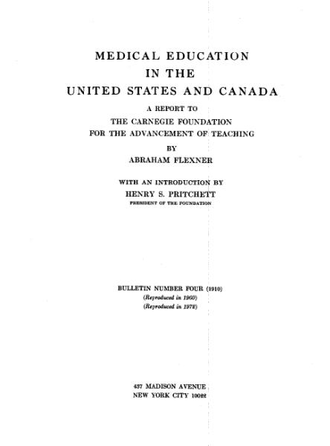
Medical Education – Brief History
1893 – Johns Hopkins Medical School
1899 – Johns Hopkins Hospital
Recognized as first US residency program
1910 – Flexner Report
Notes:
1

Slide 6
Flexner Report - 1910
2019?
Seven recommendations (Barzansky & Gevitz):
Reduce number of poorly trained physicians
Reduce number of medical schools
Increase prerequisites to enter medical training
Train physicians in a scientific manner
Engage faculty in research
Medical school control of clinical education in hospitals
Strengthen state regulation of medical licensure
Notes:
1

Slide 7
Medical Education – Brief History
1914 – First standards on internship (AMA)
1915 - NBME
1923 – Principles Regarding Graduate Medical Education
1927 – CME prototype @ Mayo Clinic
1933 - ABMS
1940’s – Specialty boards begin to pop up
1942 – LCME established
1950’s – NRMP & ECFMG

Slide 8
Medical Education – Brief History
1950’s & 60’s – Dissatisfaction with UME and GME curriculums/length of training.
Sicker patients + technology = increased errors.
1972 – LCGME formed; morphed into ACGME
1981 – ACGME & ACCME established

Slide 9
Medical Education – Brief History
1984 – Libby Zion
NY Bell Commission – 1987
IM RC – 1989
Institutes of Medicine – 1999
ACGME – 2003
Institutes of Medicine - 2008

Slide 10
Medical Education – Brief History
1990’s – Maintenance of Certification (MOC)
2000 – To Err is Human
1999 – ACGME Competencies
2001 – Crossing the Quality Chasm
2001 - ACGME Outcomes Project

Slide 11
Medical Education – Brief History
2009 – ACGME Milestones (2013 - reporting)
2012 – Continuous MOC
2014 – Core EPAs for Entering Residency
2015 – Single Accreditation System

Slide 12
GME Influencers

Slide 13
Organizations
National Academies – Health and Medicine Division
- Multiple publications; research on GME
American Medical Association (AMA)
- Advocate for GME; funding and education
Association for American Medical Colleges (AAMC)
Government Affairs & Advocacy Section

Slide 14
Organizations
American Osteopathic Association (AOA)
- Advocate international, national and state levels
Institute for Healthcare Improvement (IHI)
- Worldwide focus; use of improvement science
The Joint Commission
- Focus on improving public health by evaluating health care providers; our sponsoring institutions

Slide 15
Accreditation Bodies
Accreditation Council for Graduate Medical Education (ACGME)
- Standards for residency training programs and institutions
Accreditation Council for Continuing Medical Education (ACCME)
- Collaborations with AMA, State Medical Boards

Slide 16
Accreditation Bodies
Liaison Committee on Medical Education (LCME)
- Collaborate with AMA and AAMC; for MD degree granting schools
Commission on Osteopathic College Accreditation (COCA)
- Collaborate with AOA; for DO degree granting schools

Slide 17
Political Influencers
Federal Initiatives – funding (CMS and other sources); caps; quality payments; health insurance
Pharmaceutical – UME-GME-CME
(academic vs. private practice)
Courts – resident issues; student vs employee; immigration
Ruling political party
Local politics

Slide 18
Changing World
Slowing population growth
Aging population
Information explosion (fact vs. fake)
Advances in medicine
Advances in technology

Slide 19
GME Community
You
Local
TAGME
ACGME
AHME
Regional
Specialty Societies

Slide 20
Applying Lessons Learned

Slide 21
Accreditation
Outcomes + Expectations
Medical School – EPAs
GME – Milestones; continuous accreditation
CME – MOC; continuous learning
Transition from UME to GME to CME

Slide 22
Clinical Learning Environment + CPR
Developed to meet the needs of a rapidly changing health care environment
Multiple methods of instruction
Program Aims (= outcome)
Health care finance
Information technology
Culture of safety
CLER
Disparities

Slide 23
Educational Program
Follow the program requirements….
Anesthesia – added ultrasound
IM/FM – minimal procedures
IM – one month geriatrics
FM – delivery requirement relaxed
Surgical – Increased numbers; expectations
Radiology – integrated interventional

Slide 24
Final Thoughts…

Slide 25
Where is GME heading…
SI 2025 – responding at the Institutional level to changes in healthcare
IM 2035 – responding at the program level to changes in internal medicine
Length of education/programs?
Funding concerns (UME, GME, CME)
Faculty concerns (aging, burnout, turnover)
Congressional impact

Slide 26
Other Thoughts…

Slide 27
Upcoming Live Webinars
SI 2025 Part 4 of 4: Strategic Planning Thursday, July 18, 2019 12:00pm – 1:00pm EST
Understanding Practice Data Tuesday, August 15, 2019 12:00pm – 1:00pm EST
CPR 2019 Part 4 of 4: Putting It All Together Tuesday, August 27, 2019 12:00pm – 1:00pm EST
Crafting “Top-Notch” Goals, Objectives and Evaluations Thursday, September 12, 2019 12:00pm – 1:00pm EST
On-Demand Webinars
2019 CPR Part 1 of 4: Overview
Aims and Action Plans
SI 2025 Part 2 of 4: Changes on the Horizon
Ask Partners – Spring Freebie
Understanding the CLE
CPR 2019 Part 2 of 4: Section I & Section II
SI 2025 Part 3 of 4: GME Evolution, Funding & Future
Building Your Sponsoring Institution – The First 2 Years
Special Reviews – Helpful not Hurtful
2019 CPR Part 3 of 4: Section IV & Section V
NEW Faculty Development Series
15 Minutes to Effective Feedback
Toolbox for Teaching Millennials
Contact us today to learn how our Educational
Passports can save you time & money!
724-864-7320
www.PartnersInMedEd.com
27

Slide 28
Partners in Medical Education, Inc. provides comprehensive consulting services to the GME community.
Partners in Medical Education
724-864-7320 | info@PartnersInMedEd.com
Christine Redovan, MBA GME Consultant
Christine@PartnersInMedEd.com
www.PartnersInMedEd.com

