Slide 1
Partners Webinar Alert
Reminder…Because of the amount of individual logins for this webinar. Please DO NOT Unmute your Microphone after you enter this webinar.

Slide 2
GME Workforce Planning
Heather Peters, M. Ed, PhD
GME Consultant

Slide 3
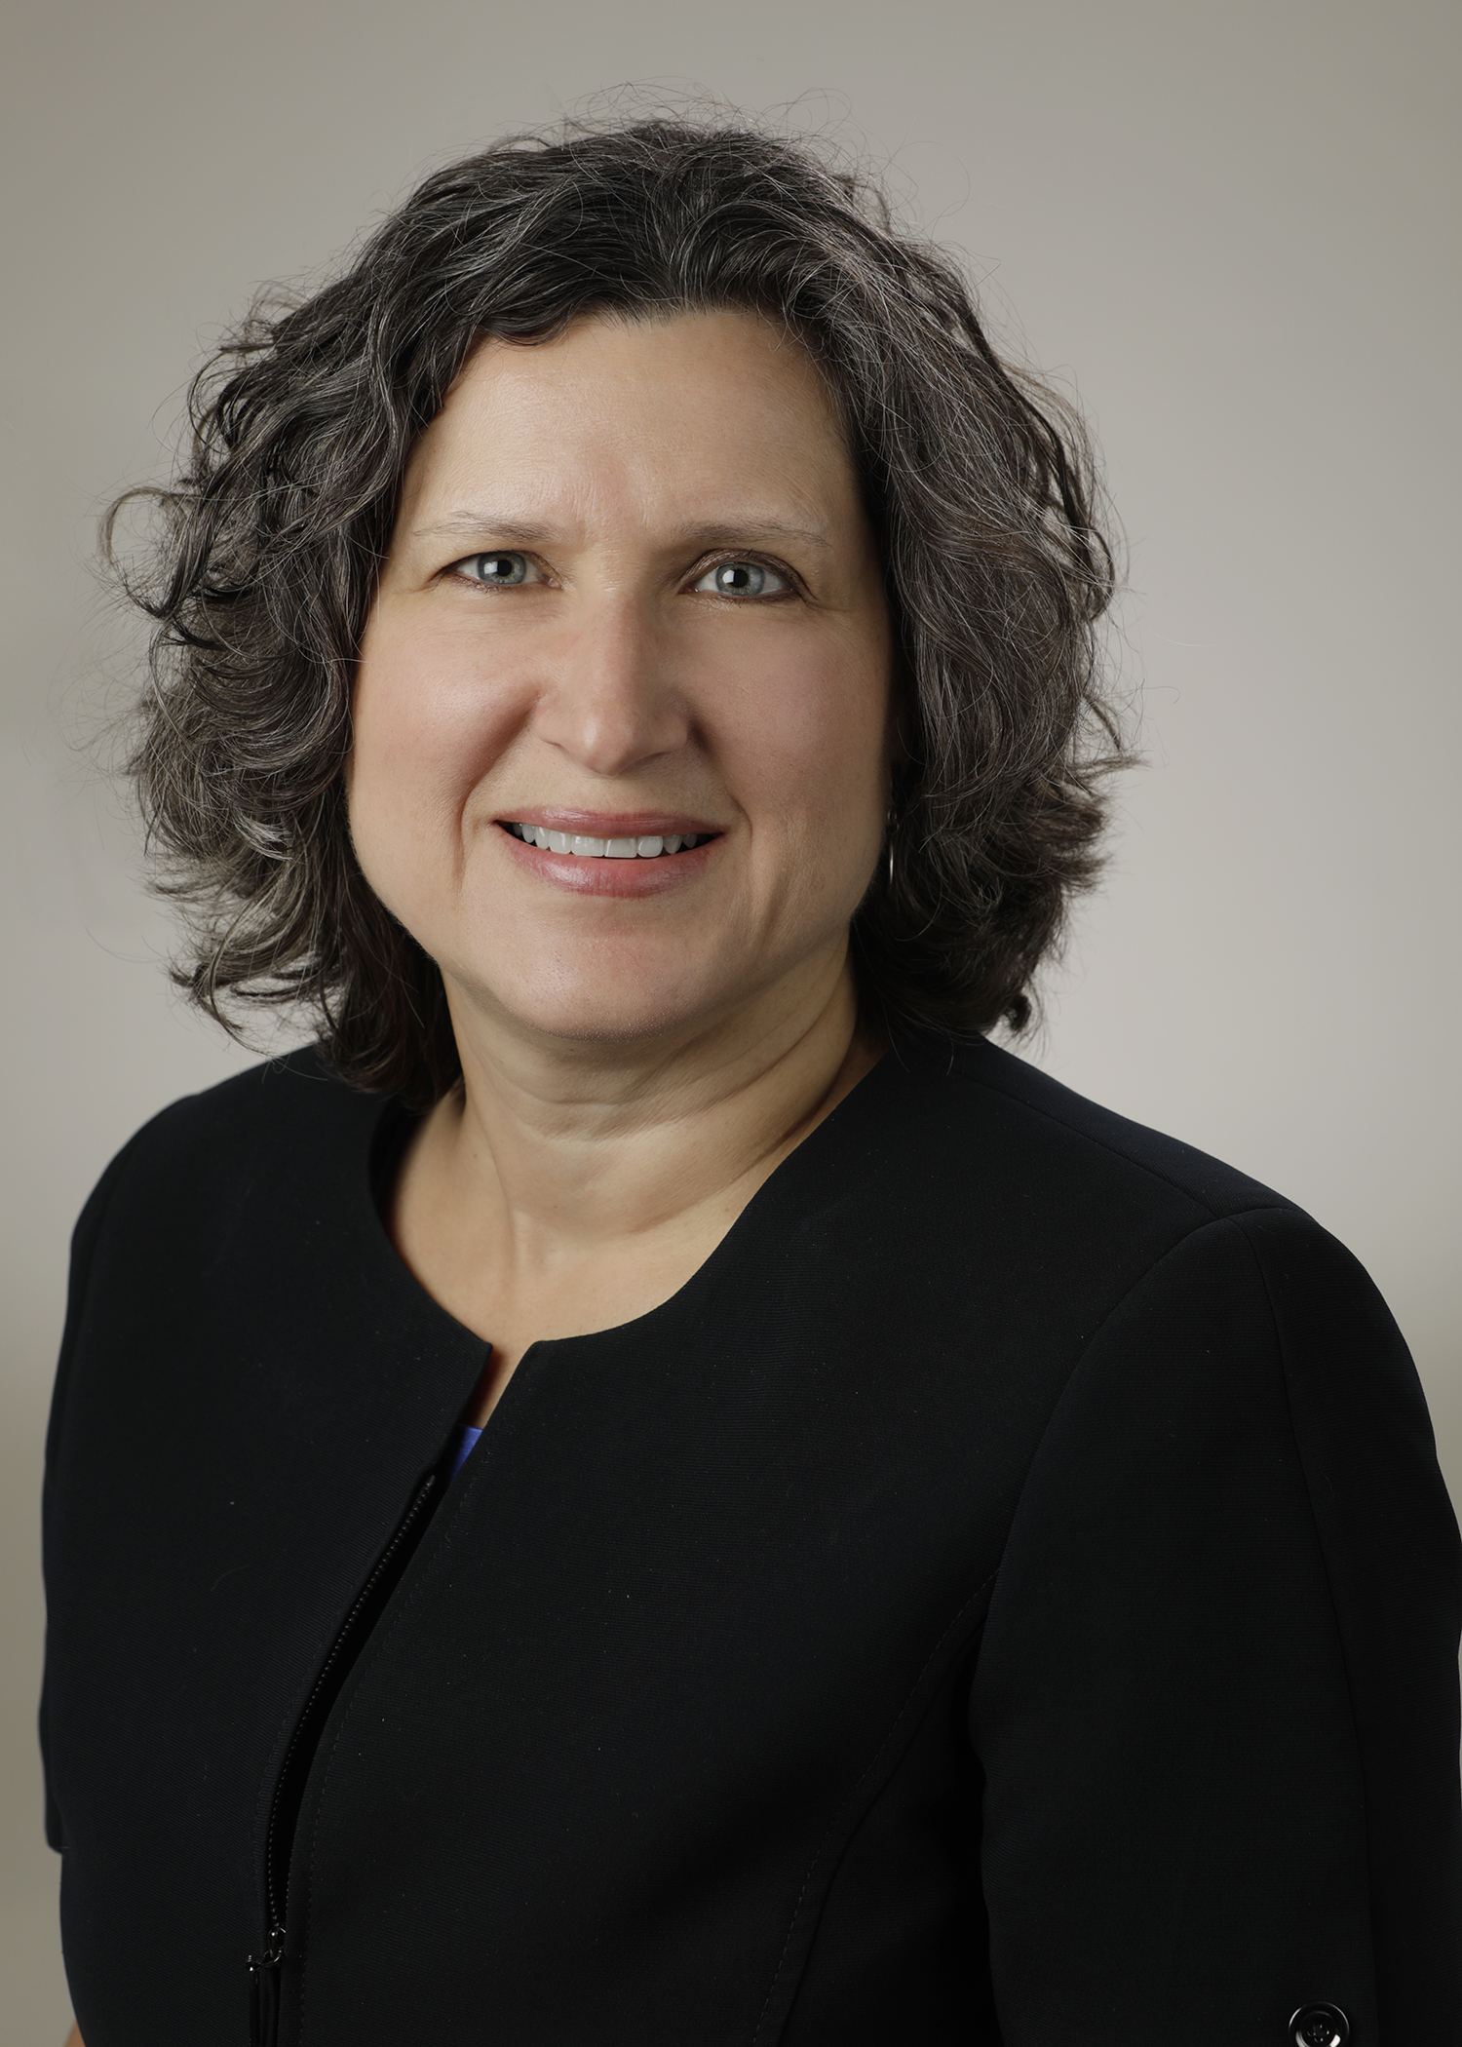
Introducing Your Presenter…
Heather Peters, M.Ed, PhD
GME Consultant
Former GME Director & DIO
Seasoned speaker at ACGME & subspecialty national meetings
Areas of Expertise: GME Strategic Planning; Program Evaluation; and Faculty Development
3 decades in education; Masters of Education in curriculum & evaluations, PhD concentration in secondary education & adult learning theories
Presented by Partners in Medical Education, Inc. 2020

Slide 4
Learning Objectives
Create an understanding of GME Personnel Needs in the Next Decade
Roles & Responsibilities
Administrative Activities & Professional Development
Monitoring & Mentoring
Discuss Strategic Planning for GME Personnel Development (10-year view)
Tools Provided to Participants:
Timeline for GME Accreditation Changes (1950-2020)
Sample GME Support Staff Survey
Sample ILP – Program Coordinators
Sample GME Personnel Strategic Planning

Slide 5
GME Workforce
GME Department
DIO
GME Director/Manager and/or Institutional Coordinator
Program Directors & Associate PD
Coordinators
Program Coordinators
Program Mangers
Assistant Program Coordinators
Faculty
Core
Faculty

Slide 6
GME Leadership Roles
DIO Role
GME Director/Manager
Institutional Coordinator
ACGME Zoom meetings
ACGME pre-conference
ACGME/AHME conferences
ACGME portal
Sponsoring Institution 2025
IC Job Descriptions

Slide 7
Program Leadership
PD
Program Structure & Governance
Struggling learners/faculty members
APD
Learning the role of the APD
Preparing to be a Program Director
Educator Skills
Roles & Responsibilities

Slide 8
2025 Faculty Roles
Diagnostic Assessor: Use data to identify performance gaps to individualize training
Learning Environment Designer, Engineer, Architect, and Implementer: Design “space” to optimize learning
Content Curator: Access, select, sequence, and deliver high-quality evidence-based content
Technology Adopter: Be an early adopter, fluent in selecting and using technology tools
Learner-Centered Navigator and Professional Coach: Guide learners to achieve identified performance targets
Clinician Role Model: Act as an exemplar for the various 2025 physician job roles
Simpson D, Marcdante K, Souza KH, Anderson A, Holmboe E. Job roles of the 2025 medical educator. JGME. 2018;10(3);243-246.

Slide 9
GME Support Workforce Roles
Position | Desired Educational Level | Desired Number of GME Years | Professional Development Focus | Best role/position to conduct performance review
Director of GME | PhD, Masters (Education, Organizational Development, Business or like emphasis) | 5+ years Previous program coordinator experience | Financial/Budget; Managing people; Moving beyond the basics of accreditation; Working with the C‐ Suite | DIO & Next level on organizational chart
Assistant Director of GME (Institutional Coordinator) | PhD, Masters or in progress (Education, Organizational Development, Business or like emphasis) | 3‐5 years Previous program manager experience or 10+ years of program coordinator experience | Role of the Director of GME; Sponsoring Institution accreditation; GMEC/GMEC Subcommittees | Director of GME
Program Managers | Working on a Masters | 6+ years of program coordinator experience | Managing people; Beginning GME financial/budget; Understanding change | Director of GME and Assistant Director of GME
Program Coordinators | Bachelors | 2+ Previous GME experience | Accreditation, Program management | Program Managers & Assistant Director of GME with input from Program Directors
Administrative Assistants | 2‐year (AA) | No previous GME experience required | Basics of GME | Program Managers

Slide 10
GME Support Staff Survey
Succession Planning
Administrative Resources
Engagement
Sample Support Staff Survey

Slide 11
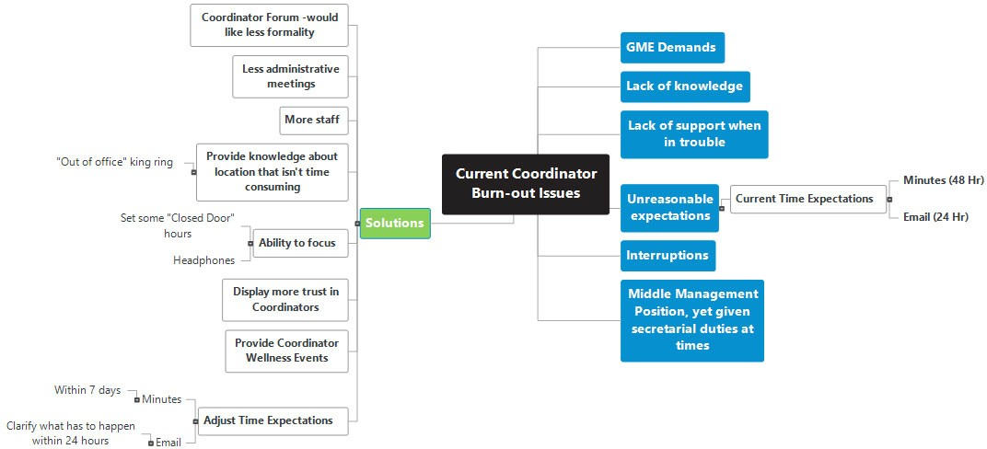
Burn-Out Issues & Solutions

Slide 12
Self-Evaluation Tool for Program Coordinators
Medical Education Knowledge
Professionalism
Systems-based Practice
Practice-Based Learning & Improvement
Interpersonal & Communication Skills
Personal Care
https://forum.ahme.org/discus/messages/88/DHMC_Program_Coordinator_Self_Reflection_Tool-5541.pdf
Aspirational
Seasoned
Solid Performer
Early Learner
Entry

Slide 13
Sample Program Coordinator Milestones
Servant Leadership
Information Management
Program Improvement
Interpersonal & Communication Skills
Professionalism
Knowledge
https://www.aafp.org/dam/AAFP/documents/events/rps_pdw/handouts/res18-89-the-importance-of-core-competencies.pdf
Servant Leadership Traits:
Listening
Awareness
Persuasion
Stewardship
Commitment to the Growth of People
Building Communities

Slide 14
When implementing any framework for development of your coordinator workforce…
don’t forget to discuss it with
Coordinators
Program Leadership
Human Resources

Slide 15
Individual Learning Plan: Coordinator Workforce
Guides program coordinator development
Individualized plans
Continuous improvement model
Sample Program Coordinator ILP

Slide 16
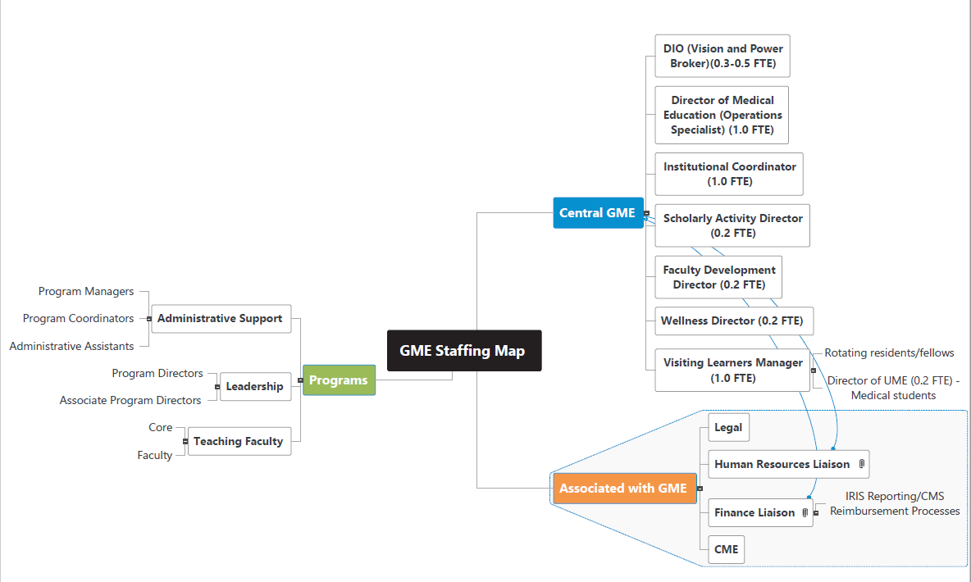
Strategic GME Staffing Plan – 10 Year Goal

Slide 17
GME Workforce Planning
Examine each role – there may be crossover
Include GME stakeholders in planning process
Sample GME Personnel Strategic Planning

Slide 18
Final Thoughts
“agile” organizations
Planning is required

Slide 19
Upcoming Live Webinar
Working with a Statistician on your Research Project
Thursday, October 8, 2020 12:00pm – 1:00pm EST Quality Improvements in GME: 5 years later
Thursday, October 22, 2020 12:00pm – 1:00pm EST
An Interdisciplinary Approach – Breaking Down the Wall
Thursday, November 5, 2020 12:00pm – 1:00pm EST Meet the Experts – Fall Freebie Thursday, November 19, 2020 12:00pm – 1:00pm EST
Latest On-Demand Webinars
Working with your Governing Board
Recognizing & Addressing Precursors of Burnout: The Value of Shame Resiliency Training to Support Resident Well-Being
Working with your IRB
Digging for Data II
Demystifying Diversity
Faculty Development Planning: Sponsoring Institution Role
ADS Annual Update: Best Practices
Graduate Medical Education Financing
Artificial Intelligence in Medicine: Its Impact on GME
Faculty Development – A More Specific Approach
NEW Faculty Development Series
15 Minutes to Effective Feedback
Toolbox for Teaching Millennials
Taking Supervision to the Next Level
Contact us today to learn how our Educational
Passports can save you time & money!
724-864-7320
www.PartnersInMedEd.com
Presented by Partners in Medical Education, Inc. 2020
19

Slide 20
Partners in Medical Education, Inc. provides comprehensive consulting services to the GME community.
Partners in Medical Education
724-864-7320 | info@PartnersInMedEd.com
Heather Peters, M.Ed, Ph.D
Heather@PartnersInMedEd.com
www.PartnersInMedEd.com
Presented by Partners in Medical Education, Inc. 2020

