Slide 1
Please Note…
Please make sure your Start Video is OFF when logging into the WebEx platform.
Here is what it should look like
ALSO
It is NORMAL to not hear any sound until the webinar starts at 12:00 noon EST.
Your phone line is muted, but you can always chat to the host, BJ Schwartz, if you have any questions or concerns during this time.

Slide 2
GMEC Best Practices
Presented by: Victoria Hanlon, MS

Slide 3
Introducing Your Presenter…
Victoria Hanlon, MS
Current DIO at a Sponsoring Institution with 12 programs
Been a member or Chair of GMEC for 12 years
Has GME experience at both the community and academic medical center levels
100% success rate establishing institutional accreditation with the ACGME

Slide 4
LEARNING OBJECTIVES
Understand the characteristics of an effective GMEC
Discuss strategies for maintaining compliance with GMEC requirements that meets ACGME expectations
Identify GMEC vulnerabilities that may impact SI accreditation

Slide 5
What Makes an Effective GMEC?
Understanding the purpose
Recognizing GMEC as a team
Knowing the essential components
Understanding how to carry out responsibilities
Ability to identify common GMEC challenges

Slide 6
Purpose
In collaboration with the DIO, have authority and responsibility for oversight and administration of GME programs (IR I.A.5.a)
Ensure compliance with all ACGME requirements (IR I.A.5.a)
Provide strategic direction for GME across SI
Analyze GME performance across SI and implement actions to improve

Slide 7
The GMEC is a Team
The optimal CLE GMEC supports high-performance teaming. The concept of teaming recognizes the dynamic and fluid nature of the many individuals of the clinical care GME team that come together in the course of providing patient care oversight to achieve a common vision and goals. Teaming recognizes the benefits of purposeful interactions in which team members quickly identify and capitalize on their various professional strengths – coordinating care work that is both safe effective and efficient. The team members collaborate and share accountability to achieve outstanding results.

Slide 8
GMEC Self-Assessment
Our GMEC shares a clearly understood common purpose
Each GMEC member is equally committed to the committee’s success
Our GMEC members have a good blend of complementary skills and talents
Our GMEC uses time-efficient processes to complete our work
Each GMEC member contributes equivalent amounts of high-quality work
Logan, J. et al. (2019). Assessment: How Well Does Your Team Function? Harvard Business Review

Slide 9
Essential Components of GMEC
Operations
ACGME required members
Every meeting must have a resident present or it doesn’t count.
Charter
Documentation of GMEC scope and operational guidelines
Structure
Frequency of meetings
Membership
Decision-making entity NOT informational
Programs are GMEC business
Agenda & meeting minutes
Subcommittees
Identify voting rules

Slide 10
Best Practices
Differentiate between information and oversight. If it’s informational, remove from agenda
Diversify GMEC membership in order to more effectively carry out responsibilities
Set an attendance threshold – Recommend 50% of meetings
Review the charter annually
Meet at least every other month

Slide 11
Best Practices
Standardize agenda & structure agenda for effective oversight
Document discussion, action and responsible party in meeting minutes
Annotate meeting minutes
Establish subcommittees to carry out portions of required GMEC responsibilities
TOOL: GMEC Annual Agenda

Slide 12
GMEC Requirements
Presented by Partners in Medical Education, Inc. 2023

Slide 13
GMEC Responsibilities
Oversight
Review & Approval

Slide 14
Oversight
How does the GMEC demonstrate oversight?
Review and discussion of data as identified in IR I.B.4.a).(1-6).
Documentation in GMEC minutes
This is your PROOF to the ACGME
APEs (program), AIR, (SI) & Special Reviews (underperforming programs)

Slide 15
Review & Approval
IR. I.B.4.b).(1-15)
Items must be approved by GMEC and documented in meeting minutes
Not all of these items will be applicable to your SI

Slide 16
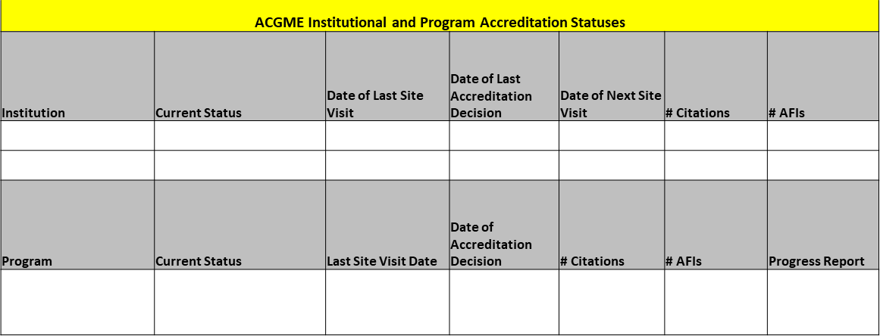
ACGME Oversight Requirements
ACGME accreditation and recognition statuses of the SI and each of its ACGME-accredited programs
GMEC review all ACGME LONs

Slide 17
ACGME Oversight Requirements
The quality of the GME learning and working environment within the SI, each of its ACGME-accredited programs, and its participating sites
ACGME Surveys
Annual Housestaff Surveys
Work Hours
SI Policies
CLER Focus Areas

Slide 18
ACGME Oversight Requirements
The quality of educational experiences in each ACGME-accredited program that lead to measurable achievement of educational outcomes
Curriculum
Board pass rates
Milestones
G&O
Rotations
Didactics

Slide 19
ACGME Oversight Requirements
Programs’ APEs and self-studies
ACGME-accredited programs’ implementation of institutional policy(ies) for vacation and leaves of absence, including medical, parental, and caregiver leaves of absence, at least annually
Policies
LOA tracking
Specialty board requirements

Slide 20
ACGME Oversight Requirements
All processes related to reductions and closures of ACGME-accredited programs, major participating sites, and the SI
Provision of summary information of patient safety reports to residents, fellows, faculty members, & other clinical staff members. At a minimum, this oversight must include verification that such summary information is being provided.
Work with patient safety team to identify what data
Event report data
EXAMPLE: hand-washing audit data

Slide 21
GMEC Vulnerabilities

Slide 22
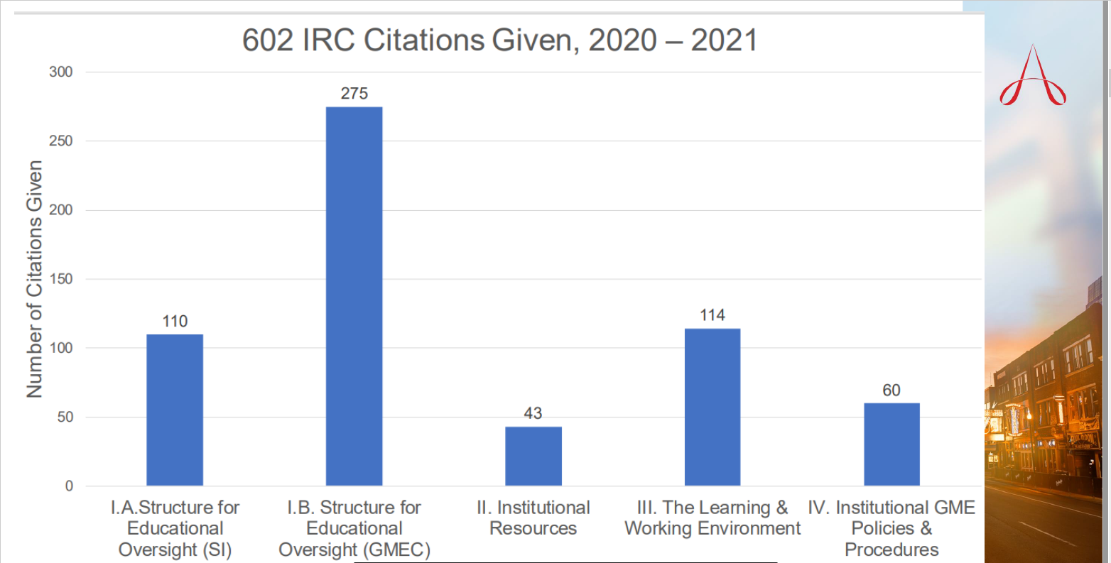
Sealy, P. & LeTourneau, J. (2023, February 23-25). DIO 101: Special Reviews and Annual Institutional Reviews (AIR) [Conference Presentation]. ACGME 2023 Annual Educational Conference, Nashville, TN.

Slide 23
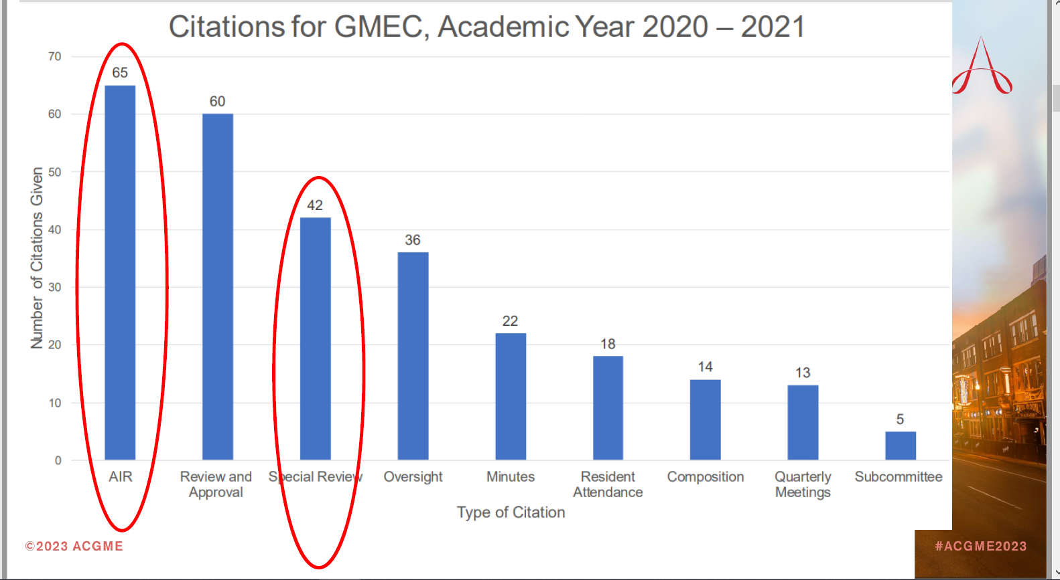
Sealy, P. & LeTourneau, J. (2023, February 23-25). DIO 101: Special Reviews and Annual Institutional Reviews (AIR) [Conference Presentation]. ACGME 2023 Annual Educational Conference, Nashville, TN.

Slide 24
Moore, S. & Orlando, J. (2023, February 23-25). DIO 101: Characteristics of an Effective GMEC [Conference Presentation]. ACGME 2023 Annual Educational Conference, Nashville, TN.

Slide 25
AIR
Citation Alert
AIR Executive Summary does not include the required institutional performance indicators
Review and discussion of AIR not documented in GMEC minutes
Monitoring of AIR action plans not documented in GMEC minutes
Performance monitoring procedures missing from AIR
AIR not conducted every year

Slide 26
AIR Best Practices
GMEC review and approve AIR performance indicators annually
Data collection and review done ahead of meeting
Use meeting time to develop action plans based on review of data
Review progress on action plans at every meeting, or every other depending on frequency of your meetings
Document your monitoring plan in AIR Executive Summary

Slide 27
Special Review
Citation Alert
Special Review protocol doesn't include minimum requirements
Special Review not initiated when program identified as underperforming
Lack of documentation of corrective actions in report and/or timelines
No GMEC monitoring of outcomes documented in GMEC minutes

Slide 28
Special Review Best Practices
GMEC review and approve Special Review protocol and underperforming criteria annually
Use GMEC review of APEs to determine need for Special Review
Special Review report reviewed and approved at GMEC meeting
Develop timelines when conducting Special Review
Monitor outcomes at every GMEC meeting, or every other depending on frequency of your meetings

Slide 29
Other Vulnerabilities
SI review of work hours (independent of program review)
No review and approval of new PDs
No review and approval of resident salaries and benefits
No review and approval of additions or deletions of participating sites
No resident on GMEC subcommittees
Unclear attendance records

Slide 30
GMEC Top 5
1
Documentation is key – If it's not documented, it didn't happen
2
Oversight = review, discuss, document & follow-up
3
Be strategic in member composition for better engagement
5
4
Standardize agenda/calendar for effective oversight
GMEC is not informational

Slide 31
Virtual Coaching Series
Program Directors – Next course starts in April 2023
GME Office – July 2023
Program Coordinators – Late in 2023
Includes:
6 one-hour interactive group sessions
2 one-on-one 30-minute individual sessions to problem-solve a concern
Limited enrollment for more interactivity
Course materials to include essential templates
Participation in a GME community network
To enroll, please visit:
https://partnersinmeded.com/virtual-coaching/

Slide 32
Upcoming Live Webinar
Back to Basics for New Coordinators III
Thursday, April 6, 2023
Special Review – When to Trigger
Tuesday, April 18, 2023
I Have A Scholarly Idea, Now What Should I Do to Turn it Into a Research Project?
Thursday, May 4, 2023
Teaching & Evaluating Professionalism
Tuesday, May 23, 2023
DIO Mentoring
Thursday, June 1, 2023
Diverse Recruitment
Tuesday, June 13, 2023
Look for our New Summer/Fall Education Schedule
To be released in early May
Latest On-Demand Webinars
Ask Partners – Spring Freebie
How Semi-Annual Evaluations Document, Educate, and Improve
Onboarding Residents
Developing Residency Budgets
Digging for Data V
Motivating Faculty to Mentor & Do Research
Meet the Experts – Fall Freebie
Lights, Camera…Zoom!
GME Educational Program Design II
Site Visits Are Coming!
SI 2025: 2022 Check Up
Contact us today to learn how our Educational
Passports can save you time & money!
724-864-7320
www.PartnersInMedEd.com

Slide 33
Partners in Medical Education, Inc. provides comprehensive
consulting services to the GME community.
Partners in Medical Education
724-864-7320 | info@PartnersInMedEd.com
Tori Hanlon, MS
Tori@partnersinmeded.com
www.PartnersInMedEd.com

