Slide 1
Please Note…
Please make sure your Start Video is OFF when logging into the WebEx platform.
Here is what it should look like
ALSO
It is NORMAL to not hear any sound until the webinar starts at 12:00 noon EST.
Your phone line is muted, but you can always chat to the host, BJ Couch, if you have any questions or concerns during this time.

Slide 2
GMEC Check-up: QIPS Edition
Tori Hanlon, MS, CHCP
May 25, 2021

Slide 3
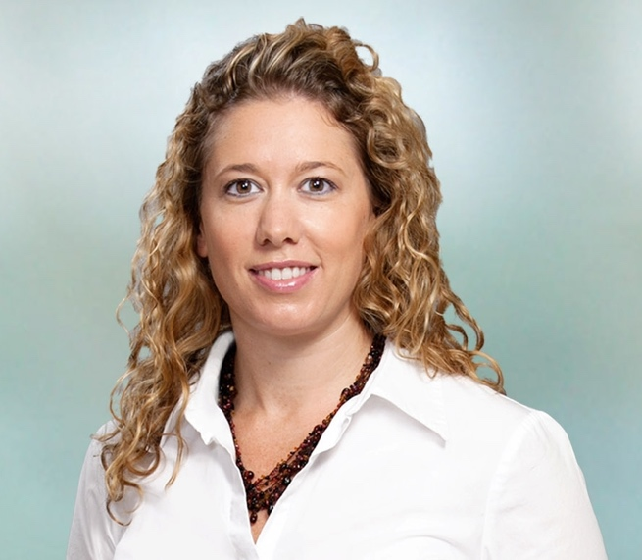
Introducing Your Presenter…
Tori Hanlon, MS, CHCP
GME Consultant
Current DIO at a Sponsoring Institution with 20 programs
Been a member or Chair of GMEC for 11 years
Experience providing solutions to programs and institutions for participation in QIPS that’s meaningful and meets ACGME requirements

Slide 4
Objectives
Understand the GMEC’s responsibility in the oversight of quality improvement and patient safety (QIPS)
Discuss strategies for enhancing GMEC engagement in QIPS
Provide tips and tools for fulfilling the ACGME’s expectations of integrating QIPS in GME

Slide 5
IMPORTANT
New ACGME Institutional Requirements effective July 1, 2021

Slide 6
Let’s Talk Oversight
Oversight
Being aware of
Reviewing
Tracking
Measuring
Documenting

Slide 7
Being aware of | CLER Pathways to Excellence; CLER National Report of Findings
Reviewing | Culture of safety survey results
Tracking | Event reports submitted by residents
Measuring | Resident QI projects (quantity and outcomes)
Documenting | QIPS discussions at GMEC; Annual institutional update in ADS

Slide 8
How Does the ACGME Know if My GMEC is Demonstrating Effective Oversight?
GMEC Meeting Minutes
Documentation of discussion
Annotated to track fulfillment of GMEC responsibilities per ACGME requirements

Slide 9
ACGME Requirements
GMEC responsibilities must include oversight of:
Quality of GME learning and working environment within the SI, programs and participating sites (I.B.4.a).(2)
QIPS is the GME learning and working environment
Tip for Programs:
This is also the
responsibility of
your PEC.

Slide 10
ACGME Requirements
Provision of summary information of patient safety reports to residents, fellows, faculty members, and other clinical staff members. At a minimum, this oversight must include verification that such summary information is being provided. (I.B.4.a).(6)
WHAT?!
Tip for Programs:
You can incorporate this
during QIPS conferences
as part of the program’s
didactics.

Slide 11
ACGME Requirements
GMEC’s responsibilities must include review and approval of:
Responses to CLER reports (I.B.4.b).(10)
Does your GMEC
Know what your
CLER report says?
Tip for Programs:
Ask your DIO for your CLER
Report. They’ll be happy to
share and it can help guide
program-level QIPS initiatives.

Slide 12
ACGME Requirements
The GMEC must demonstrate effective oversight of the SI’s accreditation through an Annual Institutional Review (I.B.5.)
What QIPS
performance
Indicators are
in your AIR?
Tip for Programs:
Programs demonstrate
oversight of accreditation
via APEs. What QIPS
indicators are in your APE?

Slide 13
Should we have a QIPS Subcommittee of the GMEC?
Handout
Size of SI
How many programs at SI?
GMEC Organization/ Structure
Frequency of GMEC Meetings
Does your GMEC meet frequently enough to allow effective oversight of QIPS?
QIPS Discussions at GMEC
Does your GMEC have meaningful QIPS discussions that result in an improved GME learning and working environment?
Does the current structure and organization (agenda and people) of your GMEC allow for effective oversight of QIPS?

Slide 14
How Can We Better Engage Residents in QIPS?
Handout
GMEC Resident Reps
Faculty buy-in
Involve and listen to residents
Educate residents on their involvement during program site visits and CLER visits

Slide 15
How involved should my GMEC be in CLER?
Share CLER report with committee
Engage GMEC in responses to CLER reports
Divide up CLER focus areas amongst GMEC meetings
Create CLER action plans/items and follow-up at GMEC at least twice a year

Slide 16
What QIPS Data Should my GMEC be Looking at?
ACGME Surveys
APEs
Annual GME Survey
Pulse Checks/Focus Polls
Clinical site data/benchmarks

Slide 17
ACGME Surveys
Resident Survey QIPS Areas
Faculty members discuss cost awareness in patient care decisions
Information not lost during shift changes or patient transfers
Culture emphasizes patient safety events
Interprofessional teamwork skills modeled or taught
Participate in adverse event analysis
Instruction on scientific inquiry principals
Education in assessing patient goals, e.g. end of life care
Opportunities for research participation
Taught about health care disparities

Slide 18
ACGME Surveys
Faculty Survey QIPS Areas
Participated in activities to enhance professional skills in QIPS
Information not lost during shift changes or patient transfers
Effective teamwork in patient care
Interprofessional teamwork skills modeled or taught
Residents/fellows participate in adverse event analysis
Know how to report patient safety events
Residents instructed in cost-effectiveness

Slide 19
APEs
CPRs
V.C.1.c).(4)
How does the PEC evaluate the quality and safety of patient care? What tools are used to obtain this data?
How does the program use practice data to help improve quality and patient safety?
How are trainees and faculty involved in initiatives for QIPS, including education?
What faculty development programs took place in the last academic year designed to enhance skills in QIPS?

Slide 20
Pulse Checks/Focus Polls
I was aware of how to report PS events, near misses and unsafe conditions at this site
Are you comfortable reporting patient safety issues?
This site was concerned with the quality of care delivered to patients
I know what the clinical site’s patient safety priorities are
Effective for participating sites

Slide 21
Final Tips
Link GME QIPS initiatives to clinical site goals
Turn QIPS initiatives into scholarly activity
Don’t overthink QIPS
Ask GMEC members what’s important to them

Slide 22
Upcoming Live Webinars
Just Released…2021 July-Dec
Summer/Fall Live Education Schedule
Downloaded it here…
https://partnersinmeded.com/educational-resources/
Impactful AIR & APE – Bridging Data & Action Thursday, June 3, 2021 12:00pm – 1:00pm EST
Survey Research Tuesday, June 22, 2021 12:00pm – 1:00pm EST
GME Grants and Funding Sources
Tuesday, July 13, 2021
12:00pm – 1:00pm EST
ADS Updates 2021 Thursday, July 29, 2021 12:00pm – 1:00pm EST
Latest On-Demand Webinars
ACGME Surveys – What Now?
Other Approaches to CCC & Evaluation
Lessons Learned from the Pandemic: Planning for the Next Disaster
Ask Partners – Spring Freebie
Digging for Data Part 3
How to Maximize Virtual Learning Part 2
Scholarly Work in Pandemic Times
How to Maximize Virtual Learning Par 1
Quality Improvement in GME: 5 years later
How to Manage A Virtual Site Visit
DIO Role & Responsibilities: Keys to Success
Working with Struggling Learners
Meet the Experts – Fall Freebie
NEW Faculty Development Series
15 Minutes to Effective Feedback
Toolbox for Teaching Millennials
Taking Supervision to the Next Level
Contact us today to learn how our Educational
Passports can save you time & money!
724-864-7320
www.PartnersInMedEd.com
22

Slide 23
Partners in Medical Education, Inc. provides comprehensive consulting services to the GME community.
Partners in Medical Education
724-864-7320 | info@PartnersInMedEd.com
Tori Hanlon, MS, CHCP
tori@partnersinmeded.com
www.PartnersInMedEd.com

