Slide 1
Please Note…
Please make sure your Start Video is OFF when logging into the WebEx platform.
Here is what it should look like
ALSO
It is NORMAL to not hear any sound until the webinar starts at 12:00 noon EST.
Your phone line is muted, but you can always chat to the host, BJ Schwartz, if you have any questions or concerns during this time.

Slide 2
Here We Grow Again...With Our Community
Heather Peters, M.Ed, Ph.D
Christine Redovan, MBA, MLIS

Slide 3
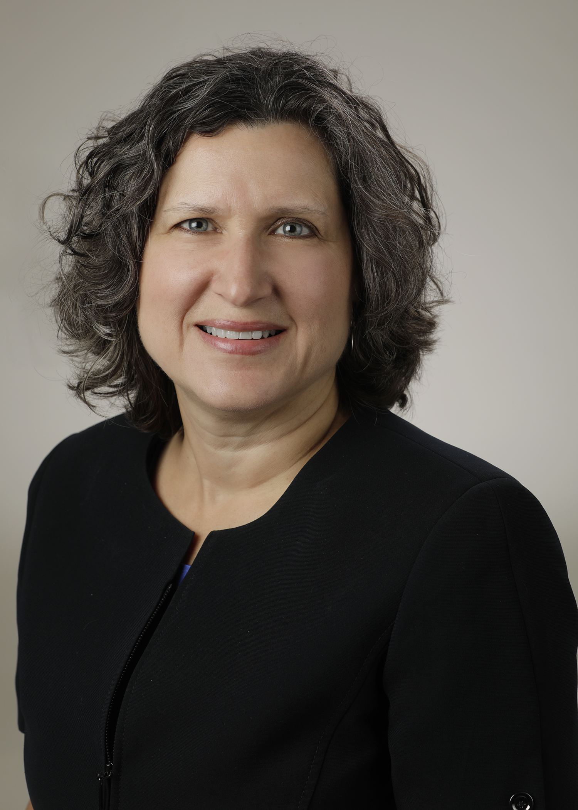
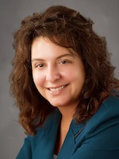
Introducing Your Presenters…
Heather Peters, M.Ed., Ph.D GME Consultant
Christine Redovan, MBA, MLIS
GME Consultant
Guided strategic planning in GME
Developed GME report cards to assess program’s ability to meet community need
Developed program improvement goals using community needs assessments
Assessed community needs in program mission and aims

Slide 4
LEARNING OBJECTIVES
EXPLORE institutional community needs assessments
ANALYZE community needs to inform program improvement
DISCOVER uses for community needs in planning mission, aims, and recruitment
DISCUSS how to communicate with GMEC and hospital leadership regarding quality improvement
Tools:
GME Report Card Template - Value to Organization
Community Health Needs Assessment Sample
Community Health Needs Assessment Implementation Plan Sample
Community Health Improvement Toolkit

Slide 5
Community and GME Growth
GME meets community needs
Medical
Social
Workforce
Education

Slide 6
Community Health Needs Assessments
What is a Community Health Needs Assessment?
"A systematic examination of the health status indicators for a given population that is used to identify key problems and assets in a community.”
Source: naacho.org

Slide 7
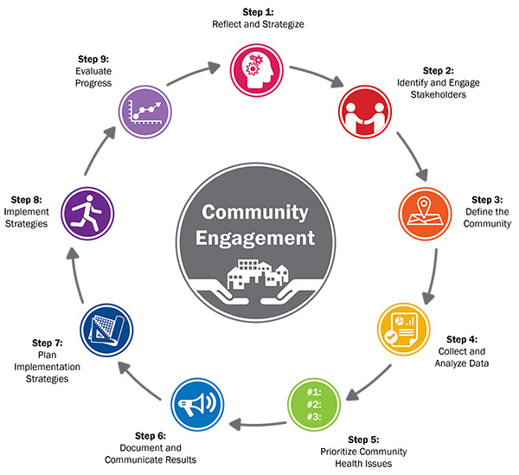
How are CHNA's completed?
Association for Community Health Improvement. (2017). Community Health Assessment Toolkit. Accessed at www.healthycommunities.org/assesstoolkit

Slide 8
Community Health Needs Assessments
Where do we find these reports?
Publicly available on your hospital website
About Us
Leadership
Community
Annual reports
Search the site

Slide 9
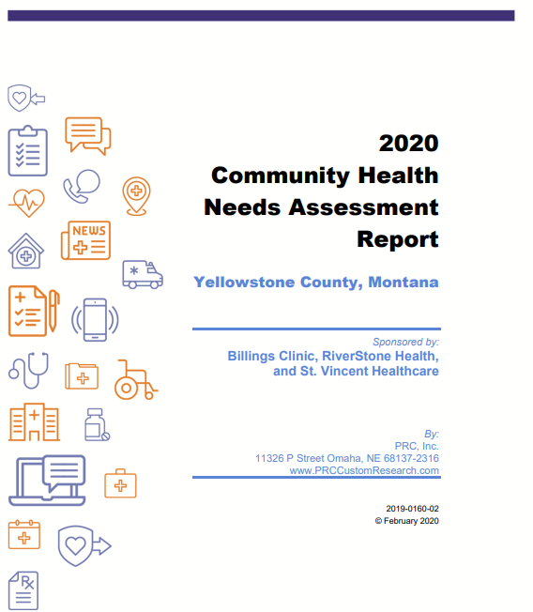
St. Vincent Healthcare
Source: riverstonehealth.org

Slide 10
What did St. Vincent Healthcare do?
Created a Community Crisis Center in partnership with four other institutions
Created a Mental Health Clinic staffed by residents and students from the local area. More than half of the trainees are from the area and intended to stay local after finishing their training
Learned it was crucial that all partners were in agreement with definitions and goals
Reinforced that collaboration was key to success
Health Research & Educational Trust. (2017, August). Hospital-community partnerships to build a Culture of Health: A compendium of case studies. Chicago, IL: Health Research & Educational Trust. Accessed at www.aha.org/partnershipcasestudies

Slide 11
Using CHNA in GME
GME workforce planning
Expansion
New
GME program needs (ACGME requirements!)
Curriculum
Research
QI
Recruitment
Mission
Aims
This Photo by Unknown author is licensed under CC BY.

Slide 12
GME Strategic Planning and Community Assessment
GME Growth Planning in the past
GME Planning today
Based on patient population growth predictions (more to come in the public resources section)
In concert with C-Suite, governing board, and corporation
Long-range – 10-15 years minimum and much larger in scope
recruitment of medstaff to support new programs
Alignment of HR/Legal and Research to provide the necessary infrastructure for a thriving GME
Medical school affiliations
Result: Sponsoring Institutions that provide GME that meets the community need now and in the future. Collaborations within the organization and the community
School district collaborations (Peds, FM)
County Health Departments
Emergency Services Organizations (EMS fellowships)
Healthcare Disparity-focused organization
Based on interest of individual medstaff
C-Suite minimally involved in decisions to move forward with new programs
Result: Sponsoring Institutions with disconnected programs that do not necessarily meet the needs of the community

Slide 13
Working with the C-Suite*
*
Hospital Leadership
Corporate Leadership
Governing Board
Academic Medical Center Leadership
Other
Know your institution’s goals
Patient Safety
Performance Improvement
Community Need
Healthcare Disparities
Healthcare Equity
Provide Metrics that Align with the Institution’s goals
Does GME add to the bottom line?
Use metrics to prove the quality and value of a program – See Report Cards

Slide 14
Value to Organization
*Adapted from Varaklis K, Parker MG, Peck JS, Bing-You RG. Aligning Strategic Interests in an Academic Medical Center: A Framework for Evaluating GME Expansion Requests. J Grad Med Educ. 2019;11(1):85–91.

Slide 15
Public Resources
Hospital web sites
American Hospital Association (aha.org)
Healthy People 2030 (health.gov)
Local, regional, state, national census (census.gov)
CDC – Community Health Assessment & Health Improvement Planning (cdc.gov)
National Association of County & City Health Officials (naacho.org)
Public libraries & librarians

Slide 16
Internal Resources
Planning, Quality, Diversity departments
Hospital Strategic Plan
Hospital Quality Improvement Plan
Hospital/Medical School library
Administration/GMEC
This Photo by Unknown author is licensed under CC BY-SA-NC.

Slide 17
How should this inform Mission, Aims, and Recruitment?
Questions:
Does your mission statement incorporate the community needs?
Do your aims address meeting community needs?
Measures: Number of Quality improvement projects align with community need
Recruitment
How do your recruitment efforts incorporate community need?
Targeting candidates from the region
Building pipeline programs (middle school, high school, college)

Slide 18
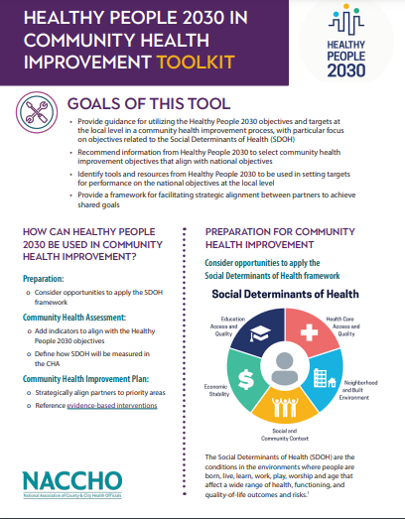
Take Action
Four Easy Steps!
1. Select indicators from CHNA & Healthy People 2030 (or alternative)
2. Align with program and institutional needs; use of strategic partners
3. Identify measurement goals (SMART)
4. Implement your plan

Slide 19
Final Thoughts....
Community Health Assessments are an important tool in our GME toolbox
Frames program mission and aims
Informs recruitment strategies
Provides a bridge to link program goals with hospital goals
Serves as a source of inspiration for curriculum, scholarly activities and meeting ACGME requirements
Drives short and long-term planning at the program and institutional level

Slide 20
Upcoming Live Webinar
ACGME Complaint Letter: Now What?
Thursday, June 9, 2022
JEDI Warriors in GME: Guardians of Justice, Equity, Diversity, and Inclusion
Thursday, June 23, 2022
Scholarly Activity – Starting the Year of Right
Tuesday, July 12, 2022
ADS 2022: Part II
Thursday, July 21, 2022
Looking Behind the Curtain at CMS Reporting
Thursday, August 4, 2022
Wellness is a Team Sport
Tuesday, August 16, 2022
Latest On-Demand Webinars
Moral Injury in Healthcare
Streamlining Your Special Review
Getting to the Next Stage - Program Improvement I
Digging for Data IV
Back to Basics – GME for New Coordinators
Leveraging RMS Technology for the Medicare Cost Report
Meet the Experts – Fall Freebie
A Successful Coordinator? You Must Be C-C-Crazy!
Planning and Tracking Scholarly Activity
GME Financing: The Basics, the Strategies, and the Upcoming Changes
The Role of Coaching
Faculty Development Series
15 Minutes to Effective Feedback
Toolbox for Teaching Millennials
Taking Supervision to the Next Level
Contact us today to learn how our Educational
Passports can save you time & money!
724-864-7320
www.PartnersInMedEd.com
Presented by Partners in Medical Education, Inc. 2022
20

Slide 21
Partners in Medical Education, Inc. provides comprehensive consulting services to
the GME community.
Partners in Medical Education
724-864-7320 | info@PartnersInMedEd.com
Heather Peters, M.Ed., Ph.D
Heather@partnersinmeded.com
Christine Redovan, MBA, MLIS
Christine@partnersinmeded.com
www.PartnersInMedEd.com

