Slide 1
Please Note…
Please make sure your Start Video is OFF when logging into the WebEx platform.
Here is what it should look like
ALSO
It is NORMAL to not hear any sound until the webinar starts at 12:00 noon EST.
Your phone line is muted, but you can always chat to the host, BJ Schwartz, if you have any questions or concerns during this time.

Slide 2
The ABC's of GMEC: Part Two
Presented by: Victoria Hanlon, MS, CHCP
Amy Durante, MHA

Slide 3
Introducing Your Presenters…
Amy Durante, MHA
Victoria Hanlon, MS, CHCP
Current Director of Medical Education with 21 programs
Creates the agenda for the site GMEC and sits on the system-wide GMEC for a large 23 hospital SI
Began her career in GME at Hospital for Special Surgery as the Radiology Fellowship Program Coordinator
Continued her career in GME at Lutheran Medical Center as the OB/GYN Residency Coordinator
Current DIO at a Sponsoring Institution with 19 programs
Been a member or Chair of a GMEC for 11 years
Began her career in GME at Georgetown University Hospital as the Associate Administrator for Surgical Specialty Education
Has GME experience at both the community and academic medical center levels

Slide 4
LEARNING OBJECTIVES
Understand the essential components related to institutional and program GMEC oversight
Discuss strategies for organizing these components to ensure compliance with ACGME expectations and requirements
Identify tips and tools for fulfilling the ACGME’s expectations for GMEC’s oversight of the SI and programs

Slide 5
RECAP
Importance of GMECs
Differentiate between program information & program oversight
Essential Components of GMECs
Membership
Structure
GMEC Responsibilities
Oversight responsibilities
Review and approval requirements
Decision-making authority

Slide 6
How Does the GMEC Demonstrate Oversight?

Slide 7
Oversight
Review & discussion of data as identified in IR I.B.4.a).(1-6)
Documentation in GMEC minutes (this is your proof to the ACGME)
APEs (program), AIR (SI) & Special Reviews (underperforming programs)

Slide 8
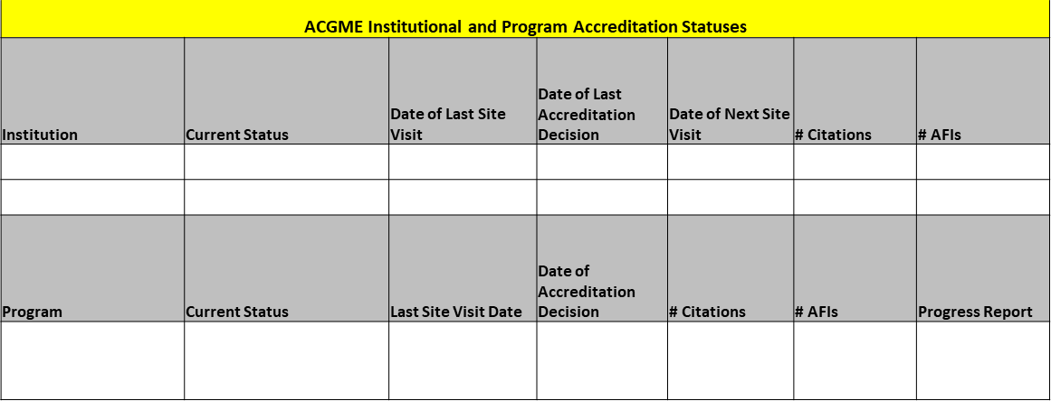
ACGME Oversight Requirements
ACGME accreditation and recognition statuses of the SI and each of its ACGME-accredited programs
GMEC review all ACGME LONs

Slide 9
ACGME Oversight Requirements
The quality of the GME learning and working environment within the SI, each of its ACGME-accredited programs, and its participating sites
ACGME Surveys
Annual Housestaff Surveys
Work Hours
SI Policies
CLER Focus Areas

Slide 10
ACGME Oversight Requirements
The quality of educational experiences in each ACGME-accredited program that lead to measurable achievement of educational outcomes
Curriculum
Board pass rates
Milestones
G&O
Rotations
Didactics

Slide 11
ACGME Oversight Requirements
Programs’ APEs and self-studies
ACGME-accredited programs’ implementation of institutional policy(ies) for vacation and leaves of absence, including medical, parental, and caregiver leaves of absence, at least annually
Policies
LOA tracking
Specialty board requirements
NEW

Slide 12
ACGME Oversight Requirements
All processes related to reductions and closures of ACGME-accredited programs, major participating sites, and the SI
Provision of summary information of patient safety reports to residents, fellows, faculty members, & other clinical staff members. At a minimum, this oversight must include verification that such summary information is being provided.
Work with patient safety team to identify what data
Event report data
EXAMPLE: hand-washing audit data

Slide 13
Annual Program Evaluations (APEs)
Review CPRs V.C.1.a)-e)

Slide 14
Tips for GMEC Oversight of APEs
TOOLS: (1) ACGME APE Template
(2) ACGME Action Plan Template
Standardize APEs across SI
Create templates for programs
Ability to use data for AIR
Monitor APE action plans at GMEC
Greater program accountability
Consider use of a GMEC sub-committee if you are a large SI or don’t want to take up time at GMEC meetings to do this

Slide 15
GMEC Decision-making Authority for APEs
Process for GMEC oversight of APEs must be designed to allow GMECs to actually make a decision
Accept programs’ APEs and action plans
Recommend program undergo a Special Review
Request more information or require additional action items

Slide 16
GMEC Decision-making Authority for APEs
Does process allow for effective oversight?
Does process allow GMEC to easily identify program vulnerabilities?
Can GMEC assess adequacy of resources?
Does process allow GMEC to assess program compliance with ACGME requirements?
Does process promote quality improvement and allow GMEC to assess program’s ability to facilitate continuous program improvement?

Slide 17
How It’s Done
Programs complete ACGME APE form and action plans which are sent to GMEC before meeting
Forms are presented and reviewed at the GMEC meeting
Programs provide written update on APE action plans at mid-point
Programs complete APE form in
residency management system
DIO reviews APE form and action
plans, PEC meeting minutes,
ACGME surveys, most recent
annual program update
DIO provides written comments/
feedback and recommendations
TOOL: APE Summary Report
GMEC reviews written DIO report
at meeting

Slide 18
Program Review
Allows more in-depth evaluation of programs
A modified “internal review” process
Provides assessment of programs’ compliance with ACGME requirements beyond data identified in APEs
Helps for site visit preparation
Still includes PEC involvement and GMEC oversight
Can do separately or in conjunction with APE

Slide 19
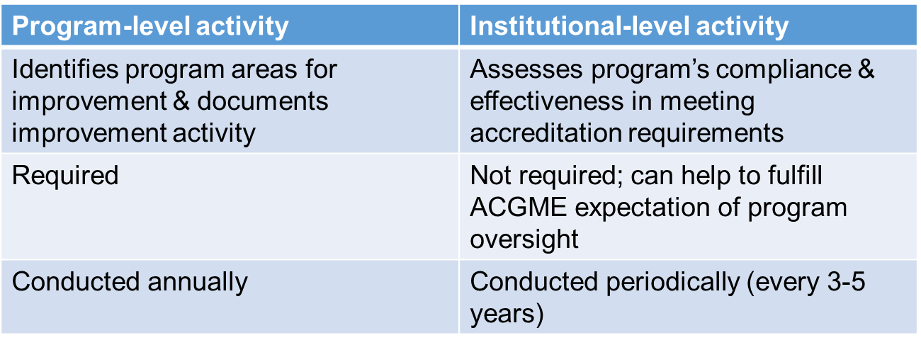
APE vs. Program Review

Slide 20
Program Review Data
PLAs
Rotation goals & objectives
Evaluation forms and processes
Program policies
Evidence of resident/fellow participation in QIPS
Meetings with PD, residents/fellows, and faculty

Slide 21
Dashboard Review Data
Board pass rate/In-service exams
Match data analysis
Filled vs. SOAP
U.S. Graduates
RMS data accuracy
Remediation/probation
Site visit documents

Slide 22
Special Review

Slide 23
Special Review Process
Establishes a variety of criteria for identifying underperformance that includes, at a minimum, program accreditation statuses of Initial Accreditation with Warning, Continued Accreditation with Warning, and adverse accreditation statuses as described by ACGME policies; and,

Slide 24
Special Review Process
Results in a timely report that describes the quality improvement goals, the corrective actions, and the process for GMEC monitoring of outcomes, including timelines.

Slide 25
Special Review Policy
Create a policy for consistency
Determine dates and/or timeline
Subcommittee members

Slide 26
Special Review Process
Form committee
Committee chair
Faculty from another program
If multiple institutions can be same program different hospital
Peer selected resident
Admin from GME
Template
Interviews
Residents, faculty, leadership
Can separate PGY levels

Slide 27
GMEC Oversight
Present at GMEC and approve report
Follow up on agenda
First to review when surveys are released
Go back in??
Major changes section on web ADS – they like it!!

Slide 28
Annual Institutional Review (AIR)

Slide 29
Annual Institutional Review (AIR)
The GMEC must identify institutional performance indicators for the AIR, to include, at a minimum:
The most recent ACGME institutional letter of notification;
Results of ACGME surveys of residents/fellows and core faculty members; and,
Each of its ACGME-accredited programs’ ACGME
accreditation information, including accreditation and recognition statuses and citations.

Slide 30
Annual Institutional Review (AIR)
Subcommittee of the GMEC
Resident member
Determine role of subcommittee
DON’T FORGET #1
GMEC must identify institutional performance indicators for the AIR
Survey to GMEC and discussion
Tall order for many institutions
Let ACGME reports assist you
Compare last years

Slide 31
Annual Institutional Review (AIR)
The DIO must annually submit a written executive summary of the AIR to the Sponsoring Institution’s Governing Body. The written executive summary must include:
A summary of institutional performance on indicators for the AIR; and,
Action plans and performance monitoring procedures resulting from the AIR.

Slide 32
Before the Governing Body
Presentation and discussion at GMEC
Shorter version to governing body
Action plans
Monitoring
Responsibility
A year goes by very quickly
Attainable and measurable goals

Slide 33
Common Themes
Document
Action plans
Others involvement
Report and approval at GMEC
Others will learn from it

Slide 34
Upcoming Live Webinar
The ABCs of GMEC: Part II
Thursday, May 19, 2022
Here We Grow Again – And With Our Community
Tuesday, May 24, 2022
ACGME Complaint Letter: Now What?
Thursday, June 9, 2022
JEDI Warriors in GME: Guardians of Justice, Equity, Diversity, and Inclusion
Thursday, June 23, 2022
Latest On-Demand Webinars
Moral Injury in Healthcare
Streamlining Your Special Review
Getting to the Next Stage - Program Improvement I
Digging for Data IV
Back to Basics – GME for New Coordinators
Leveraging RMS Technology for the Medicare Cost Report
Meet the Experts – Fall Freebie
A Successful Coordinator? You Must Be C-C-Crazy!
Planning and Tracking Scholarly Activity
GME Financing: The Basics, the Strategies, and the Upcoming Changes
The Role of Coaching
Faculty Development Series
15 Minutes to Effective Feedback
Toolbox for Teaching Millennials
Taking Supervision to the Next Level
Contact us today to learn how our Educational
Passports can save you time & money!
724-864-7320
www.PartnersInMedEd.com
Presented by Partners in Medical Education, Inc. 2022
34

Slide 35
Partners in Medical Education, Inc. provides comprehensive consulting services to
the GME community.
Partners in Medical Education
724-864-7320 | info@PartnersInMedEd.com
Carmela Meyer, EdD
Carmela@partnersinmeded.com
Christine Redovan, MBA, MLIS
Christine@partnersinmeded.com
www.PartnersInMedEd.com

