Slide 1
Please Note…
Please make sure your Start Video is OFF when logging into the WebEx platform.
Here is what it should look like
ALSO
It is NORMAL to not hear any sound until the webinar starts at 12:00 noon EST.
Your phone line is muted, but you can always chat to the host, BJ Schwartz, if you have any questions or concerns during this time.

Slide 2
Holistic Review
Christine Redovan, MBA, MLIS -- GME Consultant

Slide 3
Introducing Your Presenter…
Christine Redovan, MBA, MLIS
GME Consultant
Fifteen plus years recruitment and interview experience
Seasoned developer of mission-aligned goals in multiple program areas

Slide 4
Learning Objectives
Understand the history and theory behind holistic principles
Apply holistic processes to personal and professional goals
Integrate holistic strategies in recruiting and selecting resident candidates

Slide 5
What is holistic review?
Whole File + Whole Person + Context = Holistic Review
Application for residency, university, job. Measurable data – transcript, exams, references
What was available to you? Unique situations?
Experiences – life, job, family, culture, talents, community
Jacobs,J. (2019, March 13). What does holistic admission really mean? [Blog Post] retrieved from https://news.miami.edu/admissions/stories/2019/04/holistic-review-jay-jacobs.html

Slide 6
Brief History
1905 – Harvard; College Admission Test
1922 – Holistic principles to weed out “undesirables”
Lawsuits influence holistic practices
2000’s - Undergraduate, graduate schools, nursing schools, medical schools begin incorporating principles
2016 – Council of Graduate Schools report
2021 – Used in variety of settings

Slide 7
Holistic Principles in GME
Broad criteria linked to institutional mission and goals
Includes experiences, attributes and academic performance
Intentionally create diverse interview and selection pool
Applied equitably across entire candidate pool
Supported by performance data that links likelihood of success
Consider potential contribution to institution and field
https://www.aamc.org/services/member-capacity-building/holistic-review

Slide 8
What does holistic review accomplish?
Increase in diversity
Improved retention in program
Improved evaluation of all candidates
Less reliance on predictive validity of exam scores (conflicting research)
Evaluates soft skills for program “fit”

Slide 9
Let’s look at some examples…
After a few years of using holistic review, first year URM medical students increase from 11% to 20%.
Bates, T., Mutha, S. & Coffman, J. (2020). Practicing holistic review in medical education. Healthforce Center at UCSF. Retrieved from www.healthforce.ucsf.edu.

Slide 10
Let’s look at some examples…
The University of Texas Health Science Center at Houston
Three - fold increase in URM accepted to IM program over two years
Aibana O, Swails JL, Flores RJ, Love L. Bridging the gap: holistic review to increase diversity in graduate medical education. Acad Med. 2019;94(8):1137–1141. doi:10.1097/ACM.0000000000002779

Slide 11
Let’s look at some examples…
University of California San Francisco Pediatrics
Increased URM from 11% in 2015
to
45% in 2019
35% in 2020
Marbin, J., Rosenblush, G., Brim, R., Cruz, E., Martinez, A. & McNamara, M. (2021). Improving diversity in pediatric residency selection: Using an equity framework to implement holistic review. J Grad Med Educ, 13(2), 195-200. https://doi.org/10.4300/JGME-D-20-01024.1

Slide 12
Where do we start?
AAMC Holistic Review Framework
1. Emphasizes individual consideration
2. Guides us in developing mission-driven, diversity-oriented processes
3. Helps us use a balanced approach to accessing candidates
This Photo by Unknown Author is licensed under CC BY-SA
https://www.aamc.org/services/member-capacity-building/holistic-review

Slide 13
What is holistic review?
“Holistic Review refers to mission-aligned admissions or selection processes that take into consideration applicants’ experiences, attributes, and academic metrics as well as the value an applicant would contribute to learning, practice, and teaching. Holistic Review allows admissions committees to consider the “whole” applicant, rather than disproportionately focusing on any one factor.”
https://www.aamc.org/services/member-capacity-building/holistic-review

Slide 14
Core Principle 1
Screening and selection criteria is:
Broad
Linked to institutional mission
Promote diversity and inclusion as essential to excellence

Slide 15
Core Principle 2
Identify balance of experiences, attributes, competencies and metrics (EACM)
Apply these equally across all candidates
Supported by data

Slide 16
Core Principle 3
Consider individual contributions to the program and to medicine
Weigh and balance criteria needed to achieve program/institution outcomes

Slide 17
E-A-C-M Model
Experiences
Attributes
Competencies
Metrics

Slide 18
Experiences
The path taken to get where you are and the context in which these experiences have taken place
Personal – research, community/population experiences, educational background
Population – regional, national and world context such as pandemic and historical/social/cultural events

Slide 19
Attributes
Skills
Abilities
Personal qualities
Demographic
This Photo by Unknown Author is licensed under CC BY-SA

Slide 20
Competencies
Ways in which we apply our knowledge, skills and abilities
ACGME 6 competencies
Other specialty competencies
This Photo by Unknown Author is licensed under CC BY-SA

Slide 21
Metrics
Step scores
Transcripts
Number of publications
This Photo by Unknown Author is licensed under CC BY-SA-NC

Slide 22
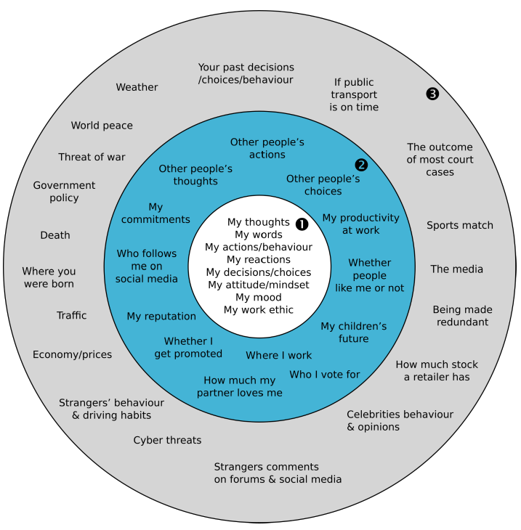
Applying Holistic Review
1 – Circle of Control
2 – Circle of Influence
3 – Circle of Concern
https://www.clairenewton.co.za/my-articles/circles-of-control.html

Slide 23
Circle of control
Recruitment materials
Interactions with applicants
Screening criteria
Who we invite for interviews
Training of interviewers
Location and type of interview
This Photo by Unknown Author is licensed under CC BY-SA

Slide 24
Circle of influence
Who applies
How our program is perceived (applicants, current and past residents)
Experiences with us/in our environment
This Photo by Unknown Author is licensed under CC BY

Slide 25
Circle of concern
Past circumstances
Weather
Location of institution
Cost of housing
Lack of public transportation
This Photo by Unknown Author is licensed under CC BY
This Photo by Unknown Author is licensed under CC BY-SA-NC
This Photo by Unknown Author is licensed under CC BY-SA

Slide 26
Using the handouts

Slide 27
Barriers to holistic review
Time
Training – tools and interviewers
Program transparency
Evaluating attributes and experiences fairly
Not widely used in GME

Slide 28
Additional Resources
Association of Program Directors in Surgery. (2020, March 2). PD Handbook: Diversity, inclusion and equity toolbox. Retrieved from www.apds.org.
Gladwell, M. (2005, October2). Getting in. The social logic of ivy league admissions. [Blog Post]. Retrieved from www.newyorker.com.
Holistic Admissions. (n.d.). Association of Public & Land-Grant Universities. Retrieved from www.aplu.org.
Kent, J. & McCarthy, M.T. (2016). Holistic review in graduate admissions: A report from the council of graduate schools. Washington, DC: Council of Graduate Schools. Retrieved from www.cgsnet.org.
Williams, C., Kwan, B., Pereira, A., Moody, E., Angus, S. & El-Bayoumi, J. (2019). A call to improve conditions for conducting holistic review in graduate medical education recruitment. MedEd Publish 8(2), 6. https://doi.org/10.15694/mep.2019.000076.1

Slide 29
Questions

Slide 30
Upcoming Live Webinar
A Day in the Life of a DIO
Thursday, September 9, 2021
12:00pm – 1:00pm EST
Resident Wellness in the Virtual World
Tuesday, September 21, 2021
The Role of Coaching
Thursday, September 30, 2021
12:00pm – 1:00pm EST
GME Financing: The Basics, the Strategies, and the Upcoming Changes
Thursday, October 7, 2021
12:00pm – 1:00pm EST
Latest On-Demand Webinars
Site Visits – What to Expect in 2021
ADS Update 2021
GME Grants and Funding Sources
Survey Research
Impactful AIR & APE – Bridging Data & Action
GMEC Checkups – QIPS Edition
ACGME Surveys – What Now?
Other Approaches to CCC & Evaluation
Lessons Learned from the Pandemic: Planning for the Next Disaster
Ask Partners – Spring Freebie
Digging for Data Part 3
How to Maximize Virtual Learning Part 2
Scholarly Work in Pandemic Times
Faculty Development Series
15 Minutes to Effective Feedback
Toolbox for Teaching Millennials
Taking Supervision to the Next Level
Contact us today to learn how our Educational
Passports can save you time & money!
724-864-7320
www.PartnersInMedEd.com
Presented by Partners in Medical Education, Inc. 2021
30

Slide 31
Partners in Medical Education, Inc. provides comprehensive consulting services
to the GME community.
Partners in Medical Education
724-864-7320 | info@PartnersInMedEd.com
Christine Redovan, MBA, MLIS
Christine@PartnersInMedEd.com
www.PartnersInMedEd.com

