Slide 1
Please Note…
Please make sure your Start Video is OFF when logging into the WebEx platform.
Here is what it should look like
ALSO
It is NORMAL to not hear any sound until the webinar starts at 12:00 noon EST.
Your phone line is muted, but you can always chat to the host, BJ Schwartz, if you have any questions or concerns during this time.

Slide 2
How Semi-Annual Evaluations Document, Educate, and Improve
Carmela Meyer, MBA, Ed.D
Heather Peters, M.Ed, Ph.D

Slide 3
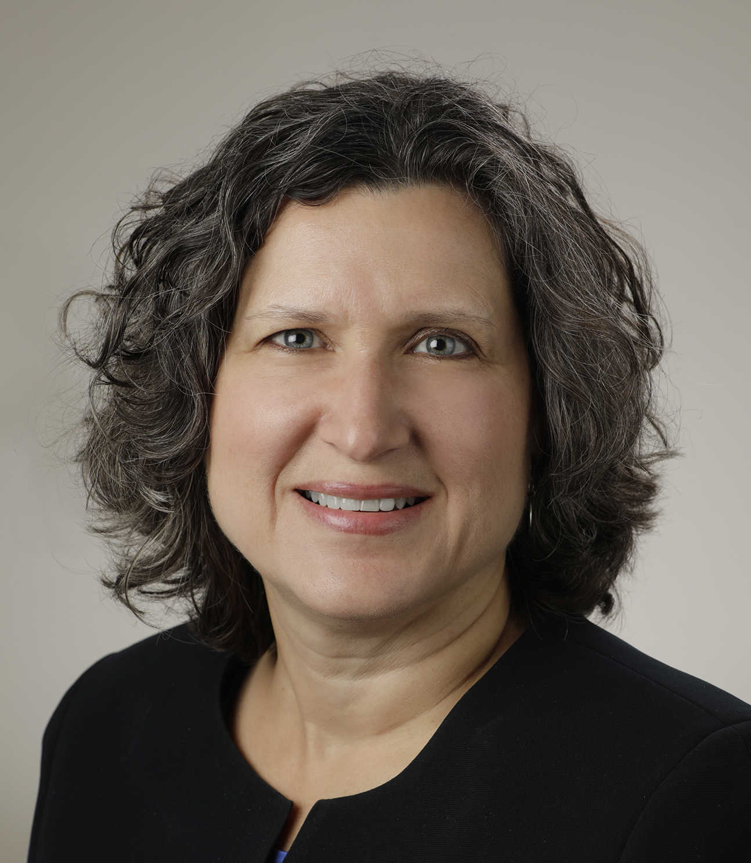
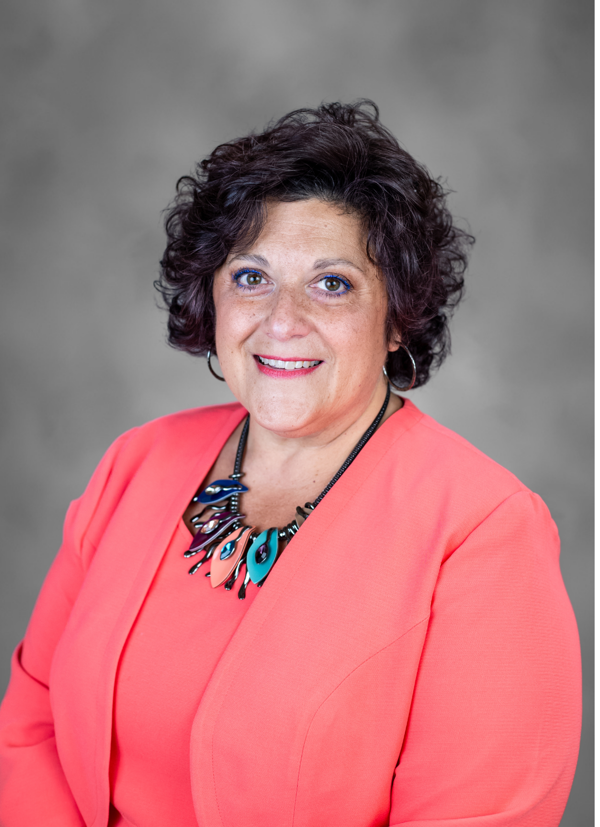
Introducing Your Presenters…
Heather Peters, MEd, PhD
Carmela Meyer, MBA, Ed.D
10+ years as Director of Education for multiple specialties (Surgery, Orthopedics, OBGYN, and Pediatrics) and 22+ years in GME
Master’s degree in curriculum and evaluation
Provided assessment education for multiple GME institutions
25+ year of GME including Associate Program Director of Curriculum and Assessment
Provided assessment education for program directors and program coordinators
Collaborated with PDs from multiple specialties to build assessment plans that align with ACGME requirements

Slide 4
Learning Objectives
EXPLAIN the expected elements of the semi-annual evaluation as a documentation and educational tool;
DISCUSS strategies for creating more efficient semi-annual evaluation meetings with trainees; and
ANALYZE trainee needs, based on the CCC meeting discussion, and translate that into individual learning plans within the framework of the semi-annual evaluation.

Slide 5
Semi-Annual Evaluations: Multiple Dimensions
Improve
Educate
Document
Semi-Annual Evaluation Form

Slide 6
Purpose of the Semi-Annual Evaluation Process
WHY: To provide the learner, the program, and the ACGME documentation of the
learner’s progress
areas of need, and
career goals
WHO: Program Director and Program Coordinator
HOW: Thorough documentation on the semi-annual evaluation form

Slide 7
WHEN: Semi-Annual Evaluation Process Timeline
Learners with Concerns
Mid-point review (February) for those in danger of non-renewal or holding their contract for any reason
Best Practice: CCC or CCC subgroup meets in February or March to clarify direction for those in difficulty
CCC Meeting: May/June
Milestones Due: June
Semi-Annual evaluation meeting: Summer
CCC Meeting: November/December
Milestones Due: January
Semi-annual evaluation meeting: Winter

Slide 8
Key Document: Semi-Annual Evaluation Form
In-depth review of the Sample Semi-annual Evaluation Template
Discussion for GME Team after Webinar: What are our goals for consistency and yet how can we make this document stand out to our learners?

Slide 9
How does the Semi-Annual Evaluation Form Educate?
Provides a consistent framework for reviewing CCC feedback, ITE scores, Procedural competence and so on
Gives emphasis to the elements of the training program that are essential to quality evaluation
Begins the process of using “common evaluation & educational language” for all participants

Slide 10
How to Make Semi-Annual Evaluation Meetings Efficient
Situation: The program director is required to have meetings with multiple trainees in a few weeks
Concern: How to make the meeting efficient, yet meaningful
Best Practices
Send out Semi-annual form ahead of time for the learner to review and begin to formulate goals that can be refined in the meeting
Set a structure for the meeting that aligns with the document (set a time limit for each section)
Go through the semi-annual form in a housestaff meeting so that all become acquainted with the form prior to the individual meetings

Slide 11
It's a process
Resident rotation evaluation
ITE
Eval form
CCC reviews all rotation evaluations and determines milestone achievement
CCC reviews results: content areas, time & study plans
CCC
Competencies reported on semi-annual and discussed strengths and challenges in each competency
ITE results discussed and study plan developed with accountability checkpoints
Semi-annual
Develop ILP for clinical activity: improve competency
Develop ILP with resident for study plans and testing
ILP

Slide 12
It's a process
Work hour logging compliance
360 forms
(nursing, allied professionals, peer, coordinator)
Eval form
CCC and PEC reviews work hour logs
Coordinator tracks compliance
CCC reviews all evaluations and assesses the milestones for communication, PBLI and professionalism
CCC
Compliance is reported on the semi-annual and discussed with the resident
Disruptive behaviors discussed and reported on the semi-annual
Semi-annual
Develop ILP to improve compliance – zero tolerance goal
Develop ILP with resident for disruptive behavior
ILP

Slide 13
ILP Components for Success
Identify the specific action that is a concern
What is the exact measure of success
Milestone | Performance Concern | Action Plan | Deadline | Expected Outcome
A/PC2: Organize and prioritize responsibilities to provide patient care that is safe, effective, and efficient. E/PROF2: Demonstrate a sense of duty and accountability to patients, society, and the profession. | Dr. Lewis’ assessment of your performance during the Same Day Sick rotation identified a lack of focus and difficulty prioritizing responsibilities. | A. Dr. Great will assess resident performance regarding milestone A/PC2 and E/PROF2 during continuity clinic on June 10 and 24. (form attached) B. Dr. Bones will evaluate resident performance on milestones A/PC2 and E/PROF2 during June outpatient rotation. C. Dr. Welby will evaluate resident performance on milestones A/PC2 and E/PROF2 during July outpatient rotation. | July 9 July 30 August 15 June 28 July 12 July 28 | Dr. Great evaluates resident’s clinical decision-making at least at a level 2 on milestone A/PC2 and E/PROF2 at a 2.5. Dr. Bones evaluates resident’s performance at least at a level 2 on milestones A/PC2, level 2.5 on E/PROF2. Dr. Welby evaluates resident’s performance at least at a level 2 on milestones A/PC2, level 2.5 on E/PROF2.
E/PROF4: Develop the ability to use self-awareness of knowledge, skills, and emotional limitations to engage in appropriate help-seeking behaviors. | Athough resident has worked on this milestone, input from faculty members’ show there does not appear to be sufficient progress. | 2a. Meet with Ms. Smith, Director of Educational Support Services. The program requires completion of education testing. Further action steps may be added based on Ms. Smith's report. | July 20 (meeting) July 28 (testing) | Ms Smith recommends next steps such as counseling, testing, medical management, etc. to Dr. PD by email.

Slide 14
ILP Components for Success
Summary of documented progress:
1A: July 9 clinic assessment completed by Dr. Great. Completed
July 30 clinic assessment Completed
August 15 clinic assessment Completed
1B: Dr. Bone’s performance evaluation achieves required levels. Completed
1C: Dr. Welby’s performance evaluation achieves required levels Completed
2A: Meeting with Smith: email update Completed
Learning Inventory. Completed
Has this resident successfully met or exceeded all expectations of this performance improvement plan? _______yes _______no
If no, outline the next steps for performance improvement below.
___________________________________________________________
PD Date Resident signature Date

Slide 15
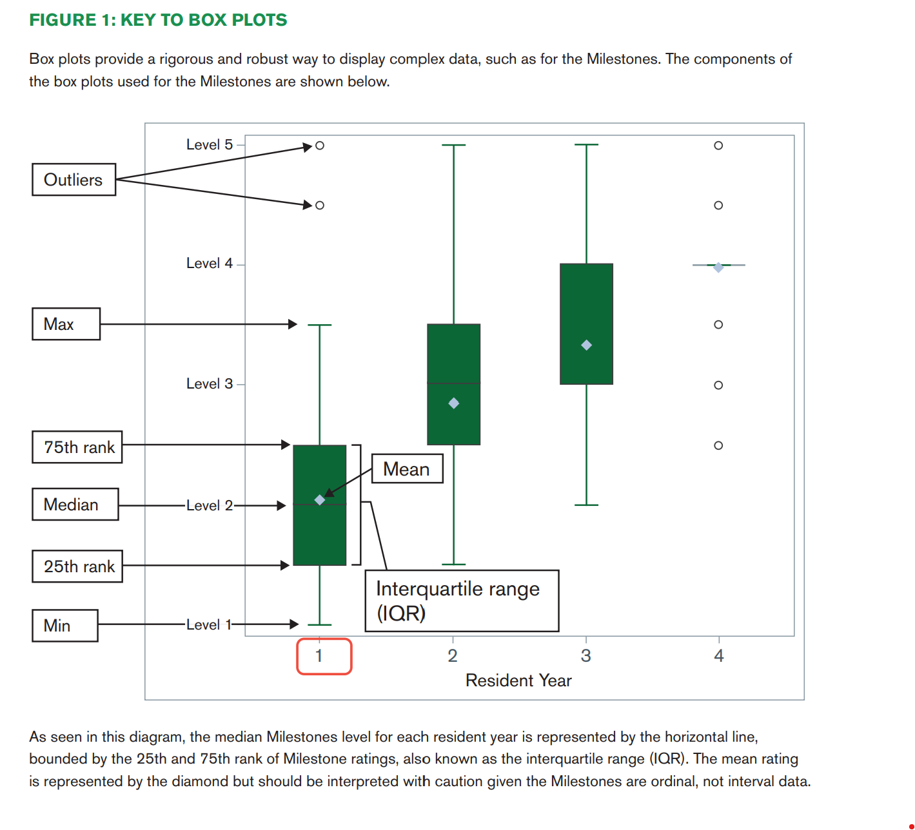
Resources
National Milestone Data: 1160-ACGME-Milestones-Report-2022-R22.pdf
Evaluation Map – Partners ACGME 2023
Semi-Annual Evaluation Template - Partners
p. 27

Slide 16
Upcoming Live Webinar
Ask Partners – Spring Freebie
Tuesday, March 21, 2023
GMEC Best Practices
Thursday, March 30, 2023
Back to Basics for New Coordinators III
Thursday, April 6, 2023
Special Review – When to Trigger
Tuesday, April 18, 2023
I Have A Scholarly Idea, Now What Should I Do to Turn it Into a Research Project?
Thursday, May 4, 2023
Latest On-Demand Webinars
Digging for Data V
Developing Residency Budgets
SI Self Study 101
Motivating Faculty to Mentor & Do Research
Meet the Experts – Fall Freebie
Lights, Camera…Zoom!
GME Educational Program Design II
Site Visits Are Coming!
SI 2025: 2022 Check Up
Back To Basics: Intermediate Topics for New Program Coordinators
GME Educational Program Design I
Wellness is a Team Sport
NEW Program Director Coaching Series
Jan – March Session – FULL
Next Session Starts April – June
6 one-hour group sessions over 12wks
2 one-on-one 30 min indiv. Sessions
Limited Enrollment for interactivity
Course Materials/GME Community Network
Email BJ@PartnersInMedEd.com for pricing and availability
Contact us today to learn how our Educational
Passports can save you time & money!
724-864-7320
www.PartnersInMedEd.com
16

Slide 17
Partners in Medical Education, Inc. provides comprehensive consulting services to the GME community.
Partners in Medical Education
724-864-7320 | info@PartnersInMedEd.com
Amy Durant, MHA
Heather@partnersinmeded.com
Cheryl Haynes, BA
Carmela@partnersinmeded.com
www.PartnersInMedEd.com

