Slide 1
Virtual Site Visits
Christine Redovan, MBA, MLIS -- GME Consultant
Heather Peters, MEd, PhD -- GME Consultant

Slide 2
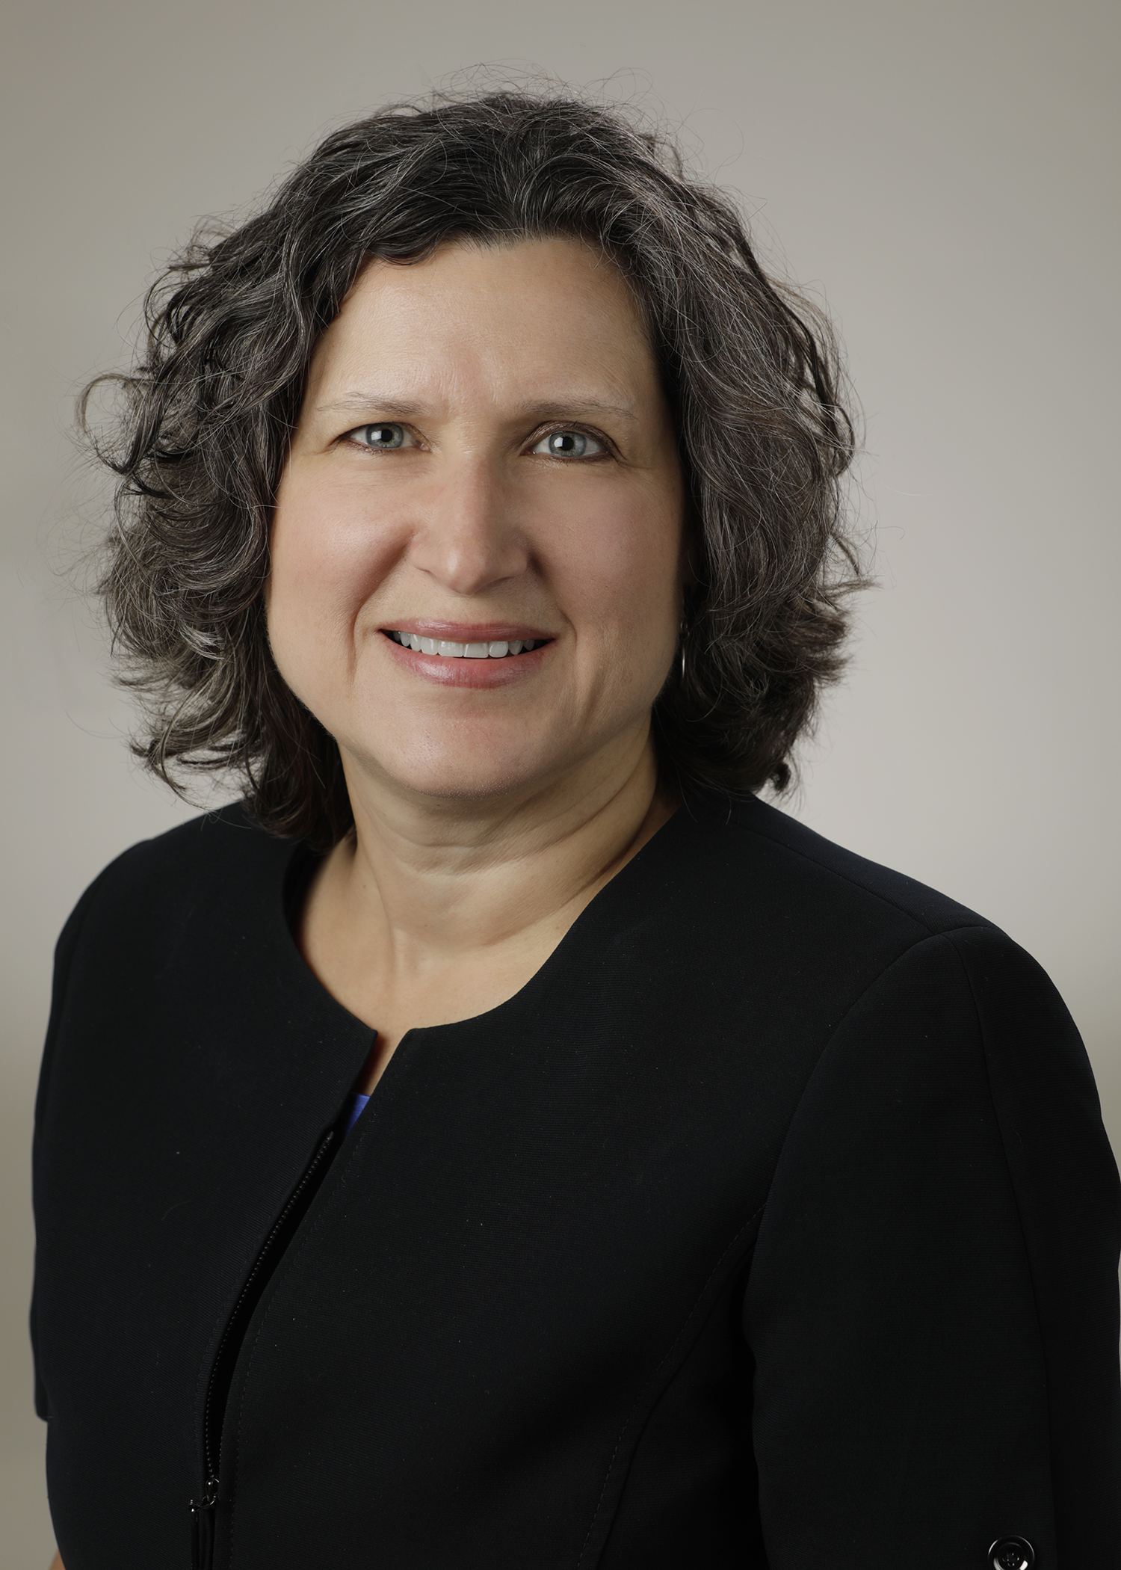
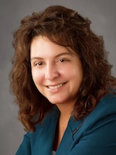
Introducing Your Presenter…
Heather Peters, M.Ed, Ph.D
GME Consultant
Christine Redovan, MBA, MLIS
GME Consultant
Former GME Director & DIO
Seasoned speaker at ACGME & subspecialty national meetings
Areas of Expertise: GME Strategic Planning; Program Evaluation; and Faculty Development
3 decades in education; Masters of Education in curriculum & evaluations, PhD concentration in secondary education & adult learning theories
Seasoned Director of Medical Education and GME Operations
Accreditation and Management Expert For New and Established Institutions and Programs
ACGME-I Accreditation Expert
Successful GME Start-Up Implementation
Focused on Continuous Accreditation Readiness. Data Mining, and Useful GME Resources
20+ years GME experience

Slide 3
Learning Objectives
DISCUSS strategies for…
Scheduling site visits
Preparing for site visits
Day of the site visit
Post site visit
Continuous site visit preparedness

Slide 4
Scheduling Site Visits
Black-out dates request from ACGME
30 days – but be ready for short notice
Approximate date in ADS
Currently a year, or more, behind
Priority
New programs
Programs/Sponsoring Institutions with concerns
Time of day varies

Slide 5
Scheduling Site Visits
New Programs
Surgery RC
Internal Medicine RC

Slide 6
Best Practices
Check ADS often for updates
Pay attention to time zone
Let RC & Field Staff know you are ready

Slide 7
Pre-Site Visit: Opportunities and Challenges
GOAL
SITE VISIT DAY
BACK UP PLANS
TECHNOLOGY
MOCK SITE VISIT
COMMUNICATION WITH
SITE VISITOR

Slide 8
COMMUNICATION WITH THE SITE VISITOR
KEY POINTS:
EMAIL FROM SITE VISITOR
DOCUMENT LISTS
DE-IDENTIFIED
ADS UPDATE
SENDING NEW DOCUMENTS
ATTESTATIONS
SPREADSHEET OF PARTICIPANTS
CHECK EMAILS FOR ACCURACY
GOAL
TAKE YOUR CUES FROM THE SITE VISITOR

Slide 9
MOCK SITE VISIT
KEY POINTS:
PARTICIPANTS NEED PRACTICE
PLAN DEBRIEF TO DISCUSS VULNERABILITIES
STRATEGIES
DOCUMENTS
GOAL
BE PROACTIVE

Slide 10
TECHNOLOGY
KEY POINTS:
MEETING WITH THE SITE VISITOR TO TEST ZOOM
TEST EVERY PARTICIPANT’S CONNECTION
TECHNOLOGY CHECK POINTS
LIGHTING
MONITORS
AUDIO
GOAL
Smeraglio, A., DiVeronica, M., Terndrup, C., McGhee, B., & Hunsaker, S. (2020). Videoconferencing: A Steep Learning Curve for Medical Educators. Journal of Graduate Medical Education, 12(5), 553–556. https://doi.org/10.4300/JGME-D-20-00514.1

Slide 11
BACK UP PLANS
KEY POINTS:
BE READY FOR ANYTHING
HAVE BACK UP COMPUTERS READY
REACH OUT TO FACULTY AND OTHER PARTICIPANTS THE DAY BEFORE TO REMIND THEM TO LOG IN A FEW MINUTES EARLY
GOAL
YOU ARE ALMOST AT THE SUMMIT

Slide 12
Day of Site Visit
Take a deep breath
Test technology
Log-in early
Documents in front of you
Take notes for debriefing
Additional recommended lists
Current QI and scholarly activity
Current faculty development

Slide 13
Day of Site Visit
Site visitor requests
Block diagram
Updated CV’s
Corrections
Do it even if you don’t agree/align with requirements
Confirm timeline
End of site visit
End of day
Next week
Site visitor debrief

Slide 14
POST SITE VISIT
SITE VISIT OUTCOME
DOCUMENTS
EMAIL WILL COME WITHIN A FEW DAYS OF THE REVIEW COMMITTEE MEETING
HOW LONG DID THE SITE VISIT GIVE YOU?
COMMUNICATION WITH SITE VISITOR
DEBRIEF
PROVIDE DOCUMENTS AND THEN TRY NOT TO SEND EXCESSIVE EMAILS
PREPARE FOR POSSIBLE CITATIONS

Slide 15
Continuous Readiness
New Programs
PEC and CCC meetings
List of updated information or changes since submission
Faculty development
Scholarly activity
Don’t stop
doing
“GME”!

Slide 16
Continuous Readiness
Initial Accreditation Programs
Current requirements & specialty application
Are you doing what you said you would?
Surveys
APE
PEC
CCC
Note & understand changes; track data

Slide 17
Continuous Readiness
Continued Accreditation Programs
Survey issues
Resident complaints
Letters of notification
Policies
Self-study
Special review
How are you meeting your aims?

Slide 18
Final thoughts…
Be patient and flexible
Work on what you can improve
Hone technological skills
Preparation is key
Work with PEC
Requirements, goals/objectives, policies, surveys
Consider a program audit
Action plans!
Ask for a special review

Slide 19
Take Care of YOU!
https://www.cdc.gov/coronavirus/2019-ncov/daily-life-coping/stress-coping/care-for-yourself.html

Slide 20
Questions

Slide 21
Upcoming Live Webinar
How to Maximize Virtual Learning Part 1 Thursday, January 21, 2021 12:00pm – 1:00pm EST
Scholarly Work in Pandemic Times Thursday, February 11, 2021 12:00pm – 1:00pm EST
How to Maximize Virtual Learning Part 2
Tuesday, February 23, 2021 12:00pm – 1:00pm EST
Digging for Data Part 3 Thursday, March 4, 2021 12:00pm – 1:00pm EST
Latest On-Demand Webinars
ADS Annual Update: Best Practices
Graduate Medical Education Financing
Artificial Intelligence in Medicine: Its Impact on GME
GME Workforce Planning
Working with a Statistician on your Research Project
Quality Improvement in GME: 5 years later
An Interdisciplinary Approach – Breaking Down the Wall
Meet the Experts – Fall Freebie
Working with Struggling Learners
DIO Role and Responsibilities: Keys to Success
NEW Faculty Development Series
15 Minutes to Effective Feedback
Toolbox for Teaching Millennials
Taking Supervision to the Next Level
Contact us today to learn how our Educational
Passports can save you time & money!
724-864-7320
www.PartnersInMedEd.com
Presented by Partners in Medical Education, Inc. 2021
21

Slide 22
Partners in Medical Education, Inc. provides comprehensive consulting services to the GME community.
www.PartnersInMedEd.com
Heather Peters, M.Ed, Ph.D
Heather@PartnersInMedEd.com
Christine Redovan, MBA, MLIS
Christine@PartnersInMedEd.com

