Slide 1
Maximizing Virtual Learning Part I
Heather Peters, MEd, PhD -- GME Consultant

Slide 2
Introducing Your Presenter…
Former GME Director & DIO
Seasoned speaker at ACGME & subspecialty national meetings
Areas of Expertise: GME Strategic Planning; Program Evaluation; and Faculty Development
3 decades in education; Masters of Education in curriculum & evaluations, PhD concentration in secondary education & adult learning theories
Heather Peters, M.Ed, Ph.D
GME Consultant

Slide 3
Learning Objectives
Maximizing Virtual Learning Part 1: Theory, Platforms, and Accountability
REVIEW learning theory: Adult Learning, Social Learning, and Bloom’s Taxonomy
DISCUSS synchronous/asynchronous learning platforms
DEVELOP accountability mechanisms for videoconferencing and tracking
Activities:
Learning activities to deepen the learning
Tools:
Tips for Virtual Education Success
Bloom’s Taxonomy
Reference List for Virtual Learning

Slide 4
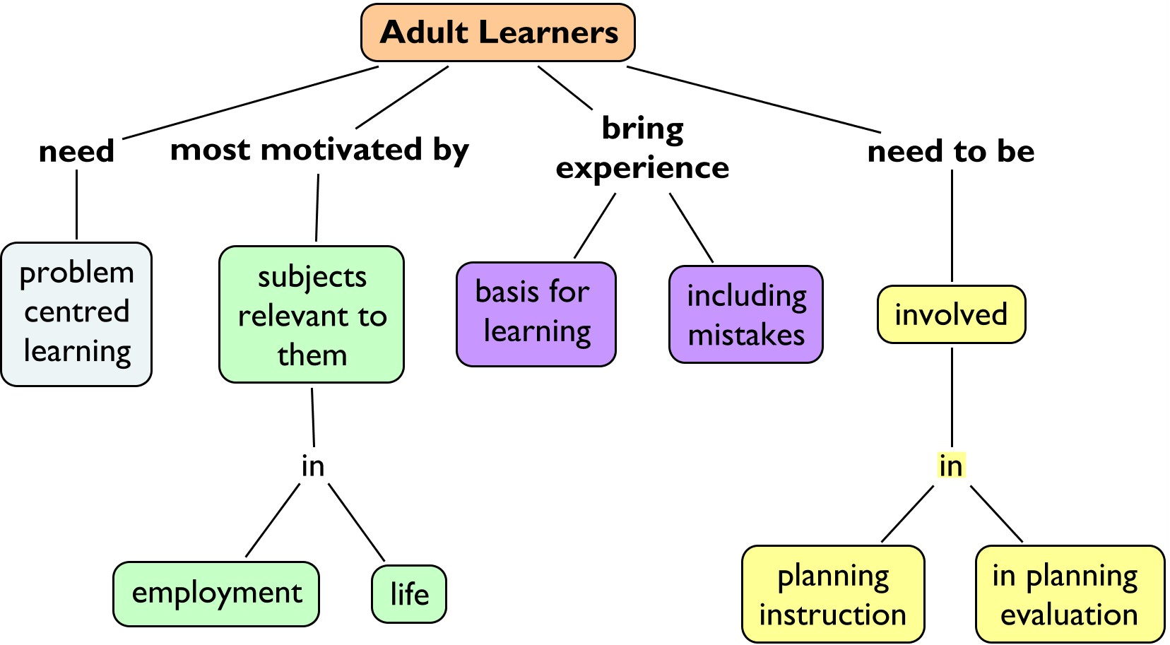
Adult Learning Principles

Slide 5
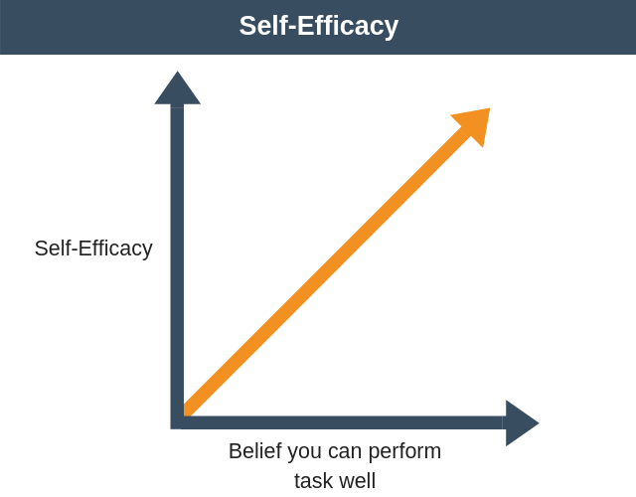
Social Learning Theory
Vicarious Learning (Observational Learning)
occurs when learners from each other
Self-Reinforcers:
Desired outcomes a person can give themselves
Self-Efficacy:
Refers to a person’s belief about their ability to perform successfully
Self-Efficacy Theory of Motivation - Team Management Training (expertprogrammanagement.com)

Slide 6
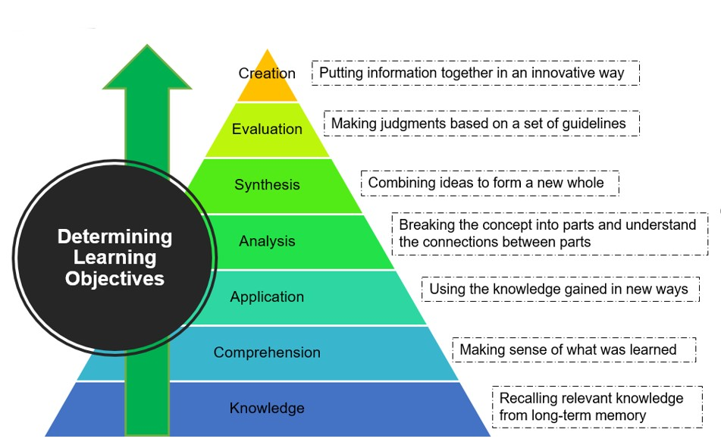
Bloom’s Taxonomy

Slide 7
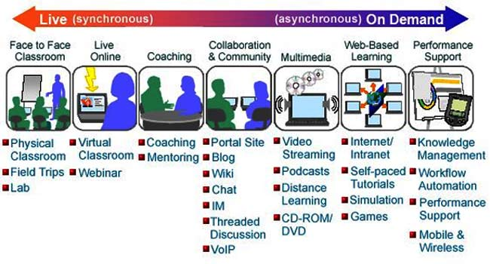
Synchronous to Asynchronous Continuum
Source: E-learning (cyprusinternetmarketingservices.com)
E-learning has been shown to be equally effective as other educational approaches for acquisition of knowledge, skills and behavior (attitude).
Means B, Toyama Y, Murphy R, Bakia M, Jones K. Evaluation of evidence-based practices in online learning: a meta-analysis and review of online learning studies. Washington, DC: US Department of Education; 2009. [revised 2010 Sept]
Cook DA, Levinson AJ, Garside S, Dupras DM, Erwin PJ, Montori VM. Internet-based learning in the health professions: a meta-analysis. JAMA. 2008;300(10):1181–96

Slide 8
Platforms
TEAMS
CBT
Zoom
Webinar & Conferencing
WebEx
Learning Management System
Modules
SDL
IT Support

Slide 9
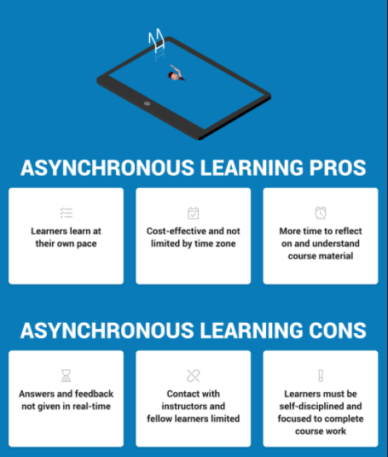
Synchronous vs Asynchronous
Synchronous vs Asynchronous Learning: Which is Right for Your Learners? | LearnUpon
Notes:
What is asynchronous learning?
Asynchronous learning is more learner-centered. It enables your learners to complete courses without the constraints of having to be in a certain place at a certain time. In essence, asynchronous learning doesn’t hinder learners by place or time. As long as they have access to the internet, asynchronous learners have the freedom to complete course materials whenever they choose, and from any location.
Although not taking place then and there, asynchronous learning still allows the opportunity for feedback. Learners are free to share thoughts and questions with instructors and fellow learners, though they may not receive an immediate response.
Some examples of asynchronous learning include:
Online courses
Email
Blogs
Pre-recorded video lessons or webinars
Online forums and discussion boards
Pros of asynchronous Learning:
Asynchronous learning offers lots of flexibility. Although there’s usually a deadline in sight, asynchronous learners can progress at their own pace and access their course at any time they choose and from any place.
It’s a cost effective way to train learners that are based in varying locations. Asynchronous learning means your learners can engage in courses regardless of their time zone or location.
With asynchronous learning, learners have significantly more time to reflect on the material they are learning, which means they are likely to understand it more thoroughly.
Additionally, asynchronous learning lends itself better to a fast-growing business. If you’ve hundreds or thousands of learners to train across the world, you can get them up to speed without the need for face-to-face training.
Cons of asynchronous Learning:
Although learners may have access to an instructor, contact through asynchronous learning may be limited. Answers to queries cannot be given instantly (for example, learners may need to wait for an answer to an email). This can be overcome by ensuring you choose an LMS that makes communication as easy as possible.
The lack of interaction with instructors and fellow learners leaves some individuals feeling isolated. This could lead to a lack of motivation and engagement in courses. So, combat learner isolation by focusing on creating great course content.
Asynchronous learning is learner-centered, so those taking courses in this way need self-discipline and focus to be successful in completing the required course work. Using tools like Gamification or a Forum helps to keep your learners engaged.

Slide 10
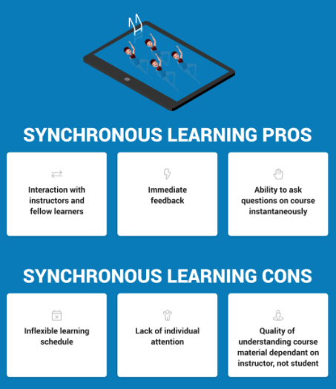
Synchronous vs Asynchronous
Synchronous vs Asynchronous Learning: Which is Right for Your Learners? | LearnUpon
Notes:
What is synchronous learning?
Synchronous learning is any type of learning that takes place in real-time, where a group of people are engaging in learning simultaneously. Although learning occurs at the same time, learners don’t have to be there in-person, or even in the same location. Synchronous learning enables learners to ask questions and receive answers on-the-spot, while also collaborating freely with their co-learners.
For employee training, synchronous learning is a popular choice. It’s a method that lends itself well to learning about updated company policies or new software that’s being rolled out. When done right, it’s also useful for customer and partner training as it creates an invaluable feedback loop.
Some examples of synchronous learning include:
Live webinars
Video conferencing
Virtual classrooms
Instant messaging
Pros of synchronous Learning:
Because of the social nature of synchronous learning, learners can easily interact with instructors and other learners, making group activities possible.
Synchronous learning takes place in real-time, which means learners can get immediate feedback. Ideas and opinions can also be promptly shared with fellow learners.
Similarly, if your learners are having trouble with any of the course content, synchronous learning allows them to ask questions and get instantaneous answers.
Cons of synchronous Learning:
Synchronous learners have to be online at a certain time, and therefore their learning has to adhere to a specific training schedule. Learners can’t access content where and when they like. To accommodate your learners and offer more flexibility, you could provide a webinar recording of the training session through your LMS.
Due to the group dynamic of real-time synchronous learning, some learners may feel they’re not receiving the individual attention they need. This is especially true if there’s any part of the training they do not fully understand. To bypass this, try checking in on the progress of your learners by setting aside time during training for one-to-one or group Q&A sessions.
The effectiveness of how well your learners understand the course content depends more on the quality of the instructor than the learners themselves. To overcome this, ensure your instructors receive relevant training so they’re fully prepared for their role. Requiring instructors to plan their sessions ahead of time will also ensure they’ll deliver a great learning experience for your learners.

Slide 11
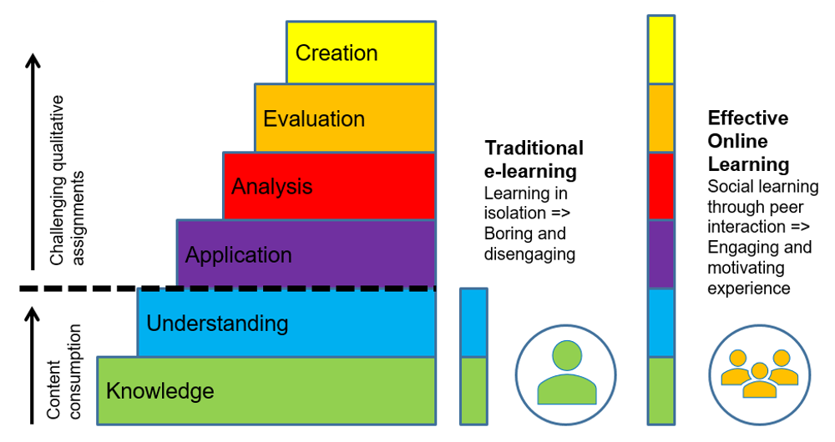
Traditional e-learning vs Effective Online Learning

Slide 12
ACTIVITY 1: Reflection
Worst
Poor
Average
Good
Excellent
Fill out Activity 1 Worksheet

Slide 13
Accountability: Who & How
Administrative Staff
Program Leadership
05
Faculty
Residents
02
01
ACCOUNTABILITY COMPONENTS
Synchronous activity rules
Cameras on – but allow breaks
Tracking asynchronous requirements
LMS (learning management system) – find one with tracking ability
Faculty Annual Reviews
Component of faculty expectations
Consider updating job descriptions, annual review template
Resident Semi-annual Reviews
Accountability component on semi-annual evaluation
04
03
Core Faculty

Slide 14
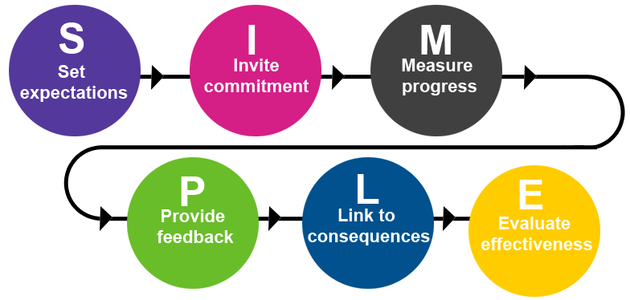
Accountability for Virtual Learning

Slide 15
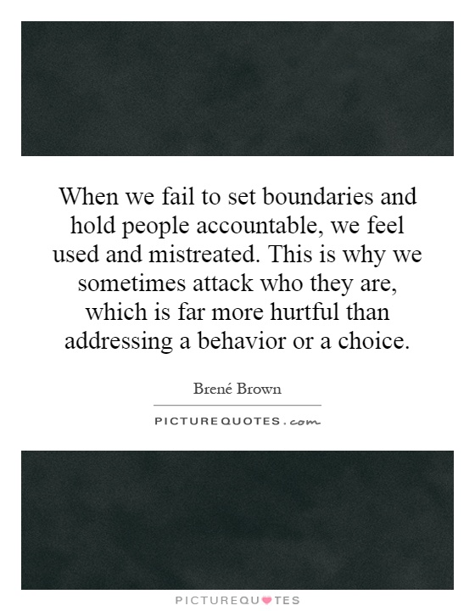

Slide 16
ACTIVITY 2: Dunning-Kruger Effect Understanding Change
Initial Peak
Mastery
Plateau of productivity
New material
Vocab – basics – practice
CONFIDENCE
Discouraging
Tricky
Enlightenment
Encouraging
Valley of Despair
EXPERIENCE
ENTHUSIASM
DESPAIR
ENLIGHTENMENT

Slide 17
Dealing with Zoom Fatigue…
01
02
Change View
Take Breaks
Reduces visual fatigue
Bigger image
Allows for more visual cues
Move away from the screen on a regular basis
Look somewhere else in the room during meetings
Sanders, E. G. (2020). Secrets of the most productive people: I’ll be right back: How to protect your energy during Zoom meetings. https://www.fastcompany.com/90490716/ill-be-right-back-how-to-protect-your-energy-during-zoom-meetings
Brennan, J. (2020). Engaging learners through Zoom: Strategies for virtual teaching across disciplines (First Edition). Jossey-Bass, a Wiley Imprint.
Presented by Partners in Medical Education, Inc. 2021

Slide 18
Take Care of YOU!
https://www.cdc.gov/coronavirus/2019-ncov/daily-life-coping/stress-coping/care-for-yourself.html

Slide 19
Questions
Notes:
As a positive, using Gallery View can allow one to see an entire community of learners. However, the downside is the experience of “visual overload because when we look at a screen, whether it's a computer or a TV screen, our minds are accustomed to processing what is in front of us as a unified whole. But a Zoom meeting in gallery view isn't one unified whole. It's the equivalent of trying to watch 5, 10, 20, or more different TV shows, side-by-side, meanwhile checking a mirror to see how you look. This is incredibly exhausting” (fastcompany). Learners can switch to Speaker View from Gallery View to see a larger image and absorb more expressive cues from the individual speaker (Sanders, 2020).
Brennan, Jonathan. Engaging Learners through Zoom (pp. 78-79). Wiley. Kindle Edition.

Slide 20
Upcoming Live Webinar
Scholarly Work in Pandemic Times Thursday, February 11, 2021 12:00pm – 1:00pm EST
How to Maximize Virtual Learning Part 2
Tuesday, February 23, 2021 12:00pm – 1:00pm EST
Digging for Data Part 3 Thursday, March 4, 2021 12:00pm – 1:00pm EST
Ask Partners – Spring Freebie Thursday, March 11, 2021 12:00pm – 1:00pm EST
Latest On-Demand Webinars
ADS Annual Update: Best Practices
Graduate Medical Education Financing
Artificial Intelligence in Medicine: Its Impact on GME
GME Workforce Planning
Working with a Statistician on your Research Project
Quality Improvement in GME: 5 years later
An Interdisciplinary Approach – Breaking Down the Wall
Meet the Experts – Fall Freebie
Working with Struggling Learners
DIO Role and Responsibilities: Keys to Success
NEW Faculty Development Series
15 Minutes to Effective Feedback
Toolbox for Teaching Millennials
Taking Supervision to the Next Level
Contact us today to learn how our Educational
Passports can save you time & money!
724-864-7320
www.PartnersInMedEd.com
Presented by Partners in Medical Education, Inc. 2021
20

Slide 21
Partners in Medical Education, Inc. provides comprehensive consulting services to the GME community.
www.PartnersInMedEd.com
Heather Peters, M.Ed, Ph.D
Heather@PartnersInMedEd.com

