Slide 1
Maximizing Virtual Learning Part 2
Heather Peters, MEd, PhD -- GME Consultant

Slide 2
Introducing Your Presenter…
Heather Peters, M.Ed, Ph.D
GME Consultant
Christine Redovan, MBA, MLIS
GME Consultant
Former GME Director & DIO
Seasoned speaker at ACGME & subspecialty national meetings
Areas of Expertise: GME Strategic Planning; Program Evaluation; and Faculty Development
3 decades in education; Masters of Education in curriculum & evaluations, PhD concentration in secondary education & adult learning theories
Seasoned Director of Medical Education and GME Operations
Accreditation and Management Expert For New and Established Institutions and Programs
ACGME-I Accreditation Expert
Successful GME Start-Up Implementation
Focused on Continuous Accreditation Readiness. Data Mining, and Useful GME Resources
20+ years GME experience

Slide 3
Learning Objectives
Maximizing Virtual Learning Part 2: Theory, Platforms, and Accountability
REVIEW of learning theories
DISCUSS components of virtual collaboration
OUTLINE tips for virtual education success
Activities:
Learning activities to deepen the learning
Tools:
Key Points for High Impact Virtual Learning Sessions
Learning Styles Visual

Slide 4
Foundational Knowledge: What is learning?
Acquisition of skills, knowledge & attitudes
Question banks
Required readings
Virtual discussions
ATTITUDES
KNOWLEDGE
SKILLS
Simulation activities

Slide 5
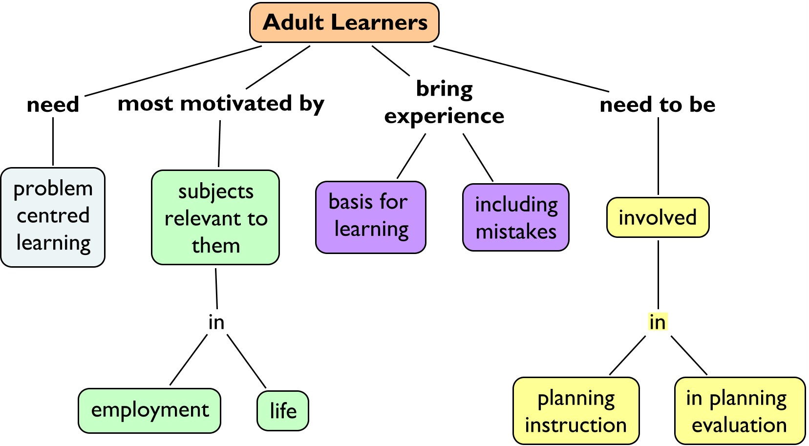
Adult Learning Principles

Slide 6
ACTIVITY 1: ADULT LEARNING PRINCIPLES
Adults will learn best:
Relevant: Practical learning and content that is related to ____ or _____.
Individualized: Self-directed activities where they have a say in the ______ and ______ of their learning.
Problem-solving: Centered on _____ _______ (e.g., case-based learning)
Experience: Adding to what has been ______ (experienced) in the past
Word Ba
learned
problems
work
process
solving
content
personal life

Slide 7
ACTIVITY 1: ADULT LEARNING PRINCIPLES
TIPS
Relevant: Practical learning and content that focuses on issues related to their work or personal life
Connecting to the material at an emotional level will increase the likelihood of action/learning
01
Individualized: self-directed activities where they have a say in the content and process of their learning
Providing choice when possible, will lead to more invested learners
02
Problem-solving: Centered on solving problems (e.g., case-based learning)
Solving problems takes discourse and willingness to tackle thorny issues. This takes tine and happens in phases
03
EXPERIENCE: Focus on adding to what has been
learned (experienced) in the past
04
Creating connections to past experiences validates the learner and motivates learning
Experience

Slide 8
ACTIVATE THE BRAIN
LEARNING THEORY &
VIRTUAL LEARNING
APPEALING
ACTIVE
SLIDES
REDUCE EXTRANEOUS PROCESS
“BRAIN-SPLITTING”
CHAT FUNCTION
AUDIENCE RESPONSE SYSTEM (ARS)
BREAK-OUT ROOMS
SOCIAL LEARNING
TAXONOMY OF LEARNING
CASE DISCUSSIONS
ACCESSIBLE
COGNITIVE LOAD THEORY
15 MINUTES
“KNOWLEDGE BURSTS”

Slide 9
ACTIVITY 2: ACTIVE VS PASSIVE

Slide 10
70-20-10 Approach to Learning
70%
20%
10%
On–the–job
Experience
Informal
Leaning
Formal Leaning

Slide 11
FIVE STEPS TO HIGH IMPACT VIRTUAL LEARNING
KNOW YOUR BACK-UP PLAN
KNOW YOUR STYLE
KNOW YOUR PLATFORM
KNOW YOUR LEARNER
KNOW YOUR GOALS

Slide 12
TYPES OF VIRTUAL COLLABORATION
Break-out Room Discussions
Lecture-activity Series
Asynchronous Discussion
INTERPERSE ACTIVITIES WITH LECTURE – DEEPEN THE LEARNING IN A BREAK-OUT ROOM ACTIVITIES
POST LECTURE WRITING PROMPTS
MIRROR THE CONCEPT OF “TURN TO A NEIGHBOR AND DISCUSS YOUR THOUGHTS”
GOOD – > BETTER – > BEST

Slide 13
ACTIVITY 3: LEARNING ACTIVITIES
Pedagogy vs Andragogy
Digging Deeper into Andragogy

Slide 14
ANSWERS
_a_ 1. independent, self-directed learning activities
_p_ 2. evaluation is accomplished through external methods (lectures, assigned readings)
_a_ 3. planning and assessment is a collaborative activity between teacher and students
_p_ 4. characterized by competitiveness and value judgments
_a_ 5. learning environment is more informal and characterized by equality/mutual respect, and cooperation
_a_ 6. teaching is characterized by inquiry projects, experimentation, independent study
_p_ 7. planning and assessment is conducted by the teacher
_p_ 8. learners are externally motivated (rewards, competition, grades)
_a_ 9. evaluation is characterized by self-assessment
_p_ 10. learners are dependent
_p_ 11. evaluation is accomplished mainly by external methods (grades, tests & quizzes)
_a_ 12. learners are intrinsically motivated

Slide 15
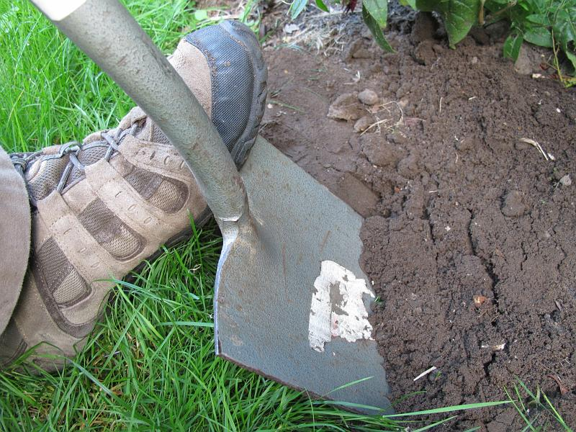
More critical thinking…
Review the Digging Deeper into Andragogy section on your worksheet
They should all be true, right?
Abstract Conceptualization: Let’s discuss two of supposed theoretical tenets of adult education and how they translate into reality

Slide 16
Theory …
…to reality
Adult learners may be quite dependent and unwilling to take responsibility for their learning.
Some individuals only grow or mature to a certain degree and then can’t (or won’t) go any further.
As people mature over the lifespan, they move from being dependent on others toward being self-directed and independent. Thus, adult learners will flourish in an environment that is more learner-centered.

Slide 17
Theory…
…to reality
There are many learning situations and adult learners in which and for whom external motivators are vital to promote and maintain interest.
Adults are more internally motivated to learn than children. This has the advantage of freeing up more of an educator’s time and resources from supervisory and motivational tasks.

Slide 18
Take Away Message: Number one principle of working with adults… VIRTUAL OR IN-PERSON
Learning Style
Know your learner
Level of knowledge
Motivation

Slide 19
Questions
Notes:
As a positive, using Gallery View can allow one to see an entire community of learners. However, the downside is the experience of “visual overload because when we look at a screen, whether it's a computer or a TV screen, our minds are accustomed to processing what is in front of us as a unified whole. But a Zoom meeting in gallery view isn't one unified whole. It's the equivalent of trying to watch 5, 10, 20, or more different TV shows, side-by-side, meanwhile checking a mirror to see how you look. This is incredibly exhausting” (fastcompany). Learners can switch to Speaker View from Gallery View to see a larger image and absorb more expressive cues from the individual speaker (Sanders, 2020).
Brennan, Jonathan. Engaging Learners through Zoom (pp. 78-79). Wiley. Kindle Edition.

Slide 20
Take Care of YOU!
https://www.cdc.gov/coronavirus/2019-ncov/daily-life-coping/stress-coping/care-for-yourself.html

Slide 21
Upcoming Live Webinar
Digging for Data Part 3 Thursday, March 4, 2021 12:00pm – 1:00pm EST
Ask Partners – Spring Freebie Thursday, March 11, 2021 12:00pm – 1:00pm EST
Lessons Learned from the Pandemic: Planning for the Next Disaster Thursday, April 8, 2021 12:00pm – 1:00pm EST
Other Approaches to CCC & Evaluation Thursday, April 27, 2021 12:00pm – 1:00pm EST
Latest On-Demand Webinars
ADS Annual Update: Best Practices
Graduate Medical Education Financing
Artificial Intelligence in Medicine: Its Impact on GME
GME Workforce Planning
Working with a Statistician on your Research Project
Quality Improvement in GME: 5 years later
An Interdisciplinary Approach – Breaking Down the Wall
Meet the Experts – Fall Freebie
Working with Struggling Learners
DIO Role and Responsibilities: Keys to Success
NEW Faculty Development Series
15 Minutes to Effective Feedback
Toolbox for Teaching Millennials
Taking Supervision to the Next Level
Contact us today to learn how our Educational
Passports can save you time & money!
724-864-7320
www.PartnersInMedEd.com
Presented by Partners in Medical Education, Inc. 2021
21

Slide 22
Partners in Medical Education, Inc. provides comprehensive consulting services to the GME community.
www.PartnersInMedEd.com
Heather Peters, M.Ed, Ph.D
Heather@PartnersInMedEd.com
Christine Redovan, MBA, MLIS
Christine@PartnersInMedEd.com

