Slide 1
Please Note…
Please make sure your Start Video is OFF when logging into the WebEx platform.
Here is what it should look like
ALSO
It is NORMAL to not hear any sound until the webinar starts at 12:00 noon EST.
Your phone line is muted, but you can always chat to the host, BJ Couch, if you have any questions or concerns during this time.

Slide 2
Impactful AIR and APE – Bridging Data and Action
Christine Redovan, MBA, MLIS -- GME Consultant

Slide 3
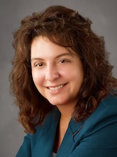
Introducing Your Presenter…
Christine Redovan, MBA, MLIS
GME Consultant
Advanced degree in library and information science
Seasoned AIR and APE editor
Over 20 years GME experience

Slide 4
Learning Objectives
Create persuasive reports that turn findings into action
Determine visualizations for impact and importance
Learn to combine data and storytelling

Slide 5
APE & AIR Requirements
Annual Program Evaluation
Annual Institutional Review
CPR – V.C.1
Documented annual program evaluation
Spells out data to review
Requires action plan
IR – I.B.5
Documented annual institutional review
Criteria established by GMEC + minimum data
Requires action plan

Slide 6
Disclaimer….
The focus of the presentation is on APE reports; however, the same process applies to AIR reports and any reports that require action.
Special review
Citation follow up at GMEC
Survey follow up at GMEC
Any time monitoring for improvement
This Photo by Unknown Author is licensed under CC BY-SA

Slide 7
APE Story - 2018
Residents have complained of the ICU rotation for years.
It is required; unable to eliminate.
Tried a few things
Talked to faculty
Talked to the DIO
Residents provided a few ideas
You’ve watched survey data continue to decline
Evaluations indicate the rotation is declining

Slide 8
APE Data - 2018
Rotation evaluation
Faculty evaluation
Survey data
Pulmonary/Critical Care ITE exam scores
This Photo by Unknown Author is licensed under CC BY

Slide 9
Rotation Evaluation - 2018
Comments:
One of the worst rotations, no teaching, nurses do everything, I feel like a medical student, I’m treated like an observer, not allowed to do anything.

Slide 10
Faculty Evaluation – 2018
Faculty complain residents are not prepared for the rotation
Lack of preparation = lack of trust
Trust their nurses over the residents
Would let residents do actual work if proved they could do it
* Notice this is qualitative data…just as important but a little more difficult to analyze.

Slide 11
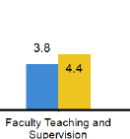
Survey Data - 2018

Slide 12
ITE Exam Scores - 2018
Pulmonary/Critical Care is 10% of exam
Over the past few years, residents have routinely scored below the 50th percentile in this area
Additional didactics were added; not received very well
Option to do more ICU; not received very well
This Photo by Unknown Author is licensed under CC BY

Slide 13
Ape Story - 2020
Over the past two years….
Provided faculty development
Held faculty accountable
Held residents accountable
Implemented a rotation orientation
Adopted a real-time intervention strategy
Adjusted the schedule so the rotation was taken at an appropriate time
Updated goals and objectives with rotation faculty involvement
Introduced focused didactics

Slide 14
Ape Data - 2020
Rotation evaluation
Faculty evaluation
Survey data
Pulmonary/Critical Care ITE exam scores

Slide 15
Rotation Evaluation - 2020
Comments: One of the best rotations, we get to do all the procedures, I felt like part of the team from day one, I’m thinking of a critical care fellowship.

Slide 16
Faculty Evaluation - 2020
I enjoy teaching the residents
We have some great interns!
Nurses – it’s a pleasure working with the residents on our team
Communication has improved dramatically
I like the personal interaction with each resident at the beginning and end of the rotation

Slide 17
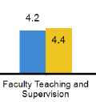
Survey Data - 2020

Slide 18
ITE Exam Scores - 2020
Pulmonary/Critical Care is 10% of exam
Residents routinely score at or above 75th percentile for this area
Simulation added as supplementary training prior to ICU rotation
Question banks
Journal club
This Photo by Unknown Author is licensed under CC BY

Slide 19
Bridging the story & data

Slide 20
Our bridge will be…
Short
Simple
Highlight best action
Remember the requirements
Maintain an objective tone

Slide 21
APE Sample Entry 2020
Refer to handout
This Photo by Unknown Author is licensed under CC BY-SA

Slide 22
Action Plans
Action plans help us build bridges
This Photo by Unknown Author is licensed under CC BY

Slide 23
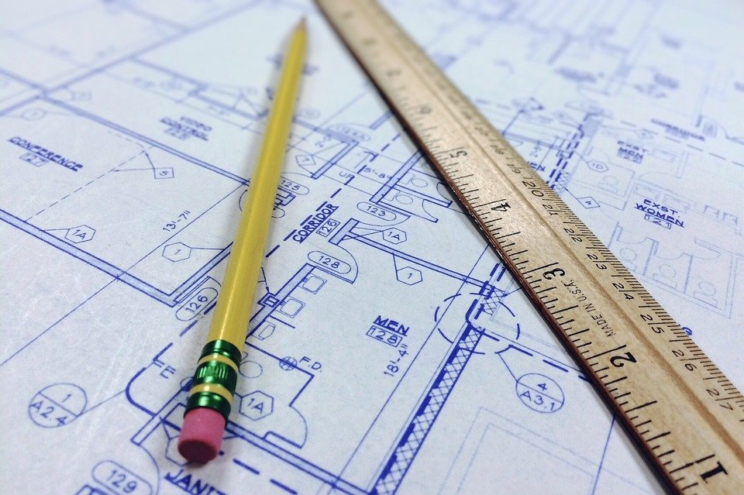
Action Plans
Action plans are SMART
Action plans are the working blueprint for improvement
Action plans drive our stories
Action plans provide data
Action plans hold us accountable

Slide 24
Final thoughts…
Visuals create impact
Use storytelling to highlight your successes in meeting your goals
Connecting with your audience will solidify what you are highlighting
This Photo by Unknown Author is licensed under CC BY

Slide 25
Take Care of YOU!
https://www.cdc.gov/coronavirus/2019-ncov/daily-life-coping/stress-coping/care-for-yourself.html

Slide 26
Questions

Slide 27
Upcoming Live Webinars
Just Released…2021 July-Dec
Summer/Fall Live Education Schedule
Downloaded it here…
https://partnersinmeded.com/educational-resources/
Survey Research Tuesday, June 22, 2021 12:00pm – 1:00pm EST
GME Grants and Funding Sources
Tuesday, July 13, 2021
12:00pm – 1:00pm EST
ADS Updates 2021 Thursday, July 29, 2021 12:00pm – 1:00pm EST
Site Visits – What to Expect in 2021
Thursday, August 12, 2021
12:00pm – 1:00pm EST
Latest On-Demand Webinars
GMEC Checkups – QIPS Edition
ACGME Surveys – What Now?
Other Approaches to CCC & Evaluation
Lessons Learned from the Pandemic: Planning for the Next Disaster
Ask Partners – Spring Freebie
Digging for Data Part 3
How to Maximize Virtual Learning Part 2
Scholarly Work in Pandemic Times
How to Maximize Virtual Learning Par 1
Quality Improvement in GME: 5 years later
How to Manage A Virtual Site Visit
DIO Role & Responsibilities: Keys to Success
Working with Struggling Learners
Faculty Development Series
15 Minutes to Effective Feedback
Toolbox for Teaching Millennials
Taking Supervision to the Next Level
Contact us today to learn how our Educational
Passports can save you time & money!
724-864-7320
www.PartnersInMedEd.com
27

Slide 28
Partners in Medical Education, Inc. provides comprehensive consulting services to the GME community.
Partners in Medical Education
724-864-7320 | info@PartnersInMedEd.com
Christine Redovan, MBA, MLIS
Christine@partnersinmeded.com
www.PartnersInMedEd.com

