Slide 1
Institutional Site Visits
Tori Hanlon, MS, CHCP
Consultant

Slide 2
Introducing Your Presenter…
Tori Hanlon, MS, CHCP
GME Consultant
Over 13 years working in Medical Education
Bachelor’s in Health Services Administration
Master’s in Health Administration and Policy
Designated Institutional Official
Experienced in GME at a large academic medical center

Slide 3
SI
NAS
IR
CLER
CPR

Slide 4
Objectives & Goals
Review the GMEC’s role and responsibilities for institutional site visits
Understand the importance of the AIR and how it will be used for the institutional site visit
Explore ways to best prepare for an institutional site visit

Slide 5
Self-Studies
http://www.acgme.org/What-We-Do/Accreditation/Self-Study

Slide 6
Institutional Self-Studies
Identify stakeholders
Engage CLER stakeholders
Think about others outside the institution
Develop institutional aims
Aims can help to provide the institution with a GME mission and vision for the future
Conduct SWOT analysis
Use in AIR

Slide 7
Institutional Aims
How would you sell your institution to someone?
What is special about your institution?
What kind of residents are you training?
Where do your residents come from?
What skills/strengths do residents bring with them?
What are you training your residents to do when they graduate?
What kinds of jobs or future training do residents choose after graduation?
What population does your institution serve?

Slide 8
Goal of Institutional SV
To demonstrate to the site visitor and the IRC that the SI is in substantial with the ACGME Institutional Requirements

Slide 9
GMEC
Structure your GMEC meetings to maximize oversight and compliance with the Institutional Requirements
Engage GMEC members

Slide 10
GMEC
Membership
Voting vs. Non-voting
Attendance
50% of meetings
Meeting minutes
Detailed, document discussion, annotated, follow up

Slide 11
AIR
Executive summaries
Documentation of AIR in GMEC meeting minutes
AIR action plans and progress on action plans

Slide 12
AIR
GMEC identify institutional performance indicators for AIR
Establish a data collection tool for performance indicators
Collect data
Organize data & other info for review & discussion at GMEC
Conduct AIR at GMEC or GMEC sub-committee
Review data, discuss & create AIR action plans
GMEC approve AIR action plans
DIO writes AIR executive summary
Submit AIR executive summary to Governing Body

Slide 13
Site Visit
Educational oversight
Resources
Learning & working environment
Policies

Slide 14
Educational Oversight
Statement of Commitment
Revise with change in signatories
Review periodically at GMEC (more often than every 5 years)
Special Review
How did the GMEC determine criteria for underperforming programs?
How does GMEC monitor corrective actions & outcomes of programs undergoing a special review?
Have special review reports available for site visit

Slide 15
Educational oversight
How does the GMEC demonstrate oversight of…
Programs
Participating sites
Educational experiences

Slide 16
Resources
Institutional GME office time & support (inc. DIO)
Program level time & support (PD, Coordinator, Faculty)
Faculty development
Resident/fellow forum
Resident/fellow salary & benefits
Technology & library resources
Food, sleep facilities, security

Slide 17
Resources
(To residents) What do you need?
(To residents) Tell me about your Resident Forum
(To DIO/CMO) How do you ensure the necessary financial, educational, administrative, etc. resources are provided to support GME?
(To PDs) What kind of support does the SI and DIO provide to you?
(To PDs & faculty) What kind of support is provided for faculty development?

Slide 18
Policies
Make sure you have ALL required policies
Updated and approved by GMEC
Policies periodically reviewed by GMEC
Includes appropriate language and requirements as written in Institutional Requirements
Living & breathing documents
Be able to speak to policies

Slide 19
Learning & Working Environment
Patient Safety
Quality Improvement
Supervision/Accountability
Professionalism
Well-Being, including fatigue mitigation
Clinical responsibilities, teamwork, transitions of care
Clinical experience & education (formerly duty hours)

Slide 20
Learning & Working Environment
How do you report a patient safety event?
Tell me about resident participation in quality improvement initiatives
How do residents receive data to improve patient outcomes?
Do you have a transitions of care policy?
Are transitions of care standardized across the institution?
How does GMEC monitor supervision?
How does GMEC monitor clinical experience & education?
What education has been provided by the SI in the learning & working environment areas?

Slide 21
Final Preparation Tips
Review & discuss annual institution update questions in WebADS with your GMEC prior to site visit
Educate GMEC members and residents as needed
Engage participating sites early

Slide 22
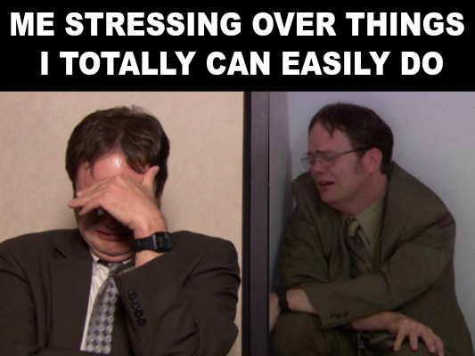

Slide 23
Upcoming Live Webinars From APE to Self-Study… and Everything in Between Tuesday, January 23, 2018
12:00pm – 1:00pm EST
Healthcare Disparities in GME Institutions Thursday, February 8, 2018 12:00pm – 1:00pm EST
AOA to ACGME Accreditation: Best Practices and Challenges Tuesday, February 20, 2018 12:00pm – 1:00pm EST Transitioning from Residency to Practice Thursday, March 1, 2018 12:00pm – 1:00pm EST
www.PartnersInMedEd.com
Partners® Snippets
On-Demand Webinars
Can I Do That? Becoming an Integral Member of the GME Education Team - INST
Getting the Most Out of Your Resident Interview – INST APE for New Programs & AOA Transitional Programs The Millennial Learner
Quality Improvement: Are You Meeting the New Requirements 2017 Common Program Requirements Update Bullying in the Workplace
Meet the Experts - Fall Freebie
Contact us today to learn
how our Educational Passports can save you time & money!
724-864-7320

Slide 24
Partners in Medical Education, Inc. provides comprehensive consulting services to the GME community.
Partners in Medical Education
724-864-7320 | info@PartnersInMedEd.com
Tori Hanlon, MS, CHCP
tori@partnersinmeded.com
www.PartnersInMedEd.com

