Slide 1
“INVISIBLE” FACULTY DEVELOPMENT: Maximizing Your Reach
Heather Peters, M.Ed., Ph.D
GME Consultant
Partners in Medical Education

Slide 2
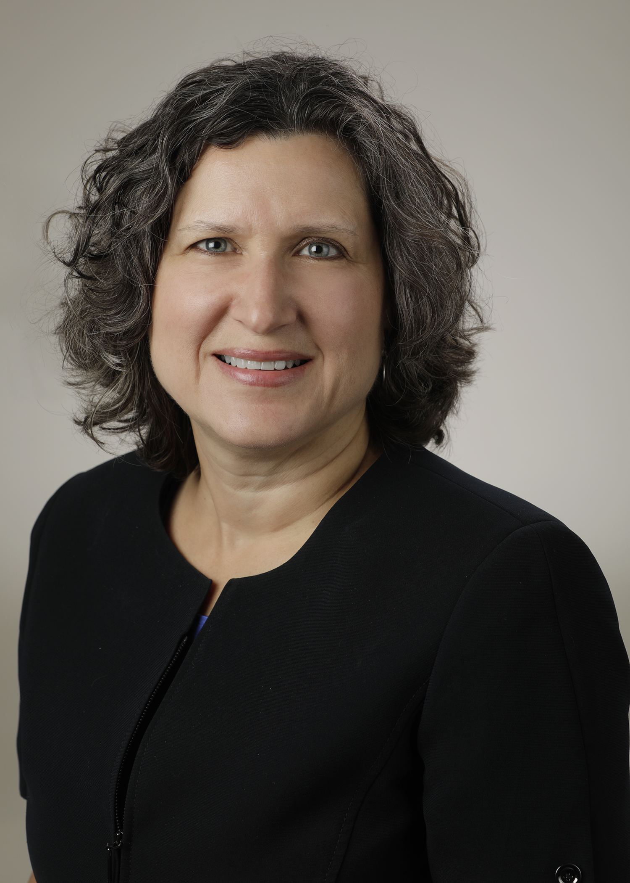
Introducing Your Presenter…
Heather Peters, M.Ed, Ph.D
GME Consultant
DIO & GME Specialist
Seasoned speaker at ACGME & sub-specialty national meetings
Areas of Expertise: Institutional and Program accreditation experience; Strategic planning; Annual Program Evaluation processes; Evaluation processes; and more
3 decades in education; Masters of Education in curriculum & evaluations, PhD concentration in secondary education & adult learning theories

Slide 3
Learning Objectives
REVIEW definition of “faculty” according to ACGME (Common Program Requirements)
DISCUSS barriers to traditional faculty development models/activities
EXPLORE other ways to provide faculty development
OUTLINE format for “Snippets” faculty development model

Slide 4
Faculty Development Requirements

Slide 5
The Role of the Faculty
FOUNDATIONAL ELEMENT
of graduate medical education
Teach residents/fellows how to care to patients
Bridge allowing residents/fellows to grow and become practice ready, ensuring that patients receive the highest quality of care
Role models for future generations of physicians by demonstrating compassion, professionalism, and a dedication to lifelong learning
Employ a scholarly approach to patient through the graduate medical education system to improve the health of the individual and the population

Slide 6
The Role of the Faculty (Continued)
Ensure that patients receive the level of care expected from a specialist in the field
Recognize and respond to the needs of the patient, residents/fellows, community and institution
Provide appropriate levels of supervision to promote patient safety
Create an effective learning environment by acting in a professional manner and attending to the well-being of the residents/fellows and themselves

Slide 7
Common Program Requirements
Faculty Development
Pursue faculty development designed to enhance their skills at least annually (II.B.2.g))

Slide 8
Common Program Requirements
Well-being
Must be also be educated to recognize those symptoms (burnout, depression, substance abuse) in themselves and how to seek appropriate care (VI.C.1.e))

Slide 9
Common Program Requirements
Program Evaluation and Improvement
Results of the faculty educational evaluations should be incorporated into program-wide faculty development plans (V.B.3)

Slide 10
Common Program Requirements
Common Program Requirements
Fatigue Mitigation
Educate to recognize the signs of fatigue and sleep deprivation (VI.D.1.a))
Educate in alertness management and fatigue management processes (VI.D.1.b))

Slide 11
Traditional Methods of Faculty Development*
*Bibliography: nos. 10-13

Slide 12
What are the barriers?
Time is limited
Not a priority
Conflicting commitments

Slide 13
Questions??

Slide 14
Methods for Maximizing Faculty Development Opportunities
The goal is “growth”

Slide 15
Using Repetition to Teach
No one learns anything the first time it’s heard
“Rule of repetition”
Increase likelihood of learning with potential for transference:
Meaningful
Limited number of items
Connected to prior learning
“Use it or lose it”

Slide 16
Using Forms to Teach
How can forms be used to teach?
Terms
Concepts
Evaluations
End of rotations
Direct observations

Slide 17
Using Visuals to Teach
Categories of Visuals:
Posters
Infographics
Screen savers
Other
Where can visuals be placed to teach?

Slide 18
Using Meetings to Teach
How can meeting develop your faculty?
Encourage leadership
Underlying concepts
Requirements
Terms
Policies

Slide 19
Using Faculty Annual Reviews to Teach
How does the faculty review lead to the development of your faculty?
Identify goals
Assess faculty development needs
Other?

Slide 20
Questions??

Slide 21
“Snippets”

Slide 22
Snippets
Snippets are an efficient, effective method for faculty development
Impart bite-sized information and skills
Meet accreditation requirements
Engaging
Uses adult learning principles
Bar-on ME, Konopasek L. Snippets: an innovative method for efficient, effective faculty development. Journal of Graduate Medical Education, 207-210. June 2014.

Slide 23
Snippets
Snippet Anatomy
Title
Learning objectives
Mini-didactic with key points
Activity to reinforce the learning
Discussion/debrief after activity
Take home points
Bar-on ME, Konopasek L. Snippets: an innovative method for efficient, effective faculty development. Journal of Graduate Medical Education, 207-210. June 2014.

Slide 24
Snippets
Four Steps to Developing a Snippet
Select an educational topic or skill and review the literature
Determine key points to be presented
Select an activity to demonstrate the educational topic or skill
Formulate take-home points, and ensure that participants have opportunity to hear them
Bar-on ME, Konopasek L. Snippets: an innovative method for efficient, effective faculty development. Journal of Graduate Medical Education, 207-210. June 2014.

Slide 25
Other Options
Online Modules:
Ohio State (FD4ME) https://fd4me.osu.edu/
YouTube Videos
NEW! Partners® Faculty Development Series
“15 Minutes to Effective Feedback” – 4-part series

Slide 26
Questions??

Slide 27
Bibliography
¹ Bar-on ME, Konopasek L. Snippets: an innovative method for efficient, effective faculty development. Journal of Graduate Medical Education, 207-210. June 2014.
² Meurer LN. Morzinski JA. Published literature on faculty development programs. Fam Med. 1997;29(4):248-250.
³ Khan N, Khan MS, Dasgupta P. Ahmed K. The surgeon as educator: fundamentals of faculty training in surgical specialties. BJU Int. 2013;111(1):171-178.
⁴ Steinert Y, McLeod PJ, Boillat M, Meterissian S, Elizov M, Macdonald ME. Faculty development a “field of dreams’? Med Educ. 2009;43(1):42-49.
⁵ Steinert Y, Macdonald ME. Boillat M, Elizov M, Merterissian S, Razack S, et al. Faculty development: if you build it, they will come. Med Educ. 2010;44(9):900-907.
⁶ Lowry S. Teaching the teachers. BMJ. 1993;306(6870):127-130.
⁷ Lowenstein SR, Fernandez G, Crane LA. Medical school faculty discontent: prevalence and predictors of intent to leave academic careers. BMC Med Educ. 2007;7:37.
⁸ Gibson DR, Campbell RM. Promoting effective teaching and learning: hospital consultants identify their needs. Med Educ. 2000;34(2):126-130.
⁹ Wall D, McAleer S. Teaching the consultant teachers: identifying the core content. Med Educ. 2000;34(2):131-138.
¹⁰Steinert Y, Mann K, Centero A, Dolmans D, Spencer J, Gelula M, et al. A systematic review of faculty development initiatives designed to improve teaching effectiveness in medical education: BEME guide no. 8. Med Teach. 2006:28(6):497-526.
¹¹McLean M. Cilliers F. Van Wyk JM. Faculty development: yesterday, today and tomorrow. Med Teach. 2008:30(6):555-584.
¹²Cook DA, Steinert Y. Online learning for faculty development: a review of literature. Med Teach. 2013:35(11):930-937.
¹³Khan N. Khan MS, Dasgupta P, Ahmed K. The surgeon as educator: fundamentals of faculty training in surgical specialties. BJU Int. 2013:111(1):171-178.

Slide 28
Upcoming Live Webinars
ACGME Section 6 and Wellness Update Tuesday, October 30, 2018 12:00pm – 1:00pm EST New Institution – The value of Graduate Medical Education Thursday, November 8, 2018 12:00pm – 1:00pm EST
Meet the Experts – Fall Freebie Tuesday, November 27, 2018 12:00pm – 1:00pm EST
Milestones – Beyond the CCC Tuesday, December 4, 2018 12:00pm – 1:00pm EST
On-Demand Webinars
Coordinator Development – How to Build a Team Responsiveness to Diverse Patient Populations
Demystifying the Resident and
Faculty ACGME Survey
Oversight of the Clinical Learning and Working Environment
Policies, PLA’s and Policing
Making “Cents” Out of GME Financing
NEW Faculty Development Series
Contact us today to learn
how our Educational
Passports can save you
time & money!
724-864-7320
www.PartnersInMedEd.com
15 Minutes to Effective Feedback
28

Slide 29
Partners in Medical Education, Inc. provides comprehensive consulting services to the GME community.
Partners in Medical Education
724-864-7320 | info@PartnersInMedEd.com
Heather Peters, M.Ed, Ph.D heather@PartnersInMedEd.com
www.PartnersInMedEd.com

