Slide 1
Partners Webinar Alert
Reminder…Because of the amount of individual logins for this webinar. Please DO NOT Unmute your Microphone after you enter this webinar.

Slide 2
Is Your Coordinator Well Enough: Coordinators as Role Models of Wellness
Cheryl Haynes, BA, C-TAGME
Guest Speaker

Slide 3
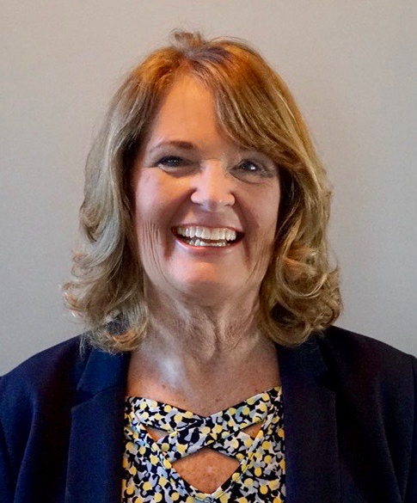
Introducing Your Presenter…
Cheryl Haynes, BA, C-TAGME
Guest Speaker
Seasoned residency manager/institutional coordinator
Board of Directors, Association of Family Medicine Administration
Seasoned speaker/presenter for ACGME, AAFP, AFMA
Published research related to coordinator well-being
21 years GME experience

Slide 4
Learning Objectives
Understand the prevalence of burnout among residency coordinators
Recognize the impact of burnout on our well being
Be aware of resources for personal and professional development

Slide 5
What is the role of the Residency Coordinator?
Multiple titles
Varied responsibilities
Gatekeepers
Counselors
Enforcers
Referees
“The backbone of the residency program.”
“The person with a finger on the pulse of the program.”
Are we well enough to carry out these roles?

Slide 6
Association of Residency Coordinators in Surgery¹
2016 Exec Committee surveyed their membership
254 members surveyed, 60% response rate
76% reported significant level of burnout
Cited increased responsibility, decreased support and education
55% no professional development or sharing of best practices

Slide 7
Association of Program Managers in Obstetrics & Gynecology²
2017 surveyed 207 members, 83% response rate
83% moderate to high job satisfaction
64% work-related burnout

Slide 8
Association of Family Medicine Administration³
2017 partnered with University of Kansas-Wichita Dept of Family & Community Medicine
Surveyed 407 members, 75.4% response rate
Job satisfaction
44% high
56% average
91% reported some level of burnout
75% moderate to high

Slide 9
Burnout
Loss of enthusiasm for work, feelings of cynicism, and a low sense of personal accomplishment” (Archives of Internal Medicine, 2010), characterized by
Emotional exhaustion
Feeling as if your work has lost “meaning”
Feeling ineffective

Slide 10
Surgery Coordinators Survey
Cited increased responsibility, decreased support and education
55% no professional development or sharing of best practices

Slide 11
AFMA/KU-Wichita Professional Development Survey⁴
2nd survey 2018
60% response rate
64% reported they had received training for their positions
92% reported they receive financial support for professional development

Slide 12
Barriers to Professional Development

Slide 13
“Time away from my position makes it extremely difficult to keep up with my workload. It is very stressful before I leave and when I come back due to workload.”

Slide 14
“It’s not the money, it’s the time and lack of support. No one does my work when I am away.”
“It’s not worth being
gone.”

Slide 15
Reasons for Burnout
AFMA³
Workload
Lack of support
Underappreciated
Non-compliant residents

Slide 16
Changes since surveys began
Milestones
CCC/PEC
Duty Hours now “Work Hours”
Common Program Requirements
Emphasis on Physician/Resident Wellness
No more PIF (Yay!)
Expansion of WebAds (really a PIF, Boo!!)
Self Study
Milestones 2.0

Slide 17
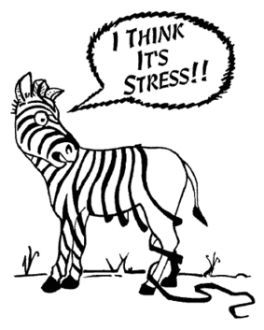
What does this change mean for us?
More work
More uncertainty
More stress

Slide 18
Is all stress bad?
Eustress
energy
motivation
depersonalization
disconnection
Burnout

Slide 19
Tenure in Position
2016 – Surgery Coordinators
34% less than 5 years
2017 OB-GYN Coordinators
40% less than 5 years
2018 Family Medicine Coordinators
51% less than 5 years

Slide 20
Turnover Intent
2016 Surgery Coordinators Survey
59% had considered leaving their position in the last year.
2017 OB/GYN Survey did not address this.
⁵2019 AFMA/KU-W 3rd survey 389/551 (71%)
50% had considered leaving their jobs in the last MONTH!

Slide 21
Resiliency
The ability to bounce back
Internal shock absorbers
The ability to struggle well

Slide 22
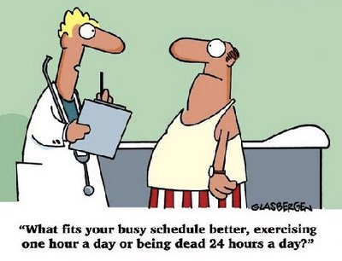
Personal Wellness
Diet
Exercise
Exercise reverses the effects of stress at the cellular level.
Burning 350 calories
3 times per week is as
effective as an
antidepressant.

Slide 23
“You can’t out-exercise a bad diet.”
Michael S. Shapiro, PhD
Director of Behavioral Science, SRAHEC

Slide 24
Personal Wellness
Hobbies
Healthy outlets
Laughter
“an instant vacation”
Milton Berle

Slide 25
Personal Wellness
Relationships
Include people who understand what you do.
Remember that your residents are not your friends.
Joy - in life and in work.

Slide 26
Professional Wellness
Education
Collaboration

Slide 27
Education
Conferences
Online training
Keep up with changes (ACGME, ABMS, etc)
Always read the Tracked Changes copy
Pay attention to the Background & Intent
“He who has a ‘why’ can conquer any ‘how’.” Nietche

Slide 28
Collaboration
Two or more people working together toward
shared goals.

Slide 29
Who shares our work goals?
Program Director
Shared stressors?
Workload
Lack of support
Underappreciated
Non-compliant residents

Slide 30
Program Director Burnout
Program Directors - How often do you feel burned out from your work?⁶
Response rate of 53.7% (245/465) AFMRD Members
36.7% - Low (Never/A few times per year)
36% - Medium (Once a Month/A few times per month
27.3% - High (Once a week/A few times per week/Everyday)

Slide 31
FM Program Directors
“In summary, the responding directors mostly represented community-based, university-affiliated programs located in communities with a population greater than 150,000, had less than 25% of the current residents as graduates of non-US medical schools, served as program director for less than 5 years, and were male.”

Slide 32
Who else shares our goals?
Chief Resident(s)
Co-workers
Professional Organizations

Slide 33
BE A ROLE MODEL
Take care of yourself first.
Find your joy.
Cultivate collaboration.
Remember that others are struggling, too!
Struggle well together.
There is comfort in normalcy.

Slide 34
Are YOU well enough?
Take the Burnout Self Assessment
courtesy of your AFMA colleagues

Slide 35
Resources for Personal Wellness & Resiliency
The Happiness Project, Gretchen Rubin
Building Resiliency: 5 Ways to a Better Life
https://www.youtube.com/watch?v=fPMqMJMiBiA
Three Easy Ways to Find Your Resiliency
https://today.duke.edu/2016/02/resilience
Happify https://www.happify.com
www.16personalities.com I am an Adventurer!

Slide 36
Q & A

Slide 37
References
¹Fountain D, Quach C, Norton D, et al. The perfect storm is on the horizon! J Surg Educ 2017; 74(6):e120-3123. PMID: 28865903.
²Ofei-Dodoo S, Irwin G, Kuhlmann Z, Kellerman R, Wright-Haviland S, Dreiling M. Assessing work-related burnout and job satisfaction among obstetrics and gynecology residency program coordinators. Kans J Med. 2019;12(1):11-16.
³Ofei-Dodoo S, Scripter C, Kellerman R, Haynes C, Marquise ME, & Bachman CS, Burnout and Job Satisfaction among Family Medicine Residency Coordinators: Results from a National Survey. Family Medicine STFM. October 2018 Volume 50, Issue 9
⁴Haynes C, Freelove R, & Ofei-Dodoo S. Assessing Family Medicine Residency Coordinators’ Work Stress and Wellbeing. Paper presented at the PDW and RPS Residency Education Symposium at the Sheraton Kansas City Hotel at Crown Center. Kansas City, MO. March 26, 2018.

Slide 38
References
⁵Ofei-Dodoo S, Long MC, Bretches M, Kruse BJ, Haynes C, Bachman CS. Work engagement, job satisfaction, and turnover intentions among family medicine residency program managers. International Journal of Medical Education. 2020;11:47-53. DOI: 10.5116/ijme.5e3e.7f16.
⁶Porter M, Hagan H, Klassen R, Yang Y, Seehusen DA, Carek PJ. Burnout and Resiliency Among Family Medicine Program Directors. Fam Med. 2018;50(2):106-112. https://doi.org/10.22454/FamMed.2018.836595
⁴Haynes C, Freelove R, & Ofei-Dodoo S. Assessing Family Medicine Residency Coordinators’ Work Stress and Wellbeing. Paper presented at the PDW and RPS Residency Education Symposium at the Sheraton Kansas City Hotel at Crown Center. Kansas City, MO. March 26, 2018.

Slide 39
Upcoming Live Webinars
Research Proposal Development: Tips for Success Thursday, April 23, 2020 12:00pm – 1:00pm EST Working with your Governing Board Tuesday, May 5, 2020 12:00pm – 1:00pm EST
Recognizing & Addressing Precursors of Burnout: The Value of Shame Resiliency Training to Support Resident Well-Being Thursday, May 28, 2020 12:00pm – 1:00pm EST
On-Demand Webinars
Feedback – From the Top Down
Evolving Resident Well-Being
We All Need Scholar Activity, Including Coordinators
Preparing for the 10 Year Site Visit
Meet the Experts – Fall Freebie
Jump Start Your GMEC
Creating a Diverse Workforce
APE Reconstructed
Digging for Data 101
PEC: Best Practices
NEW Faculty Development Series
15 Minutes to Effective Feedback
Toolbox for Teaching Millennials
Taking Supervision to the Next Level
Contact us today to learn how our Educational
Passports can save you time & money!
724-864-7320
www.PartnersInMedEd.com
39

Slide 40
Partners in Medical Education, Inc. provides comprehensive consulting services to the GME community.
Partners in Medical Education
724-864-7320 | info@PartnersInMedEd.com
Cheryl Haynes, BA, C-TAGME
Cheryl.Haynes@sr-ahec.org
www.PartnersInMedEd.com

