Slide 1
Please Note…
Please make sure your Start Video is OFF when logging into the WebEx platform.
Here is what it should look like
ALSO
It is NORMAL to not hear any sound until the webinar starts at 12:00 noon EST.
Your phone line is muted, but you can always chat to the host, BJ Schwartz, if you have any questions or concerns during this time.

Slide 2
JEDI Warriors in GME: Guardians of Justice, Equity, Diversity & Inclusion
Christine Redovan, MBA, MLIS
Cheryl Haynes, BA

Slide 3
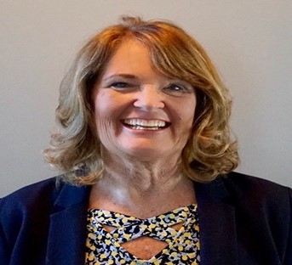
Introducing Your Presenters…
Christine Redovan, MBA, MLIS
GME Consultant
Cheryl Haynes, BA
GME Consultant
Developed holistic interview strategies for programs
Experienced using JEDI in program improvement
Experienced in incorporating JEDI into program development (curriculum, goals & objectives)
Seasoned coordinator experienced in recruiting and working with diverse faculty, residents and students

Slide 4
LEARNING OBJECTIVES
Understand the differences between the components of JEDI
Discuss the benefits and importance of JEDI in GME
Explore tools and resources for incorporating JEDI components into your program

Slide 5
Brief History
1960’s – Equality; Civil Rights (E)
1970’s – Inclusion; Multicultural Movement (I)
1980’s – Diversity; gender/race focused (D)
1990’s – Diversity; ethnicity, religion, sexual preference, ability (DEI)
2000’s – Justice; barrier focused
(JEDI)
2022 – Youmans, et.al. - DEBI
This Photo by Unknown Author is licensed under CC BY-NC

Slide 6
ACGME & Accreditation
Section I.C. Addresses recruitment and retention of a diverse and inclusive workforce.
Requirement II.A.4.a).10. specifies the need for program directors to cultivate an environment in which residents and fellows can raise concerns and provide feedback without fear of intimidation or retaliation.
Section V begins to address evaluation and asks programs to collect data on ultimate board certification rates of its graduates, with the intent of decreasing reliance on first time pass rates as a measure of excellence.
Requirement VI.B.6. states that programs and Sponsoring Institutions must provide a professional, and respectful environment free from discrimination, harassment, mistreatment, abuse, or coercion.
Source: acgme.org

Slide 7
Justice

Slide 8
What is Justice?
“Dismantling barriers to resources and opportunities in society so that all individuals and communities can live a full and dignified life”
Source: jedicollaborative.com

Slide 9
Justice in GME
It’s all about community
Awareness and acknowledgement of disparities
Understanding disparities and the effect they have
Breaking down the disparity through actions and commitment
This Photo by Unknown Author is licensed under CC BY

Slide 10
What does this look like?
Maternal mortality among Black, American Indian and Alaskan native women
COVID-19 effect on Black, Latinx and Indigenous people
Trustworthiness between GME & the community
Reframing conversations and language used

Slide 11
Equity

Slide 12
What is Equity?
The quality of being fair and impartial
Fair treatment, access, opportunity and advancement for all people.

Slide 13
Equality vs Equity

Slide 14
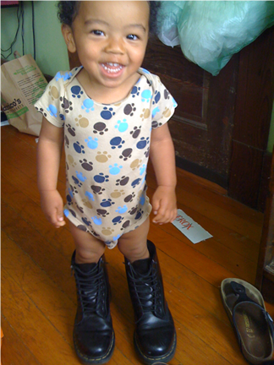
Equality is giving everyone a shoe….
…equity is giving everyone a shoe that fits.

Slide 15
Equity in GME
Virtual interviews
Holistic approach to application reviews
USMLE pass/fail
ACGME Equity Matters Curriculum
https://www.acgme.org/what-we-do/diversity-equity-and-inclusion/ACGME-Equity-Matters/

Slide 16
Diversity

Slide 17
What is Diversity?
“All the differences between us based on which we experience advantages or encounter barriers to opportunities”
Source: jedicollaborative.com

Slide 18
Diversity in GME
It’s all about the healthcare environment
Awareness and acknowledgment of underrepresented in medicine (UiM) backgrounds
Understanding diversity and the intent of culturally responsive healthcare
Improving diversity through actions and commitments
This Photo by Unknown Author is licensed under CC BY-SA-NC

Slide 19
What does this look like?
Using multiple strategic practices in recruitment
Improvement of patient outcomes from diverse healthcare teams
Investing in resident support and success
Partnerships and collaborations with UiM groups

Slide 20
Inclusion

Slide 21
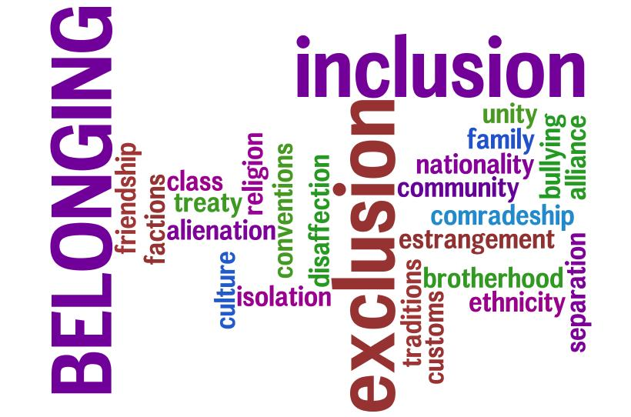
What is Inclusion?
A state of being valued, respected and supported
Focusing on the needs of every individual
Ensuring that the right conditions are in place for each person to achieve his or her full potential
Everyone belongs

Slide 22
Inclusion in GME
Professional development and education of the GME community on cultural and structural competence
Cultural competence – understanding, appreciating and interacting with people from other cultures or belief systems than your own
Structural competence – understanding and addressing health-related social justice issues that have led to health disparities and inequities

Slide 23
JEDI in Action

Slide 24
Let’s look at some examples
GMEC-JEDI Committee (Kara, et.al., 2022)
Seattle Children’s Health Equity Rounds
UC San Diego – San Diego Lung Ladies
University of Rochester – Family Medicine Antiracism Initiatives
This Photo by Unknown Author is licensed under CC BY-NC-ND

Slide 25
Make a Commitment to JEDI in GME
Research & Scholarly Activity
Patient Safety
Quality Improvement
Population Health
Evaluate your own program (Ravenna, et.al., 2022)

Slide 26
If you do nothing else…
Source: https://apdsweb.s3.amazonaws.com/webfiles/docs/APDSDiversityInclusionToolkitJune2020.pdf

Slide 27
JEDI Warriors in GME
Advance health care quality
Improve medical education
Enhance community relations
Positively impact society as a whole

Slide 28
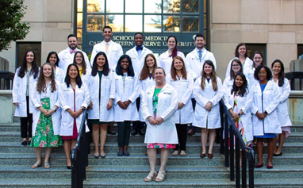

Slide 29
Questions

Slide 30
References
Association of American Medical Colleges. (2021, June). Medical schools’ and teaching hospitals’ efforts to address the maternal health crisis. Retrieved from https://www.aamchealthjustice.org/our-work/maternal-health-equity
Harmon,G. (2021, October 28). Our words matter. It’s time to get them right. [Blog Post]. American Medical Association, retrieved from https://www.ama-assn.org/about/leadership/our-words-matter-it-s-time-get-them-right
Kara, A., Wright, C., Funches, L., Williamson, F., Hicks, R., Sutton, T. & Naghan, Z. (2022). Serving on a graduate medical education diversity, equity, inclusion, and justice committee: Lessons learned from a journey of growth and healing, Front. Public Health (10) article 867035, doi: 10.3389/fpubh.2022.867035
LSA Center for Social Sciences, University of Michigan. (n.d.). Diversity in Higher Education Part I. Retrieved from https://lsa.umich.edu/social-solutions/news-events/news/insights-and-solutions/infographics/ali-series-part-i---the-history-of-diversity-in-higher-education.html

Slide 31
References
Metzl, Jonathan M. MD, PhD; Petty, JuLeigh PhD Integrating and Assessing Structural Competency in an Innovative Prehealth Curriculum at Vanderbilt University, Academic Medicine: March 2017 - Volume 92 - Issue 3 - p 354-359 doi: 10.1097/ACM.0000000000001477
Ravenna, P., Wheat, S., El Rayess, F., McCrea, L., Martonffy, A., Marshall, C., Tepperber, S., Friedman, R., & Barr, W. (2022). Diversity, equity, and inclusion milestones: Creation of a tool to evaluate graduate medical education programs, J Grad Med Educ, (14)2, 166-170, doi: 10.4300/JGME-D-21-00723.1
Seattle Children’s Hospital. (n.d.). Justice, equity, diversity, inclusion (JEDI) and antiracism in the pediatric residency program. Retrieved from https://www.seattlechildrens.org/healthcare-professionals/education/residency-fellowships/uw-pediatric-residency/equity-diversity-and-inclusion-edi-in-the-pediatric-residency-program/

Slide 32
References
UC San Diego. (n.d.). Diversity. Retrieved from https://medschool.ucsd.edu/som/medicine/divisions/pulmonary/education/fellowship/about/Pages/Diversity.aspx
University of Rochester, School of Medicine & Dentistry. (n.d.). Family Medicine Residency, Diversity & Inclusion. Retrieved from https://www.urmc.rochester.edu/education/graduate-medical-education/prospective-residents/family-medicine/diversity-inclusion.aspx
Vaughn, B. E. (2007). The history of diversity training and its pioneers. Strategic Diversity & Inclusion Management Magazine, (1)1, 11 – 16
Youmans, Q., Essien, U., Maldonado, M., & Lupton, K. (2022). Building inclusion and belonging in training environments, J Grad Med Educ, (14)3, 333-334, doi: 10.4300/JGME-D-22-00307.1

Slide 33
Upcoming Live Webinar
Scholarly Activity – Starting the Year of Right
Tuesday, July 12, 2022
ADS 2022: Part II
Thursday, July 21, 2022
Looking Behind the Curtain at CMS Reporting
Thursday, August 4, 2022
Wellness is a Team Sport
Tuesday, August 16, 2022
GME Educational Program Design I
Thursday, September 15, 2022
Back to Basics: Intermediate Topics for New Coordinators
Thursday, September 29, 2022
Latest On-Demand Webinars
ACGME Complaint Letter: Now What?
Here We Grow Again – And With Our Community
The ABCs of GMEC: Part II
ADS 2022: Part I
Ask Partners – Spring Freebie
Getting to the Next Stage – Program Improvement II
The ABCs of GMEC: Part I
Leveraging RMS Technology for the Medicare Cost Report
Back to Basics – GME for New Coordinators
Digging for Data IV
Getting to the Next Stage - Program Improvement I
Faculty Development Series
15 Minutes to Effective Feedback
Toolbox for Teaching Millennials
Taking Supervision to the Next Level
Contact us today to learn how our Educational
Passports can save you time & money!
724-864-7320
www.PartnersInMedEd.com
Presented by Partners in Medical Education, Inc. 2022
33

Slide 34
Partners in Medical Education, Inc. provides comprehensive consulting services to
the GME community.
Partners in Medical Education
724-864-7320 | info@PartnersInMedEd.com
Heather Peters, M.Ed., Ph.D
Christine@partnersinmeded.com
Carmela Meyer, Ed.D
Cheryl@partnersinmeded.com
www.PartnersInMedEd.com

