Slide 1
I, We, They – Self-, Team-, and Patient-Leadership Education in GME
Presented By:
Barry A. Doublestein, DSL
President – Leadership Solutions
Partners in Medical Education, Inc.

Slide 2
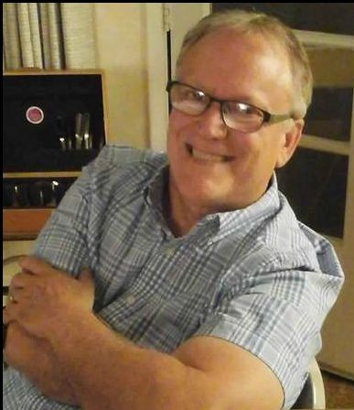
Your Presenter…..
Barry A. Doublestein, DSL
President of Leadership Solutions
President & COO of the Osteopathic Institute of the South since 1989
Passionate about physician-professionalism
Certified AOA Osteopathic Graduate Medical Education Consultant
Notes:
Introduction:
1) Honored to be part of the Partners webinar series – support their efforts to help each of you to be the best GME program possible – If you were a participant in last year’s webinar, welcome back. A small amount of the information I am going to share with you may be familiar…this I cannot help, as I have learned that this information, while not complex, is easily forgotten by those that receive it. Busyness is often one’s greatest enemy, so I will remind you of a few things upon which we touched last year…only a small amount.
2) My 35 years in UME/GME has culminated in my interest and focus on professionalism development in Medical Education – I have been frustrated that we have not made the same strides that we have with medical knowledge and technical competence
3) As a Dean of Students in a UME college almost two decades ago, and now as a regional GME clinical dean, and a consultant to the UME/GME community – I have seen the ‘dark side’ of physician education – I have been waiting for someone to step up and lead the ‘professionalism movement’ – some have tried, but little has changed…BUT THE TIMES THEY ARE A CHANGING! We can do better than just pass students or residents along to the next people in the continuum…hoping that change may happen on its own.
4) Some of you may be unsure of the letters (DSL) following my name – not a form of internet connection…but rather a very specific degree designed to bring about maximum leadership change in people, institutions, and organizations – Doctor of Strategic Leadership
5) I am going to deliver a fair amount in information…but information alone is going to be of little use for you unless you internalize it and make it part of your everyday work. I am going to involve you in a series of polling questions from time to time throughout this webinar…please add your input/questions. My plan is to give you a plan or a roadmap to understand how important the field of leadership development is for rising physicians that will take your program to a higher level of quality then you can imagine. I plan on sharing a few personal stories about my three decades of experience…not for self-agrandizement but for purposes of clarifying points. I am also wanting to challenge you to assess what you know/or do not know and consider alternatives to improving your program

Slide 3
Agenda
Defining Professional Formation
Discuss why it is important in GME
Discuss self-leadership as the foundational element in Professional Formation
Discuss team-leadership and the principles surrounding effective practice
Discuss patient-leadership that results in excellent care
Notes:
This is our agenda for today’s session. We will begin with a short definition of professional formation in medical education, why there is such a strong push for it in the community, and why it is important for those of us active in GME.
Next we will discuss self-leadership’s role as the foundational element in professional development and then move along to team leadership and the principles surrounding effective practice.
Finally, we will discuss patient-leadership that ultimately results in excellence in patient care.

Slide 4
Are you aware of the ACGME requirements for professional formation?
Notes:
POLLING – USING YES OR NO
Let us begin with a POLLING Question…It is just a yes/no query:
Are you aware of the ACGME requirements as they relate to professional formation?
Wait for an answer…..

Slide 5
Do you have an institutional plan to meet these standards?
Notes:
Poll – yes or no
A follow-up query:
Do you have an institutional plan to meet these standards?
Wait for an answer….

Slide 6
Are you satisfied that this plan is effective and complete in what it is attempting to assess?
Notes:
POLLING YES OR NO
Finally, are you satisfied that this plan is effective and complete in what it is attempting to assess?
Wait for an answer….

Slide 7
Why Profession Formation?
Notes:
So why am I spending this time focused on professional formation? It is mostly as a result of over-focus on the science of patient care and not on the art…how patient care is delivered.
Some of you may think that this is a new focus…but let me assure you that this has been around since the beginning of modern medical education.

Slide 8
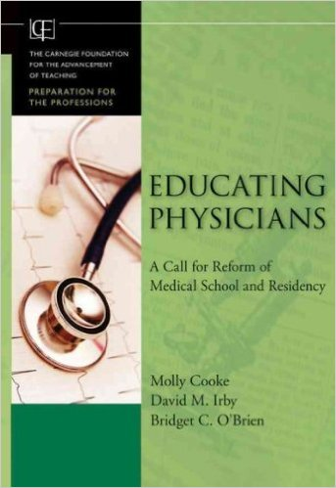
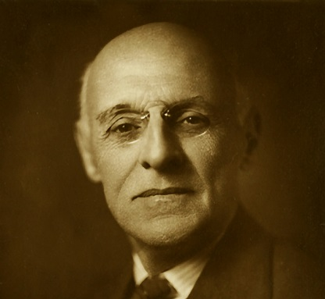
Medical Education Goals
Flexner -- 1910:
Standardization
Integration
Habits of inquiry and improvement
Professional formation
Flexner 2 -- 2010
Standardization and individualization
Integration
Habits of inquiry and improvement
Professional formation
Notes:
Professional formation was one of Flexner’s four main goals for improving medical education…however it was overshadowed by the total chaos and lack of scientific integration and basic accreditation standards found in US and Canadian medical schools of the early 20th century.
Fast-forward one hundred years, to 2010 and we find the follow-up report published by the same entity as Flexner’s original report (the Carnegie Foundation for Excellence in Teaching). They put their stamp of approval on Flexner’s four main goals, but got more specific as to what professional formation in the 21st century should look like…

Slide 9
Medical Education Goals
Professional formation:
Promote formal ethics instruction
Address the underlying messages expressed in the hidden curriculum
Offer feedback on assessment of professionalism
Promote positive role models
Create collaborative learning environments committed to excellence and continuous improvement
Cooke, M., Irby, D., O’Brien, BC. (2010). Educating Physicians: A Call for Reform of Medical School and Residency. Carnegie Foundation for the Advancement of Teaching.
Notes:
Cooke, Irby, and O’Brien identified 5 areas of focus….apparently, these areas had, in their minds, lacked focus over the last 100 years…
The promotion of formal ethics instruction – POLLING QUESTION: Do you notice, over the last few years, a paucity of students/residents that have a grasp of basic ethics? – I was approached by a chief resident just a few weeks ago, after I gave a professionalism lecture, asking me what to do when residents just don’t have a clue about what is right or, for that matter, what difference does it make to hold to a standard? This is very important for, as we will discuss a little later, everyone within your institution must agree to a certain set of values/virtues by which its behavior will be assessed. Without a standard, lapses in professionalism will occur incessantly.
Address the underlying messages in the hidden curriculum – the hidden curriculum opposes formal/established standards (by role models) who, because of certain ways in which they react in the patient setting…by their nature…oppose the standard – Ex. While an EKG technician in a hospital many years ago…I heard two surgeons battling over who was not going to treat an uninsured gunshot victim…I got the impression that not every patient, in their minds is equal…
Offer feedback on assessment of professionalism – in order to do this, we must have an agreed-upon definition of professionalism…something that the ACGME is unwilling to do….
Promote positive role models
Finally, create new cultures of inquiry that are committed to excellence and continuous improvement….let me remind you that your residents, while employees of your hospital, are students…and by nature, students are students…to learn something that they did not know prior to their involvement in your organization…..So we need a balance between service and learning…and an atmosphere of mutual respect and discovery…

Slide 10
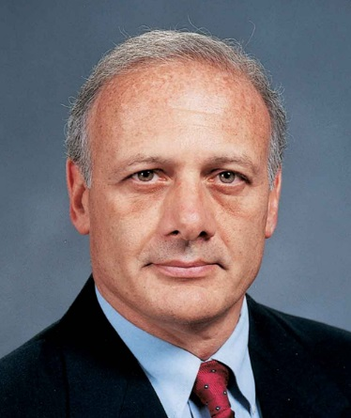
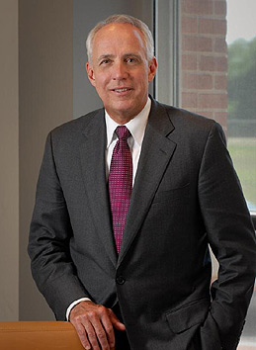
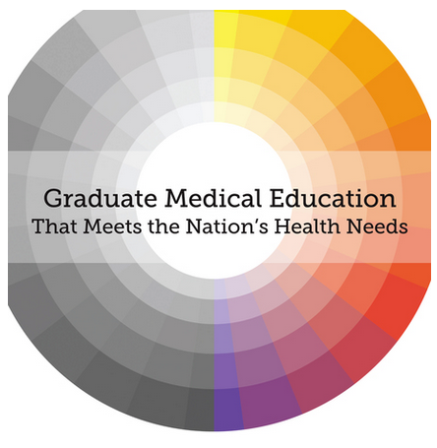
Huge Push to Focus on Professionalism in Medical Education
Thomas Nasca, MD CEO, ACGME
Darrell Kirch, MD President & CEO, AAMC
Notes:
So it is not just in Flexner’s Report and ‘Flexner II’ that we find an emphasis on professional formation. Dr. Thomas Nasca, CEO of the ACGME recently spoke at a national ACGME conference on the importance of ‘collective’ medical education to wrest control of professionalism through self-policing, or we may end up like Britain’s Royal College of Physicians who lost control over their GME by their government because they were unwilling to agree and make changes in the educational system.
Equally, speaking out about the importance of professionalism efforts is AAMC President and CEO, Dr. Darrell Kirch who changed the focus of the New MCAT to reflect on the importance of behavioral, social, and psychological elements of medicine. Additionally, they are using trained interviewers or standardized tests that measure applicants’ reactions to different physician/patient scenarios and assessing applicants on more personal qualities as to how they make decisions, handle stress, and patient cultural competence.
Finally, the Institute of Medicine, in its 2014 landmark study, recommends the development of a federal GME policy committee to oversee GME funding and governance.
So, I am sure that you will agree with me that we can no longer ignore professional formation in our medical education paradigm.

Slide 11
Defining Professional Formation
Narrowing the Focus
Notes:
So let us quickly move on to defining professional formation by narrowing our focus…in order to bring clarity and application to our organizations…

Slide 12
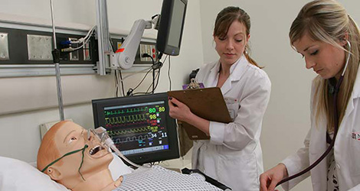
Professional Formation
Traits, Traditions, Trappings, and Mores of being a physician
Notes:
To most of my colleagues in the professionalism community, professional formation is defined as the Traits, Traditions, Trappings, and Mores of being a physician….Ex. wearing a white coat, how to act on clinical rotations as a medical student, or expectations while on call as a resident.

Slide 13
Professional Competency
How these Traits, Traditions, Trappings, and Mores are carried out in the patient/team encounter
Personalized
Notes:
But let me clearly state that there is a difference between professional formation and professional competency. Professional competency is about how well these Traits, Traditions, Trappings, and Mores are carried out in the patient/team encounter.
It is also important to stress that professional competency is very personalized – for some people excel early on in the medical education continuum, whereas, some are woefully inadequate. This highly-personalized nature can bring anxiety to almost any educator, for it may appear from the outside that it will ever be possible to improve one’s level of competency let alone an entire medical school class or a residency team.

Slide 14
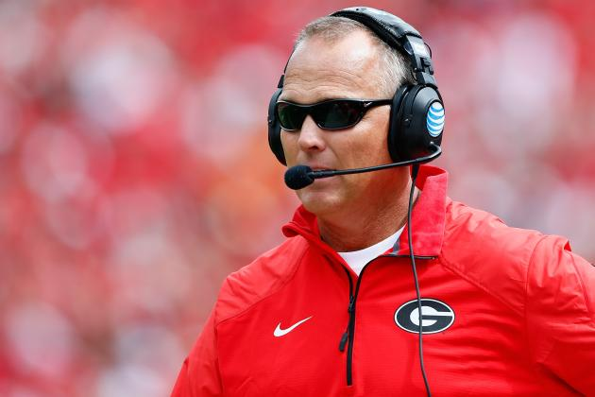
Professionalism
Adept professionals – Think, Feel, and Act in certain ways…
Notes:
Fear not for there are generalized expectations across the medical education continuum as to how one thinks, feels and acts as a professional physician.
Take for example, UGA now-former football coach Mark Richt who was summarily fired a month or so ago after 15 years as the head coach at UGA. Over those 15 years, he had a 145-51 win-loss record (.750 winning percentage), 14 bowls with a win-loss record of 9-5 (.650 winning percentage)….just didn’t win the big one…he had every reason to act unprofessionally, yet he didn’t…he is one class guy. This is what we hope from our students/residents. He truly thinks, feels and acts as a true professional.

Slide 15
Why Should This Matter to Us?
Notes:
So, by now you might be asking yourself: why should this matter to me? It is my opinion that our very future depends on the type of physicians we create as a product of our educational efforts.

Slide 16
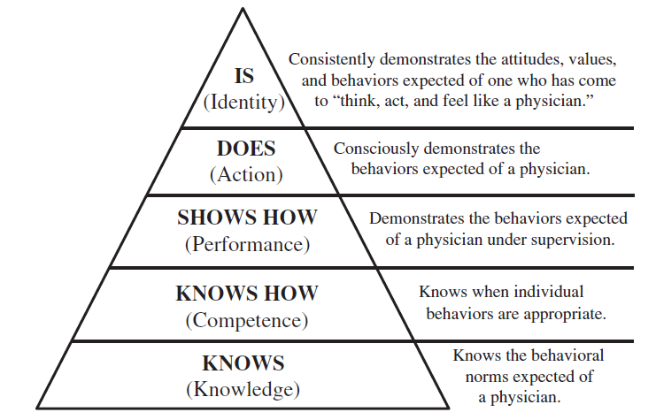
Miller’s Model of Clinical Competence - Amended
Becoming
Cruess, RL, Cruess, SR, Steinert, Y. Amending Miller’s Pyramid to Include Professional Identity Formation. Academic Med. Oct. 2015.
Notes:
This slide depicts Miller’s model of clinical Competence, which has been used as the guideline for medical school and residency to determine clinical competence…how well students and residents demonstrate their clinical skills competence. Notice how the foundation begins at KNOWLEDGE – and moves to KNOWING HOW – and moving to PERFORMANCE (showing how) – to finally DOING (action).
Two of my colleagues at the Academy for Professionalism in Health Care, Richard Cruess and his wife Sylvia Cruess (from McGill University Medical School – Montreal Canada) felt as I that this model is lacking something…it culminates in BEING (becoming or is)…This is the goal: to think, feel and act as a physician should. So it is not enough to just have our students/residents DOING physician-hood, rather it is in their BEING that we strive.
The second reason why this should matter to all of us is that inappropriate professional competency is a patient-safety issue.

Slide 17
Patient Safety Issue
Professional lapses in medical school or residency programs correlate with lapses later in practice
Earlier intervention mitigates the issues
Papadakis, M., Teherani, A., Banach, M., Knettler, T., Rattner, S., Stern, D., et al. (2005). Disciplinary action by medical boards and prior behavior in medical school. NEJM, 353(25), 2673-2682.
Notes:
Maxine Papadakis has found that professional lapses in medical school or residency programs correlate with lapses later in practice, and that earlier intervention mitigates the issues. If we catch them early, they keep from carrying lapses into practice…which harm patients.

Slide 18
Patient Safety Issue
Patients are more likely to comply with physician orders if the physician demonstrates an understanding of patient’s condition
Kim, SS, Kaplowitz, S., Johnston, MV. The effects of physician empathy on patient satisfaction and compliance. Eval Health Prof., 2004 Sep;27(3).
Notes:
Kaplowitz and Johnston have found that patients are more likely to comply with physician orders if the physician demonstrates an empathetic understanding of their patient’s condition.

Slide 19
Patient Safety Issue
Physicians with higher levels of Emotional Intelligence experience less stress, cynicism, and burnout – things that directly affect patient’s safety.
Gleichgerrcht, E., Decety, J. Empathy in Clinical Practice: How Individual Dispositions, Gender, and Experience Moderate Empathic Concern, Burnout, and Emotional Distress in Physicians. PLoS One. 2013: 8(4): e61526.
Notes:
Or, I am sure that this is no surprise that physicians with higher levels of Emotional Intelligence experience less stress, cynicism, and burnout – things that directly affect patient’s safety. Recent studies reveal that physician burnout rates are hovering around 50%.

Slide 20
Patient Safety Issue
Rudeness by fellow team members cause cognition impairment that directly endangers patients.
Riskin, A., Erez, A., Foulk, TA, Kugleman, A., Gover, A., Shoris, I., Riskin, KS., Bamberger, PA. The Impact of Rudeness on Medical Team Performance: A Randomized Trial. Pediatrics. Sept. 2015 Vol. 136(3).
Notes:
A very interesting study from the November issue of Pediatrics found that rudeness by fellow-team members cause cognition impairment that directly endangers patients. What was interesting in the study was the fact that it takes quite a while for the cognition impairment to go away…affecting other patients as well.

Slide 21
Patient-centered Care
Physicians need to be aware of the skills involved in patient-centered medicine.
Notes:
Finally, this should matter to us all for we all see the next shift taking place in patient care…where it is about patient-centered care…and unless our students and residents know to interact in this type of setting, patients will not be well-served.

Slide 22
Professional Formation is Individual and Distinct
Notes:
Now, let us shift our focus to discuss the individual and distinctive nature of professional formation.

Slide 23
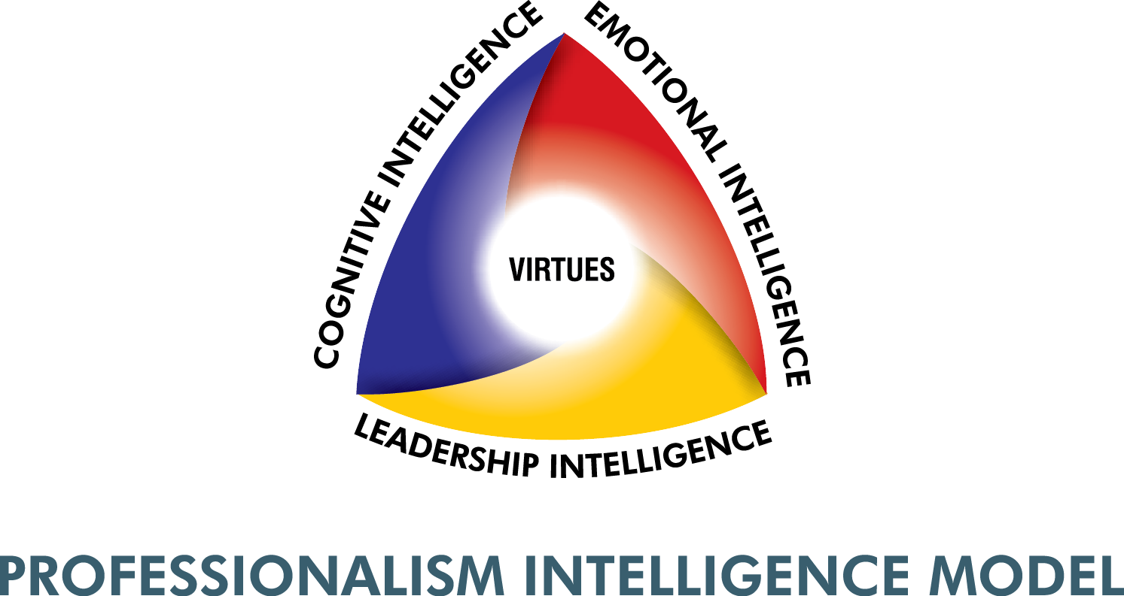
Defining Professionalism
Notes:
Since I believe that one’s professional competence is about striking a balance between one’s cognitive, emotional and leadership intelligences, the Professionalism Intelligence Model offers us an understanding of the individual and distinctive nature of this formation. Not everyone strikes a balance between these three spheres…in fact, most people act from their comfort zone…some cognitive, some emotional, or some leadership. The important thing to remember here is that this triad is about the “I” – the self, for it controls how one thinks, feels, and acts.
The aim of this model is BALANCE – you have all known people who lead from one of these intelligences over the others – smart, but incapable of proper human relationships and interactions (I heard this at Duke – the smartest physician alive, but I would not want to care for my mother) – or maybe they lead with their personality yet have difficulty with medical knowledge or technical ability or skill – or maybe one who’s behaviors are extraordinary, yet they fall short on deeply-held emotional or cognitive skills. Again, this is about the ‘I’ – or self-leadership.

Slide 24
^{Self-Leadership} ^{“I”}
Notes:
Let us look into the concept of ‘self-leadership.’

Slide 25
Characteristics of Admired Leaders
They have been mentored – Have you been mentored?
Humble – submitting to a mentor
Committed to self-improvement
Honest
Consistent
Competent
Able to accept responsibility
Able to communicate
Kouzes, J., Posner, B. (2010). The Truth About Leadership. San Francisco, CA: Jossey-Bass
Notes:
Jim Kouzes and Barry Posner, great leadership scholars, have identified certain characteristics of admired leaders. Certainly, once we discuss these characteristics, you would agree with me that we need to spend more time in our educational systems reinforcing the acquisition of these traits if we want top notch practitioners.
The first characteristic is that each of these admired leaders had mentors….Question: Have you been mentored? How important was that mentoring to establishing who you are today?
The second characteristic is that these admired leaders were humble. They humbly submitted to a mentor in order to receive their input. Are we teaching humility in our medical schools or residency programs?
The third characteristic is that these admired leaders were committed to self-improvement. I recently ran across a study that underscores the paucity of such people. Setting goals is a benchmark for those committed to self-betterment. The study showed that only 20 percent of the population sets goals. Of this 20 percent, only 30 percent actually follow-through on their goals…in real terms, this is only 6 percent of the population. We are in trouble in medical education if the numbers are similar.
The fourth characteristic of admired leaders is honesty. This includes telling the whole truth not just partial truth or incomplete truth.
The fifth characteristic is that they are consistent…they follow through on their vows or commitments, they do not waver when difficulties arise.
The sixth characteristic is that they are competent…they know themselves and what they need to know to succeed. If they don’t know something, they seek out answers.
The seventh characteristic is that they accept responsibility for their actions…they do not seek about whom to blame.
Finally, they are able to communicate well with others…listening and clearly articulating their values.

Slide 26
^{Cognitive Skills}
Notes:
So let’s take a moment to look at the cognitive skills that comprise self-leadership…

Slide 27
Cognitive Skills
Able to break problems into workable parts
Seek counsel from competent others
Draw conclusions on basis of gathered data
Explain oneself and their actions
Notes:
Physicians need to be able to break problems into workable parts. Our training programs must include structures that promote this dissection protocol.
Physicians need to seek counsel from others who have demonstrated high levels of competency in a particular area. Is your culture one that is open to inquiry?
Physicians must be able to draw workable and logical conclusions on the basis of the data collected. Again, this requires an open culture of inquiry.
Finally, every physician must be able to explain their actions in a way that others can understand. If they cannot explain it simply, they just don’t fully understand the issue or the solution.
These are skills that can be learned/acquired.

Slide 28
How Do We Do This?
Case studies – M&M
Open atmosphere of inquiry
Considering alternative ways to view problem – asking Why?
Make this process habitual through practice
Notes:
So what are some practical ways to do this?
First of all, we medical educators need to use case studies of past lapses, or use M&M or QA sessions to call out cognitive mistakes…in a non-threatening way. I was made aware of the value of this when I had a conversation with an attending who wanted to ‘jump’ on a 2nd-year resident for a significant integrity-lapse. I suggested that he do this only if the other residents did not bring up the error. He agreed and found the peer pressure to be a positive learning tool.
Second, we need to have atmospheres of open inquiry…we are, after all, educational programs that must be open to using mistakes as learning tools. We also need to remember that, we medical educators, may have experienced certain things over and over in the past, we must be willing to allow others to experience the same…allowing for learning.
Thirdly, we need to push our students and residents to ask Why? Why are you doing it that way? Or Why could one not do it this way? These types of questions promote open inquiry.
Finally, we need to develop habits that can only come from practice. Malcolm Gladwell, in his book Outliers, discusses this that only after someone repeats something 10,000 times, to they find success. Now, just any kind of practice might throw us off (if it reinforces wrongly), so let’s look at what we mean by Practice.

Slide 29
Five Elements of Practice
Designed to specifically improve performance
Has to be repeated a lot
Feedback must be continuously available
It is highly demanding mentally
It isn’t that much fun
Notes:
Practice efforts must be designed to specifically improve performance…maybe this requires simulation, in which you control the variables to promote the proper outcomes.
Practice has to be repeated a lot. One or two times is insufficient to bring about habitual practice.
Feedback on practice must be continuously available. We must begin to make feedback our top priority…
Students or residents need to be mentally engaged, for practice is highly demanding. It is not to be a second thought, rather it must be a primary action.
Finally, reminding students or residents that practice isn’t fun all the time…just because it isn’t fun doesn’t lessen its importance.

Slide 30
^{Emotional Skills}
Notes:
So let’s take a moment to look at the emotional skills that comprise self-leadership…

Slide 31
Emotional Skills
Foundational element – Why? What is one’s motivation for doing what they are doing?
Must know oneself – self-assessment
Must be dedicated to self-betterment
Must be able to control oneself
Must consider others as important as they
Must have compassion and empathy
Notes:
This is foundational as it forms the substance of one’s behaviors…it deals with the deep motivations for why one behaves in the manner they do.
One must know them self through a process of self-assessment – taking feedback from various sources and considering the validity and reality of such feedback.
One cannot lead them self if they are not dedicated to self-betterment – for being better tomorrow than they were today. As I mentioned to you before, few people are committed to self-betterment. So how do we improve the desire for self-betterment within our programs? If the culture is truly one of open inquiry and feedback is prevalent, peer pressure and intrinsic motivators are allowed to flow freely, self-betterment becomes a habit….
One must be able to control oneself…impulse control – not giving into base emotions – people consider how their actions may harm others – being considerate.
Closely tied with this is one considering others as important as they are. People thinking they are better than others is foundational to racial discrimination…this is wholly unacceptable and incompatible with excellent patient care.
Finally, one must have compassion and empathy if they hope to serve others well. We must allow our students and residents to openly demonstrate these character traits without being called unprofessional.

Slide 32
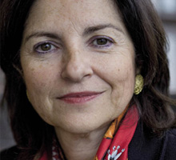
Unprofessional Behaviors
Maxine Papadakis, MD
Irresponsibility – to patients and duty
Impaired relationships with patients
Impaired team relationships
Diminished capacity for self-improvement
Papadakis, M. (2015). Medical Professionalism Best Practices. Alpha Omega Alpha Honor Medical Society. Menlo Park, CA.
Notes:
To underscore the importance of self-leadership, Maxine Papadakis has collated all unprofessional behaviors into 4 categories:
Irresponsibility to patients and duty
Impaired relationships with patients
Impaired team relationships
Finally, a diminished capacity for self-improvement.
Notice how all of these professionalism lapse categories have, as their foundation, a lack of self-leadership in some way.

Slide 33
Team-Leadership “We”
Notes:
So let us now move to team-leadership

Slide 34
Work Group vs. Team
Teams share:
Collective responsibility
Selflessness
Shared Sacrifices
Common Objectives
Rewards
Notes:
It is important to understand that there is a difference between work groups and teams. For way too long, we have seen patient care being done as a work group, a gathering of people working together. The problem is, that has failed us. Today, we work as teams. So let’s look at a few things that teams share:
Collective responsibility…no one person is exempt from sharing responsibility – happened at Cleveland Clinic with the death of an 8 year old girl. Each person was doing their job, but they did not report what they were seeing, since it wasn’t their job…instead this young girl tanked and died. Devastating…but it changed how the Clinic deals with patients…everyone has a place at the table…even parents of the child.
Selflessness – everyone looks out for others.
Shared Sacrifice – closely related to selflessness…all must sacrifice for the good of the team goal.
Common objectives – Everyone works together, not as separate entities
Finally they share common rewards – no one person is to be rewarded over others who helped to get to their goal.

Slide 35
Team Principles
Building Trust
Lencioni, P. (2012). The Advantage: Why Organizational Health Trumps Everything Else in Business. San Francisco, CA: Jossey-Bass.
Notes:
Patrick Lencioni has written much about team dysfunctions and the principles found in successful teams. The first principle is: Building trust… must have trust in everyone on the team…this happens when all members practice transparency, honesty, and nakedness in asking for forgiveness – notice that this must happen with a group of individuals who, through self-leadership practice, practice honesty, and transparency

Slide 36
Team Principles
Mastering Conflict
Lencioni, P. (2012). The Advantage: Why Organizational Health Trumps Everything Else in Business. San Francisco, CA: Jossey-Bass.
Notes:
The second principle is: Mastering conflict…conflict is not a bad thing…but fear of conflict is. When there is trust in team members, they feel free to disagree, or agree that someone else has a better idea. Conflict without trust is politics, an attempt to manipulate others in order to win an argument regardless of the truth – conflict continuum – the midpoint between artificial harmony and mean-spirited personal attacks

Slide 37
Team Principles
Achieving Commitment
Lencioni, P. (2012). The Advantage: Why Organizational Health Trumps Everything Else in Business. San Francisco, CA: Jossey-Bass.
Notes:
The third principle is: Achieving Commitment…Conflict is so important for a team cannot achieve commitment without it. People will not actively commit unless they have been heard – this is not a call for consensus…instead it is about finding commonality and walking out of the room with commitment – not just passive commitment which is dangerous – because without active commitment, the opponent will devise ways to not support the decision. This requires time to assure that everyone is clear of the decision and in agreement that it is the best option now based on known information

Slide 38
Team Principles
Embracing Accountability
Lencioni, P. (2012). The Advantage: Why Organizational Health Trumps Everything Else in Business. San Francisco, CA: Jossey-Bass.
Notes:
The fourth principle is: Embracing Accountability… peer-to-peer accountability is the most effective method of accountability…however, if the leader is unwilling to do it first, others will balk – no ‘wusses’ here – to hold someone accountable is to care about them enough to risk having them blame you for pointing out their deficiencies. How do we deal with this in a society that says: ‘You can’t judge me?’ – this is why it is so critical that everyone knows the organization’s shared values…all ‘judging’ is based upon a set of ‘agreed-upon’ principles – if no shared values, accountability looks arbitrary. There is a difference between conflict (which is about ideas and issues) and accountability (which is about performance and behavior)

Slide 39
Team Principles
Focusing on Results
Lencioni, P. (2012). The Advantage: Why Organizational Health Trumps Everything Else in Business. San Francisco, CA: Jossey-Bass.
Notes:
The fifth principle is: Focusing on results… the greatest challenge to team success is inattention to results. Is the team accomplishing what it intended to do? Again knowing shared values must be clear and imbedded throughout the team

Slide 40
Patient-Leadership “They”
Notes:
So let’s move alone to patient-leadership.

Slide 41
Simplicity
Physicians and Patients share:
Collective responsibility
Selflessness
Shared Sacrifices
Common Objectives
Rewards
Notes:
There are few relationships that are as unique as the physician-patient relationship – probably close to the spouse-spouse relationship, yet they differ in power (one leading with power over the other as compared to balancing the power relationship between two people)
But if we look at this relationship as merely a small team relationship, all of Lenconni’s rules apply.
Building Trust
Mastering Conflict
Achieving Commitment
Embracing Accountability
Focusing on Results
Including the things that teams share:
Collective responsibility
Selflessness
Shared sacrifices
Common Objectives
Rewards
You might feel as if I have short-changed you by putting as much emphasis on team- and Patient-leadership as I did on self-leadership. Well, the reason is quite simple…if one cannot lead themselves, they cannot ever expect to lead others…it’s just that simple.

Slide 42
Take Action
Notes:
So in conclusion:
If we want highly-effective teams who provide excellent patient care, we need individuals who:
Are dedicated to self-improvement/betterment
Seek feedback in their process of self-betterment
Find ways to integrate feedback into self-improvement processes
Fosters basic characteristics exemplified by great leaders
Practices a high capacity for self-improvement – how they think, feel and act
Are in agreement with the organization’s values and seeks to operate within those standards

Slide 43
Take Action
Do a Q-sort – shared virtues:
This is a one-time assessment that is open to various members of the GME program
It ranks virtues
Identifies agreed-upon virtues
Notes:
The first suggestion that I would like to make is to encourage you to do a Q-sort of your organization’s shared virtues.
This is a one-time assessment that is open to various members of the GME program.
It ranks virtues
It identifies agreed-upon virtues.
The reason for this is to identify those things by which your organizational members operate. At Duke, the Division of Head & Neck Surgery, agreed that their shared virtues are:
Integrity
Initiative
Accountability
Self-Discipline
Compassion
How can you ever hold students/residents accountable if you do not identify those things that you value most? This is an absolute necessity if you hope to be able to get a handle on professional formation in your program.

Slide 44
Take Action
Improve interviewing/on-boarding process:
Use of ethical-dilemma scenarios
Require applicants to take the Professionalism Quotient Inventory 360
Directed letters of recommendation
Notes:
The second suggestion is to improve your interviewing/on-boarding process. Identifying people who match your stated virtues and values makes your process of professional formation much less complicated. You can use certain elements to gain a better understanding of strengths/weakness of prospective applicants.
The first element is to use ethical-dilemma scenarios – what would you do if? Or How should this be handled? – these scenarios help you gain a perspective on their cognitive, emotional and leadership intelligence maturity.
Require applicants to take the Professionalism Quotient Inventory – 360…this assessment tool uncovers blind spots for which prospective applicants may be unaware
Directed letters of recommendation – these letters ask specific questions of recommenders…ex. How has the applicant handled stress?

Slide 45
Take Action
Outline shared values:
Identify shared values
Publicize shared values
Reinforce shared values
Notes:
The third suggestion is to outline your shared values. I uncovered the importance of doing this when I had a conversation with the Division-head at a prestigious surgical residency program who was frustrated with their applicants. In his mind, they all looked the same: top of their class, highest scores, yet they were missing something…he just couldn’t put his finger on it. I asked him if he had publically expressed what it was he was looking for in his applicants…he said no. This is a problem if we do not share our values (what it is that we hold dearest to us) ahead of time. Some people may not share our values. It would be a disaster finding this out when it is too late.
I suggest identifying, publicizing, and reinforcing shared values constantly…reminding people every day.

Slide 46
Take Action
Practice open feedback:
Program commitment to providing feedback
Practice feedback
Oral
M&M
Formal -- written
Notes:
The fourth suggestion is to practice open feedback.
This requires the program to be committed to providing feedback. It must be one of the organization’s highest values.
The program must practice feedback
Whether it is oral
Whether it is in formal M&M or QA sessions
Whether it is formal in a written format
Quality organizations practice feedback

Slide 47
Take Action
Welcome conflict:
Encourage open/constructive conflict
Radical: create it if it does not happen naturally
Commit to ‘appropriate method’ of confrontation
Notes:
The final suggestion is to make a commitment to welcoming conflict within your program. No one likes conflict, but if constructive, it can be extremely valuable.
Here is a radical point that I once read in a book called Crisis & Renewal – David Hurst – who believes that organizations must have crisis in order for them to grow…his radical idea is to create a crisis if one does not exist. This makes the organization stronger when done correctly.
Finally, the organization must make confrontation safe…the organization must agree to a process…going to the person privately, taking someone else along, then discussing this with the collective body…whatever you choose, but it must be clear that you value them as individuals and their growth…and that the process will be fair.

Slide 48
Questions?
Notes:
I hope that this webinar has been of value to you. If you need assistance in implementing these actions steps within your organization, I am happy to offer you my assistance. Thank you for joining me today. I am honored to be part of the work of Partners in Medical Education.
I’ll be happy to take any questions.

Slide 49
Partners’ Online Education
Upcoming Live Webinars
Refining the Annual Program Evaluation
for Self-Study Visits
Wednesday, March 2, 2016
12:00pm – 1:00pm EST
“Ask Partners” – Spring Freebie
Thursday, March 24, 2016
12:00pm – 1:00pm EST
Self-Study: Who, What, Why & How?
Tuesday, April 12, 2016
12:00pm – 1:00pm EST
GME Check-up:
Is Your GMEC Meeting Its New Responsibilities
Thursday, April 21, 2016
12:00pm – 1:00pm EST
www.PartnersInMedEd.com
Partners® Snippets
On-Demand Webinars
Self-Study Visits
Introduction to GME for
New Program Coordinators
Milestones & CCCs
GME Financing – The Basics
Single Accreditation System
The IOM Report
Institutional Requirements: What’s New?
Contact us today to learn
how our Educational Passports can save you time & money!
724-864-7320

Slide 50
Partners in Medical Education, Inc. provides comprehensive consulting services to the GME community. For more information, contact us at:
724-864-7320
Info@PartnersinMedEd.com
www.PartnersInMedEd.com
Presented by:
Barry A. Doublestein, DSL, President
Leadership Solutions
5303 Holly Brooke Lane, Loganville, GA 30052
barry@leader-solutions.net | (678) 894-0051

