Slide 1
Leading a Project Management Team
Heather Peters, M.Ed, Ph.D
GME Specialist

Slide 2
Introducing Your Presenter…
Heather Peters, M.Ed, Ph.D
GME Consultant
DIO & GME Specialist
Seasoned speaker at ACGME & sub-specialty national meetings
Institutional and Program accreditation experience
3 decades in education; Masters of Education in curriculum & evaluations, PhD concentration in secondary education & adult learning theories

Slide 3
Webinar Goals
Review basic concepts of project management
Discuss the responsibilities of the effective project team leader
Delve into an understanding of the specific characteristics needed to be a project team leader in the 21st century
Compile a list of resources to further project management and leadership competencies

Slide 4
Introduction to Our Story of Project Management
Sandra Ho – a novice project leader, a program coordinator for an internal medicine residency program
Lisa Jimenez – a certified project management leader with a decade of experience

Slide 5
Chapter 1: Forming the Team
Dr. Albert Terry (Faculty Member)
Dr. Tina Scott (Resident)
Dr. Trinh Thao (Resident)
Dr. Carlos Jimenez (APD)
Other stakeholders:
Mark Singh, MLIS (Medical Librarian)
Kris Hernandez, MBA (Finance Department)
Dr. Nancy Grier (CMO)
Dr. Max Greaves (Research Director)

Slide 6
Leading people…
Formal vs Informal Authority
Formal comes from a title or position
Informal comes from the character and capabilities of a leader
Four foundational behaviors
Demonstrate respect
Listen first
Clarify expectations
Practice accountability
Presented by Partners in Medical Education, Inc. 2017
6

Slide 7
Four Foundational Behaviors or Project Management
DEMONSTRATE RESPECT
LISTEN FIRST
CLARIFY EXPECTATIONS
PRACTICE
ACCOUNTABILITY

Slide 8
Chapter 2: The Project Management Process
MONITOR & CONTROL
PLAN
ENTER
2
INITIATE
CLOSE
5
3
EXECUTE
EXIT
4
This diagram, taken from the book “Project Management for the Unofficial Project Manager by Kogan, Blakemore and Wood

Slide 9
How to be Proactive in Project Management
Seek out information because you know you need it
Follow the plan because you believe it’s the best way
Involve people whom you know are important for this project
Identify issues and risks, analyze them, and elicit support to address t hem
Share information with the people you know need to have it
Put all important information in writing
Ask questions and encourage other people to do the same
Commit to your project’s success

Slide 10
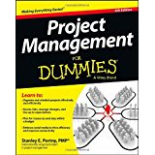
Do you have what it takes to be an effective project manager?
Are you more concerned about being everyone’s friend or getting a job done right?
Do you prefer to do technical work or manage other people doing technical work?
Do you think the best way to get a tough job done is to do it yourself?
Do you prefer your work to be predictable or constantly changing?
Do you prefer to spend your time developing ideas rather than explaining those ideas to other people?
Do you handle crises well?
Do you prefer to work by yourself or with others?
Do you think you shouldn’t have to monitor people after they’ve promised to do a task for you?
Do you believe that people should be self-motivated to perform their jobs?
Are you comfortable dealing with people at all organizational levels?

Slide 11
The project manager’s duties
Determining objectives, schedules, and resource budgets
Ensuring you have a clear, feasible project plan to reach your performance targets
Identifying and managing project risks
Creating and sustaining a well-organized, focused and committed team
Selecting or creating your team’s operating practices and procedures
Monitoring performance against plans and dealing with any problems
Resolving priority, work approach, or interpersonal conflicts
Identifying and facilitating the resolution of project issues and problems
Controlling project changes
Reporting on project activities
Keeping stakeholders informed and committed
Accomplishing objectives within time and budget targets

Slide 12
Chapter 4: Excuses for NOT Following a Structured Project-Management Approach
Excuse #1: Our projects are all crises; we have no time to plan
Response: In a crisis, you have limited time and resources to address the critical issues, and you definitely can’t afford to make mistakes so planning is essential.
Excuse #2: Structured project management is only for large projects
Response: No matter what size the project, the information you need to perform it is the same.
Excuse #3: These projects require creativity and new development. They can’t be predicted with any certainty.
Response: Some projects are more predictable than others.

Slide 13
Avoiding “Shortcuts”
“Jumping directly from starting the project to carrying out the work.”
01
“Failing to prepare in the carrying out stage.”
02
“Jumping right into the work when you join the project in the carrying out the work stage.”
03
“Only partially completing the closing stage.”
04

Slide 14
OTHER POTENTIAL CHALLENGES
Additional assignments
New people on new teams
No direct authority

Slide 15
Chapter 5: Holding people accountable – even when they don’t report to you…
Find out who has direct authority over the person and bring that supervisor into the process
Put it in writing
Be specific
Follow up
Make the person accountable to the team
Get commitment
Create a sense of urgency and importance

Slide 16
Leading Teams in the 21st Century
Don’t feel part of the team
Don’t contribute
Wait for instructions
Work is “directive”
Don’t “buy in”
Missing “Valuable” Insights & Inputs

Slide 17
Tips for Remote Teams
Use videoconferencing software (Zoom, gotomeeting)
Incorporate opportunities for “two-way” collaborations for input
Face to face meetings: budget time and money

Slide 18
The Final Chapter…

Slide 19
Project Management Resources
Achieving Competence as a Project Leader

Slide 20
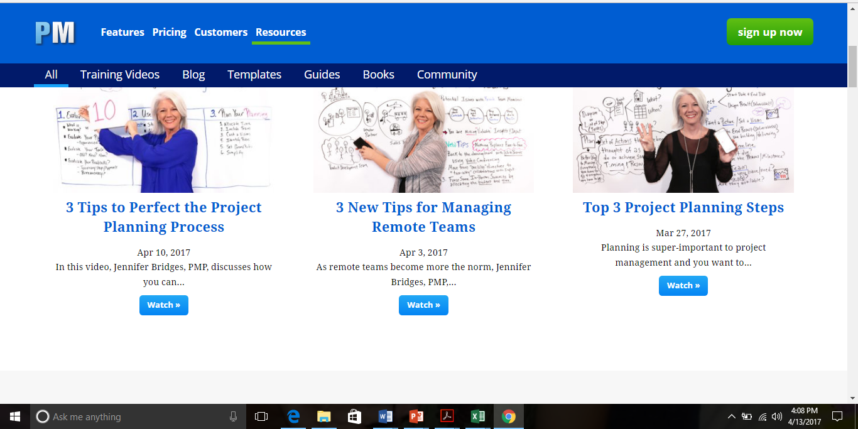
There are videos…
projectmanager.com/resources

Slide 21
There are blogs…

Slide 22
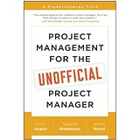
And there are books…

Slide 23
And if you are really serious, there is certification…

Slide 24
Best Practices for Project Management
Communicate with all project stakeholders
from day 1
Create a risk response team as the first line of defense when problems occur
Always hold a project kick-off meeting & include everyone
Start your project with a detailed work definition document – and make all stakeholders sign in agreement
Create a detailed work plan & model it off of previous similar projects
(if possible)
Document everything: steps, bottlenecks, changes
in scope,
etc.
Ask the team for feedback on your management methods & what you can do better to help them
When stakeholders come to you with new project requests, show them how the change will affect your project timeline or budget
If scope changes due to new requests, have everyone sign a new agreement document
Hold a meeting after the project ends to discuss lessons learned & ways to
improve
for next
time

Slide 26
Upcoming Live Webinars What do they do up there in the GME office?
Tuesday, May 23, 2017
12:00pm – 1:00pm EST
Breaking Bad News to Residents:
A five-stage process for
giving Instructive Feedback
Tuesday, May 30, 2017
12:00pm – 1:00pm EST AOA to ACGME – What are you waiting for?
Thursday, June 15, 2017
12:00pm – 1:00pm EST
www.PartnersInMedEd.com
Partners® Snippets
On-Demand Webinars
Initial ACGME Accreditation? Now What?
ABC’s of Remediation
The Stress Free Recipe:
Dealing with Burnout
The Forgotten SI: Single-Sponsor Institutions
Medical Knowledge, Patient Care,
Now What?
Ask Partners – Spring Freebie
Dissecting the ICE Bundle
Contact us today to learn
how our Educational Passports can save you time & money!
724-864-7320

Slide 27
Partners in Medical Education, Inc. provides comprehensive consulting services to the GME community.
Partners in Medical Education
724-864-7320 | info@PartnersInMedEd.com
Heather Peters, M.Ed, Ph.D
heather@partnersinmeded.com
www.PartnersInMedEd.com

