Slide 1
Lean Six Sigma for GME
Heather Peters, M.Ed, Ph.D
GME Specialist

Slide 2
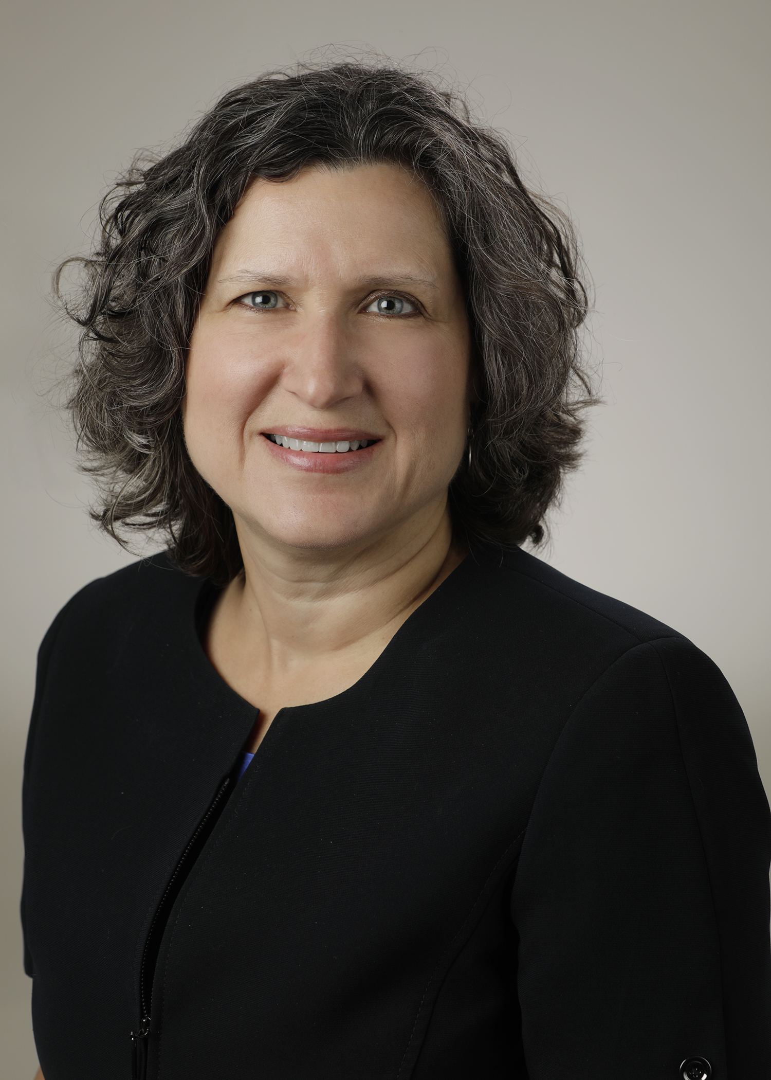
Introducing Your Presenter…
Heather Peters, M.Ed, Ph.D
GME Consultant
DIO & GME Specialist
Seasoned speaker at ACGME & sub-specialty national meetings
Institutional and Program accreditation experience
3 decades in education; Masters of Education in curriculum & evaluations, PhD concentration in secondary education & adult learning theories

Slide 3
Objectives and Goals
Provide background on Lean and Six Sigma methodologies
Investigate different tools that can be used to improve GME processes
Discuss lean and six sigma resources

Slide 4
Some Necessary Background

Slide 5
What is Six Sigma? What’s behind a name ?
Six Sigma: Problem-solving methodology
Six Sigma performance: Statistical term for a process that produces fewer than 3.4 errors per million opportunities for errors
A Six Sigma improvement: key outcomes of a work process are improved dramatically, often by 70 percent or more
Six Sigma deployment: prescriptive roll-out of the Six Sigma methodology across the institution
Six Sigma toolset: collection of methods and tools
Lean Six Sigma: hybrid practice, also called Lean Sigma

Slide 6
Six Sigma Equation Explained..

Slide 7
How Good is Good?
99% Good (3.8 Sigma) | 99.99966% Good (Six Sigma)
20,000 lost articles of mail per hour | 7 articles of mail lost per hour
Unsafe for drinking water for almost 15 minutes per day | 1 unsafe minute of drinking water every 7 months
2 short or long landings at a major airport every day | I short or long landing at major airports every five years
No electricity for almost 7 hours each month | One hour without electricity every 34 years
3 warranty claims for every new automobile | 1 warranty claim for every 980 new automobiles
5,000 incorrect surgical operations per week | 1.7 incorrect surgical operations per week
200,000 incorrect drug interactions each year | 68 incorrect drug interactions each year
48,000 to 96,000 deaths attributed to hospitals errors each year | 17 to 34 deaths attributed to hospital errors each year
Six Sigma for Dummies, 2012

Slide 8
DMAIC
Define
1
Measure
2
Analyze
3
Improve
4
Control
5
A problem
Voice of the customer (VOC)
Project targets or goal
Project boundaries or scope
Identify the gap between the current and required performance
Collect data to determine the baseline
List and prioritize causes of the problem
Prioritize the root causes to pursue in the Improve step
Create innovative solutions
Focus on the simplest and easiest solutions
Test solutions using Plan-Do-Check-Act cycle
Create a detailed implementation plan.
Monitor the improvement to ensure continued and sustainable success
Create a control plan

Slide 9
The Hierarchy of Six Sigma Roles
Exec Leadership
Champions
Master Black Belts
Black Belts
Green Belts
Yellow Belts
Project Team Members
Notes:
p. 55
So let’s talk a bit about the roles that you will see in an organization that has adopted Lean Six Sigma.
But remember, even if you organization hasn’t adopted Lean Six Sigma, you can become a leader by becoming a black belt.
The belts will probably evoke the concept that we are all familiar with, the black belt judo or karate enthusiast.
The highest belt or level is the master black belt. They are black belts with teaching skills – they are hands on experts who teach the other belt levels.
Next comes the black belts. They are most highly trained experts and they are the mentors and coaches in applying Lean Six Sigma methods and tools.
The next level is the green belts. Green belts are process leaders, process owners, professional staff, operational specialists, managers and executives who have a significant degree of business, leadership, statistical and problem-solving skills.
And then ether are the yellow belts. The goal of yellow belts is to think in a data-driven, cause-and-effect process manner and apply this thinking to their areas of work.

Slide 10
Determining a Viable Project for Lean Six Sigma

Slide 11
Deciding whether a project is worthwhile in GME
Business | GME Operations
Hard savings reduce expenses and result in a financial improvement | Hard savings reduce time spent on activities but do not diminish the returns
Soft savings are financial benefits that may occur as a result of a Lean Six Sigma project but aren’t accountable as a direct result of the project. | Soft savings are reduce time and resources that may occur as a result of a Lean Six Sigma project but aren’t accountable as a direct result of the project
Potential savings are a from of hard savings but require some action or decision to be realized | Potential savings are a form of hard savings but require some action or decision to be realized
Notes:
p. 75
Cost improvements, even in the business world encompass more than just direct costs. They are reductions in labor, inventory, material, excess equipment, space, and so on. But to make this information meaningful for us in the GME world, I want to focus on a reduction of time. For us, time is our currency and we often feel that it is not well spent.
When processes are duplicated between siloed departments, this creates a time burden. An example of this that we commonly see is when we have independently operating research departments in every GME program.
When processes bottleneck waiting for the next step in the process, that is also a time burden for the GME organization. We see this when we have to IT activate the rotating resident’s badge and they require you to provide this information 10 days ahead of their arrival on campus.
When too many approvals have to be obtained to complete a document. I just finished the PLA process for my institution and because our patient care and therefore learner bandwidth is ever evolving, my executive suite only allows for one year PLA agreements. And it’s painful to get the signatures at the multipole levels. And then someone goes on vacation and it cripples the flow of documents.
An example of hard savings in a GME project is time conserved when we determine a way to reduce the amount of time the GME coordinators spend tracking duty hour compliance
An example of soft savings in GME would be if you created a new process for evaluations and the residents’ compliance rates improved because of the project, interestingly, the rates for compliance for reporting duty hours also improved. The time saved by coordinators expended went down in both processes, however, you cannot tie the reduction of time for tracking because the compliance is better in a related but separate processes.
An example of potential savings is GME would be if you created a new process and the project was the redesign. However, the process redesign needs to be implemented before you can determine if there is actually savings of time and resources actually realized. Until the, the savings can only be considered “potential”

Slide 12
Identifying improvement opportunities…
Reducing or eliminating wastes
Cutting back on bottlenecks and flow
Speeding up changeover times
Decreasing inventory
Improving information flow
Optimizing physical layout
Standardizing work
Notes:
p. 99
Reducing or eliminating wastes
Matching/balancing cycle time with takt time
Cutting back on bottlenecks and flow
Decreasing inventory
Speeding up changeover times
Improving information flow
Optimizing physical layout
Standardizing work
Maximizing equipment uptime and availability
Enhancing process capability

Slide 13
Activity 1: What Projects Came to Mind
Let’s go back over the list from the previous page.
What came to mind?
Write down a list of possible ideas and we will use them in an activity later in the webinar

Slide 14
Let’s look at some tools…
Project Selection Guide
Voice of the Customer Translation Matrix
Process Voices
Swimlane diagram or Process map
Fishbone diagram (Ishikawa)
5 Whys?

Slide 15
Activity 2: Project Selection Guide
Take one or two of the projects that you came up with in the first activity.
Using the Project Selection Guide (provided handout), score your proposed project
Did your project score exceed 80?

Slide 16
Voice of the Customer Translation Matrix
Trainee Comment (What are they saying?) | Gathering More Understanding (Why are they saying it?) | Trainee Needs (What do they want/need?)
The residents stated on the program evaluation survey that the supervision is only sufficient “sometimes”
A focus group was held to discuss why the residents stated that supervision was sufficient “sometimes.” Comments made during the focus groups include:
Some faculty do not provide supervision and residents are often left on their own; this seems to be faculty that are also more disengaged in teaching overall
Some rotations (PICU, NICU and wards) do not have consistent supervision
Most of the core faculty provide more than adequate supervision
The residents need supervision that is consistent across rotations and faculty members, whether core or non-core.
The supervision policy needs to be reinforced and faculty need to be accountable for patient safety reasons as well as resident well-being reasons.

Slide 17
Activity 3: Process Voices
So now take the project that you scored in the previous activity
In this project, what would the voice of the trainee be?
In this project, what would the voice of the GME be?
In this project, what would the voice of the Program Leadership?
In this project, what would the voice of the Administrative Staff be?
In this project, what would the voice of the ACGME be?
In this project, what would the voice of the Process be?

Slide 18
Swimlane map & Process map
Use consistent symbols
Inspection
Document
Storage
Start/End
Decision Point
Process
Data
Transport
Notes:
While process maps or swimlane maps are not new, when they are used in LSS, you need to remember a couple of parameters.
The first is that you should use consistent symbols. If you are mapping out a process, use the shapes to tell the story of the current processes.
Be prepared to help others understand the map. While I see a lot of org charts, these are different than process maps. In GME, we need to employ more process maps.
Process maps help us understand how many hand-offs we have in the current process. Or how many times a process has a step, such as an inspection which slows down the process significantly. For example, onboarding rotating residents and medical students is a responsibility that many of us participate in.

Slide 19
Fishbone diagram (Ishikawa)
An important tool for the analyze phase
What is contributing to the current situation?
Use six main categories (environment, methods, process, people, paperwork, management)
Use the “5 whys” method

Slide 20
Fishbone Diagram (Ishikawa)
Sample Text
Sample
Text
Sample
Text
Sample
Text
Another Sample Text
Another Sample Text
Another Sample Text
Another Sample Text
Another Sample Text
Sample
Text
Sample
Text

Slide 21
Determine the Root Cause: 5 Whys
Problem Statement: You are on your way home from work and your car stops in the middle of the road.
1. Why did your car stop? – Because it ran out of gas.
2. Why did it run out of gas? – Because I didn’t buy any gas on my way to work.
3. Why didn’t you buy any gas on your way to work? – Because I didn’t have my gas credit card.
4. Why didn’t you have your gas credit card? – My daughter forgot to give me back my card after she borrowed it.
5. Why did your daughter forget to give you back your gas credit card? – She is mad at me because I grounded her for missing curfew

Slide 22
Activity 4: 5 Whys
Problem Statement:
1. Why –
2. Why –
3. Why –
4. Why –
5. Why
–

Slide 23
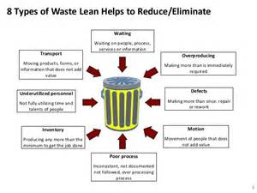
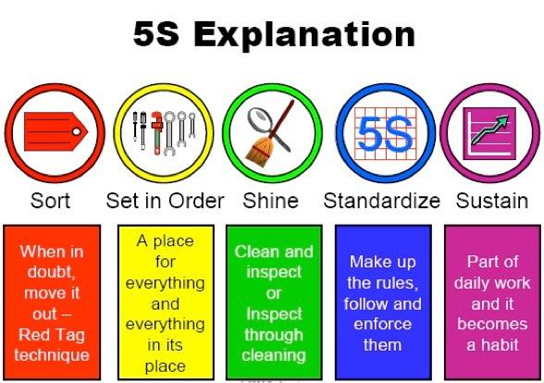
Lean = “a philosophy of continuously simplifying processes and eliminating wastes”
Eight wastes
5S
Waiting
Transportation
Overproduction
Non-Utilized Talent
Defects
Inventory
Motion
Extra-Processing

Slide 24
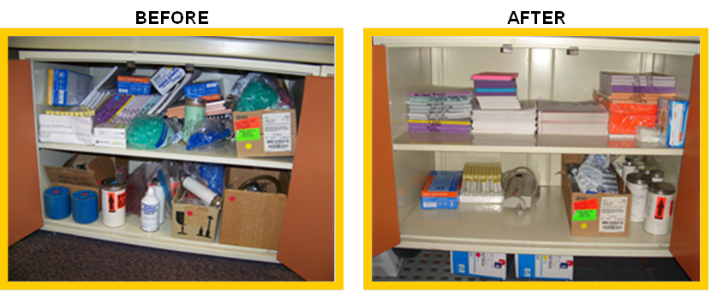
5s Example

Slide 25
Activity 5: 5S List
Think about places around your office that needs some organization:
Your desk drawers
Supply areas

Slide 26
Lean Six Sigma Common Benefits
Time Management
Employee Motivation
Reduced Project Time
Strategic Planning

Slide 27
Lean Six Sigma in Graduate Medical Education

Slide 28
Lean Six Sigma in Medical Education
What are the implications of implementation science for medical education?
Price DW, Wagner DP, Krane NK, Rougas SC, Lowitt NR, Offodile RS, Easdown LJ, Andrews MA, Kodner CM, Lypson M, Barnes BE
Medical Education Online 2015
Tool | Potential use in medical education | Example
Six Sigma concepts focuses on developing and implementing consistent, efficient, reliable (error-free) processes to predictability meet the needs of a customer from the customer’s frame of reference | Identity the needs and desires of the users (clinicians, other staff), stakeholders (organizational leaders), and beneficiaries (patients) of an educational activity Identify desired educational and learning implementation Develop “performance-improvement” educational activities and maintenance of certification part IV activities (American Board of Medical Specialties 2015) | The needs assessment identifies that multiple stakeholders in the process think a checklist of steps would help, as would the ability to practice the steps together. A simulation scenarios is developed using standardized patients and partial task trainers and both residents and attending physicians accrue recognition and CME credit for participation. Three flawless performance and re-demonstration of flawless performance every 3 months are effective in maintaining skills in 92% of participants.

Slide 29
Lean Six Sigma in Medical Education
What are the implications of implementation science for medical education?
Price DW, Wagner DP, Krane NK, Rougas SC, Lowitt NR, Offodile RS, Easdown LJ, Andrews MA, Kodner CM, Lypson M, Barnes BE
Medical Education Online 2015
Tool | Potential use in medial education | Example
Fishbone diagrams | Identify priority areas to focus on in an educational activity Illustrate gaps between current and desired performance | A Fishbone diagram is developed to illustrate possible contributing factors to surgical site infections The team uses this to identify potential practice gaps and focus areas for the infection reduction effort

Slide 30
Finding resources for Lean Six Sigma

Slide 31
How Do I Get Trained in Lean Six Sigma?
Six Sigma Overview
Six Sigma Define Phase
Six Sigma Project Deployment
Process Mapping
Cause and Effect
FMEA
https://sixsigmatraining.us/product/online-yellow-belt/
https://6sigma.com/yellow-belt/

Slide 32
Finding Resources for Lean Six Sigma on YouTube
Process mapping
The pitfalls of process maps and how to avoid them
Lead Six Sigma Process Mapping
Quick Overview of Process Mapping
Fishbone diagrams
Fishbone Diagram – Quality and Safety in Healthcare
What is a Fishbone diagram?
8 wastes
8 Wastes of Lean
The 8 Wastes in Health Care
5S Methodology
Lean: The 5S Methodology
5S Methodology and Tips
Swim Lane Diagrams
Swimlane Diagram Tutorial
Swimlane Lane Process map

Slide 33
Books

Slide 34
Activity 6: Write down your “aha” thoughts

Slide 36
Upcoming Live Webinars
Initial & Pre-Accreditation: Annual Data Updates
Tuesday, August 1, 2017
12:00pm – 1:00pm EST
Can I Do That? Becoming an Integral Member of the GME Education Team Thursday, August 10, 2017
12:00pm – 1:00pm EST
Get the Most Out of Your Resident Interview Tuesday, August 22, 2017
12:00pm – 1:00pm EST
www.PartnersInMedEd.com
Partners® Snippets
On-Demand Webinars
Ask Partners – Spring Freebie
Institutional Readiness in NAS
Using #SocialMedia and Technology in #GME
Leading the Team: Project Management Basics
What do They Do Up There in the GME Office?
Breaking Bad News to Residents: A Five Stage Process for Giving Instructive Feedback AOA to ACGME – What are you Waiting For?
Contact us today to learn
how our Educational Passports can save you time & money!
724-864-7320

Slide 37
Partners in Medical Education, Inc. provides comprehensive consulting services to the GME community.
Partners in Medical Education
724-864-7320 | info@PartnersInMedEd.com
Heather Peters, M.Ed, Ph.D
heather@partnersinmeded.com
www.PartnersInMedEd.com

