Slide 1
Lessons Learned: Accepting Displaced Orphan Residents
Shirley Meade
GME Consultant

Slide 2
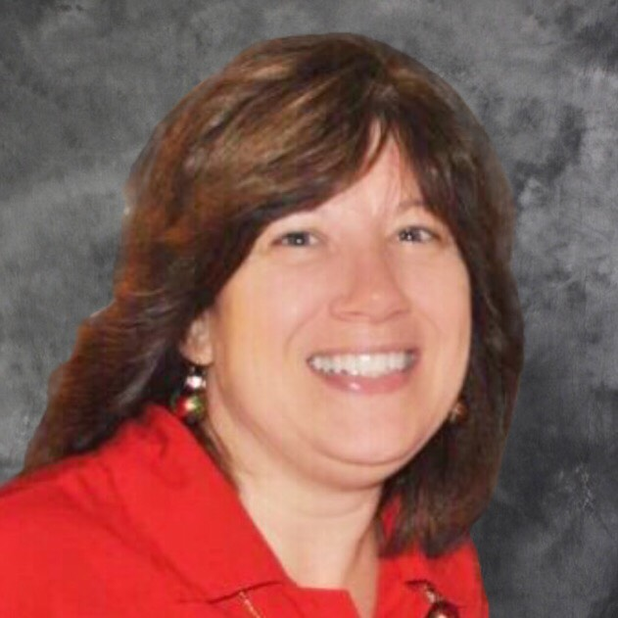
Introducing Your Presenter…
Shirley Meade GME Consultant
Shirley has 30 years of Graduate Medical Education (GME) experience.
She began her career as a Program Coordinator in Internal Medicine at a University Hospital.
Shirley has worked in the Institution office with the (DIO) in a University Hospital and in a Suburban Hospital spanning 20 years.
She currently the Operations Manager of GME and Medical Education at Abington Hospital – Jefferson Health.

Slide 3
Learning Objectives
Learn who the responsible parties are at the institution and home hospital.
Review documentation needed prior to accepting a displaced orphan resident.
Examine how to ensure funding for displaced orphan residents transfers with them to the receiving hospital.
Discuss 3 case studies to understand the differences of each situation.

Slide 4
Definitions
Displaced (orphan) resident – a graduate medical trainee whose home hospital closes for whatever reason, and therefore can no longer continue training their existing residents and/or fellows due to the hospital closure.
Home hospital – the hospital that has the existing residency and fellowship programs, and is shutting them down permanently.
Receiving hospital – the hospital that is taking in displaced orphan resident(s) due to the closure of a hospital.

Slide 5
Process
Requires a team:
Program Director
Program Coordinator
Resident
Designated Institutional Official
Graduate Medical Education
Chief Executive Officer or President
Finance Office or Reimbursement Expert
Legal Office

Slide 6
Program Director & Coordinator Responsibility
The Program Director must apply to the ACGME Resident Review Committee through the Accreditation Data System (ADS) after communication with the Designated Institutional Official (DIO).
The DIO must provide prior approval in conjunction with GMEC:
Changes in resident complement (Permanent and Temporary) if needed.
Complement total.
Programs must hold a status of Continued Accreditation to be considered for a complement increase.
A sound educational rationale must be included with the request.

Slide 7
Program Director & Resident Responsibility
Resident submits application, letters, score reports, medical school transcripts, visa requirement. The same process as required with ERAS documentation during interview season.
Interview and communications between program and displaced orphan resident.

Slide 8
Program Directors & Resident Responsibility
Direct communication between home hospital and receiving hospital
ACGME Program Requirement:
III.C. Resident Transfers
The program must obtain verification of previous educational
experiences and a summative competency-based performance
evaluation prior to acceptance of a transferring resident, and
milestones evaluation upon matriculation. (Core)
Required documents:
previous training record (ex. OSCE)
Federation of State Medical Boards (FSMB)
https://www.fsmb.org/closed-programs/

Slide 9
Finance Responsibility
Home hospital to submit a closed hospital letter to the receiving hospital. This must include the date the resident is being released to begin work at the receiving hospital.
Obtain release letter signed by CEO/CFO of home institution and receiving institution.
Consult legal office for contractual obligations, if needed.
Signed release letter submitted to GME/Program offices in order to offer a resident contract.

Slide 10
Finance Responsibility
Submit CMS Part A Reimbursement, Medicare Audit Contractor (MAC) letter within 60 days after beginning training.
Include detailed resident listing to accompany letter.
Invoice home hospital (salaries, benefits, administrative fees, expenses, travel) if included in contract to collect monies owed to receiving hospital.
To qualify for federal funding to transfer to the receiving hospital, residents must be employed and present at the closing of the “home” hospital on the day the home hospital closes. Ref. AAMC

Slide 11
Graduate Medical Education Responsibility
Offer letter sent by Program Director shared with GME Office.
Contract/Resident employment agreement offered to displaced orphan resident after hospital receives the closed hospital letter from Finance.
GME and Program builds a Resident Management Suite file.
Prepare Orientation.
Monitor check list for completion of tasks by responsible parties at receiving institution.

Slide 12
Policy & Checklist
Advise to develop a policy or sign checklist between responsible parties at receiving institution with DIO oversight.
__ Program Director informs DIO of potential displaced orphan resident
__ DIO/GME seeks permission (CEO/President and Finance)
__ Program applies to ACGME ADS seeking increase, if needed.
__ DIO approves ADS increase, if needed.
__ Program Director interview orphan resident(s)
__ Finance receives closed hospital release letter signed by CFO/President and sends
copy to GME and Program.
__ Legal and Finance negotiate contractual obligations, if any.
__ Finance to follow up billing and reimbursements.
__ Receiving program obtains displaced orphan resident educational file.
__ Program Director offer letter sent to resident.
__ GME contract/employment agreement initiated.
__ GME/Program plan resident orientation.
__ Program ensures resident returns to the “home” hospital on the day the home hospital
closes.
__ Finance sends MAC letter within 60 days after training start date at receiving hospital.

Slide 13
Internal Team
Title | Designee/Responsible Party
Designated Institutional Official & Director, Medical Education
GME Operations Manager
Program Director | Program specific
Program Coordinator | Program specific
Finance, Reimbursement Director
Legal
CEO/President

Slide 14
Case Study 1:
Family Medicine Resident Chippenham & Johnston-Willis Hospitals Richmond, Virginia
Program Directors & Resident Communications
Application, letter of education and good standing.
Finance and Legal Communications.
CFO Release letter, MAC letter.
PGY1 CMS funding belongs to the Commonwealth of Virginia, normally with no exceptions.

Slide 15
Case Study 2:
Internal Medicine Residents Providence Hospital, Washington DC
Program Directors & Resident Communications
Application, letter of education and good standing.
Finance and Legal Communications.
CFO Release letter. MAC letter.
Funding, contract covered until 4/15/2019, travel expenses.
Refer to contract and deadlines
Apply and complete forms (accounts payable), etc.
$168,000+ for salary and expenses.
$7,000+ for travel back to home hospital during last week the home hospital is opened.
Check or electronic payment.

Slide 16
Case Study 3:
Internal Medicine Residents Hahnemann Hospital Philadelphia, Pennsylvania
Program Directors & Resident Communications
Application, letter of education and good standing.
No OSCE submitted.
Finance and Legal Communications.
CFO Release letter, MAC letter.
No agreements or contracts between institutions.
Medical malpractice insurance
Obtain individual tail certificate.

Slide 17
Next Step
Applying to CMS for future funding

Slide 18
Questions

Slide 19
References
Orlowski, MD, MACP, Janis M. Hahnemann to close programs, release residents with Medicare funding. AAMC: Insights, Medical Education. July 25, 2019
https//www.aamc.org/news-insights/Hahnemann-close-programs-release-residents-medicare-funding/

Slide 20
Upcoming Live Webinars
Is your Coordinator Well Enough: Coordinators as Role Models of Wellness Thursday, April 9, 2020 12:00pm – 1:00pm EST Research Proposal Development: Tips for Success Thursday, April 23, 2020 12:00pm – 1:00pm EST Working with your Governing Board Tuesday, May 5, 2020 12:00pm – 1:00pm EST
On-Demand Webinars
Feedback – From the Top Down
Evolving Resident Well-Being
We All Need Scholar Activity, Including Coordinators
Preparing for the 10 Year Site Visit
Meet the Experts – Fall Freebie
Jump Start Your GMEC
Creating a Diverse Workforce
APE Reconstructed
Digging for Data 101
PEC: Best Practices
NEW Faculty Development Series
15 Minutes to Effective Feedback
Toolbox for Teaching Millennials
Taking Supervision to the Next Level
Contact us today to learn how our Educational
Passports can save you time & money!
724-864-7320
www.PartnersInMedEd.com
20

Slide 21
Partners in Medical Education, Inc. provides comprehensive consulting services to the GME community.
Partners in Medical Education
724-864-7320 | info@PartnersInMedEd.com
Shirley Meade
Shirley.meade@jefferson.edu
www.PartnersInMedEd.com

