Slide 1
Lessons Learned from the Pandemic: Planning for the Next Disaster
Heather Peters, MEd, PhD
Tori Hanlon, MS, CHCP

Slide 2
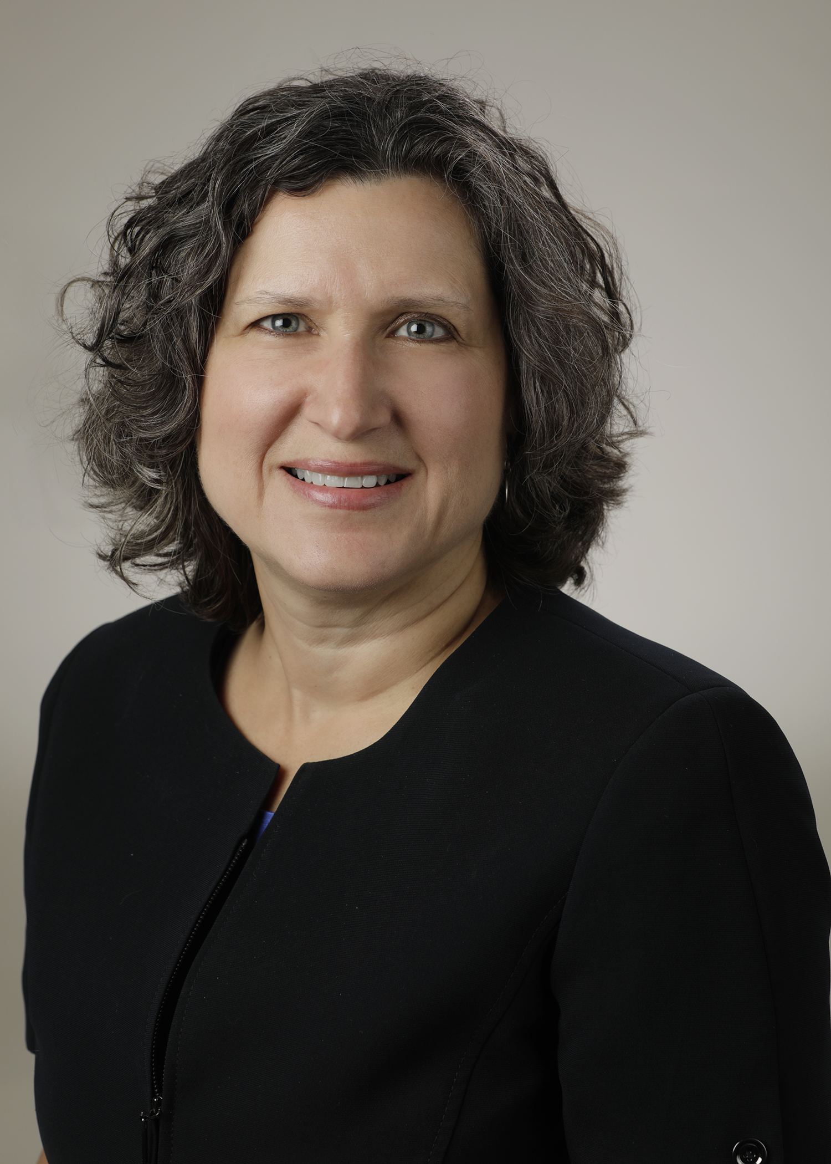
Introducing Your Presenters…
Tori Hanlon, MS, CHCP
GME Consultant
Heather Peters, M.Ed, Ph.D
GME Consultant
Over 13 years working in Medical Education
Bachelor’s in Health Services Administration
Master’s in Health Administration and Policy
Designated Institutional Official
Experienced in GME at a large academic medical center
Former GME Director & DIO
Seasoned speaker at ACGME & subspecialty national meetings
Areas of Expertise: GME Strategic Planning; Program Evaluation; and Faculty Development
3 decades in education; Masters of Education in curriculum & evaluations, PhD concentration in secondary education & adult learning theories

Slide 3
Objectives & Tools
DEFINE types of disasters
DISCUSS disaster planning in GME using a Disaster Phases Framework
REVIEW communication concepts for a disaster
DISCUSS recommended GME policy considerations
Discuss ACGME expectations during disasters
Tools
Template: GME Disaster Policy
Emergency Management Phases

Slide 4
Definitions of Disaster
An occurrence that has resulted in property damage, deaths, and/or injuries to a community (FEMA)
An occurrence disrupting the normal conditions of existence and causing a level of suffering that exceeds the capacity of adjustment of the affected community (WHO)
A serious disruption occurring over a short or long period of time that causes widespread human, material, economic or environmental loss which exceeds the ability of the affected community of society to cope using its own resources (Wikipedia)

Slide 5
Why do we Care?
Can define how we look at an event
What to do about it

Slide 6
It is the people
who matter most, and
without the people
we have no disaster.
World Health Organization, Disasters and Emergencies Definitions Training Package,
https://apps.who.int/disasters/repo/7656.pdf

Slide 7
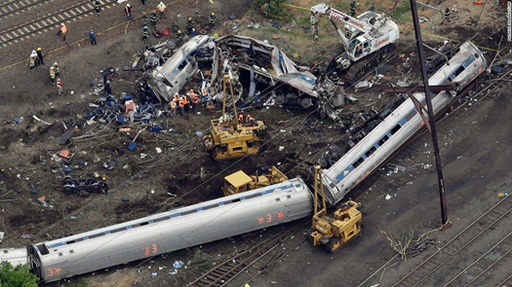
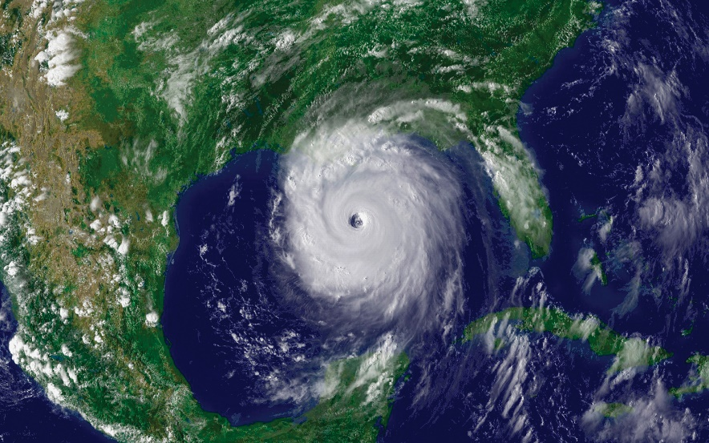
Types of Disasters
Weather
Major incident
Train derailment
Hospital closure
Active shooter

Slide 8
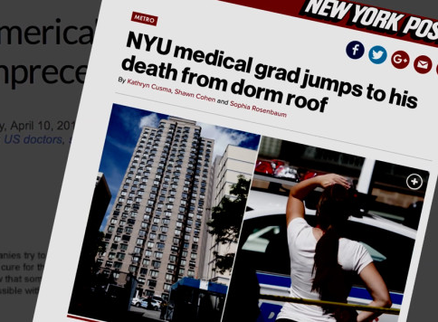
Types of Disasters
Pandemic
Suicide

Slide 9
Phases of Emergency Management

Slide 10
4 Phases of Emergency Management
Mitigation
Preparedness
Response
Recovery

Slide 11
Phase 1: Mitigation
Preventing future emergencies or minimizing their effects
Activities that prevent an emergency, reduce the chance of an emergency happening, or reduce the damaging effects of unavoidable emergencies Mitigation activities should be considered long before an emergency Occur before and after emergencies

Slide 12
GME Disaster Mitigation
IN ACTION
Organize Planning Process & Resources
Coordinate stakeholder engagement and information collection
Assess Risks
Develop Mitigation Strategy
Adopt & Implement Plan
Prioritize mitigation strategies and commit to implementation to reduce risks
Assess goals, evaluate progress in implementing mitigation actions, adjust to address current realities
Stakeholders = Hospital Administration, Clinical Leadership, Regional DIOs
What types of threats/disasters/emergencies can affect GME?
If they occurred, what impact would those disasters have on GME programs/trainees?
Based on above impacts, what capabilities should GME programs/trainees have?
Identify gaps in capabilities

Slide 13
Phase 2: Preparedness
Planning, training, educational activities for emergencies
Plans or preparations for what to do, where to go, who to call for help Preparedness activities will improve chances of successfully dealing with an emergency Occurs before emergencies

Slide 14
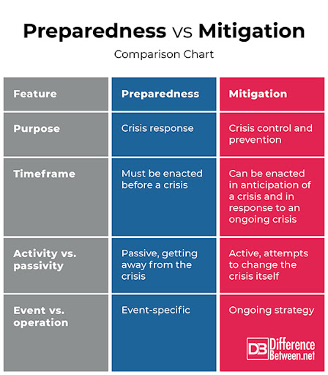

Slide 15
Disaster Preparedness Checklist
Policies
Communication plans
Education/awareness
Disaster drills
Identification of roles & responsibilities
Flexible & adaptable plan

Slide 16
GME Disaster Preparedness IN ACTION
Washington University School of Medicine in St. Louis. (2020, April 23). WU/BJH/SLCH Graduate Medical Education Consortium Disaster Plan & Policy. Retrieved 2021, March 28 from https://gme.wustl.edu/policies-procedures/disaster-plan-policy/

Slide 17
Phase 3: Response
Responding safely to an emergency
Actions taken to save lives and prevent further damage Putting preparedness plans into action Business and other operations do not function normally Occurs during an emergency | Address immediate threats Ensure people out of harm's way Assess damage Repair, restore, re-establish Leadership important

Slide 18
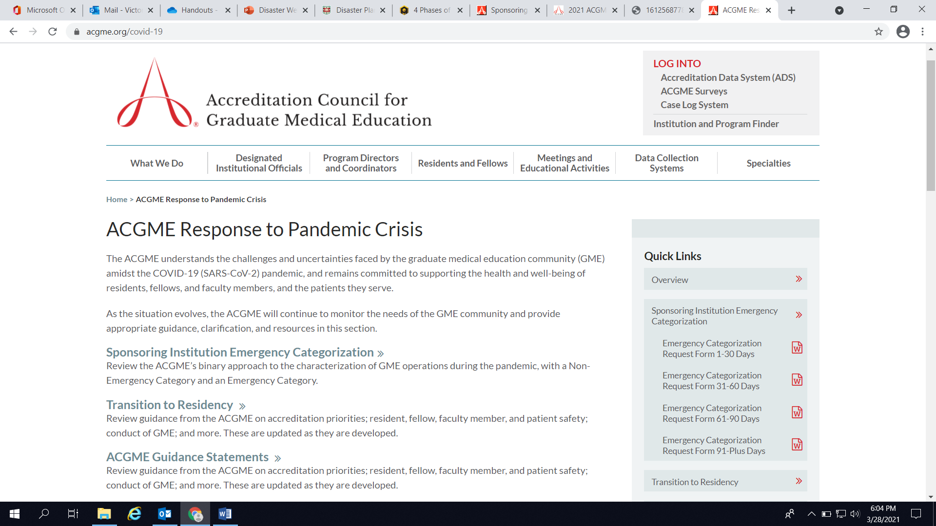
GME Disaster Response
IN ACTION

Slide 19
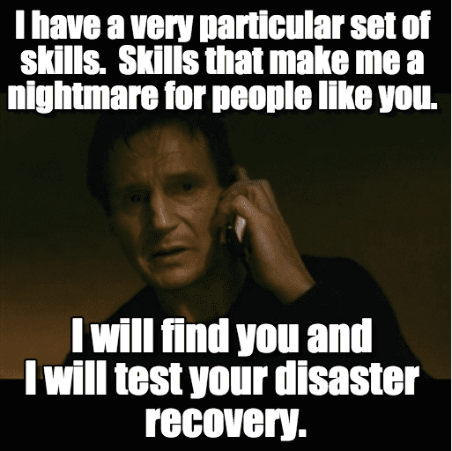
Phase 4: Recovery
Restoration efforts from an emergency
Actions taken to return to a normal or safer situation Recovery activities occur concurrently with regular operations Safety and well-being Coping mechanisms Occurs after an emergency | Obtain new resources Rebuild/create partnerships Reduce financial burdens Reduce vulnerability of future disasters Create strategic protocols and action plans

Slide 20
GME Disaster Recovery
IN ACTION
AACOM, AAMC, ACGME, ECFMG/ FAIMER. (2021). Transition in a Time of Disruption: Practical Guidance to Support the Move from Undergraduate Medical Education to Graduate Medical Education.

Slide 21
Best Practices for Disaster Policies
This Photo by Unknown author is licensed under CC BY-NC-ND.
Review Disaster and related policies annually
Keep policies flexible – it's difficult to make your policy work for every disaster
Review the disaster policies already in place (departments, services)
Consider an "expedited approval" process for policies to be implemented in a time of disaster
Create "Emergency Plans" for various disasters:
Suicide of Trainee
Weather Disaster
Pandemic
Financial
REMINDER: GME policies do NOT have to look just like hospital policies.

Slide 22
Communication Plans What Plans?
Emergency Contact Policy
Annual Update:
Mobile number
Back up mobile number
Email Addresses: This includes the mandate that all key personnel maintain a secondary email account with an established, national provider that is not dependent on the institutional IT system
Emergency Address: This will be classified as an address where an individual would plan to relocate out of the immediate area if their primary address was impacted by the disaster.
Program Level​
"Phone/Text Trees"​
Emergency Contact Info​
Initiator & Back-up plans​
Practice Drills
Institutional Level​
"Phone/Text Trees"​
Emergency Contact Info
DIO succession plan
Initiator & Back-up plans​
Practice Drills
KEY POINT: Keep this data in a place that will not be affected if your computer system goes down.

Slide 23
Communicating with Programs
"No one is telling my anything"
Don't forget anyone...
Trainees
Faculty
Program Leadership
Administrative Staff
Ideas:
Well-being check-ins
Reassuring messages to the different groups above
Be generous with thank you and please
Show appreciation
Surveys of wellness for ALL GROUPS
"What is going to happen?"
"How is this going to impact my future ____?"

Slide 24
ACGME and Disasters
Overview:
Communication with ACGME
"Extraordinary Circumstances"
Resources

Slide 25
Communicating with the ACGME
Extraordinary Circumstances:
The ACGME may invoke the Extraordinary Circumstances policy in response to circumstances that significantly alter the ability of a sponsor and its programs to support resident education. The ACGME is committed to assisting in reconstituting or restructuring residents’ educational experiences as quickly as possible. Examples of extraordinary circumstances include abrupt hospital closures, natural disasters, or a catastrophic loss of funding.
Contact them early
Communicate with the ACGME during disasters
Trainees might be relocated to other programs
Trainees might have their education interrupted
They can link you up with resources
GME is a small world
Other programs will be willing to help...but they need to know you need help

Slide 26
Extraordinary Circumstances
When the ACGME deems that a Sponsoring Institution’s ability to support resident education has been significantly altered, the Sponsoring Institution must:
REVISE its educational program to comply with the applicable Common, specialty specific Institutional and Program Requirements within 30 days of the invocation of the policy; and,
ARRANGE temporary transfers to other programs or institutions until such time as the program(s) can provide an adequate educational experience for each of its residents and/or fellows; or,
ASSIST the residents and/or fellows in permanent transfers to other ACGME-accredited programs in which they can continue their education.

Slide 27
ACGME DIO/IC Zoom Meetings
Resources​
Venting frustration​
Asking questions
Start-up
Initially DIOs
Added Institutional Coordinators in Summer
Frequency
Weekly
Every other week
Monthly
This Photo by Unknown author is licensed under CC BY-NC.

Slide 28
The aim of the ACGME Well-Being in the Time of COVID-19 Resource Library is to provide readily usable resources specific to understanding and managing psychological, emotional, and physical well-being through crises. These curated resources have been selected because they serve the needs of those who work in the integrated clinical learning environment and thus promote the well-being of all members of that interdisciplinary and interprofessional community, as individuals and as a whole.

Slide 29
Table of Contents
AWARE Well-Being Resources
Grief
Leadership
Organizational Well-Being
PTSD
Self-Care
Residents and Fellows
Clinical
Anxiety
Workforce

Slide 30
IDEA EXCHANGE
Trainee Forums
Psychological First Aid – 8 Core Actions
1 | Contact and Engagement: To respond to contacts initiated by struggling GME trainees, or to initiate contacts in a non-intrusive, compassionate, and helpful manner.
2 | Safety and Comfort: To enhance immediate and ongoing safety, and provide physical and emotional comfort during COVID-19
3 | Stabilization (if needed): To calm and orient emotionally overwhelmed or disoriented GME trainees.
4 | Information Gathering on Current Needs and Concerns: To identify immediate GME trainee needs and concerns, gather additional information, and tailor Psychological First Aid interventions.
5 | Practical Assistance: To offer practical help to GME trainees in addressing immediate needs and concerns.
6 | Connection with Social Supports: To help establish brief or ongoing contacts with primary support persons and other sources of support, including family members, friends, and community helping resources.
7 | Information on Coping: To provide information about stress reactions and coping to reduce distress and promote adaptive functioning.
8 | Linkage with Collaborative Services: To link GME trainees with available services needed at the time or in the future

Slide 31
Disasters have lasting impact...

Slide 32
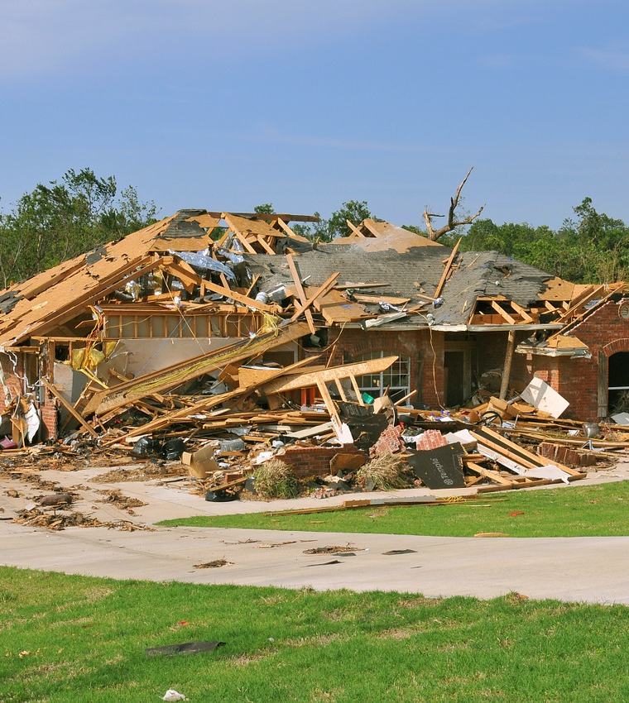
Take Home Points
Plan ahead
Review plans frequently
Expect the unexpected
After a disaster,
review/revise plans
This Photo by Unknown author is licensed under CC BY-ND.

Slide 33
Resources
Weather
Lessons from Katrina: A Program Director’s Perspective – Ramesh Ayyala, MD, FRCS, https://www.aaojournal.org/action/showPdf?pii=S0161-6420%2807%2900526-X
Major Incident (Hospital Closure)
Medicare Rules When a Teaching Hospital Closes (AAMC), https://www.aamc.org/media/33321/download
Pandemic
AFSP’s After a Suicide: A Toolkit for Physician Residency/Fellowship Programs
Suicide
ACGME Response to Pandemic Crisis, https://acgme.org/covid-19

Slide 34
Upcoming Live Webinar
Other Approaches to CCC & Evaluation Thursday, April 27, 2021 12:00pm – 1:00pm EST
ACGME Surveys – What Now? Thursday, May 6, 2021 12:00pm – 1:00pm EST
GMEC Checkups – QIPS Edition Thursday, May 25, 2021 12:00pm – 1:00pm EST
Impactful AIR & APE – Bridging Data & Action Thursday, June 3, 2021 12:00pm – 1:00pm EST
Latest On-Demand Webinars
Ask Partners – Spring Freebie
Digging for Data Part 3
How to Maximize Virtual Learning Part 2
Scholarly Work in Pandemic Times
How to Maximize Virtual Learning Par 1
Quality Improvement in GME: 5 years later
How to Manage A Virtual Site Visit
DIO Role & Responsibilities: Keys to Success
Working with Struggling Learners
Meet the Experts – Fall Freebie
NEW Faculty Development Series
15 Minutes to Effective Feedback
Toolbox for Teaching Millennials
Taking Supervision to the Next Level
Contact us today to learn how our Educational
Passports can save you time & money!
724-864-7320
www.PartnersInMedEd.com
34

Slide 35
Partners in Medical Education, Inc. provides comprehensive consulting services to the GME community.
www.PartnersInMedEd.com
Tori Hanlon, MS, CHCP
Tori@PartnersInMedEd.com
Heather Peters, Med, PhD
Heather@PartnersInMedEd.com

