Slide 1
Please Note…
Please make sure your Start Video is OFF when logging into the WebEx platform.
Here is what it should look like
ALSO
It is NORMAL to not hear any sound until the webinar starts at 12:00 noon EST.
Your phone line is muted, but you can always chat to the host, BJ Schwartz, if you have any questions or concerns during this time.

Slide 2
Lights! Camera! ZOOM!!
Presented by:
Amy Durant, MHA
Cheryl Haynes, BA
GME Consultants

Slide 3
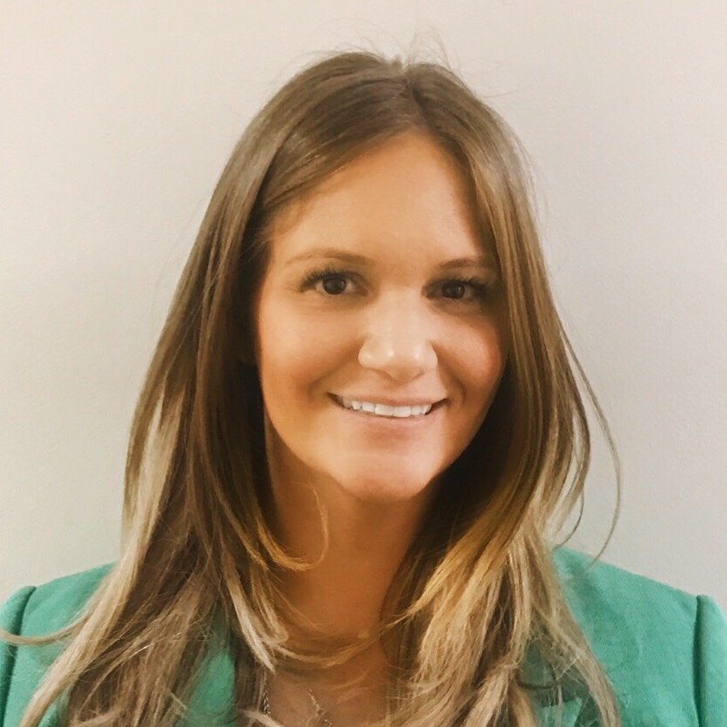
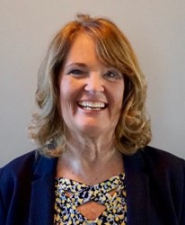
Introducing Your Presenters…
Amy Durant, MHA
GME Consultant
Cheryl Haynes, BA
GME Consultant
15 years of program and institutional experience.
In addition to specific program accreditation assistance, Amy has created GME wide initiatives such as toolkits and faculty development sessions for entire GME communities to benefit from which aid programs and institutions in maintaining compliance.
Successfully facilitated virtual mock site visits for programs and institutions.
18 years of program administration experience.
7 years of experience in developing educational curriculum for coordinators and presenting at state, regional and national conferences.
Successfully facilitated virtual mock site visits for programs and institutions.

Slide 4
Learning Objectives
Discuss strategies for optimizing your virtual presence.
Provide tips and tools for successful virtual communication.
Understand how virtual platforms can be optimized for interviews and faculty development.

Slide 6
Angry
Annoyed
Waste of my time
Do they even know what they are doing?
Is this what I paid for?
Are they still trying to figure this out?
Do they have experience with this?

Slide 7
How did we get here?
1990 – “CU-SeeMe” – the first desktop video conferencing platform – created by a student at Cornell
2012 - Zoom created, launched system with 15 video participants
End of 1st month: 400K users
Nov 2013 – 1 Million users
Jan 2022 – 300 Million daily meeting participants

Slide 8
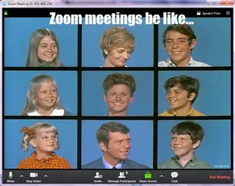

Slide 9
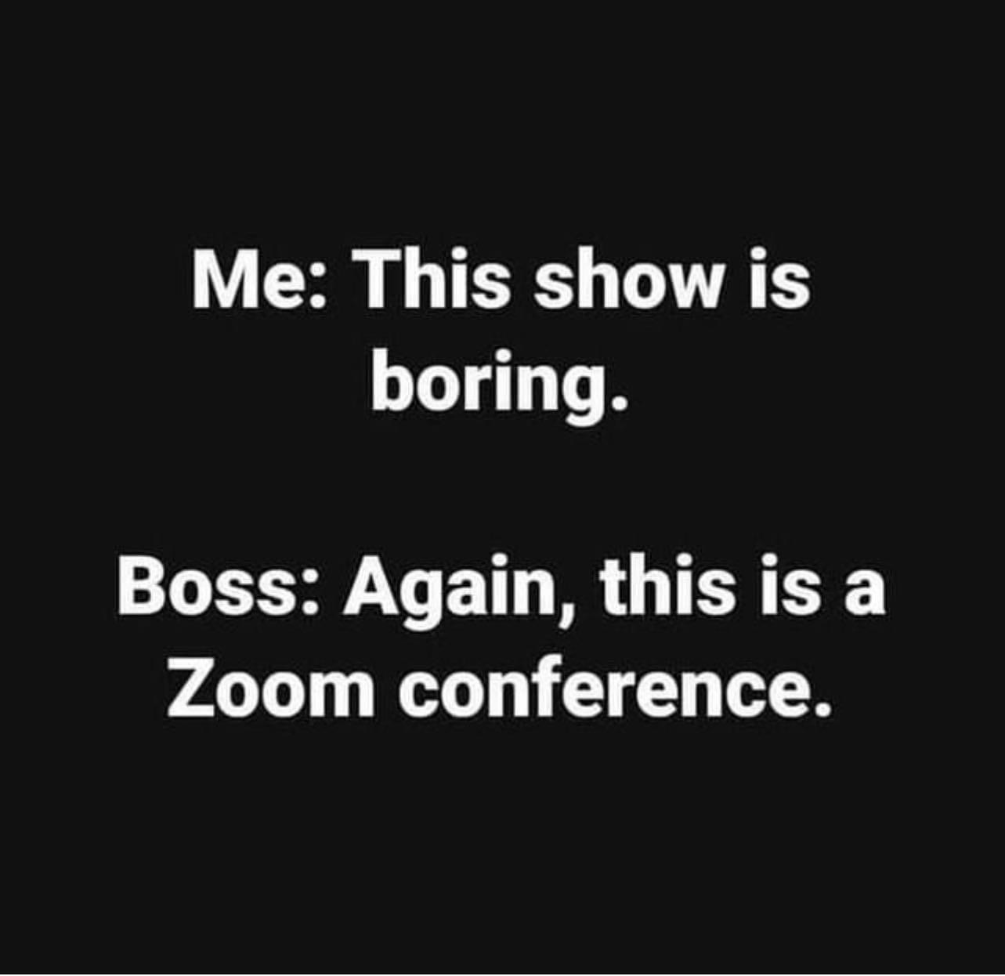
Notes:
Segway to Professionalism

Slide 10
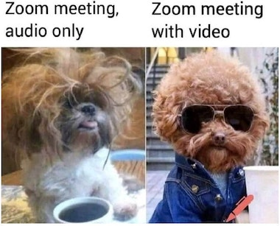
Professionalism Redefined?
Appearance
Would you wear it in the office?
Would you look like that in the office?
Backgrounds
Would you have it in your office?
Noise?
Food???
Don’t do anything on Zoom you wouldn’t do in a live meeting.

Slide 11
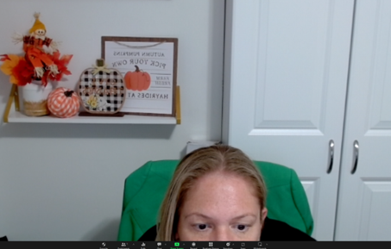
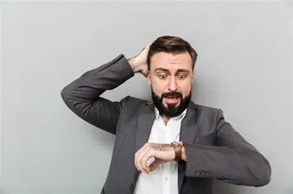
Professionalism Redefined?

Slide 12
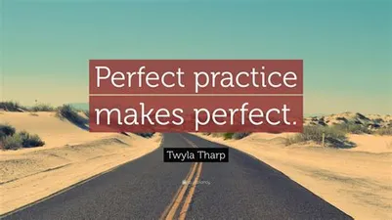
Professionalism Redefined?
Added backgrounds
Pets
Children
Spouses
Pay proper attention
For yourselves
For your work
Respect for others
Is that really funny?

Slide 13
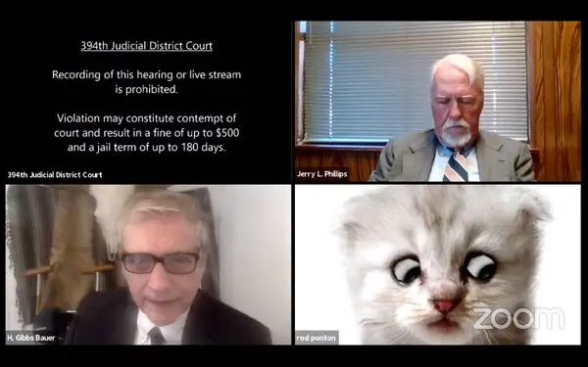
Virtual Meetings
Be prepared, check your device in advance:
camera on?
appropriate identification visible?
filters?
“You can’t put toothpaste back in the tube.”

Slide 14
Effective Virtual Meetings
Hosts:
Start and end on time – 90 seconds
Have an agenda – FOLLOW it!
Don’t let one person monopolize
50-minute meetings instead of an hour
Attendees:
Be present and engaged
Mute your microphone if not talking
Stay off of your keyboard
Act as if you can be seen and heard!

Slide 15
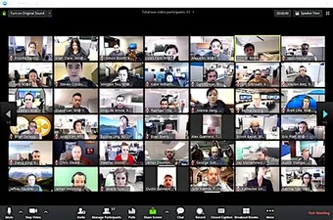
Large Virtual Meeting
Faculty development sessions
Faculty/resident retreats
Webinars
A word from the not so wise
Recording doesn’t occur in breakout rooms but stays on
Check your host
If using the same account you can get bumped out of the “top spot”
Background for breaks to inform as well as be more professional
Music
Video

Slide 16
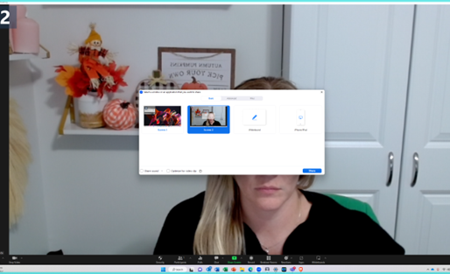
Share Sound, Optimize Your Video Clip

Slide 17
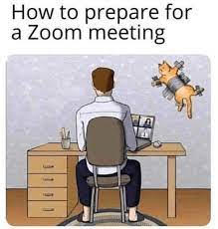
ACGME Virtual Site Visits
Instructions provided by ACGME:
Zoom
Individual devices
computer/laptop/IPAD/phone
with camera and microphone
full name visible on the screen
be in a quiet place/no interruptions
Log in 5 minutes prior
Cameras and microphones on
Word of Advice: Participate!

Slide 18
Virtual Interviews
Breakout rooms
People in waiting room
Attestation forms
Agenda
Discussion

Slide 19
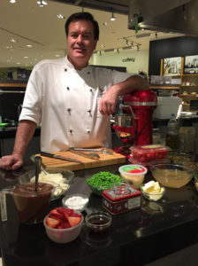
Virtual Meetings can be Fun!
Well-being
“Cooking contests”
Yoga
Thanksgiving
Trivia Contests
Name that Tune!

Slide 20
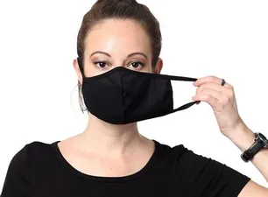
The Virtual World
Keeps us safe
Allows for a better work-life balance
More productive
Allows for more meetings
Productive
Zoom fatigue
Longer meetings??

Slide 21
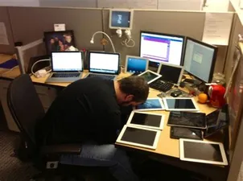
Virtual??
The phone still works
Do you really need to meet?
So much to look at
Did I miss something?
Are you there?

Slide 22
Upcoming Live Webinar
Lights, Camera…Zoom!
Thursday, November 17, 2022
Meet the Experts – Fall Freebie
Tuesday, November 29, 2022
Motivating Faculty to Mentor & Do Research
Thursday, December 8, 2022
Sponsoring Institution Self-Study 101
Thursday, December 15, 2022
Look for our 2023 Jan – June Webinar Education Schedule
To be released on Monday, November 14, 2022
Latest On-Demand Webinars
GME Educational Program Design I
Wellness is a Team Sport
Looking Behind the Curtain at CMS Reporting
ADS 2022: Part II
Scholarly Activity – Starting the Year Off Right
JEDI Warriors in GME: Guardians of Justice, Equity, Diversity, and Inclusion
ACGME Complaint Letter: Now What?
Here We Grow Again – And With Our Community
The ABCs of GMEC: Part II
ADS 2022: Part I
Ask Partners – Spring Freebie
Faculty Development Series
15 Minutes to Effective Feedback
Toolbox for Teaching Millennials
Taking Supervision to the Next Level
Contact us today to learn how our Educational
Passports can save you time & money!
724-864-7320
www.PartnersInMedEd.com
Presented by Partners in Medical Education, Inc. 2022
22

Slide 23
Partners in Medical Education, Inc. provides comprehensive consulting services to the GME community.
Partners in Medical Education
724-864-7320 | info@PartnersInMedEd.com
Amy Durant, MHA
Amy@partnersinmeded.com
Cheryl Haynes, BA
Cheryl@partnersinmeded.com
www.PartnersInMedEd.com

