Slide 1
Patient Care, Medical Knowledge…Now What?
PARTNERS IN MEDICAL EDUCATION, INC.
Presented by: Amy Lefkovic, MHA
Manager, GME & Academic Affairs, Staten Island University Hospital

Slide 2
Introducing Your Presenter
Amy Lefkovic, MHA
Received her Bachelors Degree in Health Information Management from Kean University
Began her career in Graduate Medical Education (GME) at Hospital for Special Surgery as the Radiology Fellowship Program Coordinator
Received her Masters degree in Healthcare Administration from Seton Hall University
Continued her career in GME at Lutheran Medical Center as the OB/GYN Residency Coordinator
Is currently the Manager of GME and Academic Affairs at Staten Island University Hospital

Slide 3
Goals and Objectives
To review the six core competencies.
To examine evaluation methods for the six core competencies.
To explore additional ways in which programs can assist their trainees in meeting the expectation of the six core competencies.

Slide 4
Common Program Requirements
The program director (as well as the faculty) must administer and maintain an educational environment conducive to educating the residents in each of the ACGME competency areas II.A.4. II.B.1.b
The curriculum must contain competency-based goals and objectives for each assignment at each educational level, which the program must distribute to residents and faculty at least annually, in either written or electronic form IV.A.2.

Slide 5
Core Competencies
1. Patient Care and Procedural Skills
2. Medical Knowledge
3. Practice-Based Learning and Improvement
4. Interpersonal and Communication Skills
5. Professionalism
6. Systems-Based Practice

Slide 6
Patient Care and Procedural Skills
Compassionate
Appropriate
Effective
Procedures for the area of practice

Slide 7
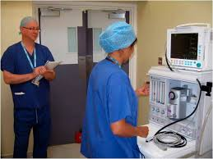
Evaluation Method
Direct observation
Faculty evaluations
360 evaluations
Procedure logs
Appropriate participation

Slide 8
Medical Knowledge
Established and evolving
Biomedical
Clinical
Epidemiological
Social-behavioral sciences
Application of knowledge to patient care

Slide 9
Evaluation Method
Direct observation
Faculty evaluations
360 evaluation
Case presentations
In-training exam and board scores
Conference attendance
Continuing educational conferences

Slide 10
Patient Care and Procedural Skills
Medical Knowledge
Skills to being a great doctor…but wait there is much more!

Slide 11
Practice-Based Learning and Improvement
½ page requirement
Investigate
Self-Evaluation
Life-Long Learning
Deficiencies

Slide 12
Practice-Based Learning and Improvement Cont.
Limits in knowledge
Learning goals
Use Quality Improvement methods
Locate, appraise and assimilate evidence
Participate in the education of patients, families, students residents and other health professionals

Slide 13
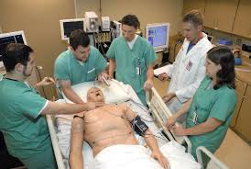
Breakdown
Practice-Based
Practice makes perfect
Learning and Improvement
Learn from the mistakes made and improve on them

Slide 14
Evaluation Method
Faculty evaluations
Self evaluations
360 evaluations
Participation in Quality Improvement projects or conferences
Requested participation in hospital wide resident committees
Chart reviews

Slide 15
Challenges
Admit imperfections
Self reflection
Unaware of deficiencies
Unaware of quality improvement methods
Patient safety

Slide 16
Interpersonal and Communication Skills
Effective exchange of information with
Patients
Families
Public
Physicians
Health related agencies
Across broad range of socioeconomic and cultural backgrounds

Slide 17
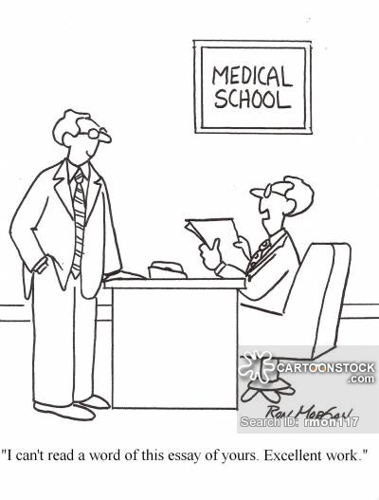
Interpersonal and Communication Skills Cont.
Work effectively as a member of leader of a healthcare team
Maintain comprehensive, timely and legible medical records

Slide 18
Evaluation Method
Faculty evaluations
360 evaluations
Self evaluation
Direct observation
Chart review

Slide 19
Breakdown
Interpersonal
Occurrences with others
Communication skills
Understanding and communicate effectively

Slide 20
Challenges
Time
Number of patients
Family
Cultural backgrounds/beliefs
Work as a team

Slide 21
Professionalism
Sensitivity to a diverse patient population including but not limited to diversity in gender, age, culture race, religion and disabilities and sexual orientation
Scientists
Responsiveness to patient care that supersedes self-interest

Slide 22
Professionalism Cont.
Respect for patient privacy
Accountability to
Patients
Society
Profession
Adherence to ethical principles
Compassion

Slide 23
Evaluation Method
Faculty evaluations
360 evaluations
Self evaluation
Direct observation
Conference attendance
Dress code

Slide 24
Breakdown
Professionalism
the conduct, aims, or qualities that characterize or mark a profession or a professional person

Slide 25
Challenges
New to work force
Casual
Unaware of deficiencies
Millennials
Cultural backgrounds

Slide 26
Systems-Based Practice
Awareness and responsiveness to larger context and system of health care
Call on other resources to provide optimal health care
Considerations of cost awareness and risk-benefit analysis

Slide 27
Systems-Based Practice Cont.
Advocate for quality patient care
Work in interprofessional teams
Identify system errors
Implement potential solutions

Slide 28
Evaluation Method
Faculty evaluations
360 evaluations
Self evaluation
Direct observation
Interdisciplinary conference attendance
Quality Improvement project

Slide 29
Breakdown
Systems-Based Practice
All the processes in the health care system that operate to provide cost effective care to individual patients and to populations
It includes the appointment system and referral process all the way to the governmental organization of health care

Slide 30
Challenges
Administrative – pushback
Going too far
Are faculty aware?
Large health systems
Call on others as “resources” seen as help

Slide 31
Importance of the “Additional” Competencies
Better person
Way of remembering
Similar with slight differences to use as building blocks

Slide 32
Importance of the “Additional” Competencies Cont.
Provide Program Directors with toolkit
Self reflection
Remind helping people
Administrative guidance

Slide 33
Meeting the Expectations
Chairmen evaluation of faculty on meeting competencies
Policy to outline specifics
Read goals and objectives?
Program Coordinator involvement

Slide 34
Meeting the Expectations Cont.
Remediation
Exercises on how to meet expectations
Articles on competency
Cultural diversity training
Self evaluations to include all competencies

Slide 35
Meeting the Expectations Cont.
Common evaluation methods
Make sure address all competencies
Give requirements to residents
Ask if understand them
Ask how accomplish them

Slide 36
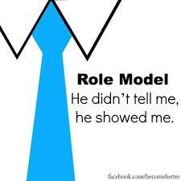
Role Models
Designated Institutional Official
Department of Academic Affairs
Program Director
Faculty
Program Coordinator
Chief Residents

Slide 37
References
https://www.acgme.org/Portals/0/PFAssets/ProgramResources/430_CompetencyDefinitions_RO_ED_10182007.pdf
https://www.med.unc.edu/apselect/educational.../systems-based-practice-workbook
https://www.merriam-webster.com/dictionary

Slide 38
Upcoming Live Webinars
Ask Partners – Spring Freebie
Thursday, March 23, 2017
12:00pm – 1:00pm EST Institutional Readiness in NAS Tuesday, March 2, 2017
12:00pm – 1:00pm EST Using #Social Media and Technology in #GME Thursday, April 20, 2017
12:00pm – 1:00pm EST
www.PartnersInMedEd.com
Partners® Snippets
On-Demand Webinars
Documentation and Coding to Teaching Physicians Keeping up with Institutional NAS Requirements
New Program Accreditation. Let’s get Started
GME Finance – The Basics (2016 Update)
Maximizing Resident Forums
What Every Coordinator Needs to Know about NAS
CLER
Contact us today to learn
how our Educational Passports can save you time & money!
724-864-7320

Slide 39
Partners in Medical Education, Inc. provides comprehensive consulting services to the GME community.
Partners in Medical Education
724-864-7320 | info@PartnersInMedEd.com
Amy Lefkovic, MHA
amy@partnersinmeded.com
www.PartnersInMedEd.com

