Slide 1
”Meet the Experts” Fall Freebie
Heather Peters, M.Ed, Ph.D Christine Redovan, MBA Tori Hanlon, MS, CHCP
Pam Royston, PhD

Slide 2
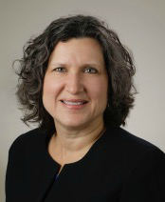
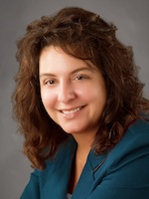
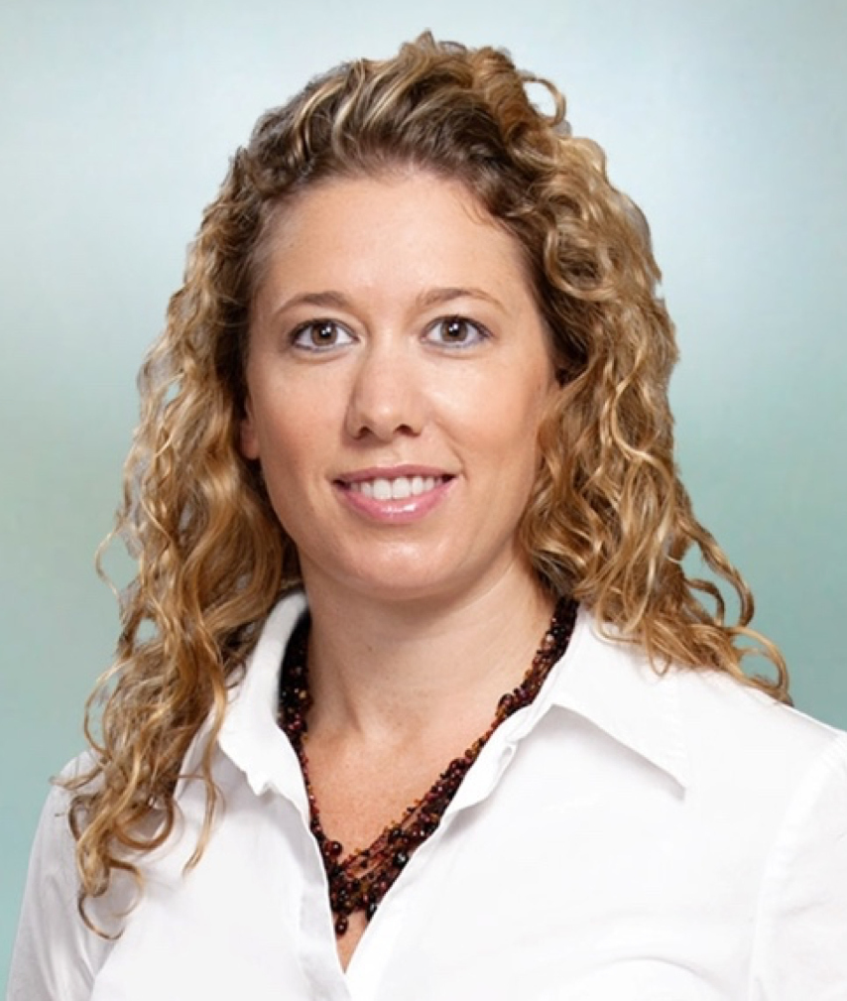
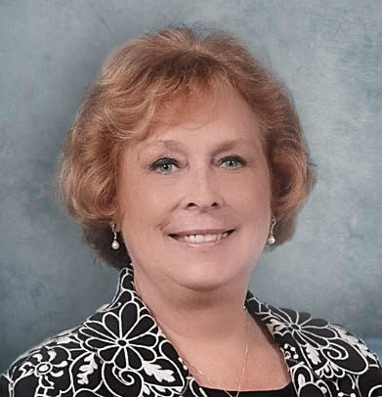
Partners Consulting Team
Heather Peters, M.Ed, Ph.D
GME Consultant
Christine Redovan, MBA
GME Consultant
Tori Hanlon, MS, CHCP GME Consultant
Pamela Royston, Ph.D
GME Consultant
GME Director & DIO
Seasoned speaker at ACGME & sub-specialty national meetings
Institutional and Program accreditation experience
3 decades in education; Masters of Education in curriculum & evaluations, PhD concentration in secondary education & adult learning theories
15+ years GME Operations, Accreditation and Management success
Focused on continual readiness and offering timely and useful GME resources
Over 13 years working in Medical Education
Bachelor’s in Health Services Administration
Master’s in Health Administration and Policy
Designated Institutional Official
Experienced in GME at a large academic medical center
GME Director & DIO
(GME) program analysis and strategic planning
GME Agreements and Contracts
Certified MBTI Consultant
New residency program development – pre-startup through implementation
GME policy development and integration with HR policy

Slide 3
GME Leaders need to have long-term vision…
Putting out fires
Building excellent educational programs

Slide 4
Learning Objectives
Elaborate on the need for strategic planning in today’s GME environment
Discuss the stages of strategic planning
Review concepts related to strategic planning: strategic thinking, C-Suite Speak

Slide 5
Strategic Planning Phases
How can we improve?
Goals
Desired Outcomes
Strategies
Measures & Targets
Results
Mission
Where do we want to go?
How did we do?
How do we measure success?
How do we get there?

Slide 6
Strategic Thinking
Use both logical and creative thinking processes
Clearly define visions (GME and personal)
Break down large tasks into smaller objectives
Recognize when to revise the plan to stay flexible
Have frequent “Aha” moments
Committed lifelong learners
Take time to allow real thinking
Seek advice from others
Balance creativity with realism
Non-judgmental
Be patient, don’t rush to conclusions!

Slide 7
Corporate Strategic Plans
Where does GME fit?
Part of the strategic planning process?
Are you considered a major stakeholder in your institution?
Do the major initiatives that came out of the corporate strategic plan include GME-specific initiatives

Slide 8
Corporate Strategic Plans
Have you learned to speak “C-Suite Speak”?
What kind of outcomes can you provide as evidence of GME value/contribution to the institution?
What data is meaningful to your C-Suite?
Doximity Ratings
Board Certification Percentage
ACGME Surveys
Recruitment of graduates

Slide 9
Partners’ 2019 Webinars
4-part Series: “SI 2025”
Part 2: Strategic Planning for GME

Slide 10
Trends in GME
Christine Redovan, MBA
GME Consultant

Slide 11
Why GME?
Medical Education
Health Care Delivery
GME

Slide 12
What is Happening?
Aging Population
Growing Population
Exponential Scientific/Medical knowledge growth
Reliance/Expectation on technology
Big data meets medicine
Consolidation
Health insurance markets

Slide 13
Who is Involved?
Public
ACGME
AAMC
IOM
Joint Commission
LCME
AMA
CODA
All of Us
CMS
Technology

Slide 14
We must align medical education with current and future health care delivery

Slide 15
GME Drivers
Physician Shortage
Medical school response
Frozen funding
GME slots not rising fast enough
Physician Practice
Scope of practice
Complexity of medicine
Transition from stage to the next

Slide 16
GME Drivers
Health Care Delivery
Move from central setting to ambulatory care centers
Move from solo to team practice
Communities
Mismatch between training and community needs
Differing/unclear/inadequate healthcare workforce needs at every level
Sponsors vs. private sector

Slide 17
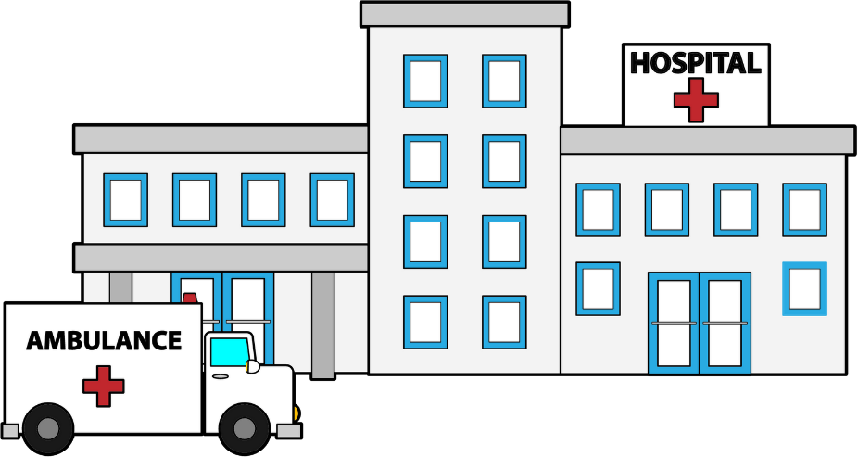
GME Drivers
Training Sites
Not training for environment of practice
Lack of stress and mental health awareness
Access to care for rural/underserved populations
Competition for training sites
Supply of qualified preceptors

Slide 18
Where are we going?
Care collaboration
Physician leaders
Marketing/Business/Consolidation
Technological challenges
Technological advancements
Government influence
Complexity of healthcare system

Slide 19
Resources
Association of American Medical Colleges. (2018, May). Results of the 2017 medical school enrollment survey. Retrieved from https://members.aamc.org/iweb/upload/Results_of_the_2017_Medical_School_Enrollment_Survey.pdf
Duval, J.F., Opas, L.M., Nasca, T.J., Foster Johnson, P., & Weiss, K.B. (2017). Report of the SI2025 task force. Journal of Graduate Medical Education, (9)6s, 11-57. doi:10.4300/1949-8349.9.6s.11
Association of Academic Health Centers. (n.d.). Adapting graduate medical education (GME) to 21st century healthcare [Blog Post]. Retrieved from http://www.aahcdc.org/21st-Century-AHCs/Advancing-the-Education-Model-for-21st-Century-Medicine/Adapting-Graduate-Medical-Education-GME-to-21st-Century-Healthcare

Slide 20
The Value of Social Media in GME
Tori Hanlon, MS, CHCP

Slide 21
Objectives
Understand how social media is used to facilitate learning
Explore opportunities for GME professionals to engage in social media for professional development

Slide 22
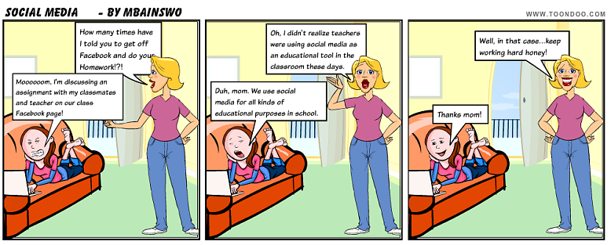

Slide 23
Social Media in Learning
Social media breaks down the walls of traditional learning environments
Classroom (didactics)
Clinical setting (teaching rounds, preceptorship)
Scholarly activity
Enables accessibility and gives learning more control over the time path and place at which they learn

Slide 24
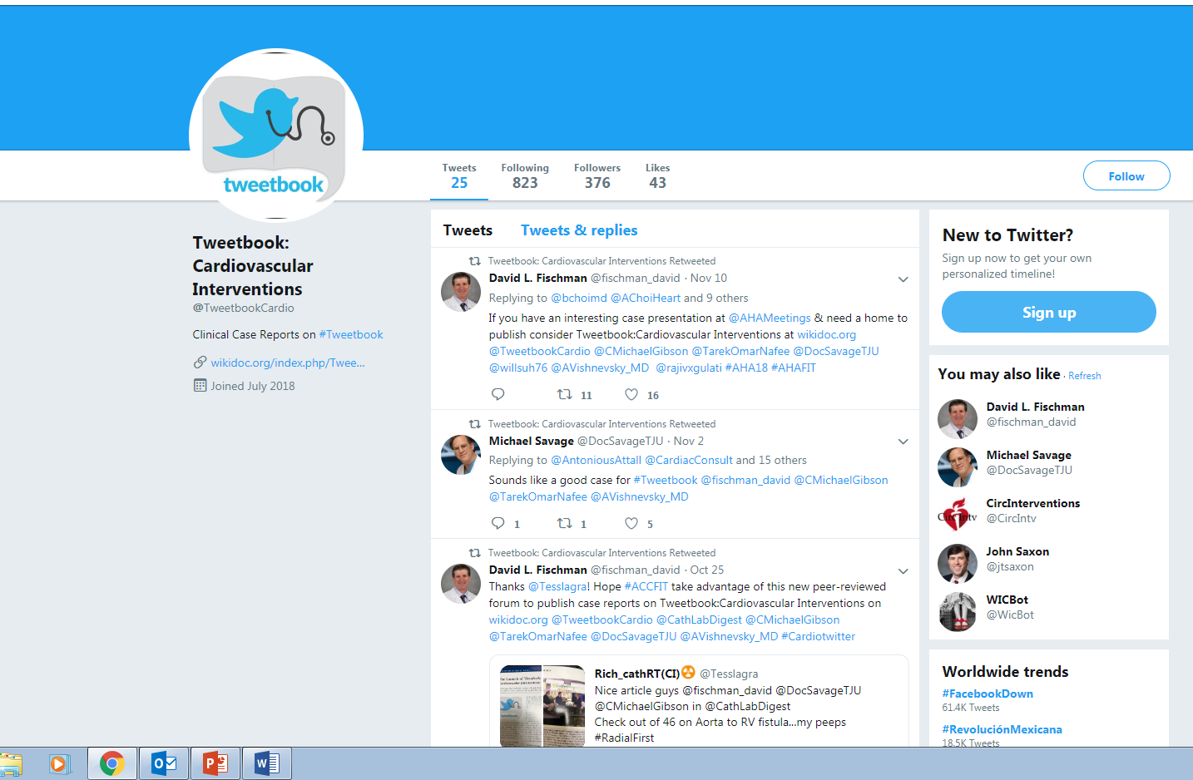

Slide 25
Social Media in Learning
Fosters peer-to-peer interaction
Builds relationships/networks
Encourages self-directed learning
It’s FREE

Slide 26
Social Media for GME Professionals
GME Program Administrators/Educators (624 members)
MedEd Chat
@MedEdPORTAL

Slide 27
Resources
https://www.cathlabdigest.com/article/Launch-Tweetbook-Cardiovascular-Interventions
https://er.educause.edu/articles/2017/4/learning-in-bursts-microlearning-with-social-media
http://omerad.msu.edu/about-us/publications/dr-ed-an-electronic-discussion-group-for-medical-educators
https://themedicaleducator.lpages.co/the-medical-educator-library/

Slide 28
Building a “Bench”- Developing New Core Faculty
Pam Royston, PhD
Consultant

Slide 29
Learning Objectives
Summarize key components of new faculty development
Identify strategies for implementing a new faculty orientation
Distinguish the secondary benefits of faculty orientation

Slide 30
Content
Faculty (Core) expectations (weaving in program standards and GME structure)
Setting Expectations
Providing Feedback
Determining Competency (evaluation)
The Struggling learner & remediation
Scholarly Activity

Slide 31
Delivery Method
Has to be at the right time
Sensitive to time commitment
Has to be convenient
COMPROMISE!

Slide 32
Session 1
Do you know what is expected of you?
Lines of Responsibility in GME
Program Standards
Core
Detail
Outcome
Institutional Requirements
Clinical Learning Environment

Slide 33
Session 2
Setting expectations
For the program
Resident rotations including off service rotators
Other expectations
Schedules
Entering orders, writing prescriptions, discharge summaries
Setting patient agendas

Slide 34
Session 3
Feedback: “What?!!! I was never told!”
Coach or Boss – difference between feedback & evaluation
Why it’s difficult to give feedback
When to give feedback
How to give feedback
Location
Tone
Specific
Positive as well as improvement
ACSS (Ask, Continue, Stop, Start)
Generational differences
How to handle negative reactions

Slide 35
Session 4
Problem Resident
Identification of issue in consultation with PD & CCC
Academic or misconduct
Investigate, confirm & refine
Review data – 360’s
Are there secondary causes – the 6 D’s
Refine issue based on Milestones
Remediation – Performance Improvement Plan
Continuous Coaching

Slide 36
Session 5
Litigation in Medical Education
Decisions concerning resident progress
Fair and equitable
Due Process was followed
Review Due Process Policy
Academic (student) versus misconduct (employee)
Follow the Process!!!
Give feedback
Provide written documentation of deficiencies
Provide time for corrective action
Give feedback!
This always involves the PD and DIO

Slide 37
Session 6
Professionalism
Integration with all core faculty
Professionalism as faculty - not patient care
Hidden curriculum
Self reflection based on resident feedback
Role modeling develops residents sense of professionalism

Slide 38
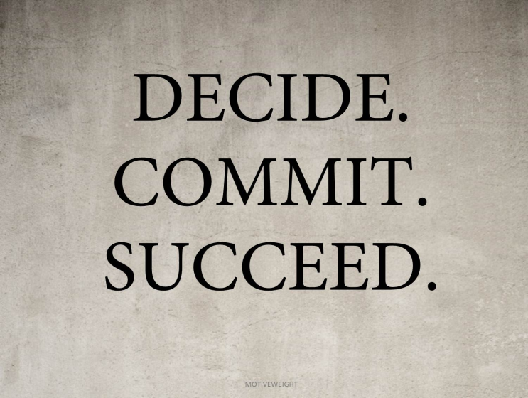
Take Home Message
Do something- commit!
Small groups builds trust
Keep it safe
Don’t accept the barriers
Time
Place
Clinical activity

Slide 39
Secondary Benefits
Scholarly activity projects between different specialties
Camaraderie
Information funneled back into program – faculty development snippets!
Standards are minimum – commit to excel

Slide 40
Upcoming Live Webinars
Milestones – Beyond the CCC Tuesday, December 4, 2018 12:00pm – 1:00pm EST
Mentoring the GME Coordinator: The First 3 Years Thursday, December 13, 2018 12:00pm – 1:00pm EST
SI 2025 Part 1 of 4: Introduction & Overview Tuesday, January 8, 2019 12:00pm – 1:00pm EST
Onboarding the New Coordinator Thursday, January 24, 2019 12:00pm – 1:00pm EST
On-Demand Webinars
Coordinator Development – How to Build a Team Responsiveness to Diverse Patient Populations
Demystifying the Resident and
Faculty ACGME Survey
Oversight of the Clinical Learning and Working Environment
Policies, PLA’s and Policing
Making “Cents” Out of GME Financing
NEW Faculty Development Series
Contact us today to learn
how our Educational
Passports can save you
time & money!
724-864-7320
www.PartnersInMedEd.com
15 Minutes to Effective Feedback
40

Slide 41
Partners in Medical Education, Inc. provides comprehensive consulting services to the GME community.
Partners in Medical Education
724-864-7320 | info@PartnersInMedEd.com
Heather Peters, M.Ed, Ph.D heather@PartnersInMedEd.com
Christine Redovan MBA christine@PartnersInMedEd.com
Tori Hanlon, MS, CHCP tori@PartnersInMedEd.com
Pamela Royston, Ph.D pam@PartnersInMedEd.com
www.PartnersInMedEd.com

