Slide 1
”Meet the Experts – Fall Freebie”
Heather Peters, M.Ed, Ph.D Christine Redovan, MBA Pam Royston, Ph.D
Grace Brannan, Ph.D

Slide 2
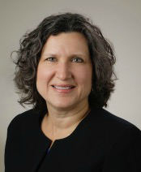
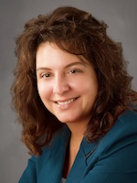
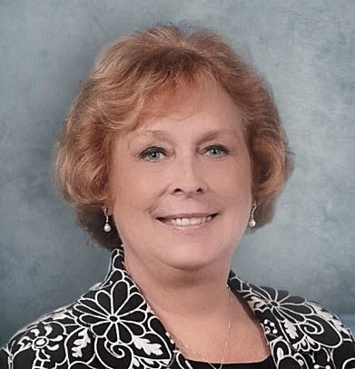
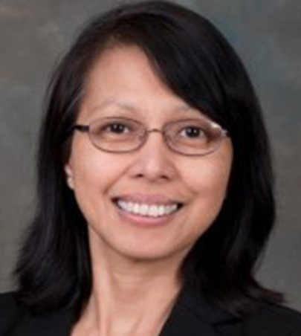
Partners Consulting Team
Heather Peters, M.Ed, Ph.D
GME Consultant
Christine Redovan, MBA
GME Consultant
Pamela Royston, Ph.D
GME Consultant
Grace Brannan, Ph.D GME Consultant
GME Director & DIO
Seasoned speaker at ACGME & sub-specialty national meetings
Institutional and Program accreditation experience
3 decades in education; Masters of Education in curriculum & evaluations, PhD concentration in secondary education & adult learning theories
15+ years GME Operations, Accreditation and Management success
Focused on continual readiness and offering timely and useful GME resources
GME Director & DIO
(GME) program analysis and strategic planning
GME Agreements and Contracts
Certified MBTI Consultant
New residency program development – pre-startup through implementation
GME policy development and integration with HR policy
13+ years in GME and UME Research Administration
Works with MD and DO residency programs to create and implement scholarly strategies
As an Executive Director, led a team that served residents and physician faculty and preceptors across 25 teaching hospitals and 3 campuses.
As an Associate Dean for Research, created and implemented a unified UME-GME Research Strategy for a medical school and its 14 residency programs, 8 specialties, 4 hospitals and 150+ residents

Slide 3
Best Practices for the Program Evaluation Committee (PEC)
Heather Peters, M.Ed, Ph.D
Graduate Medical Education Consultant

Slide 4
ACGME REQUIREMENTS
V.C. Program Evaluation and Improvement
The program director must appoint the Program Evaluation Committee to conduct and document the Annual Program Evaluation as part of the program’s continuous improvement process.
V.C.1.b).(1) acting as an advisor to the program director, through program oversight; (Core)
V.C.1.b).(2) review of the program’s self-determined goals and progress toward meeting them; (Core)
V.C.1.b).(3) guiding ongoing program improvement, including development of new goals, based upon outcomes; and, (Core)
V.C.1.b).(4) review of the current operating environment to identify strengths, challenges, opportunities, and threats as related to the program’s mission and aims. (Core)

Slide 5
Program Evaluation & Improvement
PEC must have at least 2 faculty, one of whom is a core faculty member
Responsibilities of PEC:
advisor to PD, through program oversight
review of the program’s self-determined goals & progress
developing new goals, based on outcomes
SWOT
“continuous improvement process”

Slide 6
Background and Intent
In order to achieve its mission and train quality physicians, a program must evaluate its performance and plan for improvement in the Annual Program Evaluation.
Performance of residents and faculty members is a reflection of program quality and the (program should use metrics) that reflect the goals that a program has set for itself.
The Program Evaluation Committee utilizes outcome parameters and other data to assess the program’s progress toward achievement of its goals and aims.
BOTTOM LINE – The ACGME has taken the concept of the self-study and now expects this to be done by the PEC each year!

Slide 7
Curriculum
Outcomes from Previous APE
ACGME letters of notification, citations, AFIs
Quality and safety of patient care
aggregate trainee and faculty:
well-being
recruitment & retention
workforce diversity
engagement in QI and PS
scholarly activity
ACGME trainee and faculty surveys
written evaluations of the program
achievement of the Milestones
in-training exams
board pass and certification rates
graduate performance
Aggregate faculty:
evaluation
professional development
Action Plan:
discussed with trainees and faculty
submitted to the DIO
Aggregate Trainee:
APE Components (2019 CPRs)

Slide 8
Key Take-Away
This CANNOT be accomplished in one or even 2 meetings per year!

Slide 9
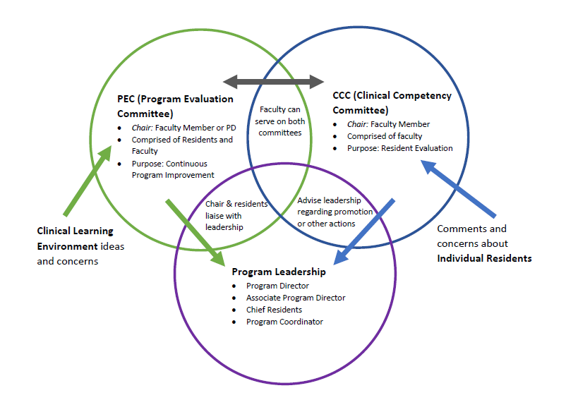
PROGRAM STRUCTURE

Slide 10
Best Practices
Do
Educate PEC members about their role and responsibilities
Follow up on APE action items as part of your standing PEC agenda
Have lots of residents on the PEC to give them a voice in program improvement (one or more per training year)
Have rotation directors present their data and follow-up action plans
Don’t
Conduct a PEC meeting without an agenda
Expect that all issues will be resolved in one PEC meeting – that’s the nature of change – it takes time
Require the PD to chair the PEC – this is a great opportunity to train a fledging leader

Slide 11
Role of PEC Member
Be respectful of other’s viewpoints
Bring an open mind
Be prepared with possible solutions
Be in touch with your peers/colleagues so that your voice reflects their thoughts
Be professional when discussing the business of the committee outside the committee

Slide 12
For More…
Join us in 2020 for a full webinar on the topic
Templates
Guidelines
Experiences from the field

Slide 13
Pseudo Academics
Christine Redovan, MBA, MLIS
Graduate Medical Education Consultant

Slide 14
Objective
Recognize fake/predatory academic journals and conferences
This Photo by Unknown Author is licensed under CC BY-SA

Slide 15
Started with fake news…
Made up news and information has a big impact on:
- Confidence in each other
Sources of where news and information is obtained
Confidence in the government
Understanding of current issues
This Photo by Unknown Author is licensed under CC BY-NC

Slide 16
…and infiltrated medicine
Fake Medical Claims
Explosion of Journals
Predatory Journals
Predatory Publishing (closed and open source)
Fake metrics/benchmarks
Predatory Conferences
Spoofing of trustworthy name
Dilution of accurate information

Slide 17
Impact on GME
Pressure for publication
Academic ranking
ACGME requirements
Competitive specialties
Competitive organizations

Slide 18
Let’s go through an example…

Slide 19
About us…

Slide 20
What is Scholars Portal?

Slide 21
Member of Recognized Industry Initiative?
No, adopts rules, not a member of COPE.

Slide 22
This was published…
No reference to item in quotations
Only one author?

Slide 23
Credential of author
No real info; Wikipedia & Facebook page
Largest private university in India; designated web site
If associated with a university, why a yahoo email?

Slide 24
Dated References
Use of old references
All 3 of these references are NOT in the reference list

Slide 25
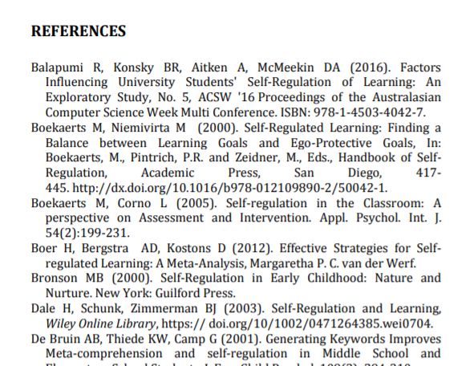
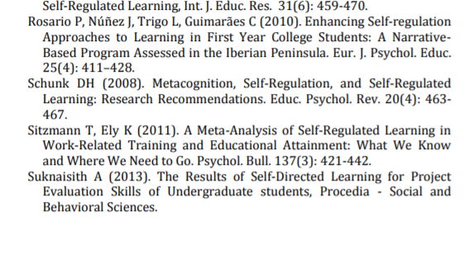
Missing References
Ghatala?
Combs?
Schneider?

Slide 26
Sorting Journals out…
Adapted from thinkchecksubmit.org checklist:
You and/or colleagues know the journal?
Easily identify and contact publisher?
Clear on peer review type/process?
Indexed in services you use?
Clear on types of fees and what used for?
Recognizable editorial board?
Publisher member of recognized industry initiative?

Slide 27
Predatory Conferences
Doctors receive multiple invitations to present
Misleading or false
Claim of real leading academic support
Lack of editorial oversight
Mimic real conference names
Typically sponsored by predatory journals or organizations
Accept submissions in short time frame
Spoof email invitations
Use of real academic leader’s likeness in marketing

Slide 28
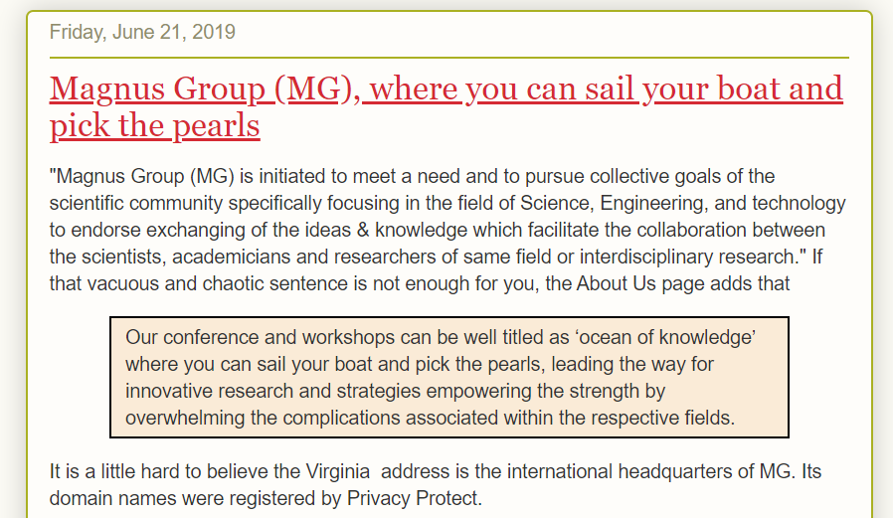
List of Flaky Academic Conferences
Blog site that publishes the email received along with the research the site has done.

Slide 29
Sorting Conferences out…
Adapted from thinkcheckattend.org checklist:
Research organizers and sponsors
Review agenda and editorial committee
Are the proceedings published?
This Photo by Unknown Author is licensed under CC BY-SA

Slide 30
Resources/References
Bowling Green State University Libraries. (2019, November 12). Predatory journals and publishers: Is the journal or publisher predatory? Retrieved from https://libguides.bgsu.edu/predatoryjournals
Kaye, D.H. (n.d.). Flaky academic conferences [Blog post]. Retrieved from http://flakyc.blogspot.com/
Laine, C. & Winkler, M. (2017). Identifying predatory or pseudo-journals. Biochemica Medica, 27(2), 285-291. doi: 10.11613/BM.2017.031
Mitchell, A., Gottfried, J., Stocking, G.,Walker, M. & Fedeli, S. (2019). Many American say made-up news is a critical problem that needs to be fixed. Pew Research Center. Retrieved from https://www.pewresearch.org/
Think.Check.Attend. (n.d.). Choose the right conference to attend and present your research. Retrieved from https://thinkcheckattend.org/
Think.Check.Submit. (n.d.). Choose the right journal for your research. Retrieved from https://thinkchecksubmit.org/

Slide 31
Maximizing Resident FTE’s – Being Prepared for A CMS Audit
Pam Royston, Ph.D
Graduate Medical Education Consultant

Slide 32
Learning Objectives
State when resident FTE’s need to be finalized
Indicate what rotations count, don’t count, and maybe count
Describe good rotation names
Do you need an agreement???

Slide 33
What is a resident FTE?
Each resident has the potential for counting as 1 – Full time Equivalent Status.
Resident time can be counted depending on the activity and the setting in which it is performed
Quick calculation – 30 days/365 calendar days = .082

Slide 34
When do you need to finalize the FTE count?
FTE counts are due approximately 60 – 90 days after the hospital’s fiscal year closes
Fiscal year is any other date than calendar year of December 31st
March 31st
June 30th
September 30th

Slide 35
Fiscal Year
If you don’t use a residency management system to calculate FTE’s, you will need to do a fiscal year conversion
Fiscal year conversion – you calculate the resident count for each year you work in
Example: Fiscal Year is September 30th
Resident FTE’s calculated 10/1/18 to 6/30/19 - new residents, new PGY levels.
Three-month resident FTE’s 7/1/19 to 9/30/19

Slide 36
What rotations count for reimbursement?
Need to be in an accredited residency training programs
 | Hospital |  | Nonhospital
Activity | DGME | IME | DGME | IME
Patient Care | Yes | Yes | Yes | Yes
Vacation/Sick | Yes | Yes | Yes | Yes
Didactic | Yes | Yes | Yes | No
Research | Yes | No | No | No
Notes:
Rotations count when they are in patient care related activities. This is true both hospital and non-hospital settings.
Questionable rotations are things such as research, quality improvement, administration, and informatics. If the rotations are done in the hospital it is likely you can claim the direct but not the indirect funding.

Slide 37
Rotation Names
Make sure rotation names are clear and describe rotation
Electives and/or subspecialty on the schedule- change it to the name of the rotation once selected
What is senior teaching? Make sure first to state the service first – IM:Senior
Anything with “Out” in the name will be considered outside of the hospital
Titles with non-clinical will have IME deducted
Notes:
When there is an audit, a sample will be pulled. Rotations that are adjusted will be applied to the population. These have a major impact on counts.

Slide 38
Do you need an agreement?
Medicare and accreditation are different!!
Rotation agreement needed:
Private physician on your medical staff
Clinics – non providers (no Medicare reimbursement)

Slide 39
Keep Agreement Simple
Key elements:
Hospital pays all the residents cost including stipends and fringe benefits
Physician agrees to supervise the resident
Professional liability insurance is provided
Physician will be required to provide an evaluation

Slide 40
Authorship (How to Keep Scholarly Work Ethical)
Grace Brannan, Ph.D
Graduate Medical Education Consultant

Slide 41
Learning Objective
Discuss Authorship and provide Best Practices

Slide 42
What is Authorship?
Authorship refers to “the state or fact of being the person who wrote a particular book, article, play, etc.”
https://dictionary.cambridge.org/us/dictionary/english/authorship
Importance: it gives credit for work done and it also determines responsibility for the paper.

Slide 43
What is ICMJE?
ICMJE stands for “International Committee of Medical Journal Editors”
ICMJE is “a small group of general medical journal editors and representatives of selected related organizations working together to improve the quality of medical science and its reporting”
http://www.icmje.org/
Crafted an authorship recommendation followed by many journals. http://www.icmje.org/recommendations/

Slide 44
ICMJE Authorship Criteria
An Author must meet all 4 criteria:
1. Substantial contributions to the conception or design of the work; or the acquisition, analysis, or interpretation of data for the work; AND
2. Drafting the work or revising it critically for important intellectual content; AND
3. Final approval of the version to be published; AND
4. Agreement to be accountable for all aspects of the work in ensuring that questions related to the accuracy or integrity of any part of the work are appropriately investigated and resolved.

Slide 45
Implications
Journals ask for attestation of contribution
Complaints and Dispute can hinder publication or presentation of work—Affects meeting ACGME requirements
Reputation of program

Slide 46
Best Practices
Do
Have a policy in place
Communicate policy to everyone
Discuss and decide responsibilities and authorship at the beginning and update as needed
Document participation via email and shared drive
Don’t
Wait until the end of the study to decide authorship
Provide authorship to those not meeting the criteria

Slide 47
Key Take-Away
Authorship policy, early discussion and transparency among the team are critical!

Slide 48
Thank You!

Slide 49
Upcoming Live Webinars
Jump Start Your GME Thursday, December 5, 2019 12:00pm – 1:00pm EST
Creating a Diverse Workforce Tuesday, December 17, 2019 12:00pm – 1:00pm EST
APE Reconstructed Tuesday, January 7, 2020 12:00pm – 1:00pm EST
On-Demand Webinars
Special Reviews – Helpful not Hurtful
2019 CPR Part 3 of 4: Section IV & Section V
GME Is Not Just GME
SI 2025 Part 4 of 4: Strategic Planning
Understanding Practice Data
CPR 2019 Part 4 of 4: Putting It All Together
Crafting “Top Notch” Goals, Objectives and Evaluations
Feedback – From the Top Down
Evolving Resident Well-Being
We All Need Scholar Activity, Including Coordinators
NEW Faculty Development Series
15 Minutes to Effective Feedback
Toolbox for Teaching Millennials
Taking Supervision to the Next Level
Contact us today to learn how our Educational
Passports can save you time & money!
724-864-7320
www.PartnersInMedEd.com
49

Slide 50
Partners in Medical Education, Inc. provides comprehensive consulting services to the GME community.
Partners in Medical Education
724-864-7320 | info@PartnersInMedEd.com
Heather Peters, M.Ed, Ph.D
Heather@PartnersInMedEd.com
Christine Redovan, MBA, MLIS
Christine@PartnersInMedEd.com
Pam Royston, Ph.D
Pamela.roystonr@PartnersInMedEd.com
Grace Brannan, Ph.D
gdbconsulting@outlook.com
www.PartnersInMedEd.com
Presented by Partners in Medical Education, Inc. 2019

