Slide 1
Partners Webinar Alert
Reminder…Because of the amount of individual logins for this webinar. Please DO NOT Unmute your Microphone after you enter this webinar.

Slide 2
”Meet the Experts – Fall Freebie”
Heather Peters, M.Ed, Ph.D Christine Redovan, MBA

Slide 3
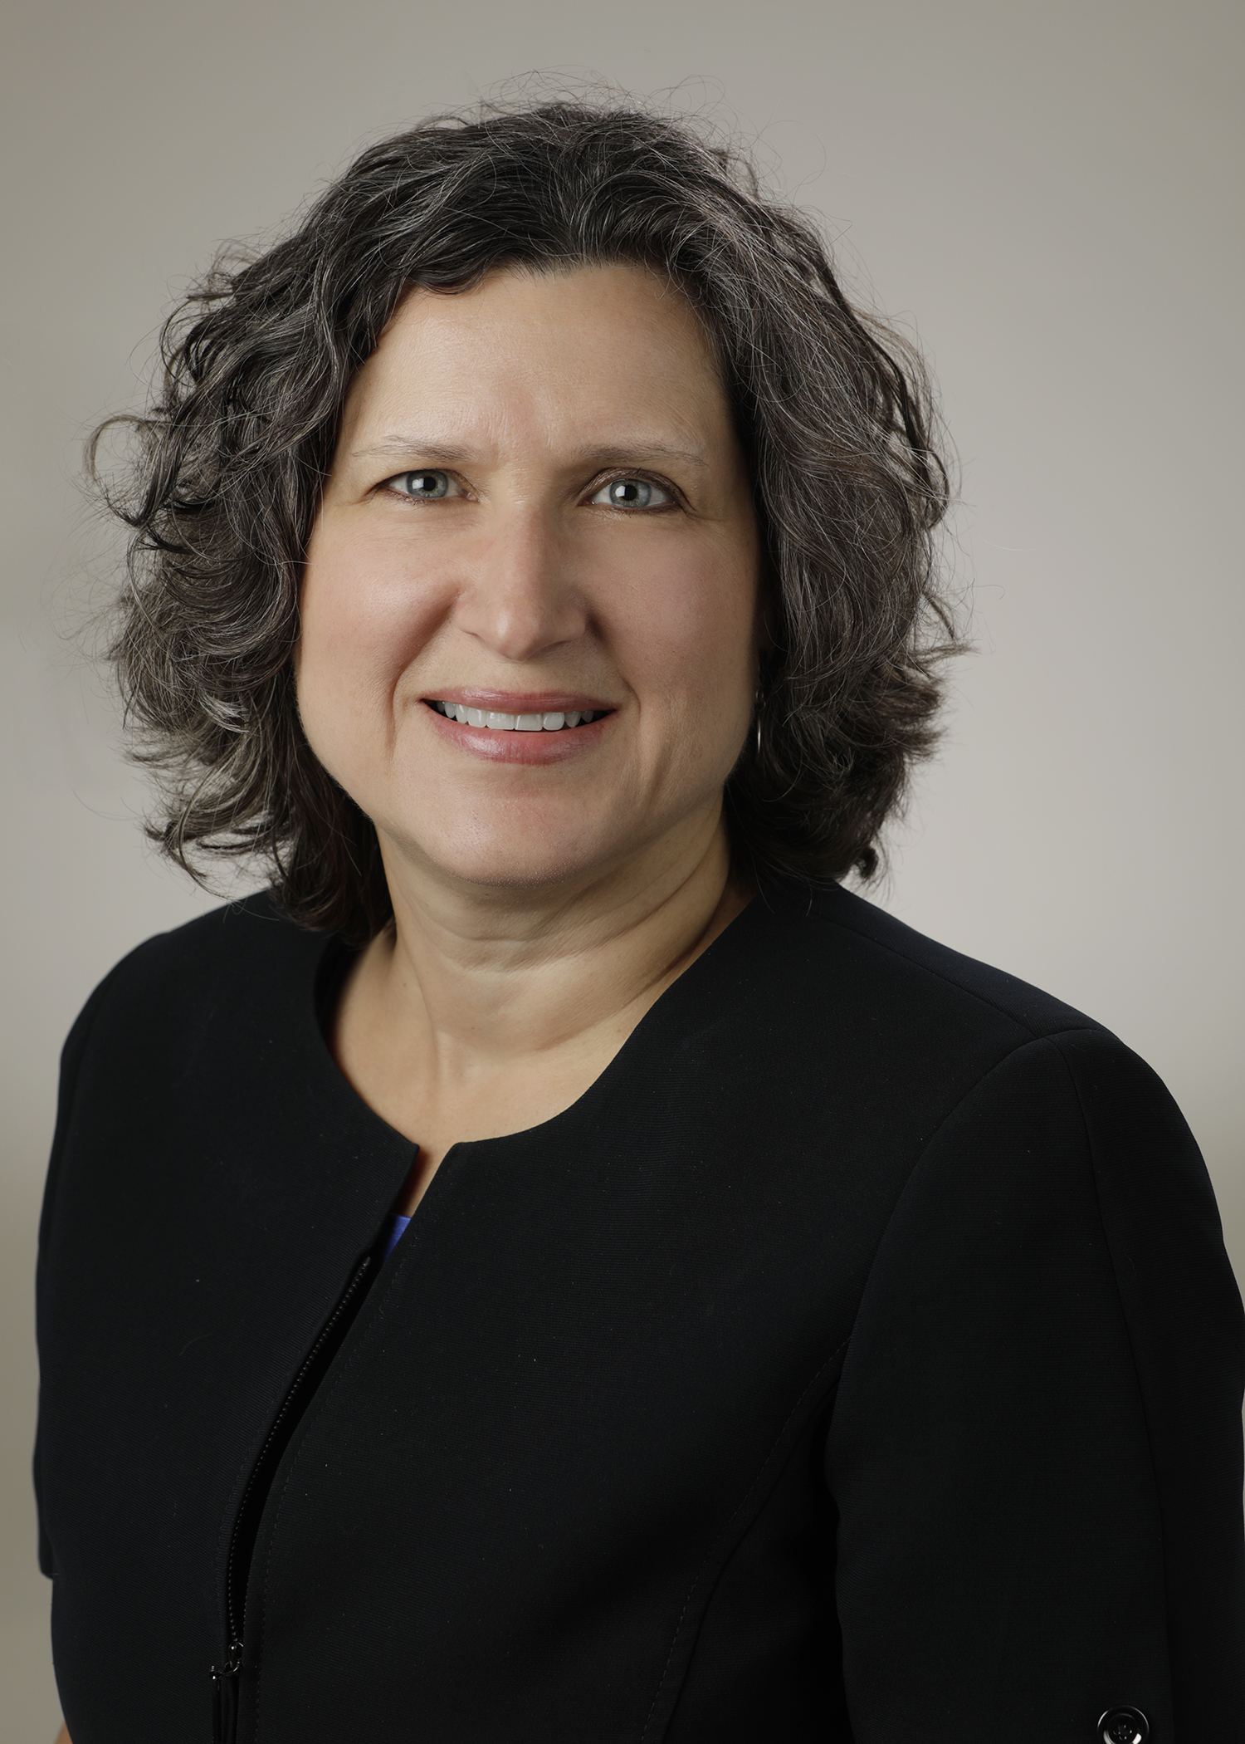
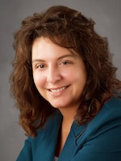
Introducing Your Presenter…
Heather Peters, M.Ed, Ph.D
GME Consultant
Christine Redovan, MBA, MLIS
GME Consultant
Former GME Director & DIO
Seasoned speaker at ACGME & subspecialty national meetings
Areas of Expertise: GME Strategic Planning; Program Evaluation; and Faculty Development
3 decades in education; Masters of Education in curriculum & evaluations, PhD concentration in secondary education & adult learning theories
Seasoned Director of Medical Education and GME Operations
Accreditation and Management Expert For New and Established Institutions and Programs
ACGME-I Accreditation Expert
Successful GME Start-Up Implementation
Focused on Continuous Accreditation Readiness. Data Mining, and Useful GME Resources
20+ years GME experience

Slide 4
Resident Complaints
Christine Redovan, MBA, MLIS -- GME Consultant
4

Slide 5
Resident Complaints
Uptick since the pandemic
Institution and program level
Difficult to find published information about number and types of complaints
Confusion on when to report to ACGME

Slide 6
ACGME Pathways
Ombudsperson
Anonymous problem solving
Does not affect accreditation
Does not go to RC
Educational opportunity
Complaint
Confidential reporting system
Specific compliance with requirements
Reviewed by RC
Potential impact on accreditation
Source: https://acgme.org/Residents-and-Fellows/Report-an-Issue

Slide 7
Resident Complaints
The letter will come via email
Read carefully
Follow the instructions
Note response due date

Slide 8
Resident Complaints
It’s tempting to “hide” the letter. Don’t do it!
DIO must be involved
GMEC must be involved
GMEC must document the complaint and the response
GMEC must document any follow-up
Summarize the complaint and response with GMEC maintaining resident confidentiality to the extent possible

Slide 9
Resident Complaints
Steps to Resolution
Investigate the complaint
Interviews/Meetings
Gather documents
Draft response
Be factual; not defensive
Include dates and documentation to support the facts

Slide 10
Resident Complaints
Steps to Resolution
Have a trusted, neutral party review
Ensures no bias in response
Confirms all parts of the complaint have been addressed
4. Review with GMEC
Summarize response; document and obtain GMEC approval
DIO to sign any program responses
Chair of GMEC (if not DIO) to sign any institutional responses

Slide 11
Resident Complaints
Afterwards….
Do not take it personally
Review your internal mechanisms for concerns/complaints
Opportunity for root cause analysis. Why did the complaint get this far?

Slide 12
Documenting the Sponsoring Institution Responsibilities
Heather Peters, M.Ed, Ph.D -- GME Consultant
12

Slide 13
The Role of the GMEC: Oversight
Accreditation
Clinical Learning Environment
Annual Program Evaluation (APE)

Slide 14
The Role of the GMEC: Support
Resources
Learning Environment
Ensuring Leadership & Administrative Support

Slide 15
The Role of the GMEC: Documentation
Annual Institutional Review (AIR)
Tracking GMEC Requirements
Policies
Documenting Discussion

Slide 16
Sponsoring Institution Citations
GMEC Documentation Issues:
Format of minutes not meeting expectations
Not documenting GMEC responsibilities
Lack of identification of voting members of GMEC
Lack of discussion in minutes
Lack of approval process evident in minutes
Lack of evidence of program oversight due to the absence of APE review from programs
Lack of evidence or review of ACGME surveys
Lack of evidence of reviews of Letters of Notification
GMEC learning and working environment – participating sites with no representation on GMEC
Annual Institutional Review (AIR) – missing elements
Special Review Protocol – missing elements

Slide 17
Minutes
Evidence for ACGME – are you meeting requirements?
Voting needs to be evident in your minutes
Clear, concise – show discussion and results
Different from medical staff/other types of minutes
TIP: If you gave your minutes to someone who did not attend the meeting…would they understand what happened?

Slide 18
Minutes
Require follow-up; name of person responsible and expected date
Documentation of follow-up
GMEC provides resources, if needed
TIP: Trace through your minutes. Are the loops closed? Are there dead ends?

Slide 19
Meeting GMEC Requirements
Tracking GMEC responsibilities in the agenda
Tracking the requirements for the AIR
Topic | Presenter | Voting Required | IR REQ | Page
Welcome/ Call to Order | Heather Peters, PhD
Approval of Minutes | Heather Peters, PhD | X |  | 3-8
Monthly Monitoring Report - Information · Work Hour violations for each program · Residents on LOA · Residents on Remediation | Heather Peters, PhD |  | I.B.4.b) (3) I.B.4.b) (4)
Program Evaluation Committee (PEC) Education | Heather Peters, PhD |  | I.B.4.a)(3)

Slide 20
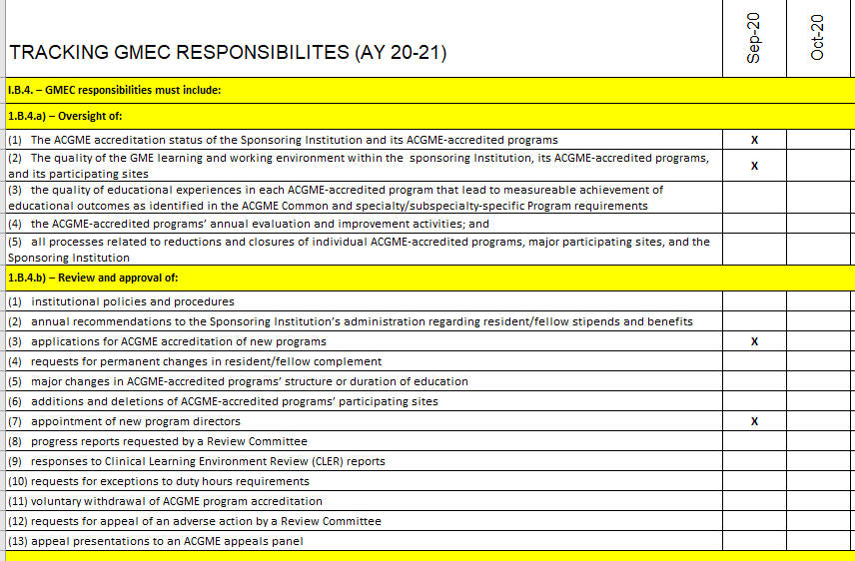
Tracking of GMEC Responsibilities
Reminders:
Document all GMEC responsibilities over the course of the academic year in your minutes
Complete list of Responsibilities: I.B.4, I.B.5 and I.B.6 sections
Best Practices:
Add areas of the requirements that you have citations in or any other potential vulnerabilities
Include in AIR to inform and educate GMEC about responsibilties

Slide 21
GMEC Planning
Possible Categories:
Follow-up from previous GMEC meetings
Membership of GMEC
COVID-19
Policies
Subcommittee Reports
Resident Forum Report
APE Reports/Action Plans Progress Reports
AIR
Quality Reports
ACGME Surveys
Accreditation Reports (Letters of Notification, Program Director Approval)
CLER

Slide 22
GME Updates You May Have Missed
Christine Redovan, MBA, MLIS -- GME Consultant
22

Slide 23
GME Updates
New TY + Ophthalmology requirement
Effective July 1, 2021 – Ophthalmology programs must either offer first year training or a joined TY-OPH training.
Potential collaboration and/or new programs
Citations not expected until 2023; but start planning now
Ophthalmology RC website has much more detail. (https://acgme.org/Specialties/Documents-and-Resources/pfcatid/13/Ophthalmology)

Slide 24
GME Updates
Coordinator timelines released by the ACGME Coordinator Advisory Group
Includes residency, fellowship and institutional timelines
Fully customizable to your institution
Recommend adopting across programs; use as a coordinator committee meeting activity
CAG site: https://acgme.org/Program-Directors-and-Coordinators/Welcome/ACGME-Coordinator-Advisory-Group

Slide 25
GME Updates
ACGME CLER Visits Resuming
Pilot visits have begun
All virtual; no walking rounds during the pilot
Heavy technology requirement
Pilot focus is on the CLE response to COVID-19
Pilot requests responses to questions from C-Suite and Patient Safety to be submitted prior to the visit
Trying out a new protocol….subject to change based on results/experiences
New report on CLE’s released. Results from small and unique settings. (https://acgme.org/Portals/0/PDFs/CLER/CLERSpecialReportUniqueSettings2020.pdf)

Slide 26
GME Updates
ADS imports ABMS data for faculty.
Exportable survey report data from ADS. Ideal for making red, yellow, green dashboards.
Many requirement changes/updates pending ACGME Board approval. Keep an eye open.
ACGME 2019-2020 Data Book
Pursuing Excellence report published
2019-2020 ACGME Annual Report
(source: acgme.org)

Slide 28
Upcoming Live Webinar Working with Struggling Learners
Thursday, December 3, 2020 12:00pm – 1:00pm EST
DIO Role and Responsibilities: Keys to Success
Thursday, December 17, 2020 12:00pm – 1:00pm EST
How to Manage Virtual Site Visit Tuesday, January 5, 2021 12:00pm – 1:00pm EST
How to Maximize Virtual Learning Part 1 Thursday, January 21, 2021 12:00pm – 1:00pm EST
Latest On-Demand Webinars
Working with your Governing Board
Recognizing & Addressing Precursors of Burnout: The Value of Shame Resiliency Training to Support Resident Well-Being
Working with your IRB
Digging for Data II
Demystifying Diversity
Faculty Development Planning: Sponsoring Institution Role
ADS Annual Update: Best Practices
Graduate Medical Education Financing
Artificial Intelligence in Medicine: Its Impact on GME
Faculty Development – A More Specific Approach
NEW Faculty Development Series
15 Minutes to Effective Feedback
Toolbox for Teaching Millennials
Taking Supervision to the Next Level
Contact us today to learn how our Educational
Passports can save you time & money!
724-864-7320
www.PartnersInMedEd.com
Presented by Partners in Medical Education, Inc. 2020
28

Slide 29
Partners in Medical Education, Inc. provides comprehensive consulting services to the GME community.
www.PartnersInMedEd.com
Heather Peters, M.Ed, Ph.D
Heather@PartnersInMedEd.com
Christine Redovan, MBA, MLIS
Christine@PartnersInMedEd.com

