Slide 1
Please Note…
Please make sure your Start Video is OFF when logging into the WebEx platform.
Here is what it should look like
ALSO
It is NORMAL to not hear any sound until the webinar starts at 12:00 noon EST.
Your phone line is muted, but you can always chat to the host, BJ Schwartz, if you have any questions or concerns during this time.

Slide 2
Meet the Experts
Heather Peters, M.Ed, Ph.D Carmela Meyer, MBA, Ed.D
Amy Durante, MHA Cheryl Haynes, BA
Christine Redovan, MBA, MLIS

Slide 3
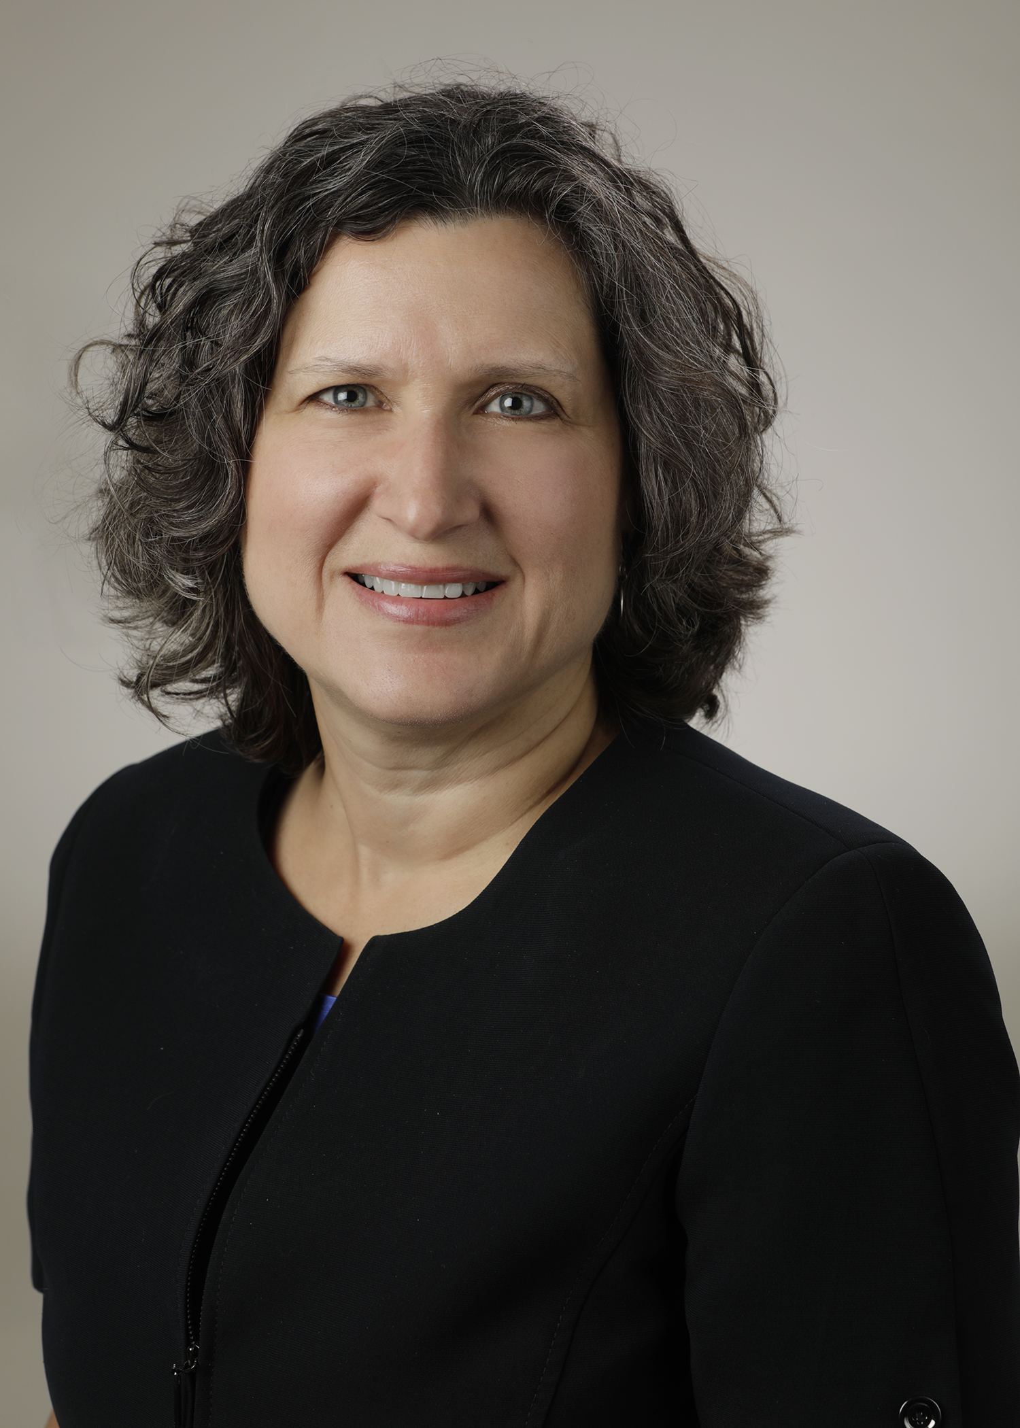
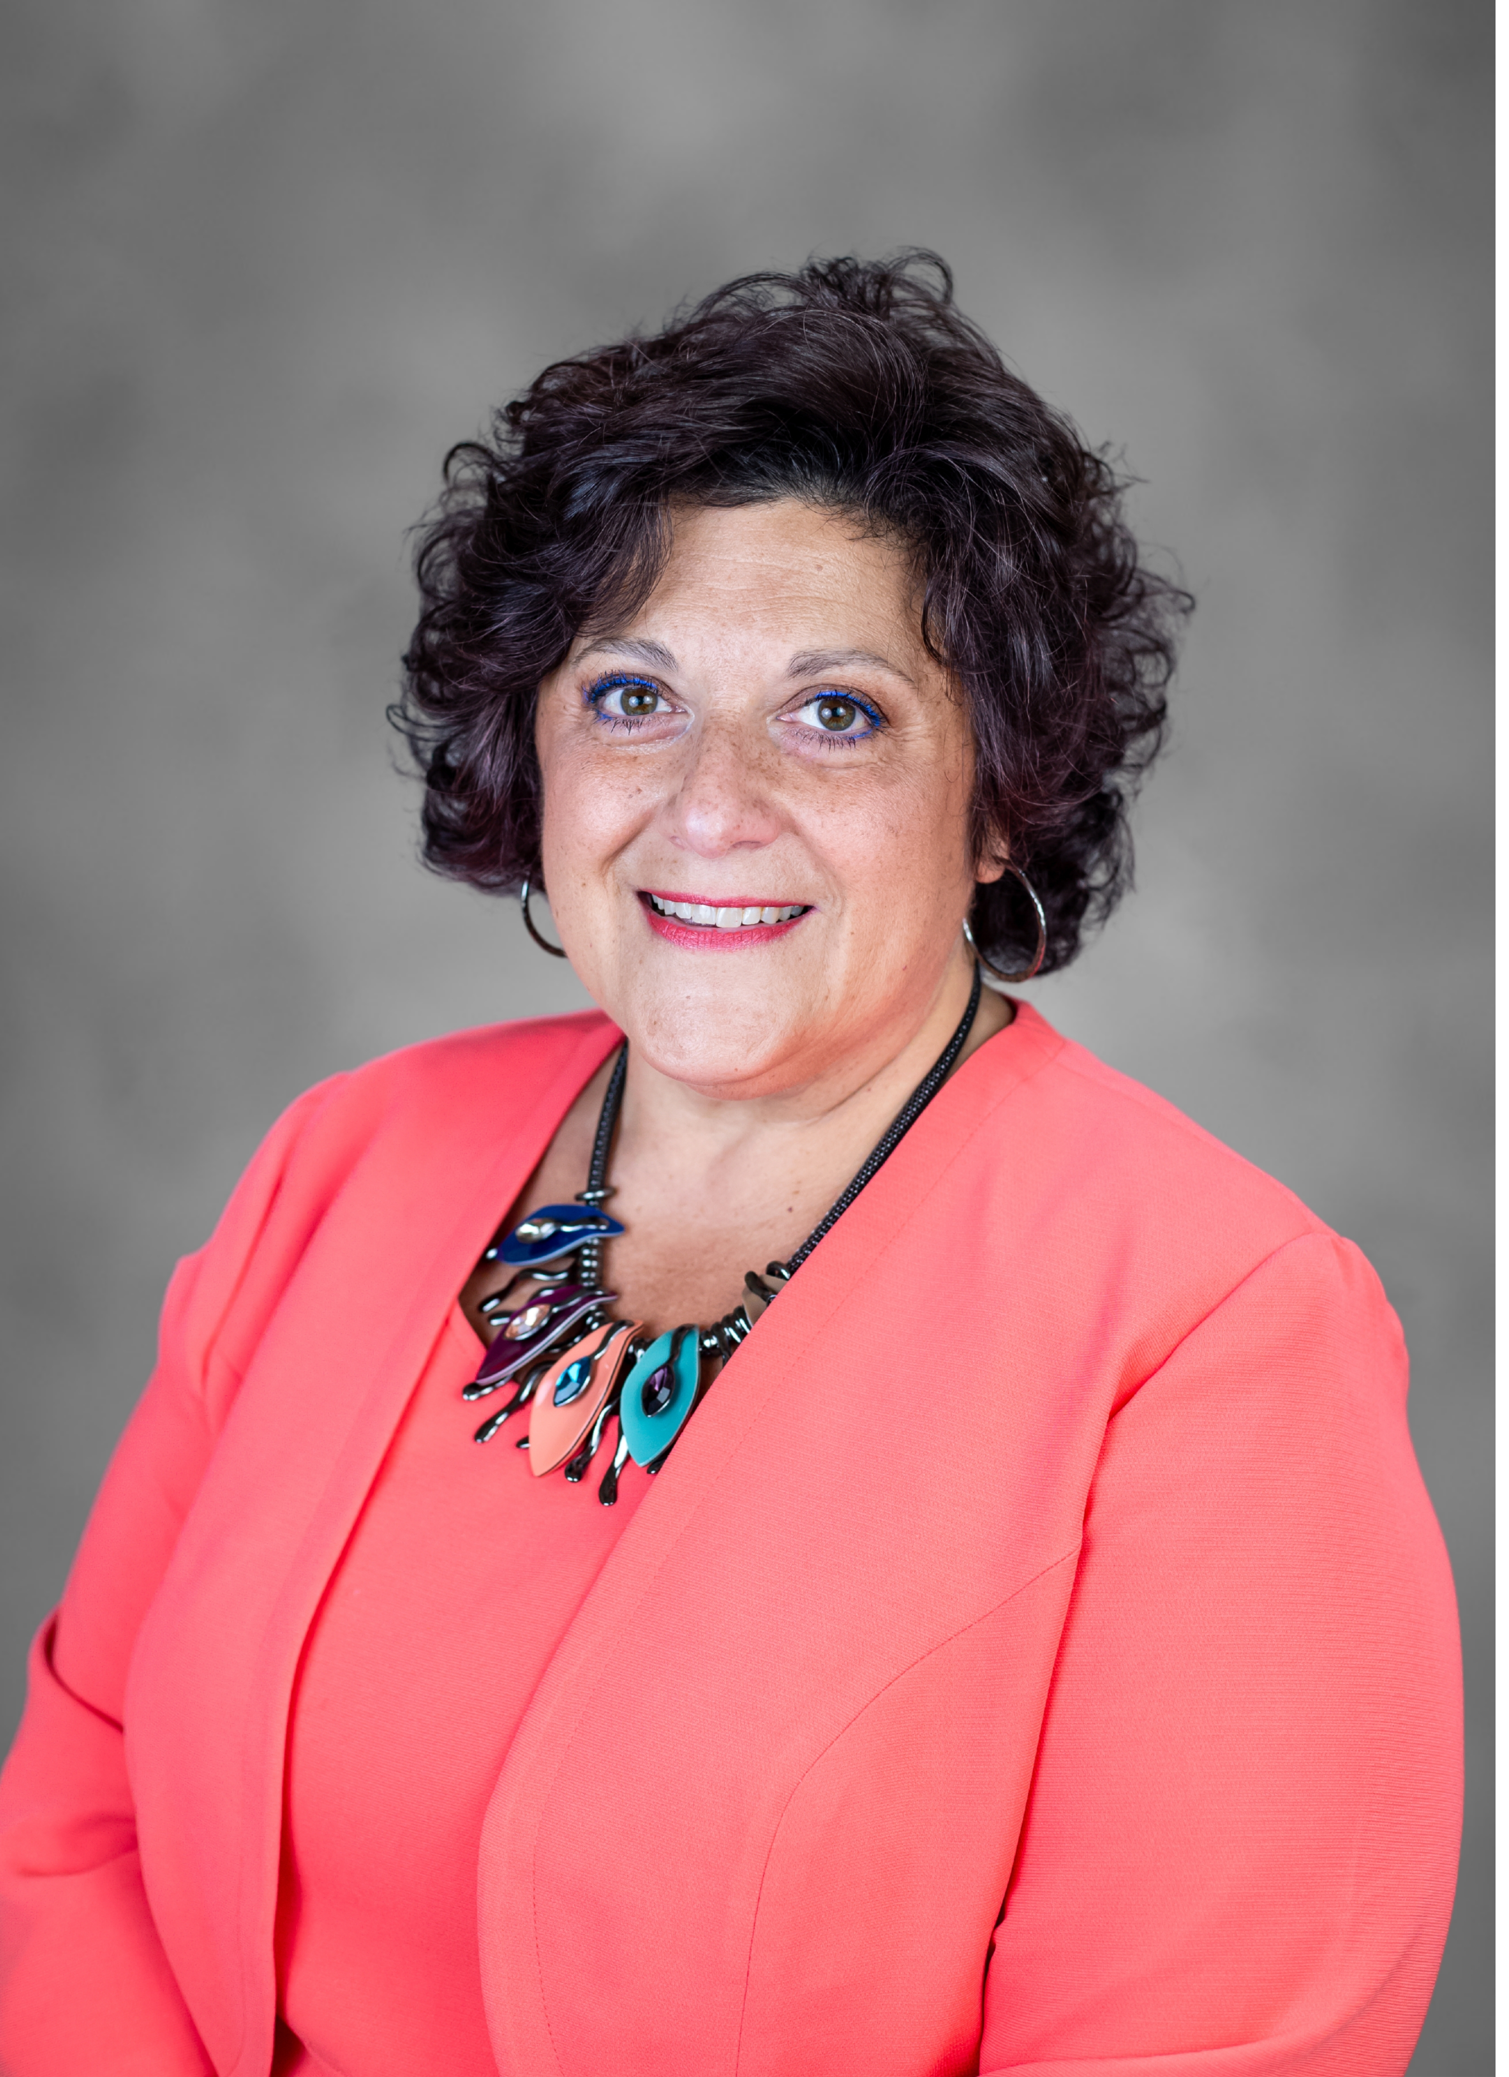
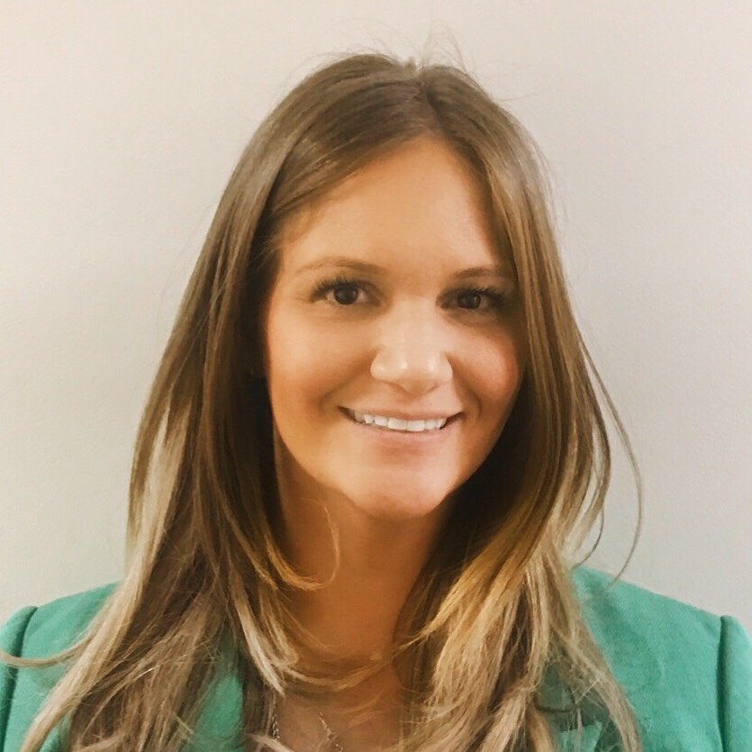
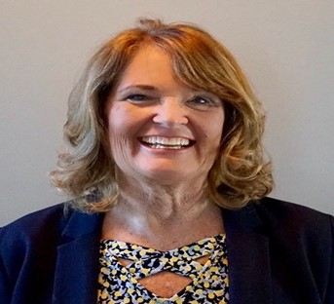
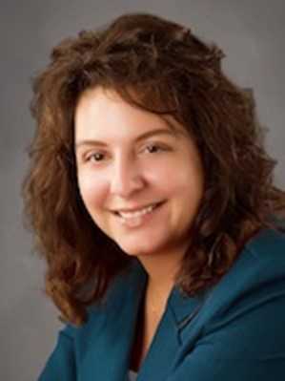
Introducing Your Presenters…
Heather Peters, M.Ed, Ph.D
GME Consultant
Carmela Meyer, MBA, Ed.D
GME Consultant
Amy Durant, MHA
GME Consultant
Cheryl Haynes, BA GME Consultant
Christine Redovan, MBA, MLIS
GME Consultant
Partners’ Consultants have over 125 Years combined consulting experience and look forward to sharing their insights and solutions on some of the biggest challenges they have run into this year.

Slide 4
Learning Objectives
Evaluate how well your GMEC is meeting the current expectations
Determine action needed to prepare your faculty for a site visit
Create an environment for professional identity formation
Identify underperformance and ways to conduct a Special Review
Discover the latest new and updated ACGME resources for GME advancement and improvement
Presented by Partners in Medical Education, Inc. 2022

Slide 5
GMEC 2022: Is Your GMEC Meeting the Current Expectations? Heather Peters, PhD
Presented by Partners in Medical Education, Inc. 2022

Slide 6
Some questions?
Is your GMEC an "information" dump or "rich with discussion"?
Best Practice: Highlight text, color text, or italics
Is your GMEC tracking attendance of all voting members?
Best Practice: Put tracking table at the top of each set of minutes – easier to track attendance of voting members
Does your GMEC have peer-selected residents and fellows?
Site Visit Inquiry: They will be asked if they were peer-selected
Does your GMEC have annotated minutes that provide evidence of how you meet the requirements in I.B.4.-6?
Presented by Partners in Medical Education, Inc. 2022

Slide 7
SI FAQs – Annotated Minutes SI Requirements I.B.4.-6.
GMEC meeting minutes submitted for the IRC’s review must clearly document execution of required functions and responsibilities.
When submitting GMEC meeting minutes to the ACGME, Sponsoring Institutions are asked to annotate those minutes, which is to say that a reference to a specific Institutional Requirement should accompany each GMEC action that fulfills that requirement. Ideally, annotations should be easy to identify (e.g., in bold type)
Methods for Tracking:
1. Embedded in the text
2. Place in a column
Best Practices:
Annual Tracking Excel Spreadsheet

Slide 8
Are Your Faculty Ready For a Site Visit?
Cheryl Haynes, BA
Presented by Partners in Medical Education, Inc. 2022

Slide 9
"The best results in life are often held back by false constructs and untested assumptions."
Tim Ferris
Author, blogger, Apple podcaster
"It's been a long time, don't assume anything."
Cheryl Haynes
GME Consultant

Slide 10
The Three S's of Faculty Preparation
Structure –
ACGME Competencies
curriculum
Supervision -
Levels/Definitions
Program Policy
Scholarship
Faculty Scholarly Activity
Resident Scholarly Activity
Presented by Partners in Medical Education, Inc. 2022

Slide 11
Structure
Can your faculty discuss/describe:
How/where residents are taught:
Longitudinal Curriculum
Systems-based Practice
Patient Safety & Quality Improvement
Transitions of Care & Handoffs
Presented by Partners in Medical Education, Inc. 2022

Slide 12
Supervision
Can your faculty discuss/describe:
Current ACGME definitions and requirements for supervision of residents and fellows
Program Supervision Policy
circumstances for escalation of care
address transitions of care and resident fatigue or illness
Transitions of Care Policies?

Slide 13
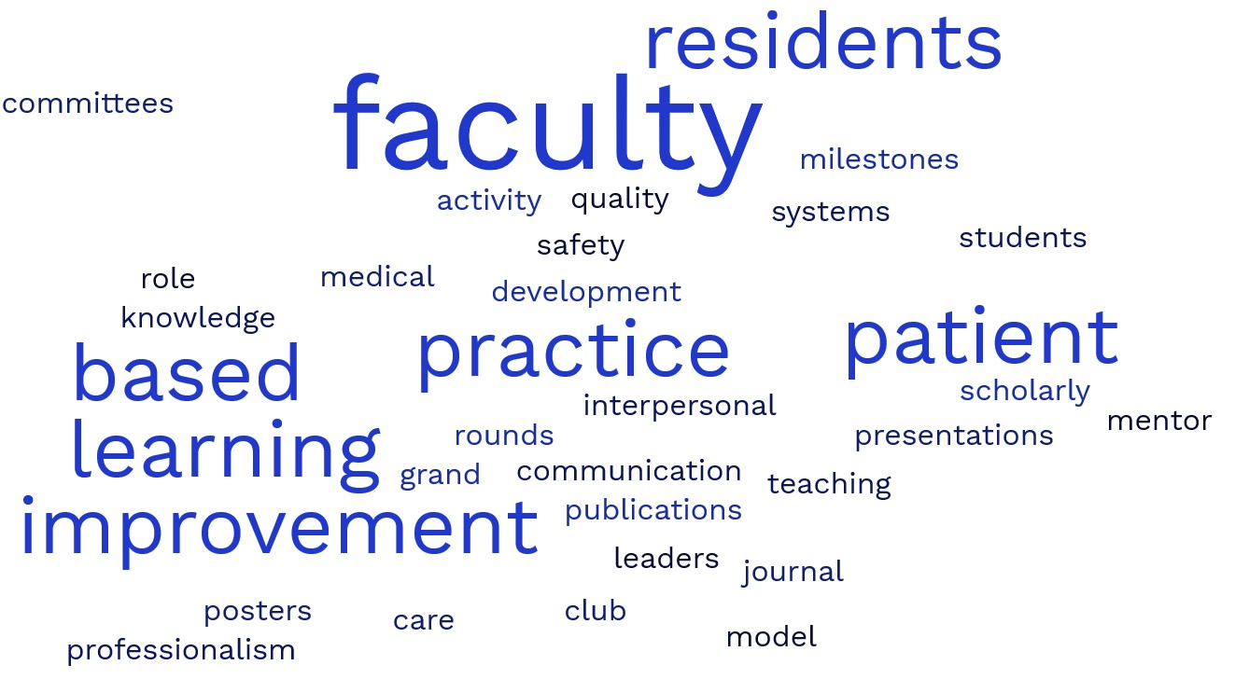
Scholarship
Faculty Development
Curriculum
How often?
Attendance
Faculty Scholarly Activity
Do your faculty know what to report?
Grand Rounds
Course Development
How does your faculty support Resident/Fellow Scholarly Activity?
Presented by Partners in Medical Education, Inc. 2022

Slide 14
Get them Ready
Faculty Meetings
Posted Infographics
Faculty Pearls emails
Case Conferences
Communicate and discuss
changes to ACGME requirements
curricular changes
Policy review
"What do you do if____?"
Presented by Partners in Medical Education, Inc. 2022

Slide 15
Addressing the Increased Emphasis on Professionalism: How to Tie Curriculum and Evaluation to the ACGME Surveys Carmela Meyer, MBA, EdD
Presented by Partners in Medical Education, Inc. 2022

Slide 16
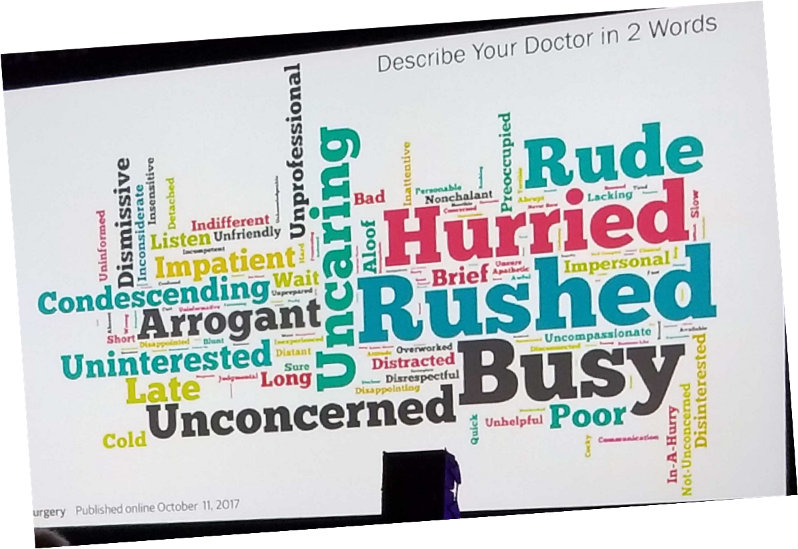
This is not what we want for our residents, fellows or faculty members.
Presented by Partners in Medical Education, Inc. 2022

Slide 17
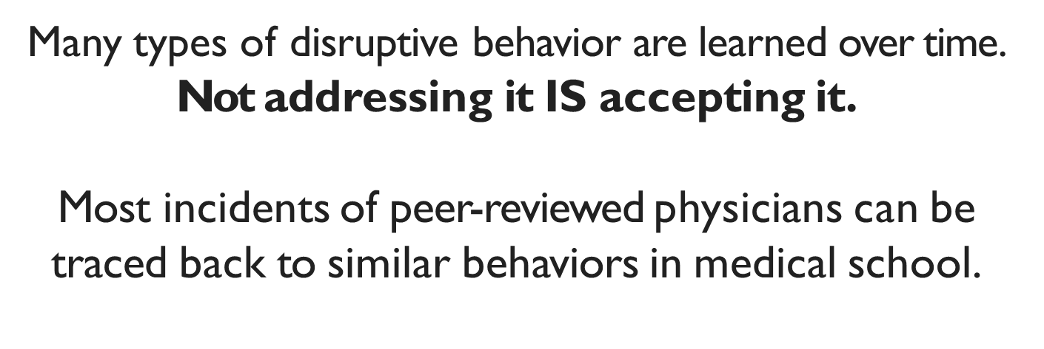
Presented by Partners in Medical Education, Inc. 2022

Slide 18
Presented by Partners in Medical Education, Inc. 2022

Slide 19
Chapters Career Compass, Setting Clear Expectations. https://www.youtube.com/watch?v=Iovdu7mbI30
Presented by Partners in Medical Education, Inc. 2022

Slide 20
Communicate Expectations and Policies
1. Set Clear and Specific Expectations
Dress code, behavior, when you want the resident to arrive vs. when clinic starts
2. Include professionalism in all curriculum
3. Discuss supervision expectations
4. Let the resident/fellow know what criteria you will use to evaluate them.
Presented by Partners in Medical Education, Inc. 2022

Slide 21
Be sure to verbally discuss expectations – not just read a list
You show commitment by modeling the behavior you want to see.
Residents show commitment by agreeing to follow the expectations - sign
Presented by Partners in Medical Education, Inc. 2022

Slide 22
Stick to your expectations - critical
Resident arrives 5 minutes late: I noticed you were a little late this morning. Patients depend on us, so let's be on time, ok?
2nd Offense: private conversation sitting down in your office
3rd Offense: documentation (evaluation) and meeting.
PD needs to regularly meet with residents if faculty report bad behavior or they will stop reporting it. It also should appear on semi-annual or annual evaluation.
Presented by Partners in Medical Education, Inc. 2022

Slide 23
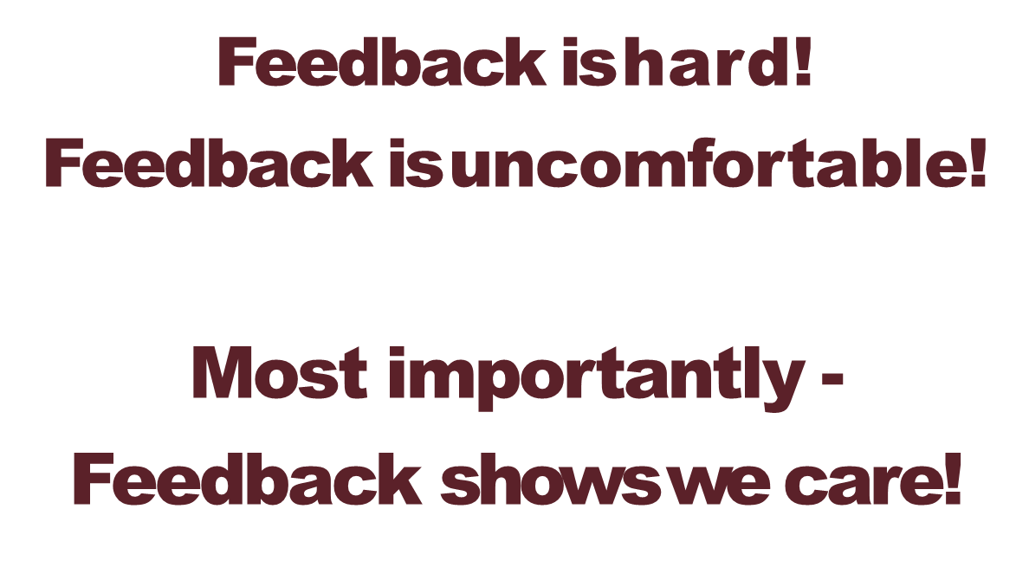
Presented by Partners in Medical Education, Inc. 2022

Slide 24
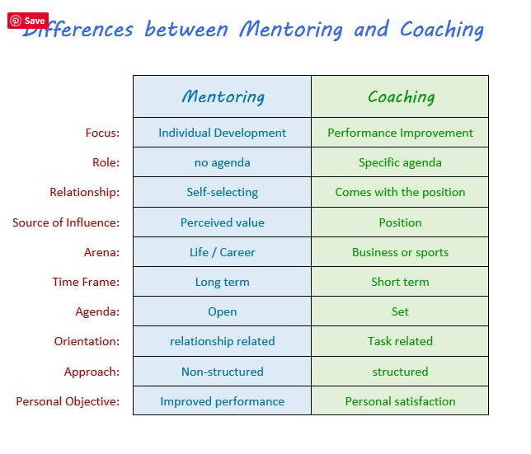
Presented by Partners in Medical Education, Inc. 2022

Slide 25
Special Reviews Amy Durante, MHA

Slide 26
ACGME Requirements
The GMEC must demonstrate effective oversight of underperforming program(s) through a Special Review process. (I.B.6.)
The Special Review process must include a protocol that: (I.B.6.a)
-establishes a variety of criteria for identifying underperformance that includes, at a minimum, program accreditation statuses of Initial Accreditation with Warning, Continued Accreditation with Warning, and adverse accreditation statuses as described by ACGME policies; and, (I.B.6.a).(1)
-results in a timely report that describes the quality improvement goals, the corrective actions, and the process for GMEC monitoring of outcomes, including timelines. (I.B.6.a).(2))
Presented by Partners in Medical Education, Inc. 2022

Slide 27
Citations!!
Presented by Partners in Medical Education, Inc. 2022

Slide 28
Identifying Underperformance
ACGME surveys
• #1 go to
•Comparison to other years to identify trends
•Only do once
•Faculty and residents/fellow
•85% cut off
Presented by Partners in Medical Education, Inc. 2022

Slide 29
Identifying Underperformance
Board pass rate
Citations
Program compliance
•Annual Program Evaluation (APE) submission
•APE Action Plans
•Resident/Fellow Town Halls
•Case logs
Presented by Partners in Medical Education, Inc. 2022

Slide 30
Identifying Underperformance
Initial Accreditation with Warning
Continued Accreditation with Warning
Probationary Accreditation
Presented by Partners in Medical Education, Inc. 2022

Slide 31
Oversight
Present these indicators at GMEC
Document review
Document decision to conduct a Special Review
Presented by Partners in Medical Education, Inc. 2022

Slide 32
Special Review Committee
Special Review policy
Include the criteria
“Other circumstances”
• Committee members
Timeline – don’t be too strict
Appoint a committee
• DIO or GME representative
Faculty from another program – GREAT learning exercise
Resident?
Subcommittee?
Peer-selected resident
Another program

Slide 33
Special Review Committee
Interviews
Program leadership
Departmental leadership
Faculty
Residents/Fellows
Each level in separate interviews
Utilize the opportunity
Compliance with ACGME requirements
Evaluations
Required policies and procedures
Case logs
Presented by Partners in Medical Education, Inc. 2022

Slide 34
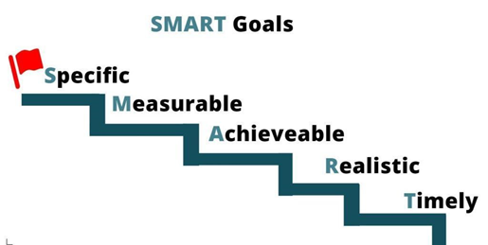
Special Review Report
List it all!
Individuals interviewed
Documents reviewed
Summary of interviews while maintaining anonymity
Top 4-5 areas
Quality improvement goals and the corrective actions
SMART goals
Suggestions/Recommendations
Presented by Partners in Medical Education, Inc. 2022

Slide 35
GMEC
Approve the Special Review report
Monitoring
Standing agenda item
They are coming for you!!
Presented by Partners in Medical Education, Inc. 2022

Slide 36
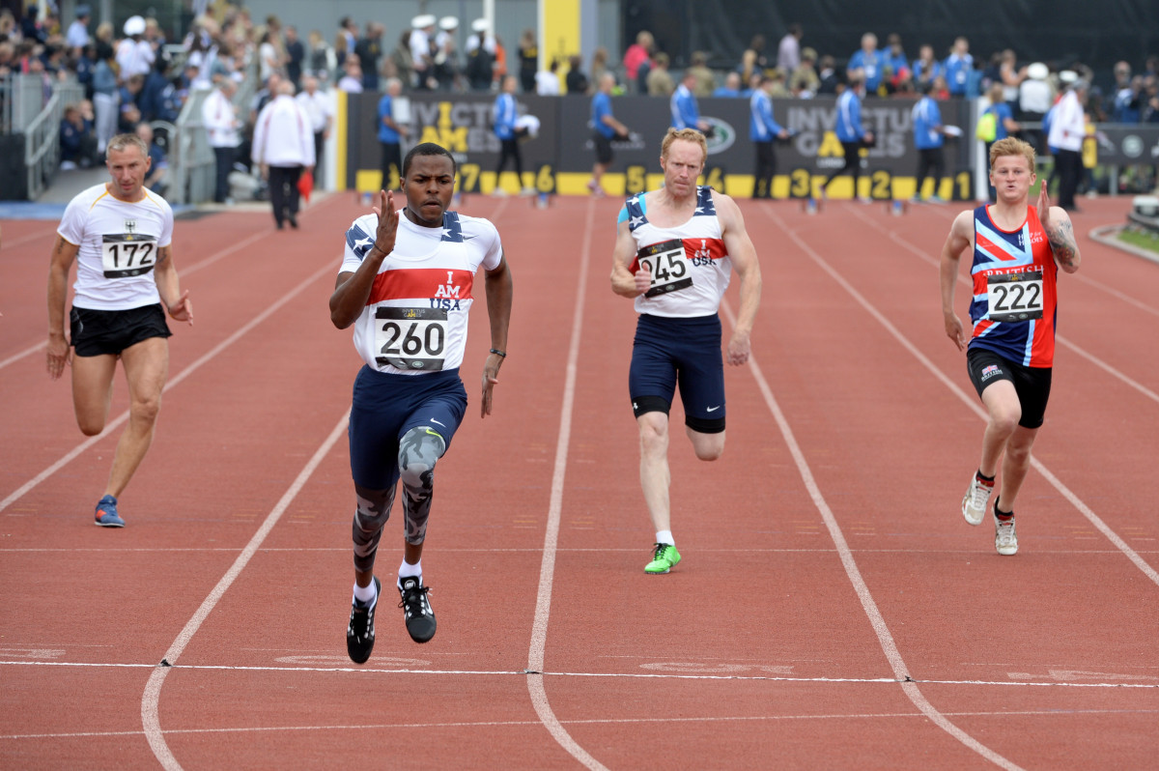
Keeping Up With the ACGME - 2022
Christine Redovan, MBA, MLIS
Presented by Partners in Medical Education, Inc. 2022

Slide 37
Sponsoring Institution
New requirements went into effect July 1, 2022
Paid resident leave is the big change
ACGME guidance on website
Not being cited until July 1, 2023
FAQs updated (Jan 2022)
Institutional Requirements currently under revision...again!
This Photo by Unknown author is licensed under CC BY.
Presented by Partners in Medical Education, Inc. 2022

Slide 38
Common Program Requirements
Updated CPR – Effective July 1, 2023
Lots of consolidation and moving of requirements to background and intent. Numbering has changed.
II.A.1.a - GMEC verify license and faculty appointment of new PD
II.A.4.a.7 - Report mistreatment
II.B.2.f.2 - Faculty development in health inequities
IV.A.1 - Aims to program applicants
IV.A.5 - Formal educational activities in patient safety goals, tools and techniques
VI.B.5 - Psychologically safe learning environment
CPR FAQ (8/25/22) - 22 pages

Slide 39
Specialty Updates
Major requirement updates:
Internal Medicine (7/1/2022)
Family Medicine (7/1/2023)
Focused requirement updates:
OB/GYN (9/17/2022)
Case log updates:
Ophthalmology
OB/GYN
MFM
REI
Check for any case log updates on the documents and resources page of each RC.

Slide 40
Review & Comment
Located under "what we do" tab
General Surgery - closed; awaiting approval
Pediatrics – closed; awaiting approval
Psychiatry subspecialties – gathering feedback stage
Brain Injury Medicine
UME Foundational Competencies –open; apply to be part of working group for 2023
Correctional/Carceral Medicine – expected approval for the specialty September 2022; delayed?
This Photo by Unknown author is licensed under CC BY-NC-ND.
Presented by Partners in Medical Education, Inc. 2022

Slide 41
New Resources
Clinician Educator Milestones
Equity Matters Practice Toolkit
National Plan for Health Workforce Wellbeing
Open office hours with VP of Sponsoring Institution
Program Emergency Categorization
ACGME Answers series
This Photo by Unknown author is licensed under CC BY-SA.
Presented by Partners in Medical Education, Inc. 2022

Slide 42
Updated Resources
ACGME Databook 2021-2022
ACGME Policies and Procedures (June 11, 2022)
2022 National Milestone Report
Rural Track Designation Resources
DIO "cheat sheets" (June & July 2022)
ACGME Annual Report 2021-2022

Slide 43
Upcoming Live Webinar
Motivating Faculty to Mentor & Do Research
Thursday, December 8, 2022
Sponsoring Institution Self-Study 101
Thursday, December 15, 2022
Digging for Data V
Thursday, January 5, 2023
Developing Residency Budgets
Thursday, January 19, 2023
Onboarding Residents
Thursday, February 2, 2023
How Semi-Annual Evaluations Document, Educate, and Improve
Thursday, February 9, 2023
Latest On-Demand Webinars
GME Educational Program Design I
Wellness is a Team Sport
Looking Behind the Curtain at CMS Reporting
ADS 2022: Part II
Scholarly Activity – Starting the Year Off Right
JEDI Warriors in GME: Guardians of Justice, Equity, Diversity, and Inclusion
ACGME Complaint Letter: Now What?
Here We Grow Again – And With Our Community
The ABCs of GMEC: Part II
ADS 2022: Part I
Ask Partners – Spring Freebie
Faculty Development Series
15 Minutes to Effective Feedback
Toolbox for Teaching Millennials
Taking Supervision to the Next Level
Contact us today to learn how our Educational
Passports can save you time & money!
724-864-7320
www.PartnersInMedEd.com
Presented by Partners in Medical Education, Inc. 2022
43

Slide 44
Partners in Medical Education, Inc. provides comprehensive consulting services to the GME community.
Partners in Medical Education
724-864-7320 | info@PartnersInMedEd.com
www.PartnersInMedEd.com
Heather Peters, M.Ed, Ph.D
Heather@partnersinmeded.com
Carmela Meyer, MBA, Ed.D
Carmela@partnersinmeded.com
Amy Durante, MHA
Amy@partnersinmeded.com
Cheryl Haynes, BA
Cheryl@partnersinmeded.com
Christine Redovan, MBA, MLIS
Christine@partnersinmeded.com

