Slide 1
”Meet The Experts” Fall Freebie
Heather Peters, M.Ed, Ph.D Christine Redovan, MBA GME Consultant Amy Lefkovic, MHA

Slide 2
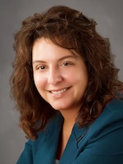
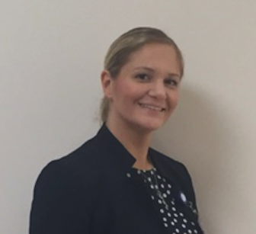
Partners Consulting Team
Heather Peters, M.Ed, Ph.D
GME Consultant
Christine Redovan, MBA
GME Consultant
Amy Lefkovic, MHA
GME Director & DIO
Seasoned speaker at ACGME & sub-specialty national meetings
Institutional and Program accreditation experience
3 decades in education; Masters of Education in curriculum & evaluations, PhD concentration in secondary education & adult learning theories
10+ years GME Operations, Accreditation and Management success
Focused on continual readiness and offering timely and useful GME resources
Received her Bachelors Degree in Health Information Management from Kean University
Began her career in Graduate Medical Education (GME) at Hospital for Special Surgery as the Radiology Fellowship Program Coordinator
Received her Masters degree in Healthcare Administration from Seton Hall University
Continued her career in GME at Lutheran Medical Center as the OB/GYN Residency Coordinator
Is currently the Manager of GME and Academic Affairs at Staten Island University Hospital

Slide 3
Working with the Struggling Learner
Presented by:
Heather Peters, M.Ed., Ph.D.

Slide 4
Importance of Learner Remediation
Takes more time
Will lead to a breakdown in morale
Will impact the programs reputation
Deficiencies will not go away on their own
Impact on patient safety & quality of care
Our obligation is to educate all learners

Slide 5
Prevalence
17-20% of medical trainees will experience difficulty during residency due to learning/behavior issues
50% will seek help
How do we reach the other 50%?

Slide 6
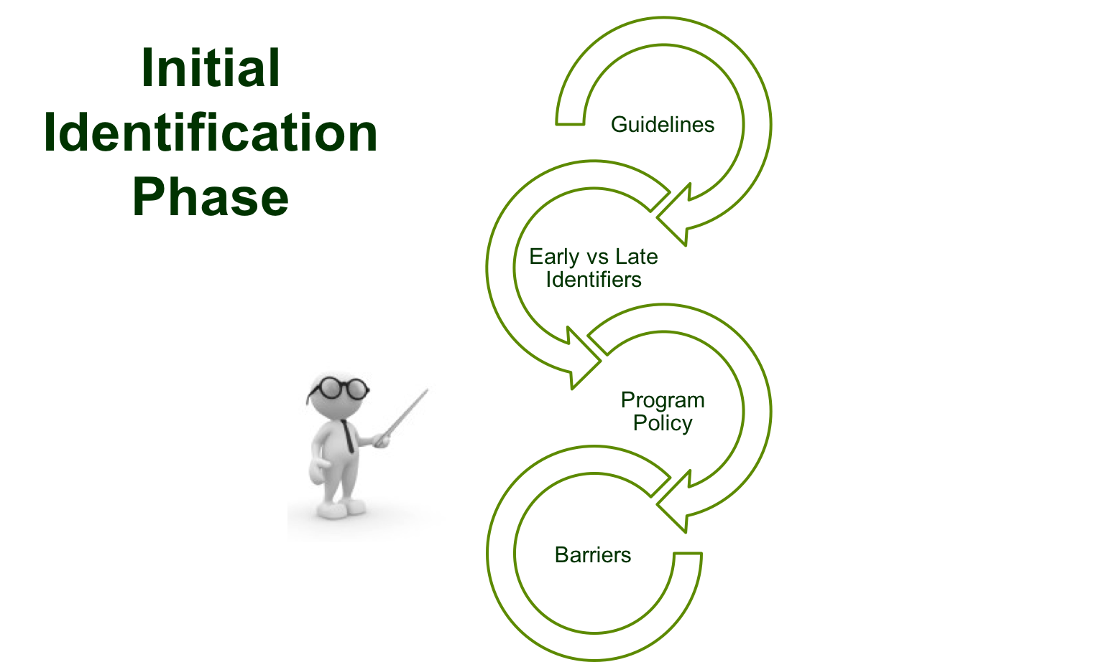

Slide 7
Initial Identification Phase Guidelines
Beginning of residency -- focused observation time for all residents
Review meeting in the first few months of residency
Evaluations in the first few months of residency are maybe the most important
Instruct chief residents on how to spot deficits for the purpose of support, not remediation
Tools
“Presenting Behavior Aligned with Competencies”
“Alarm Bells for Trainees”

Slide 8
Common Identifiers during Initial Identification Stage

Slide 9
Policy Issues to Consider
Program policy for remediation and probation deal with early identification of issues?
Section in your faculty manual that discusses early identification of struggling learners?
NOTE: Remember to align institutional and program policies for remediation and probation.

Slide 10
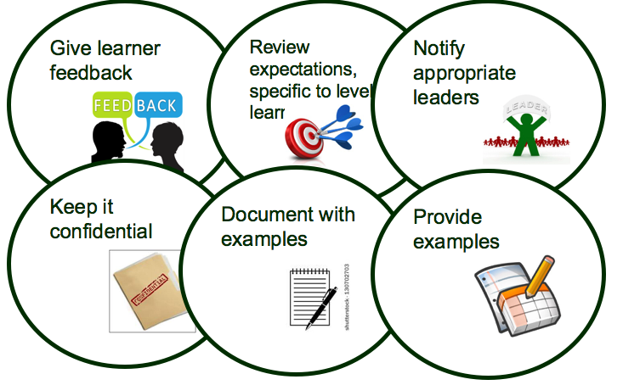
Responsibilities of Educators

Slide 11
60%

Slide 12
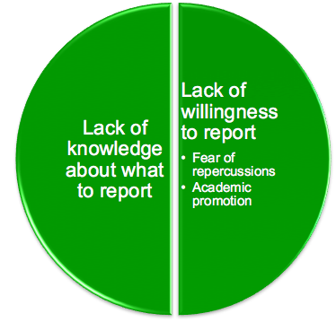
Faculty-Faculty-Faculty

Slide 13
Documentation
Presented by:
Christine Redovan, MBA
GME Consultant

Slide 14
Goals & Objectives
Understand what documentation is required for ACGME
Review documentation best practices

Slide 15
Why is documentation important?
If not in writing it did not happen
When did we review…?
Important for project management
Leaves little room for disagreements
Tracks success metrics
Records creativity
Builds trust and stability
Makes things more real
Required for ACGME accreditation!

Slide 16
Specifics for Institutions
Institutional Requirements
Statement of Commitment
GMEC Responsibilities
AIR
Resident & Fellow Engagement in learning environment
Patient Safety
Quality Improvement
Transitions of Care
Supervision
Duty Hours, Fatigue Management & Mitigation
Professionalism
Liability Insurance

Slide 17
Specifics for Institutions
Institutional Requirements
Institutional GME Policies and Procedures
Resident Contract
Vacations & Leaves
Supervision
Appointment eligibility
And much more!

Slide 18
Specifics for Programs
Common Program Requirements
PD and Faculty qualifications
Changes to the program curriculum and structure
Formative & Summative evaluations
Progression through the program
Milestone attainment
Program Evaluation Committee
Resident performance
Faculty development
Graduate performance
Program quality
Action plan and progress on previous years plan
Approval of APE by teaching faculty

Slide 19
Specifics for Programs
Common Program Requirements
Duty hours
Violations
Staying beyond scheduled shift
Moonlighting
Supervision
Specialty specific requirements
Case volume and type
Patient volume
And much more!

Slide 20
How to document
Minutes
Record of what was agreed to in a meeting
Tedious, time consuming
Good minutes are essential
Three main items
What was achieved/discussed during the meeting
Decisions that were made
Actions that were agreed on

Slide 21
How to document
Which sounds better?
We discussed a change to the IM program. Everyone agreed to the change.
- OR -
We discussed data from recent cardiology rotation evaluations, IM residents rotating at County Hospital for cardiology have been lacking in exposure and content for the last six months. The program reached out to City Hospital to discuss sending residents there for the Cardiology experience. All in attendance agreed that City provides a better experience than County, other programs send their residents to City for Nephrology and Urology and have had not complaints, and this will open the doors for further partnering with City. Members voted to move forward with a PLA with City for Cardiology. The PD will provide an update to the GMEC in six months

Slide 22
How to document
1. We discussed a change to the IM program. Everyone agreed to the change.
2. We discussed data from recent cardiology rotation evaluations, IM residents rotating at County Hospital for cardiology have been lacking in exposure and content for the last six months. The program reached out to City Hospital to discuss sending residents there for the Cardiology experience. All in attendance agreed that City provides a better experience than County, other programs send their residents to City for Nephrology and Urology and have had not complaints, and this will open the doors for further partnering with City. Members voted to move forward with a PLA with City for Cardiology. The PD will provide an update to the GMEC in six months.

Slide 23
How to document
Sample Minutes Template
Topic | Discussion | Recommendations/Actions | Vote | Follow-up

Slide 24
How to document
Reports
Tailor to the audience
Summary of major points
Use tables and graphs to get your point across
Highlight positives and negatives
Provides historical record
Flowcharts (excellent for processes)
Templates

Slide 25
How to document
Electronic Documenting Systems
Project management software
Excel spreadsheets
Databases
Residency Management Systems
Make sure you can get out what you want
If using a third-party vendor, understand what happens to your data
Back up electronic data no matter what system you use

Slide 26
Challenges
Time consuming
Expensive (time & tools)
How much is too much?
Difficult to maintain
Requires continuous updating
Vague or incomplete

Slide 27
The ABC’s of the GME Roles
Presented by:
Amy Lefkovic, MHA

Slide 28
Goals & Objectives
To review and understand the importance of the various roles within Graduate Medical Education.

Slide 29
Designated Institutional Official (DIO)
The Sponsoring Institution must identify a: I.A.5.
Designated Institutional Official (DIO): The individual who, in collaboration with a Graduate Medical Education Committee (GMEC), must have authority and responsibility for the oversight and administration of each of the Sponsoring Institution’s ACGME accredited programs, as well as for ensuring compliance with the ACGME
Institutional
Common
and specialty/subspecialty specific Program Requirements; I.A.5.a)
http://www.acgme.org/Portals/0/PDFs/FAQ/InstitutionalRequirements_07012015.pdf

Slide 30
DIO Cont.
Sufficient financial support
Protected time
Engage in professional development
Mentor/guide
sufficient salary support and resources are provided for effective GME administration. II.A.3.

Slide 31
Department of Academic Affairs
Office of Graduate Medical Education
Director/manager/coordinator
Assist DIO, GMEC, Program Directors and Program Coordinators with administrative requirements
Institutional
Common
Reimbursement

Slide 32
Program Director (PD)
Qualifications of the program director must include: II.A.3.
requisite specialty expertise and documented educational and administrative experience acceptable to the Review Committee; II.A.3.a)
Scholarly activity

Slide 33
Program Director (PD) Cont.
certification in the specialty by the American Board of _____, or specialty qualifications that are acceptable to the Review Committee; and, II.A.3.b)
current medical licensure and appropriate medical staff appointment. II.A.3.c)

Slide 34
Program Director (PD) Cont.
Voted into position by GMEC
Approved by the ACGME
The program director should continue in his or her position for a length of time adequate to maintain continuity of leadership and program stability II.A.2.
Leader/educator/mentor/advocate

Slide 35
Associate Program Director
Title listed in web ADS
Assist PD in their duties
Oversee certain responsibilities
Resident mentor

Slide 36
Program Coordinator
The program coordinator(s) has (have) sufficient support and time to effectively carry out his/her (their) responsibilities; II.B.4.
Administrative support
Motherly figure/resident support person
Forefront of the programs inner workings
http://www.acgme.org/Portals/0/PDFs/FAQ/InstitutionalRequirements_07012015.pdf

Slide 37
Graduate Medical Education Committee (GMEC)
Must include
DIO
Minimum of two PD’s from ACGME-accredited programs
Minimum of two peer-selected residents/fellows f rom ACGME-accredited programs
Quality improvement or patient safety officer
Oversight/review/approval
Meeting minutes
Meet quarterly
Larger health systems

Slide 38
Chief Residents
Senior resident/chosen resident
Additional year
Go to person for residents
Schedule
Compliance
Administrative interests
Chief resident meetings ensure anonymity

Slide 39
Resident
Subspecialty fellows
Administrative
Knowledgeable in medicine
Compliant
Compassionate
Program requirements???

Slide 40
Resident/Fellow Forum
House Staff Association
Raise concerns
Advocate
Wellness
Family

Slide 41
Upcoming Live Webinars CLER
Thursday, December 1, 2016
12:00pm – 1:00pm EST
www.PartnersInMedEd.com
Partners® Snippets
On-Demand Webinars
GMEC Check-Up: Is your GMEC
meeting its responsibilities?
A Proactive Approach to Supervising Residents Improves Patient Safety
New Institutional Accreditation:
Let’s Get Started!
Dealing Effectively with the
Struggling Medical Learner
Special Review: Required and Useful
Osteopathic Recognition
Fatigue Management & Mitigation
Contact us today to learn
how our Educational Passports can save you time & money!
724-864-7320

Slide 42
Partners in Medical Education, Inc. provides comprehensive consulting services to the GME community.
Partners in Medical Education
724-864-7320 | info@PartnersInMedEd.com
www.PartnersInMedEd.com

