Slide 1
Mentoring the Coordinator
Heather Peters, M. Ed, PhD
GME Consultant

Slide 2
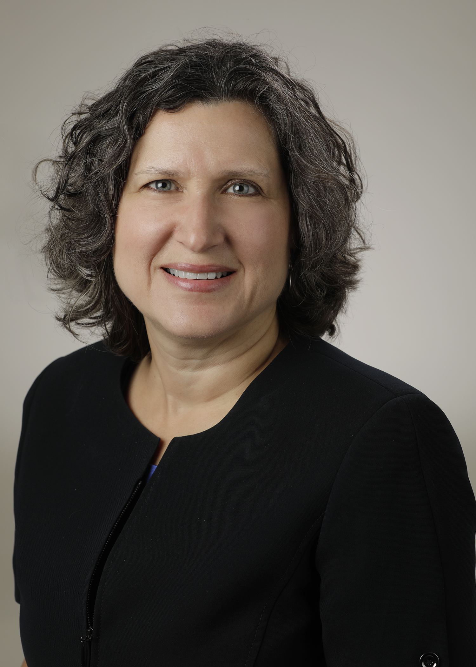
Introducing Your Presenter…
Heather Peters, M.Ed, Ph.D
GME Consultant
DIO & GME Specialist
Seasoned speaker at ACGME & sub-specialty national meetings
Areas of Expertise: Institutional and Program accreditation experience; Strategic planning; Annual Program Evaluation processes; Evaluation processes; and more
3 decades in education; Masters of Education in curriculum & evaluations, PhD concentration in secondary education & adult learning theories

Slide 3
Learning Objectives
Provide overview of the coordinator’s responsibilities
Define skills, knowledge and attitudes necessary for the GME coordinator
Describe the possible trajectory for coordinators as they become more experienced

Slide 4
A word about mentoring…

Slide 5
What kind of mentor should you be?
WIZARD
Listen to my counsel, heed my work, and you may succeed grasshopper.
SERGEANT
Tell them what you’re gonna tell them. Then tell ‘them what you told ‘them.
COMIC
Keep them laughing and they’ll go away feeling good.
PARTNER
MOTIVATOR
You are responsible for your own learning. I am responsible for supporting, facilitating, and learning with you.
You can do anything if you simply put your mind to it.

Slide 6
Six Qualities of
Great Mentoring Partnerships
Balance
Abundance
Truth
Passion
Trust
Courage
Managers as Mentors: Building Partnerships for Learning; C. Bell; Berrett-Koehler Publishers, Inc; 1998.

Slide 7
Adult Learning Principles
Adults
Therefore
Adults are motivated to learn as they develop needs and interests that learning will satisfy.
Mentees needs and interests are the appropriate starting points for mentoring.
.
Adult orientation to learning is life-centered or work-centered.
Appropriate frameworks for organizing mentoring are life- and/or work-related situations, not academic or theoretical subjects.
Adults have a deep need to be self-directing.
Best approach for mentoring involves active participation in a planned series of experiences, the analysis of those experiences, and their application to work and life situations.
Experience is the richest resource for adult learning.
Mentoring must make optimum provision for previous experience.
The Mentor’s Guide: Facilitating Effective Learning Relationships; L. Zachary; The Jossey-Bass Higher and Adult Education Series; Jossey-Bass; 2000.

Slide 8
Supporting the struggling mentee …without rescuing
A baby bluebird’s first flight is lesson in how to mentor…
Current state
Desired state
When does too much support become rescuing?
When does too little support become callousness?
Beyond the Myths and Magic of Mentoring: How to Facilitate an Effective Mentoring Process; M. Murray; John Wiley & Sons; 2001

Slide 9
Responsibilities of the GME Coordinator
Coordinator
Job Description

Slide 10
Leadership Team:
Program Director
Associate Program Director
Resident &
Chief Residents
Faculty

Slide 11
Program Structure
CCC
PEC
Leadership

Slide 12
Time: Didactic Conferences, Conference Meetings
Technology: ERAS, ACGME WebADS
Paperwork: Files, Licenses, Scholarly Activity
Leadership Team:
Program Director
Associate Program Director
Planning: Recruitment, Orientation, Graduation

Slide 13
Resident &
Chief Residents
Support: Listening Ear, Shoulder to Cry On
Data: Evaluations for CCC, Rotation Evaluations for PEC, Compliance
Paperwork: Files, Licensing Requirements, DEA
Meetings: Housestaff meetings, Didactics, PEC meetings

Slide 14
Paperwork: Files, Licenses, Scholarly Activity
Data: RVUs, Evaluation Feedback, Compliance
Paperwork: Files, Certification, Licensing, Scholarly Activity, Schedules
Faculty
Meetings: Faculty Meetings, Department

Slide 15
The Life of the GME Coordinator
Day-to-day Resident Schedules
Monitoring calendars
Emails
Forms
Evaluations:
Faculty
Rotation/Service
360
Self
Peer
Work Hour tracking
Rotation Schedule
Vacation Requests
Compliance
PEC
CCC
Milestone Submission (2x/year)
In-Training Exam
Licensing
PLAs
Recruitment
WebADS
Block Schedule
Citation Responses
Scholarly Activity
Resident Status
Graduation
Orientation
Revising Goals & Objectives
Annual Program Evaluation
Site visits
CLER
Accreditation
Self-study
Daily
Weekly
Monthly
Yearly
Occasional

Slide 17
What Does it Take to be a Successful Coordinator?

Slide 18
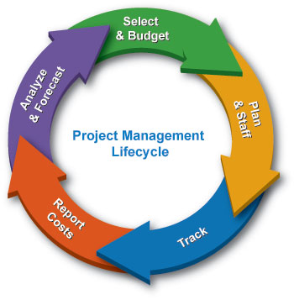
An Understanding of the Many Roles of the Coordinator
Fairy God-Person | Counselor/Therapist
Project Manager | Glue
This Photo by Unknown Author is licensed under CC BY-SA
This Photo by Unknown Author is licensed under CC BY-SA
This Photo by Unknown Author is licensed under CC BY-NC-ND

Slide 19
Specific Knowledge, Skills and Attitudes
attitudes
skills
knowledge

Slide 20
Knowledge Domain
Institutional Knowledge
Graduate Medical Education
Specialty-Specific Knowledge

Slide 21
Skills Domain
Orientation
Schedules
Meeting management
Compliance Tracking
Resident Issues
Reports
Faculty Support
Program Director Support
Recruitment
Graduation
Evaluations
Accreditation Requirements
Credentialing Requests

Slide 22
Attitude Domain
Problem-solver
Diligence
Patience
Perseverance
Comfortable with the Unknown

Slide 23
Questions??

Slide 24
Potential Career Paths for GME Coordinators

Slide 25
Coordinator Development
2-3 Years
Develop understanding of residency year
4-5 Years
TAGME (Training Administrators of GME) Certification
Promoting excellence in management of graduate medical education training programs through certification
Optimum time to change specialties
6-10 Years
Develop plans for next position

Slide 26
Possible Future Careers
Consultant
Medical Education Liaison
Hospital Administration
Program Manager
Residency Management System
Central GME

Slide 27
Back to Mentoring…

Slide 28
Support without rescuing revisited…
Desired state
Current state
Opportunities for growth involve risk.

Slide 29
Wrapping Up!

Slide 30
How to use these questions
After this webinar to deepen the learning of the material presented
In a coordinator training session
In a new program director orientation

Slide 31
Upcoming Live Webinars
SI 2025 Part 1 of 4: Introduction & Overview Tuesday, January 8, 2019 12:00pm – 1:00pm EST
Onboarding the New Coordinator Thursday, January 24, 2019 12:00pm – 1:00pm EST
2019 CPR Part 1 of 4: Overview Thursday, February 7, 2019 12:00pm – 1:00pm EST Aims and Action Plans Thursday, February 21, 2019 12:00pm – 1:00pm EST
On-Demand Webinars
Coordinator Development – How to Build a Team Responsiveness to Diverse Patient Populations
Demystifying the Resident and
Faculty ACGME Survey
Oversight of the Clinical Learning and Working Environment
Policies, PLA’s and Policing
Making “Cents” Out of GME Financing
NEW Faculty Development Series
Contact us today to learn
how our Educational
Passports can save you
time & money!
724-864-7320
www.PartnersInMedEd.com
15 Minutes to Effective Feedback
31

Slide 32
Partners in Medical Education, Inc. provides comprehensive consulting services to the GME community.
Partners in Medical Education
724-864-7320 | info@PartnersInMedEd.com
Heather Peters, M.Ed, Ph.D heather@PartnersInMedEd.com
www.PartnersInMedEd.com

