Slide 1
Milestones: Beyond the CCC
Pam Royston, Ph.D
Heather Peters, M.Ed., Ph.D
GME Consultants
Partners in Medical Education

Slide 2
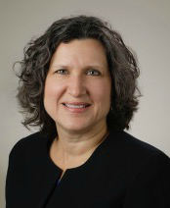
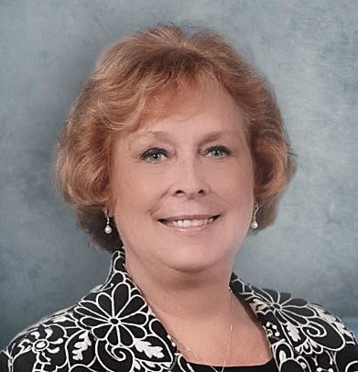
Partners Consulting Team
Heather Peters, M.Ed, Ph.D
GME Consultant
Pamela Royston, Ph.D
GME Consultant
GME Director & DIO
Seasoned speaker at ACGME & sub-specialty national meetings
Institutional and Program accreditation experience
3 decades in education; Masters of Education in curriculum & evaluations, PhD concentration in secondary education & adult learning theories
GME Director & DIO
(GME) program analysis and strategic planning
GME Agreements and Contracts
Certified MBTI Consultant
New residency program development – pre-startup through implementation
GME policy development and integration with HR policy

Slide 3
Learning Objectives
Provide overview of milestones
Discuss the role of the CCC
Investigate how to use the ACGME milestone reports to improve your residency program outcomes
Define how the CCC informs the PEC about the evaluation process
3

Slide 4
Brief Overview of Milestones

Slide 5
Purpose of Milestones
A
B
C
D
E
Articulate shared understanding of expectations
Describe a trajectory -- beginner to exceptional resident or practitioner
Organized under six domains of clinical competency
Set aspirational goals of excellence
Represent a subset of all
sub-
competencies
Source: Yangmour N. Coordinator Role in Assessment and Milestones. ACGME. July 2018.
Presented by Partners in Medical Education, Inc. 2018
5

Slide 6
Dreyfus & Dreyfus Development Model
Expert/
Master
Proficient
Competent
Advanced Beginner
Novice
GME Training provides time, practice and experience to move along the trajectory
Sources: Dreyfus SE and Dreyfus HL. 1980; Carraccio CL et al. Acad Med 2008;83:761-7
Presented by Partners in Medical Education, Inc. 2018
6

Slide 7
Dreyfus & Dreyfus Development Model
Expert/
Master
Proficient
Competent
Advanced Beginner
Novice
Presented by Partners in Medical Education, Inc. 2018
7

Slide 8
Milestone Template
Competency and Sub-Competency illustrated
Milestone Description: Template
Level 1 | Level 2 | Level 3 | Level 4 | Level 5
What are the expectations for a beginning resident? | What are the expectations for a resident who has advanced over entry, but is performing as a lower level than expected at mid-residency | What are the key developmental milestones mid-residency? What should they be able to do well in the realm of the specialty at this point? | What does a graduating resident look like? What additional knowledge, skills and attitudes have they obtained? Are they ready for certification? | Stretch Goals – Exceeds expectations NOTE: For some specialties, Level 5 is a graduating resident
Comments:
Presented by Partners in Medical Education, Inc. 2018
8

Slide 9
Developmental Progression or Set of Milestones
Sub-competency
PC1. History (Appropriate for age and impairment)
Level 1 | Level 2 | Level 3 | Level 4 | Level 5
Acquires a general medical history | Acquires a basic physiatric history including medical, functional, and psychosocial elements | Acquires a comprehensive physiatric history integrating medical, functional, and psychosocial elements Seeks and obtains data from secondary sources when needed | Efficiently acquires and presents a relevant history in a prioritized and hypothesis driven fashion across a wide spectrum of pages and impairments Elicits subtleties and information that may not be readily volunteered by the patient | Gathers and synthesizes information in a highly efficient manner Rapidly focuses on presenting problem, and elicits key information in a prioritized fashion Models the gathering of subtle and difficult information from the patient
General Competency
Milestone
Presented by Partners in Medical Education, Inc. 2018
9

Slide 10
Understanding the Role of the CCC

Slide 11
CCC Requirements
Appointed by program director
COMPOSITION:
1. Minimum of 3 faculty members
2. Non-physicians are allowed
3. NO RESIDENTS
Advise program director regarding promotion, remediation, and other adverse actions
Review all evaluations by all evaluators semi-annually
Presented by Partners in Medical Education, Inc. 2018

Slide 12
Clinical Competency Committee
End-of-Rotation Evaluations
Current Tools used to inform Milestones
Tools to Transition in July-Dec 2019
Tools to Transition in Jan-June 2020
In-House
Testing
OpLogs
Patient Evaluations
Faculty Comments
ITE
Simulations
Nursing Evaluations
Student Evaluations
Clinical Competency Committee
Peer Evaluations
Prof Resp:
Eval Comp
Conf Att
Self
Evaluations
Operative/
Procedural
Forms
Assessment of Milestones
Presented by Partners in Medical Education, Inc. 2018

Slide 13
Best Practices
Remind members of confidentiality
Set a timer!
Homework before meetings
Keep minimal minutes
Include representation from each major service
Faculty Chair
Presented by Partners in Medical Education, Inc. 2018

Slide 14
The CCC is not…
Part of “due process” review
Required to report to the GMEC
Same as
the PEC
Presented by Partners in Medical Education, Inc. 2018

Slide 15
Questions??
Presented by Partners in Medical Education, Inc. 2018

Slide 16
How to Use Milestones to Improve Program Outcomes

Slide 17
Milestones – Improving Residence Performance
MODELING
ATTITUDES
SKILLS
KNOWLEDGE
Presented by Partners in Medical Education, Inc. 2018

Slide 18
Expected Benefits of Milestone Assessment
Program Benefits
Public Benefits
Presented by Partners in Medical Education, Inc. 2018
18

Slide 19
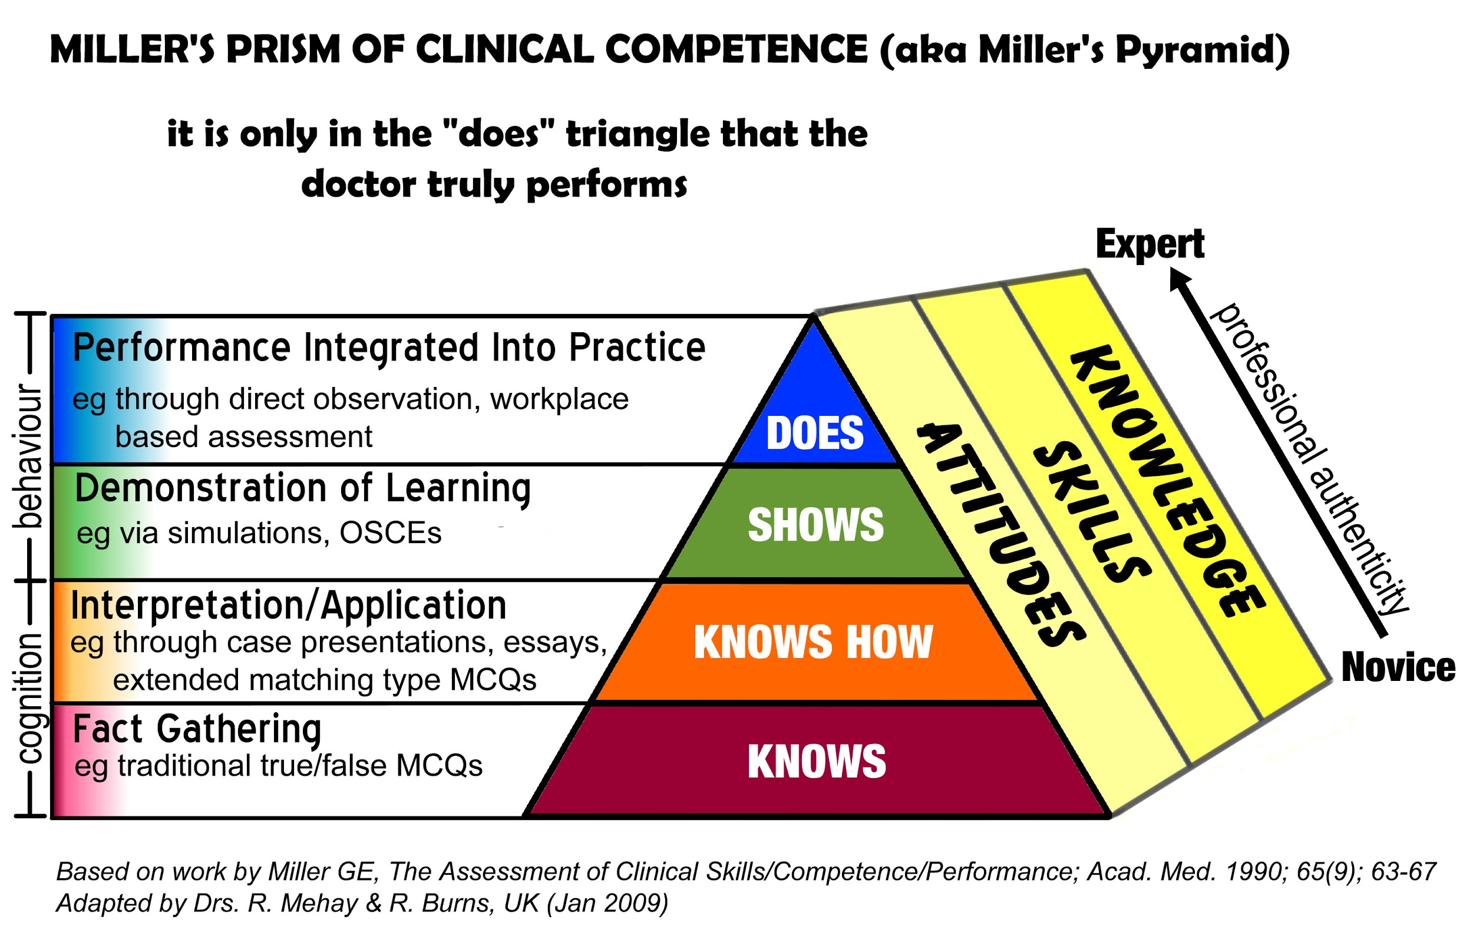
CCC Remediation with Individualized Educational Plan
Presented by Partners in Medical Education, Inc. 2018
19

Slide 20
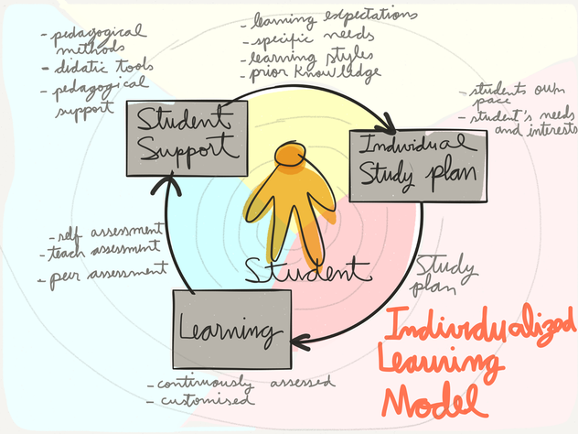
Individualized learning plan
Presented by Partners in Medical Education, Inc. 2018
20

Slide 21
Assessment Tools
Other Evaluations
OSCE’s
Check-off sheets
Direct Observations
Resident Assessments
End of Rotation evaluation
Presented by Partners in Medical Education, Inc. 2018
21

Slide 22
How do we Assess Milestones Levels?
Milestones are a summary of how a resident is progressing
We have to gather data to be able to decide on how residents progress on the milestones
Some subcompetencies may be more amenable to monthly, quarterly, or semi-annual global rating scales, some may be collected once during the entire program
Presented by Partners in Medical Education, Inc. 2018
22

Slide 23
Assessment Issues
Can the Milestones Report replace current assessment tools or end-of-rotation evaluation forms?
Presented by Partners in Medical Education, Inc. 2018
23

Slide 24
Interfacing with the PEC
Presented by Partners in Medical Education, Inc. 2018

Slide 25
Program Structure
CCC
PEC
Leadership
Presented by Partners in Medical Education, Inc. 2018

Slide 26
Information Flow
CCC
PEC
Identify issues with the evaluation processes:
Missing milestones
Lack of narrative comments
Missing elements of 360 evaluations
Presented by Partners in Medical Education, Inc. 2018

Slide 27
PEC
APE data informs the
AIR
at the institutional level
APE
Aggregated averages
Deficiencies:
Core Competencies
Milestones
Presented by Partners in Medical Education, Inc. 2018

Slide 28
Questions??
Presented by Partners in Medical Education, Inc. 2018

Slide 29
Putting it all together
Discussion questions

Slide 30
How to use these questions
After this webinar to deepen the learning of the material presented
In a coordinator training session about the CCC
In a new program director orientation
Presented by Partners in Medical Education, Inc. 2018

Slide 31
Upcoming Live Webinars
Mentoring the GME Coordinator: The First 3 Years Thursday, December 13, 2018 12:00pm – 1:00pm EST
SI 2025 Part 1 of 4: Introduction & Overview Tuesday, January 8, 2019 12:00pm – 1:00pm EST
Onboarding the New Coordinator Thursday, January 24, 2019 12:00pm – 1:00pm EST
2019 CPR Part 1 of 4: Overview Thursday, February 7, 2019 12:00pm – 1:00pm EST
On-Demand Webinars
Coordinator Development – How to Build a Team Responsiveness to Diverse Patient Populations
Demystifying the Resident and
Faculty ACGME Survey
Oversight of the Clinical Learning and Working Environment
Policies, PLA’s and Policing
Making “Cents” Out of GME Financing
NEW Faculty Development Series
Contact us today to learn
how our Educational
Passports can save you
time & money!
724-864-7320
www.PartnersInMedEd.com
15 Minutes to Effective Feedback
31

Slide 32
Partners in Medical Education, Inc. provides comprehensive consulting services to the GME community.
Partners in Medical Education
724-864-7320 | info@PartnersInMedEd.com
Heather Peters, M.Ed, Ph.D heather@PartnersInMedEd.com
Pamela Royston, Ph.D pam@PartnersInMedEd.com
www.PartnersInMedEd.com

