Slide 1
New Sponsoring Institutions
Pam Royston, PhD
Consultant

Slide 2
Introducing Your Presenter…
Pamela Royston, Ph.D
DIO, GME & Finance Expert
Over 25 years experience in medical education, both undergraduate and graduate
Institutional, Program, FQHC start-up and maintenance
National Speaker GME Accreditation and Financing
Ph.D - A.T. Still University

Slide 3
Learning Objectives
Recognize how to integrate institutional sponsorship with institutional strategies
Explain ACGME Institutional Accreditation
Describe required structural elements and qualities of Sponsoring Institutions (SIs)
Recognize the roles, responsibilities and activities associated with institutional sponsorship
Describe common challenges in institutional applications
State the steps to complete prior to the application

Slide 4
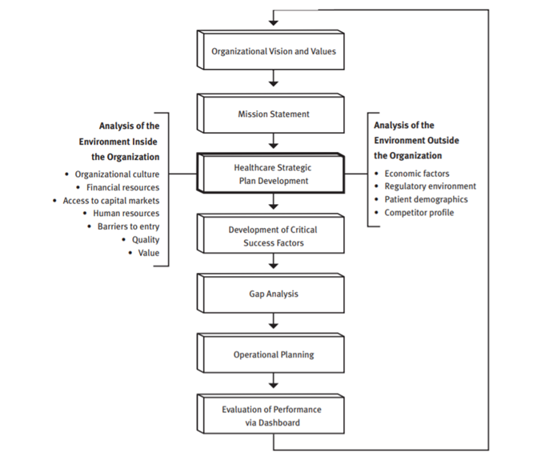
Strategic Alignment
Notes:
It is essential residency education aligns with the organization’s mission and vision. While the benefits of residency programs are enticing, implementing programs can be challenging to hospital services and require changes in reporting relationships and responsibilities of physicians and management. The sponsoring institution should be reviewing the mission and vision to ensure they integrate with training physicians.

Slide 5
Strategic Pillars
Customer-driven Excellence
Personal and Community Health
Learning and Innovation Learning and Innovation
Financial Vitality
Notes:
Residency programs align well with four strategic pillars:
Customer-driven Excellence – GME/Residency Programs help deliver high quality patient care because it facilitates adaptation to changing modalities of care and provides 24/7 specialty care access. It is also known to help elevate physician practice and expertise.
Personal and Community Health – GME/Residency Programs provide additional access and services to the indigent population and stimulate community pride because of the improved image and reputation of a teaching hospital.
Learning and Innovation – GME/Residency Programs help attract and retain quality medical staff and support continuing medical education.
Financial Vitality – GME/Residency Programs increase referrals to tertiary care services and provide additional reimbursement from CMS/Medicare, which would improve our long-term operating margin.

Slide 6
Institutional Accreditation
Sponsoring Institutions must apply for and receive institutional accreditation before applying for program accreditation
Application is the same for all Sponsoring Institutions
Institutional Review Committee (IRC) uses peer review process to determine Sponsoring Institutions’ substantial compliance with ACGME Institutional Requirements

Slide 7
ACGME Accredited Sponsoring Institution
Definition: The organization (or entity) that assumes the ultimate financial and academic responsibility for a program of graduate medical education. The sponsoring institution has the primary purpose of providing educational programs and/or health care services.
Examples: a university; a medical school; a hospital; a school of public health; a health department; a public health agency; an organized health care delivery system; a medical examiner’s office; a consortium; an educational organization.
Notes:
The decision is how to structure the sponsoring institution. There are pro’s and con’s to all.

Slide 8
SI- Consortium, Systems, Medical Schools
Pro’s
Con’s
Tend to have more resources
Data analysis
Economies of scale
Focus on data
Difficult for quick intervention
No cost savings – still need leadership at local level
Difficult to individualize – focus is on conformity and culture
Notes:
This type of structure tends to be distant from program oversight. Tends to work well with mature programs or experienced residency leadership.

Slide 9
Hospital or Local Sponsorship
Pro’s
Con’s
Local control
Policies
Oversight
Quick Intervention
Broad knowledge base
Less resources
Limited specialization – accreditation specialist, data analysis
Data may not be as robust
Notes:
Approximately 1/3 of the SI are single program sponsors. Smaller SI’s tend to have strong relationships. They have to knowledgable in all facets of accreditation – no specialization.

Slide 10
Steps Prior to Application
Designated Institutional Official
Graduate Medical Education Committee (GMEC)
Organizational Structure
Graduate Medical Education Policies
Statement of Commitment to GMEC

Slide 11
Designated Institutional Official (DIO)
I.A.5.a) Designated Institutional Official (DIO): The individual who, in collaboration with a Graduate Medical Education Committee (GMEC), must have authority and responsibility for the oversight and administration of each of the Sponsoring Institution’s ACGME accredited programs, as well as for ensuring compliance with the ACGME Institutional, Common, and specialty-/subspecialty specific Program Requirements
Notes:
The Designated institutional official or DIO are challenged with significant and increasing responsibilities that extend to the educational, fiscal, and administrative health of the institution’s GME enterprise; the institution’s compliance with local, state, and federal laws and regulation; and the support and development of residency program directors and the well-being of the residents.

Slide 12
Responsibilities of the DIO
ACGME compliance
Resident education (e.g., orientation)
Program director mentorship
GME finance and budget
GME Office administration
Legal and Human Resources issues
Patient safety and quality improvement
Well-being
Notes:
In the past several years, the role of the institutional GME leader has grown to include a pivotal role in:
• Educating various governing bodies about the value of GME and advocacy, both within and outside the institution
• Defining and ensuring a healthy clinical learning environment
• Aligning GME resources and resident engagement with institutional mission, workforce, and societal needs
• Creating and monitoring a continuous educational improvement model
ACGME does not have written requirements for this individual. However to be effective in the role the individual needs to have strong leadership capabilities and knowledge of graduate medical education. The Association of American Medical Colleges (AAMC) Group on Resident Affairs (GRA) has a document on Institutional Leadership Competencies.

Slide 13
DIO – Consortium, System, or Medical School
Typically a physician
Typically have prior experience in residency education
Good with interpretation of data
Sometimes limited comprehension on educational support and over simplifying processes
Relies on directors or managers at the site of education
Notes:
2017 2017 Group on Resident Affairs (GRA) Member Survey Report - 82% indicates the DIO are physicians
40% who responded to this survey indicated oversight of programs at other insitutions – meaning a consortium, system or medical school arrangement. N =142 responses out of 302

Slide 14
DIO – Hospital or Local Sponsorship
More non-physicians
Education – at least Master’s degree
Single program sponsors
Function of size and has more intimate knowledge of programs / issues

Slide 15
Graduate Medical Education Committee (GMEC)
The Graduate Medical Education Committee (GMEC) is charged with the responsibility to ensure that the Sponsoring Institution and each of its residency programs are in substantial compliance with the Accreditation Council for General Medical Education (ACGME).
The GMEC should communicate the needs of the educational programs to the Board of Directors.

Slide 16
I.B.4.a) GMEC Responsibilities: Oversight
Accreditation status of the Sponsoring Institution and each program
Quality of learning and working environment with the Sponsoring Institution, each program, and its participating sites
Quality of educational experiences in each program that lead to measurable achievement of educational outcomes as identified in the ACGME Common and specialty-/subspecialty-specific Program Requirements
Programs’ annual evaluation and improvement activities
All process related to reductions and closures of the Sponsoring Institution, programs, and participating sites
Notes:
Oversight of program accreditation, learning environments, education, program improvement, and major program decisions
Review and approval of policies, procedures, recommendations for resident stipends/benefits, ACGME submissions
Annual Institutional Review (AIR)
Special Review process

Slide 17
Graduate Medical Education Committee (GMEC)
DIO must be a member, but does not have to be the chair
Program Director(s)
At least 2 peer-selected residents
Quality improvement/patient safety officer
Other stakeholders in GME

Slide 18
I.B.4.b) GMEC Responsibilities: Review and Approval
GME policies/procedures
Stipends/benefits
New program applications
Changes in complement
Program structure or duration of education
Site additions/deletions
New Program Directors
Progress reports
Duty hour exceptions
Voluntary withdrawal of accreditation
Requests for appeal of adverse action
Appeal presentations
Notes:
Must meet at least quarterly
Must keep detailed minutes that reflect fulfillment of required responsibilities
Can have subcommittees
Resident representatives
GMEC review and approval

Slide 19
Organization Structure
Board of Directors
Graduate Medical Education Committee
Chief Executive Officer
Chief Medical Officer
Designated Institutional Official
Administrative Director Medical Education
Program Directors
Medical Education Coordinators
Residents
Notes:
Example but there are other ways to structure/

Slide 20
IV. Institutional GME Policies and Procedures
Resident eligibility
Terms and conditions of appointment
Available to applicant by time of interview
Inclusion in resident agreement/contract
Promotion/Renewal/Dismissal
Grievances
Benefits

Slide 21
IV. Institutional GME Policies and Procedures
Work Hours
Supervision
Various subject-specific policies
vendors
non-competition
disasters
closure/reduction
Patient Safety
Well being
Professionalism

Slide 22
Statement of Commitment
Key language
“Royston SI affirms its commitment to Graduate Medical Education by providing and maintaining the institutional infrastructure including personnel, equipment, facilities and financial and personnel resources necessary to support an appropriate learning environment.”
Notes:
Statement should specifically mention financial support, education resources, and human resources (despite its length or brevity; length is not necessarily positive). • Statement should be signed within a year of the site visit by a representative of the governing body (e.g., the Chair of the BOD), the administration (e.g., CEO), and the faculty (e.g., could be the DIO or program director, but should not be the same individual as the previous two individuals).

Slide 23
Multiple Steps for Application
https://acgme.org/Designated-Institutional-Officials/Institutional-Review-Committee/Institutional-Application-and-Requirements
Complete intent to apply to open an account in the Accreditation Data System (ADS)

Slide 24
Accreditation Data System

Slide 25
Required Attachments
Initial Institutional Application
Organizational charts
Statement of commitment to GME
GMEC minutes
GMEC membership
AIR performance indicators
Special Review protocol

Slide 26
Institutional Applications
Reviewed by the Institutional Review Committee (IRC) for substantial compliance with ACGME Institutional Requirements
No initial site visit (unlike core program applications)
Considered on a first-come, first-serve basis at one of three annual meetings
Sponsoring Institution remains in “Application” status until IRC review
Possible decisions:
Initial Accreditation
Accreditation Withheld
IRC letter of notification and citations within 60 days

Slide 27
Common Concerns in Institutional Applications
Connections between application questions and Institutional Requirements (Check the margins!)
Defining the proposed SI: participating sites, number of programs, resident complements
Governing body, senior leadership and reporting relationships within the SI
Statement of commitment language/signatures

Slide 28
Common Concerns in Institutional Applications
GMEC minutes
Attendance records
Time range
Reflect fulfillment of required responsibilities (not only IR Section I)
Resident peer selection process (GMEC and subcommittees)
GME program administration elements

Slide 29
Common Concerns in Institutional Applications
Resident forum (all required elements in one body)
SI oversight extends to all requirements and participating sites

Slide 30
Upcoming Live Webinars
Meet the Experts – Fall Freebie Tuesday, November 27, 2018 12:00pm – 1:00pm EST
Milestones – Beyond the CCC Tuesday, December 4, 2018 12:00pm – 1:00pm EST
Mentoring the GME Coordinator: The First 3 Years Thursday, December 13, 2018 12:00pm – 1:00pm EST
On-Demand Webinars
Coordinator Development – How to Build a Team Responsiveness to Diverse Patient Populations
Demystifying the Resident and
Faculty ACGME Survey
Oversight of the Clinical Learning and Working Environment
Policies, PLA’s and Policing
Making “Cents” Out of GME Financing
NEW Faculty Development Series
Contact us today to learn
how our Educational
Passports can save you
time & money!
724-864-7320
www.PartnersInMedEd.com
15 Minutes to Effective Feedback
30

Slide 31
Partners in Medical Education, Inc. provides comprehensive consulting services to the GME community.
Partners in Medical Education
724-864-7320 | info@PartnersInMedEd.com
Pam Royston, PhD, Consultant
Pam@PartnersInMedEd.com
www.PartnersInMedEd.com

