Slide 1
Osteopathic Recognition
PARTNERS IN MEDICAL EDUCATION, INC.
Presented by: Tori Hanlon, MS, CHCP
GME Consultant

Slide 2
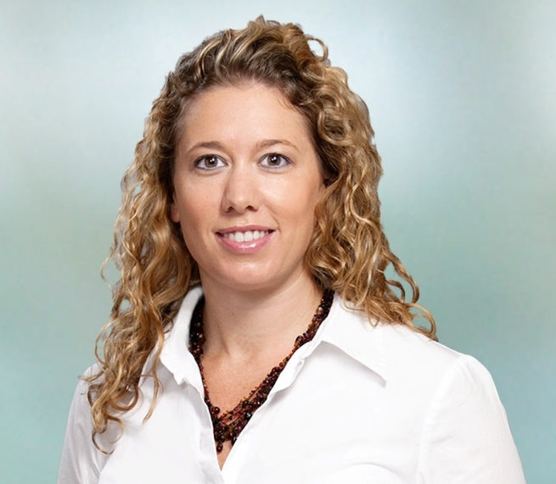
Introducing Your Presenter…
Tori Hanlon, MS, CHCP
GME Consultant
Over 11 years working in Medical Education
Bachelor’s in Health Services Administration
Master’s in Health Administration and Policy
Director of Medical Education and Designated Institutional Official
Experienced in GME at a large academic medical center

Slide 3
Osteopathic Recognition is a CHOICE

Slide 4
Objectives and Goals
To determine whether OR is the right choice for your program
To examine the OR application and process
To review the OR Requirements

Slide 5
What is Osteopathic Recognition?
Commitment by a GME program to teach and assess osteopathic principles and practices
CHOICE = COMMITMENT

Slide 6
What is Osteopathic Recognition?
Continue philosophy of OPP from UME to GME
Improve patient care through OMM
Provide structure and resources

Slide 7
WHY Osteopathic Recognition?
Alignment of program requirements and OR requirements
NOT another site visit
NOT more expensive
Program & institutional culture
Does your SI and major participating sites support a philosophy of OPP?
OPP as a tool to improve healthcare delivery
ACGME’s self-study

Slide 8
AACOM Survey
Spring 2015, 3rd year medical students
Goal: To determine if osteopathic medical students were interested in pursuing GME programs with OR
947 responses = 17% enrollment

Slide 9
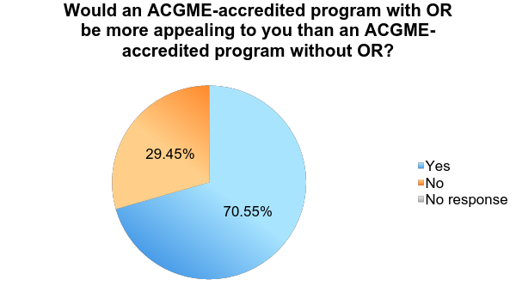
AACOM Survey
"Survey Results: Appeal of ACGME-accredited Programs with Osteopathic Recognition among Third Year Osteopathic Medical Students." Survey Results: Appeal of ACGME-accredited Programs with Osteopathic Recognition among Third Year Osteopathic Medical Students. N.p., n.d. Web.

Slide 10
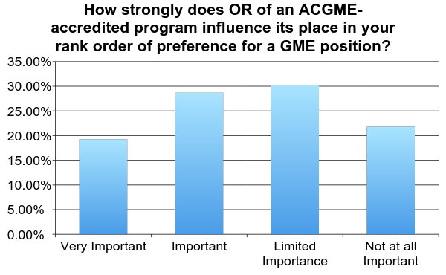
AACOM Survey
"Survey Results: Appeal of ACGME-accredited Programs with Osteopathic Recognition among Third Year Osteopathic Medical Students." Survey Results: Appeal of ACGME-accredited Programs with Osteopathic Recognition among Third Year Osteopathic Medical Students. N.p., n.d. Web.

Slide 11
AACOM Survey
"Survey Results: Appeal of ACGME-accredited Programs with Osteopathic Recognition among Third Year Osteopathic Medical Students." Survey Results: Appeal of ACGME-accredited Programs with Osteopathic Recognition among Third Year Osteopathic Medical Students. N.p., n.d. Web.

Slide 12
AACOM Survey
Strong desire to utilize & build on OPP & OMT skills in residency
Commitment to initial reason(s) for attending a COM
Interest in employing OMT in future practice through additional training
Belief that osteopathic medicine is beneficial to patient care
Perception that programs with osteopathic recognition are likely to be more “DO friendly” & receptive to accepting DO students

Slide 13
OR Application/Process & OR Requirements

Slide 14
Eligibility
AOA programs in pre-accreditation
OR application will not be reviewed until initial
accreditation has been granted
ACGME accredited programs

Slide 15
OR Application Process
Application submission
OPC Recognition decision
Recognition maintenance

Slide 16
OR Application
Initiated by PD or DIO in ADS
Program information
Program personnel
Osteopathic residents
Rotation sites
Program application questions
Duty hour, patient safety, learning environment
Overall evaluation methods

Slide 17
Program Personnel
PD + Core Faculty
*AOA board certification identified
Director of Osteopathic-Focused Education
PD
Co-PD
Osteopathic-Focused Track Director
Must be listed on faculty roster in ADS
May be board-certified in different specialty BUT meet faculty
qualifications of that specialty
May be Track Director for more than one program

Slide 18
Application Uploads
Faculty eval of residents
Semiannual & summative evals
Program-specific eval tools
Faculty & program eval forms
Supplemental educator form
Block diagram
OR-specific application questions

Slide 19
Supplemental Educator Form
Used for faculty who have large role in
osteopathic education not listed in program’s
faculty roster in ADS
REQUIRED upload

Slide 20
Application Uploads
Faculty eval of residents
Semiannual & summative evals
Program-specific eval tools
Faculty & program eval forms
Supplemental educator form
Block diagram
OR-specific application questions

Slide 21
OR Application Questions
Osteopathic Principles & Practice
Competencies
Osteopathic focused curriculum & required
experiences
Faculty
Resident eligibility

Slide 22
OPP
Will all residents in the program receive osteopathic-focused education?
Whole program vs. track
If track, one resident per PGY minimum

Slide 23
OPP
In what clinical settings will OPP, and specifically OMT, be taught and practiced?
Various settings & rotations
Core rotations

Slide 24
Competencies
Patient care
Medical knowledge
Practice-based learning & improvement
Interpersonal & communication skills
Professionalism
Systems-based practice

Slide 25
Osteopathic Focused Curriculum
How does the program plan to create an environment that supports scholarly activity that advances OPP?
Osteopathic learning environment
Scholarly activity

Slide 26
Osteopathic Learning Environment
Variable
Longitudinal & focused educational experiences
“Environment of inquiry”
Milestones

Slide 27
Scholarly Activity
Incorporate OPP into scholarly activity used to
meet specialty-specific requirements
Residents vs. faculty
Didactics
OMT workshops
Osteopathic Journal Clubs

Slide 28
Resident Eligibility
Describe how the program will ensure that non-AOA medical school graduates have sufficient background and/or instruction in OPP and OMT to prepare them to engage in the curriculum of the program?

Slide 29
Resident Eligibility
Some level of preparation
Training before start of residency
Rotations
Courses
Ability to “catch up” during program

Slide 30
OR Application Process
Application submission
OPC Recognition decision
Recognition maintenance

Slide 31
OPC Decision
Initial Recognition vs. Recognition Withheld
Five (5) day notice following OPC meeting
Sept 8-10, 2016
Jan 30-31, 2017
March 31-April 1, 2017

Slide 32
Initial Recognition
Annual ADS update
Response to citations & AFIs
OR Milestones

Slide 33
OR Application Process
Application submission
OPC Recognition decision
Recognition maintenance

Slide 34
Recognition Maintenance
Continued Recognition
Reviewed by OPC every 5 years
10 year site visit review
Attrition rates (OR)
# of osteopathic-focused residents & faculty

Slide 35
Board Take Rate
OR Requirement V.A.2.a)
Not enforceable
Likely be removed from OR Requirements
Board pass rate still applicable

Slide 36
OR Applications
54 OR Applications
36 Initial Recognition
18 Application stage
Derm (1), FM (39), Sports Med (1), IM (9), Peds
(1), IM/Peds (1), Transitional (2)

Slide 37
Upcoming Live Webinars
Fatigue Management & Mitigation
Thursday, July 28, 2016
12:00pm – 1:00pm EST
Milestones to EPAs
Tuesday, August 2, 2016
12:00pm – 1:00pm EST
Documentation and Coding
for Teaching Physicians
Thursday, August 18, 2016
12:00pm – 1:00pm EST
DIO – Keeping Up with
Institutional NAS Requirements
Tuesday, September 6, 2016
12:00pm – 1:00pm EST
www.PartnersInMedEd.com
Partners® Snippets
On-Demand Webinars
GMEC Check-Up: Is your GMEC
meeting its responsibilities?
Self-Study Visits
Dealing Effectively with the
Struggling Medical Learner
Milestones & CCCs
New Institutional Accreditation:
Let’s Get Started!
Single Accreditation System
The IOM Report
Contact us today to learn
how our Educational Passports can save you time & money!
724-864-7320

Slide 38
Partners in Medical Education, Inc. provides comprehensive consulting services to the GME community.
Partners in Medical Education
724-864-7320 | info@PartnersInMedEd.com
Tori Hanlon, MS, CHCP
tori@partnersinmeded.com
www.PartnersInMedEd.com

